Slide 1
Section 9.6
Functions with Radicals

Slide 2
Objectives
Recognize radical functions.
Evaluate radical functions.
Find the domain and range of radical functions.
Graph radical functions.

Slide 3
Review of Functions and Function Notation
Relation, Domain, and Range
A relation is a set of ordered pairs of real numbers.
The domain D of a relation is the set of all first coordinates in the relation.
The range R of a relation is the set of all second coordinates in the relation.

Slide 4
Review of Functions and Function Notation
Function
A function is a relation in which each domain element has exactly one corresponding range element.

Slide 5
Review of Functions and Function Notation
Vertical Line Test
If any vertical line intersects the graph of a relation at more than one point, then the relation is not a function.

Slide 6
Evaluating Radical Functions
Radical Function
A radical function is a function of the form
in which the radicand contains a variable expression.
The domain of such a function depends on the index, n:
1. If n is an even number, the domain is the set of all x such that
2. If n is an odd number, the domain is the set of all real numbers,

Slide 7
Example 1: Finding the Domain of a Radical Function
Determine the domain of each radical function.
Solution
Because the index is 2, the radicand must be nonnegative. (That is, the expression under the radical sign cannot be negative.)

Slide 8
Example 1: Finding the Domain of a Radical Function (cont.)
Thus we must have
and the domain is the interval of real numbers

Slide 9
Example 1: Finding the Domain of a Radical Function (cont.)
Solution
Because the index is 3, an odd number, the radicand may be any real number.
Thus the domain is the set of all real numbers

Slide 10
Example 2: Evaluating Radical Functions
Complete each table by finding the corresponding f(x) values for the given values of x.
x | f(x)
0 | ?
4 | ?
6 | ?
x | f(x)
7 | ?
6 | ?
−1 | ?

Slide 11
Example 2: Evaluating Radical Functions (cont.)
Solutions
a.
x | f(x)
0
4
6
b.
x | f(x)
7
6
−1

Slide 12
Example 3: Graphing a Radical Function
Graph the function
Solution
For the domain we have
x + 5 ≥ 0
x ≥ –5.
To see the nature of the graph we select a few values for x in the domain and find the corresponding values of y. Then we plot the points on a graph.

Slide 13
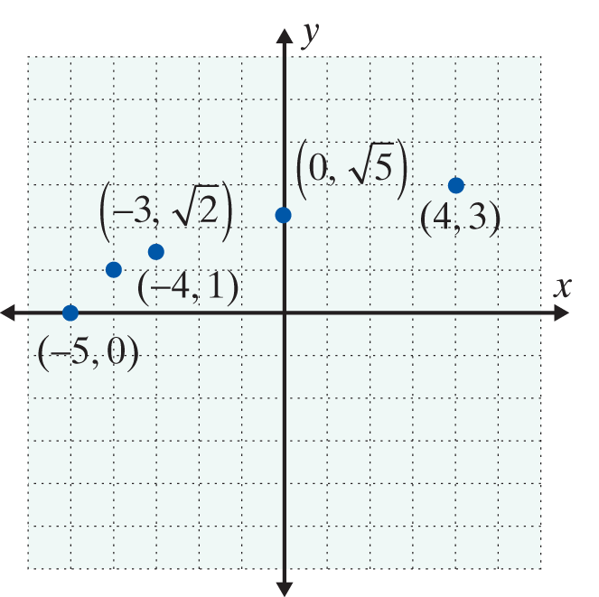
Example 3: Graphing a Radical Function (cont.)
x | y
−5 | 0
−4 | 1
−3
0
4 | 3

Slide 14
Example 3: Graphing a Radical Function (cont.)
Note that is the principal square root. This means that y ≥ 0. Thus the point (−5, 0) is on the x­-axis and the remaining points on the graph are above the x-axis. So, we can complete the graph by drawing a smooth curve that passes through the selected points. The graph of the function is shown on next slide.

Slide 15
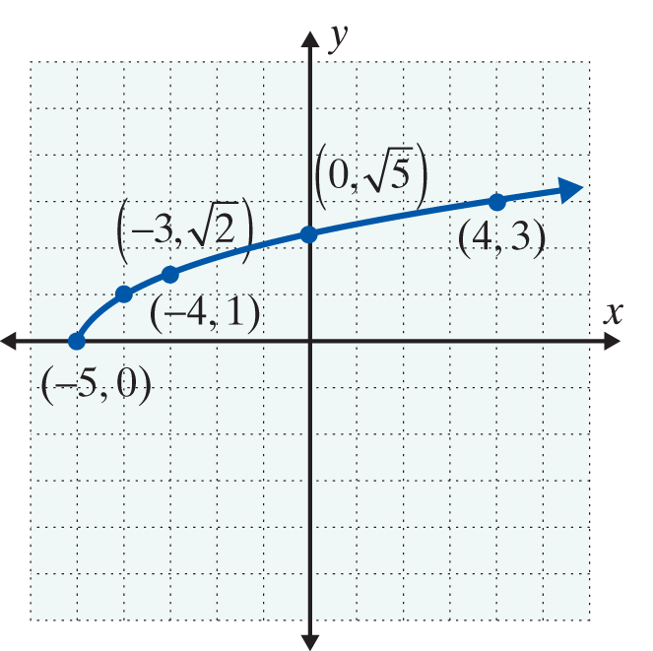
Example 3: Graphing a Radical Function (cont.)
We see that the domain is [−5, ∞) and the range is [0, ∞).

Slide 16

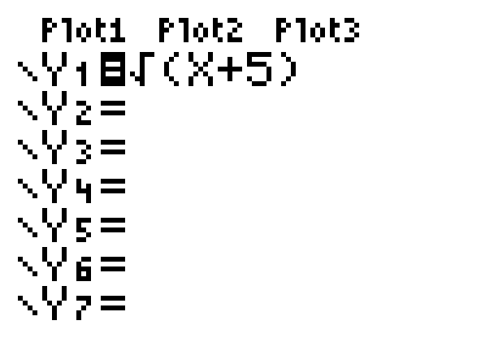
Example 3: Graphing a Radical Function (cont.)
To use a TI-84 Plus graphing calculator to graph this function,
Step 1:
Press and enter the function as shown:

Slide 17

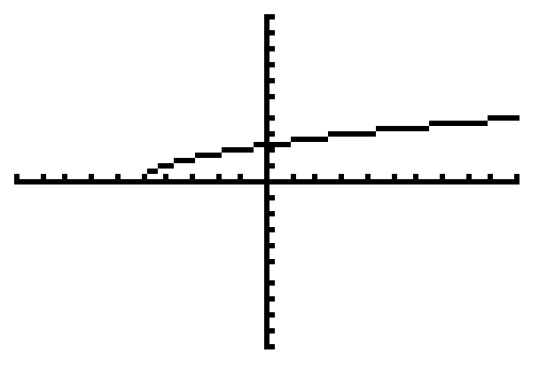
Example 3: Graphing a Radical Function (cont.)
Step 2:
Press . (You may need to adjust the
window.) The result will be the graph as shown here:

Slide 18


Example 4: Using a TI-84 Plus to Graph a Radical Function
a. Use the TABLE feature of a TI-84 Plus graphing calculator to locate many points on the graph of the
function
Solution Using the TABLE feature of a TI-84 Plus:
Step 1: Press and enter the function as follows:
1. Press .
2. Choose 4:
3. Enter 2x − 3) and press .

Slide 19


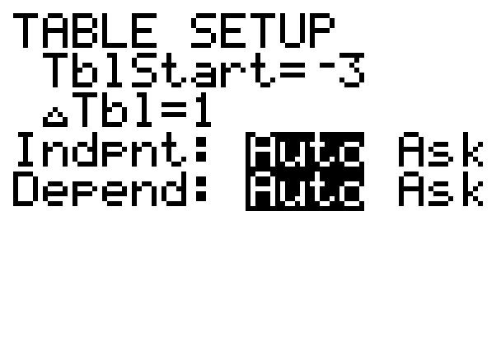
Example 4: Using a TI-84 Plus to Graph a Radical Function (cont.)
Step 2: Press TBLSET (which is ) and set the display as shown here:

Slide 20
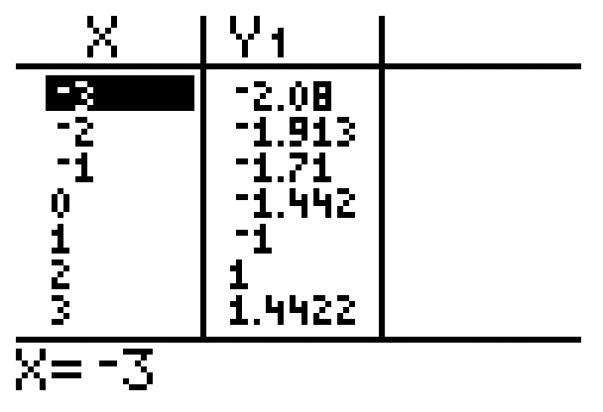
Example 4: Using a TI-84 Plus to Graph a Radical Function (cont.)
Step 3: Press TBLSET (which is ) and the
display will appear as follows:

Slide 21
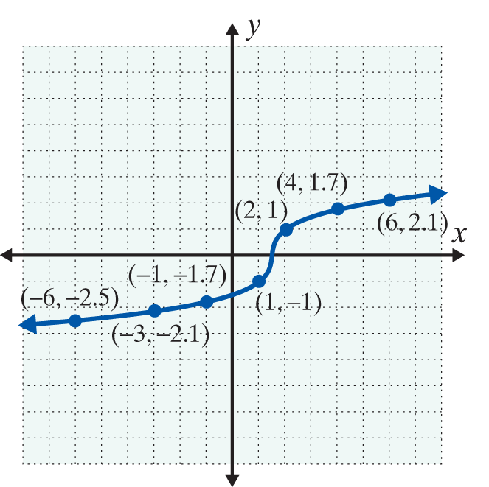
Example 4: Using a TI-84 Plus to Graph a Radical Function (cont.)
b. Plot several points (approximately) on a graph and then connect them with a smooth curve.
Solution
Once your calculator is displaying the table, you may scroll up and down the display to find as many points as you like. A few are shown here to see the nature of the graph.

Slide 22
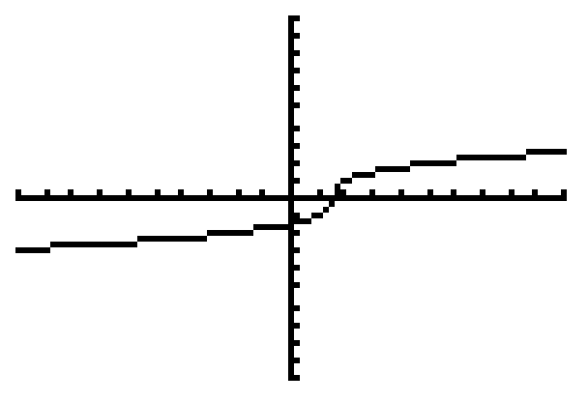
Example 4: Using a TI-84 Plus to Graph a Radical Function (cont.)
c. Use a TI-84 Plus graphing calculator to graph the function.
Solution
Press and the display will appear with the curve as follows:

Slide 23
Practice Problems
Find the indicated value of the function.

Slide 24
Practice Problems
Use a calculator to estimate the value of the function accurate to 4 decimal places.

Slide 25
Practice Problem Answers
1.
2. 1
3. −2
4. 2.6458
5. 2.1544

