Slide 1
HAWKES LEARNING
Keeping Yourself Organized

Slide 2
Ways to Keep Yourself Organized
Workspace
File System
Planner
HAWKES LEARNING

Slide 3
Keep a Detailed and Up-to-Date Planner
Important
Work shifts
Medical appointments
Flexible
Study sessions
Shopping trips
Non-essential
Parties
Outings

Slide 4
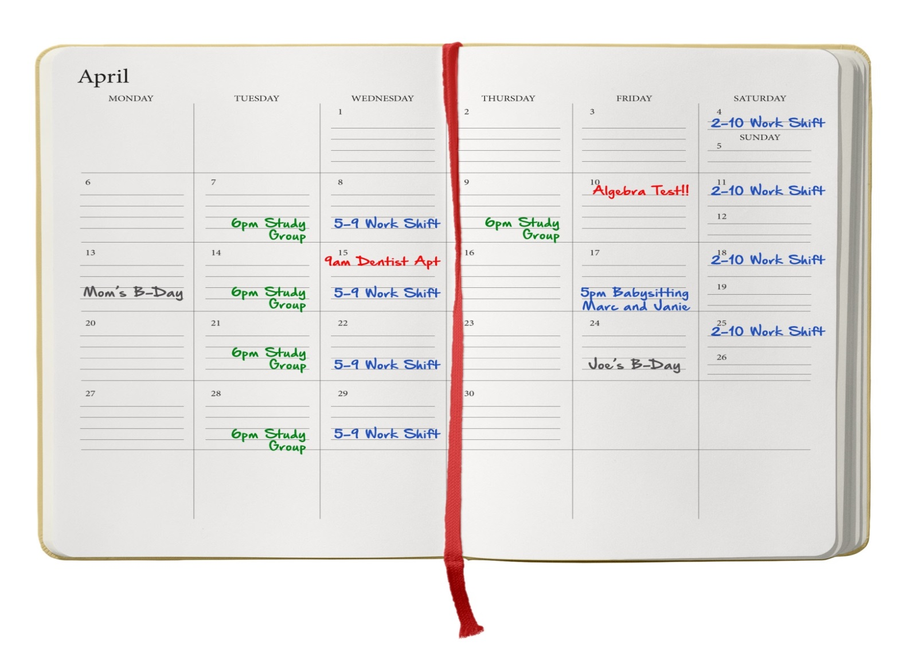
Monthly Planner

Slide 5
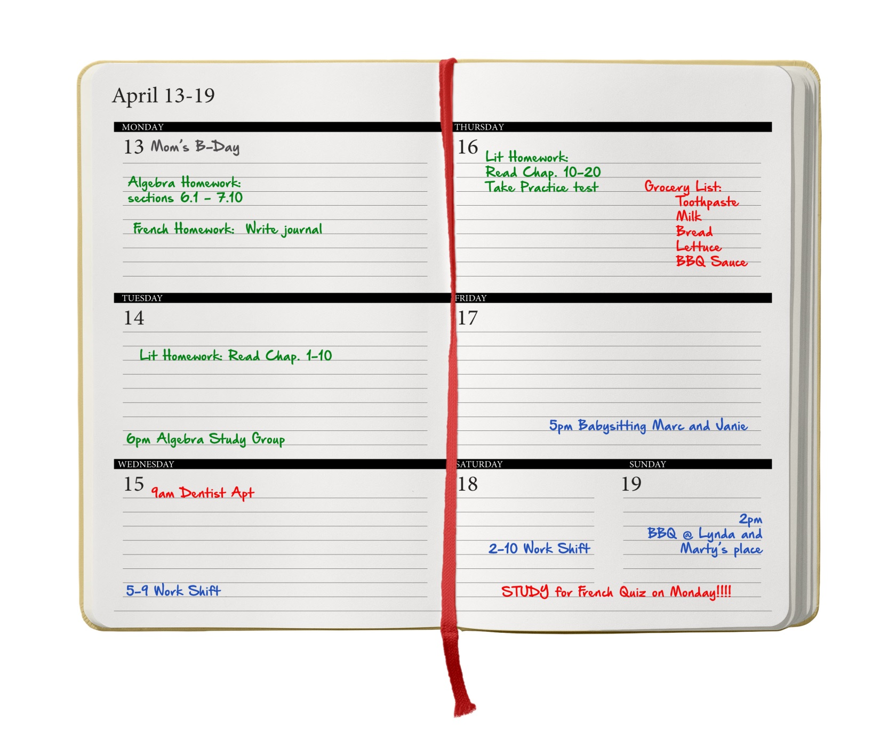
Weekly Planner

Slide 6
Use a System to File Important Papers
What to Save
Where to Save
+
HAWKES LEARNING

Slide 7
What to Save
School
Current course
documents
Tests, papers, projects
Home
Statements and bills
Licenses and certificates
HAWKES LEARNING

Slide 8
Where to Save
Folders or notebooks
Course notebooks
Home documents
Electronic documents
Computer or flash drive
Folders and subfolders
HAWKES LEARNING

Slide 9
Create and Maintain an Organized Workspace
Study preferences
Work habits
Home
Campus
Computer
HAWKES LEARNING

Slide 10




HAWKES LEARNING

