Slide 1
HAWKES LEARNING
Pre-Reading Strategies

Slide 2
Pre-Reading Strategies
Scan the title, table of contents, and major headings
Make predictions and find connections
Make a plan for reading the full text
HAWKES LEARNING

Slide 3
Title, Table of Contents, and Headings
Title
Topic
Table of Contents
Major Headings
HAWKES LEARNING

Slide 4
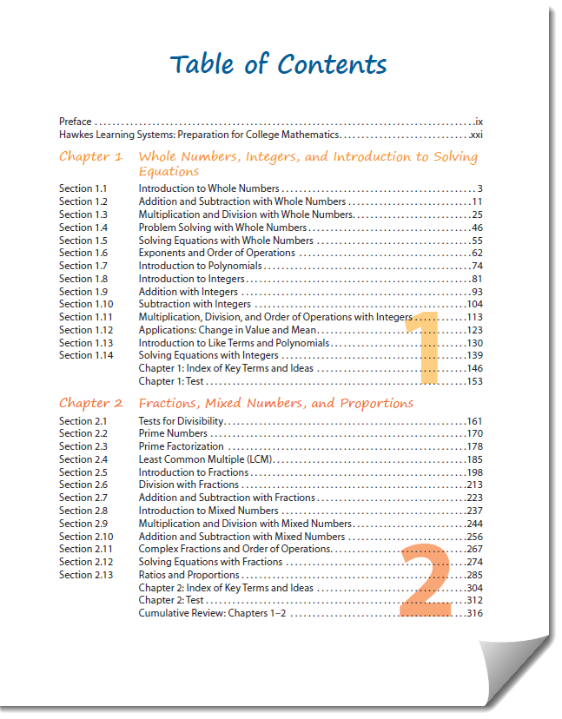
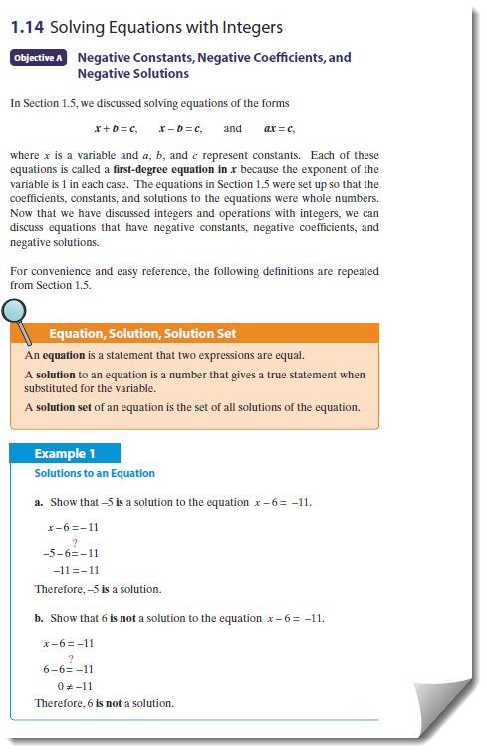
Title, Table of Contents, and Headings
HAWKES LEARNING

Slide 5
Make Predictions
Who?
What?
Where?
When?
Why?
How?
HAWKES LEARNING

Slide 6
Make Connections
What I Know
What I Want to Know
What I Learned
→
→
HAWKES LEARNING

Slide 7
Make a Reading Plan
How should I take notes on this reading?
How much time will I need to read the full text?
What materials will I need?
HAWKES LEARNING

Slide 8




HAWKES LEARNING

