Slide 1
HAWKES LEARNING
Using Visual Clues

Slide 2
Three Types of Visual Clues
Font Design
Images
Charts and Graphs
HAWKES LEARNING

Slide 3
Font Design
Calls attention to important information through size and style of letters.
Bold words show important terms and organization.
Consider adding own visual clues like highlighting or underlining.
HAWKES LEARNING

Slide 4

Font Type
HAWKES LEARNING

Slide 5
Images
Need to be read just like words in a text.
Identify what the image includes.
Find a connection to your own knowledge and experience.
HAWKES LEARNING

Slide 6
Charts and Graphs
Bar Graphs
Pie Charts
Line Graphs
HAWKES LEARNING

Slide 7
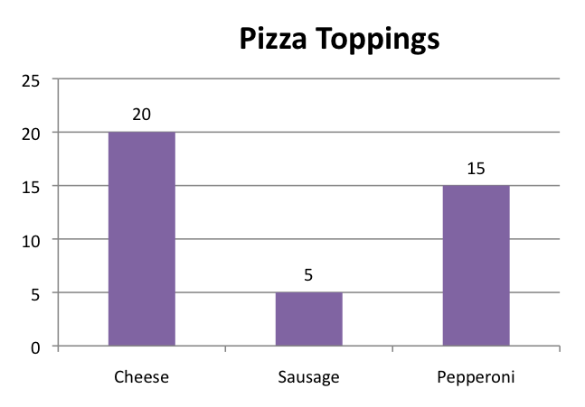
Bar Graph
HAWKES LEARNING

Slide 8
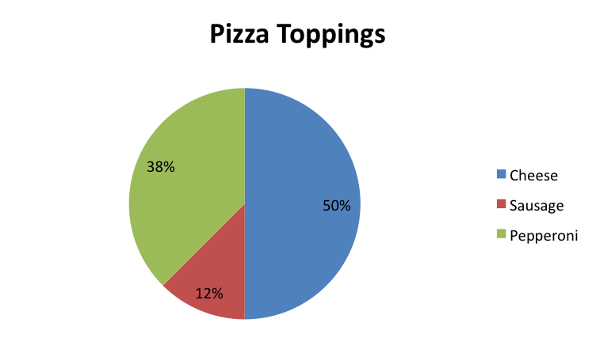
Pie Chart
HAWKES LEARNING

Slide 9
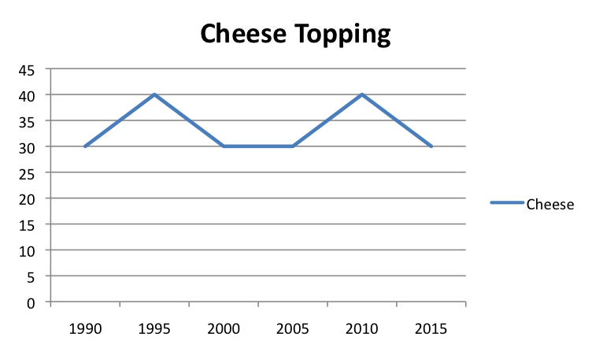
Line Graph
HAWKES LEARNING

Slide 10
Examine the Components
Title
Numbers
Legend
HAWKES LEARNING

Slide 11
Conclusions
Font Design
→
Better Understanding of a Text
Images
→
Charts and Graphs
→
HAWKES LEARNING

Slide 12


