Slide 1
HAWKES LEARNING
Finding Connections and Patterns

Slide 2

Finding Connections and Patterns
HAWKES LEARNING

Slide 3


Strategies for Finding Connections and Patterns
Outline the General and Specific Information
Locate Patterns in Vocabulary
Locate Patterns in the Details
HAWKES LEARNING

Slide 4


Outline General and Specific Info
General | Specific
College Sports | Football Gymnastics Scholarships Stadium Expenses
HAWKES LEARNING

Slide 5

Outlining Questions
What is the author’s purpose?
What does the author want me to learn?
What questions do I still have?
HAWKES LEARNING

Slide 6

Active Reading Strategies
Initial Notes
Marking and Annotating
Summarizing
HAWKES LEARNING

Slide 7

Initial Notes
Write down your first impressions of the text
HAWKES LEARNING

Slide 8
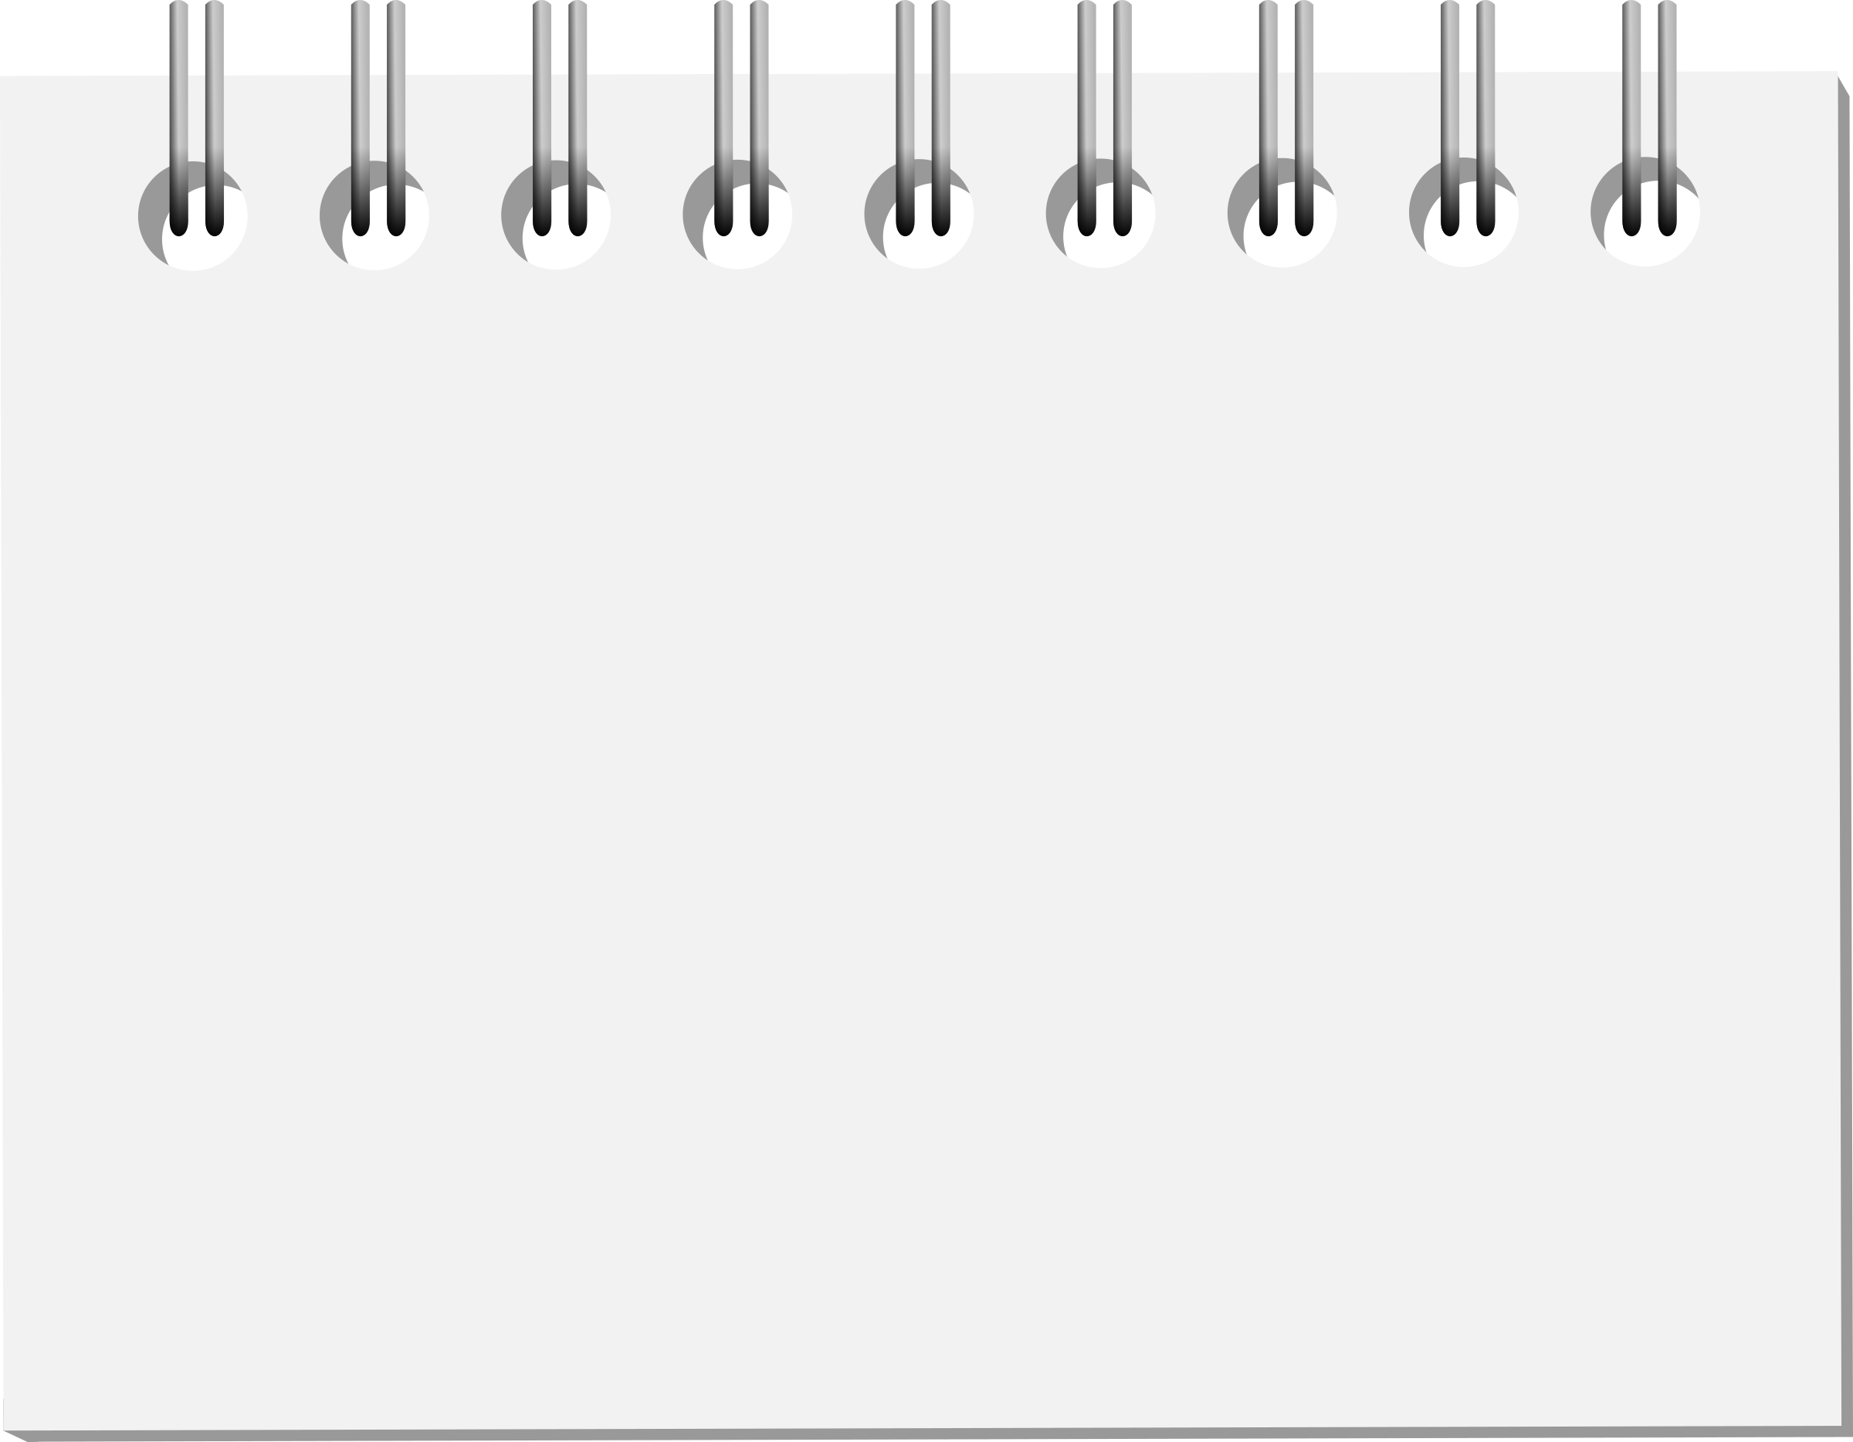
Initial Notes: Examples
-cites relevant expert
-thesis statement seems incomplete
-extremely negative words—author seems biased?
HAWKES LEARNING

Slide 9



Marking
HAWKES LEARNING

Slide 10


Annotating
HAWKES LEARNING

Slide 11

Annotating Examples
-here is the thesis
-look up this word!
-check this statistic
-seems biased here
HAWKES LEARNING

Slide 12
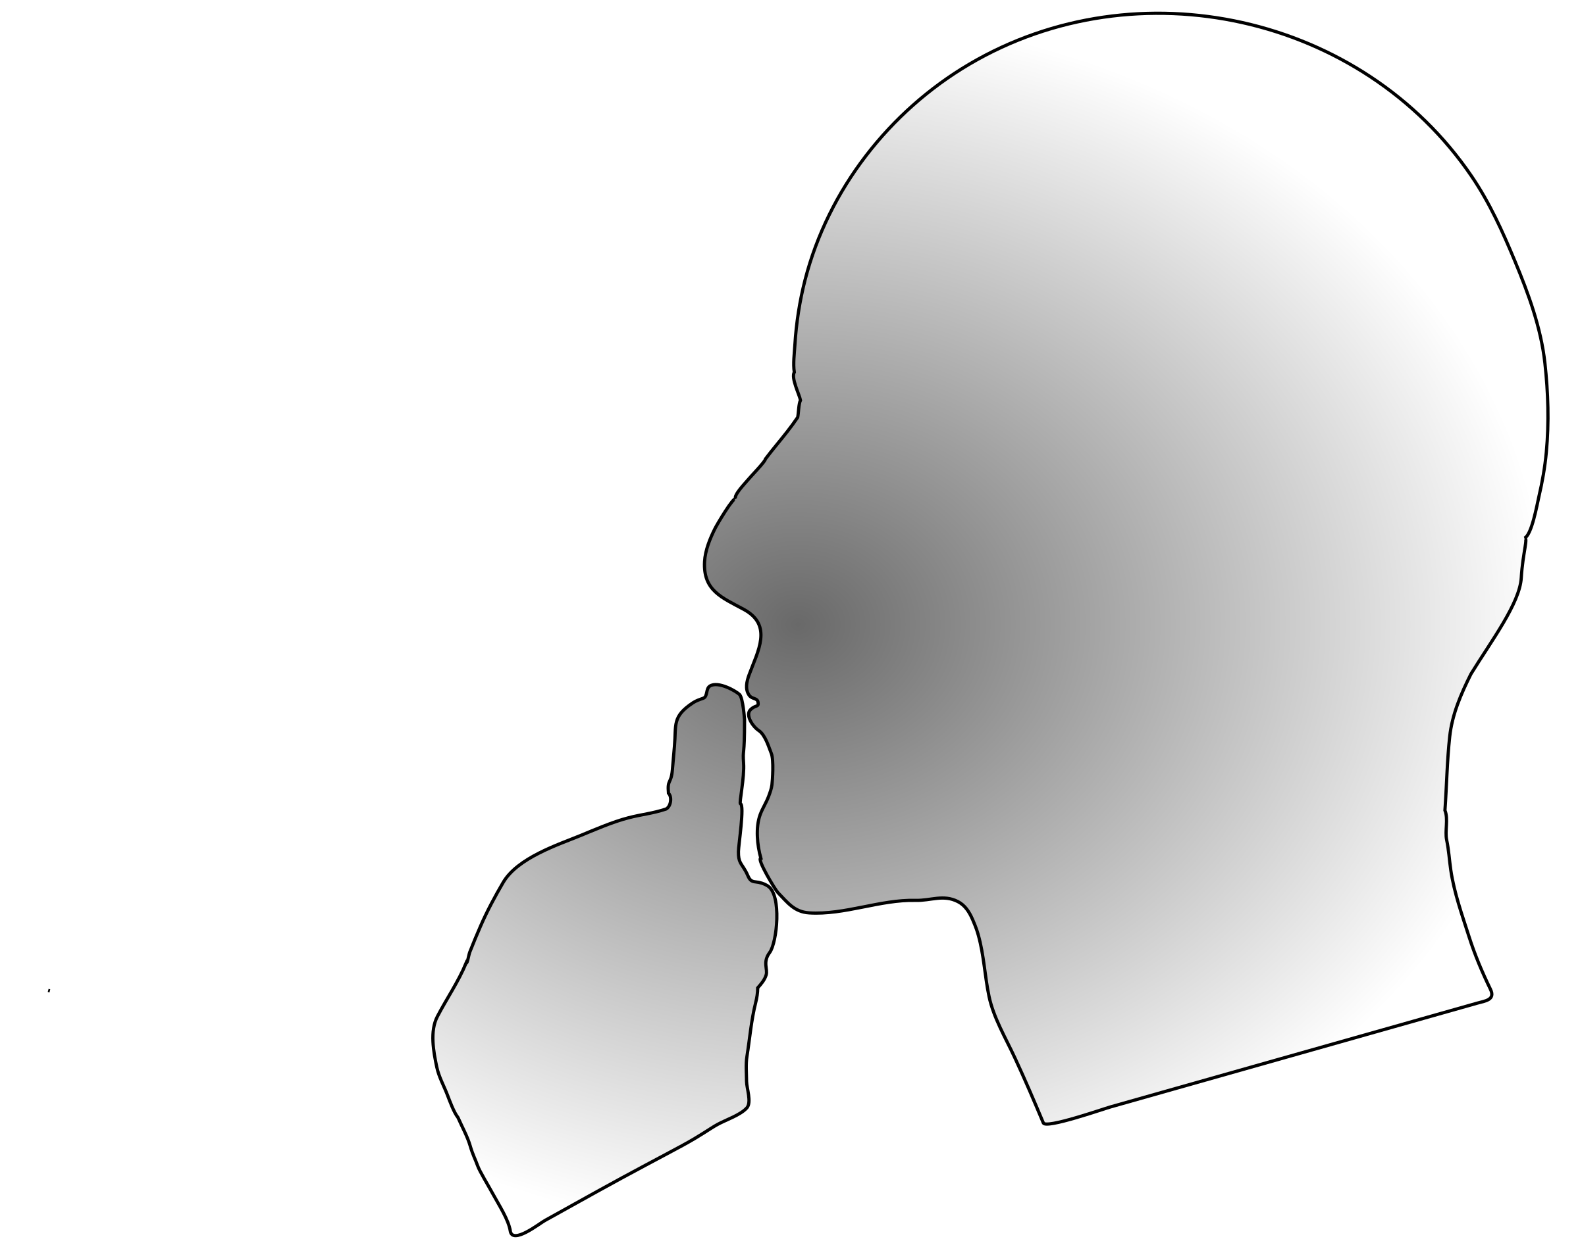
Summarizing
HAWKES LEARNING

Slide 13
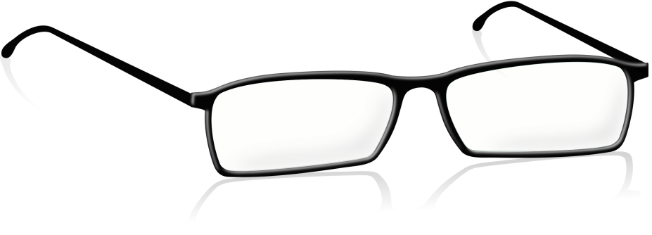
Excerpt to Be Summarized
According to a 2016 study from the American Vision Council (AVC), more than 188 million people require some form of vision correction in the United States. This explains why eye doctors' offices are usually busy and difficult to book at the last minute.
Because of this steady business, today people are buying their prescription eyewear in a new way—online. According to AVC, shoppers spent close to $1.5 billion on prescription eyewear online last year. It was the fourth straight year with more than $1 billion worth of optical products sold online.
HAWKES LEARNING

Slide 14
Summary of Excerpt
More than three-fourths of American adults have a vision issue that needs correction. Most opt to buy glasses, and it’s becoming more popular to purchase them online. Because of this, the eyeglass industry produces billions of dollars in revenue.
HAWKES LEARNING

Slide 15
Types of Outlines
Mind Maps
Story Frames
HAWKES LEARNING

Slide 16
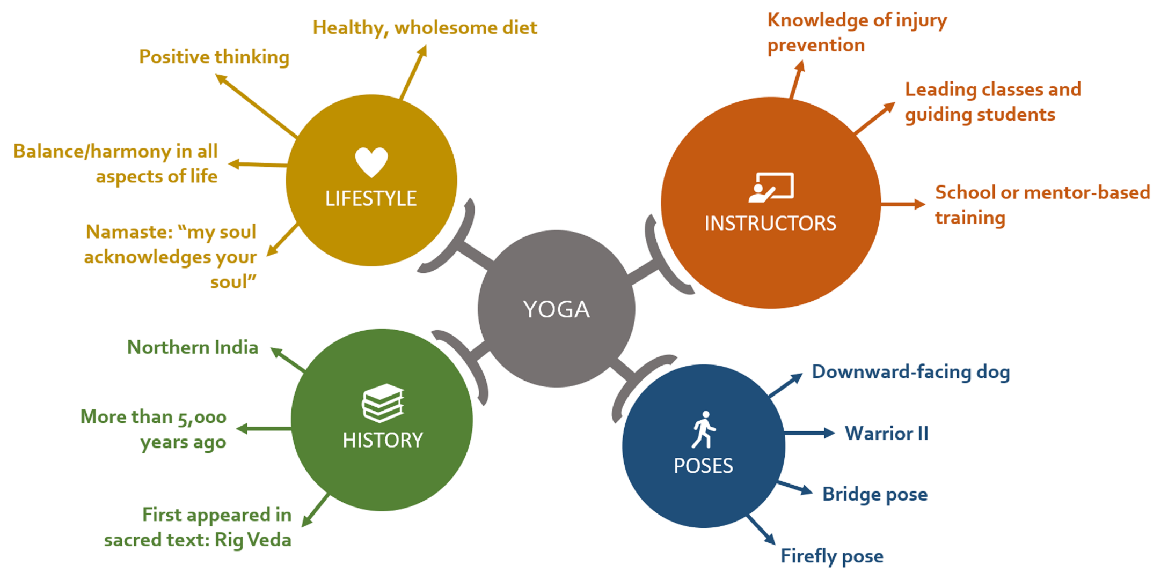
Mind Maps
HAWKES LEARNING

Slide 17


Story Frame Example
Albert Einstein was born:
He grew up in:
His childhood was:
His first accomplishment was:
His greatest accomplishment was:
He passed away in:
Because of his accomplishments, today we have:
HAWKES LEARNING

Slide 18


Locate Patterns in Vocabulary
HAWKES LEARNING

Slide 19
Patterns in Vocabulary
Purpose
Intentions
&
HAWKES LEARNING

Slide 20

Repeated Words
HAWKES LEARNING

Slide 21

Example of Repeated Words
Believe in your strength. Believe in your wisdom. Believe in your passion. Believe in yourself.
HAWKES LEARNING

Slide 22
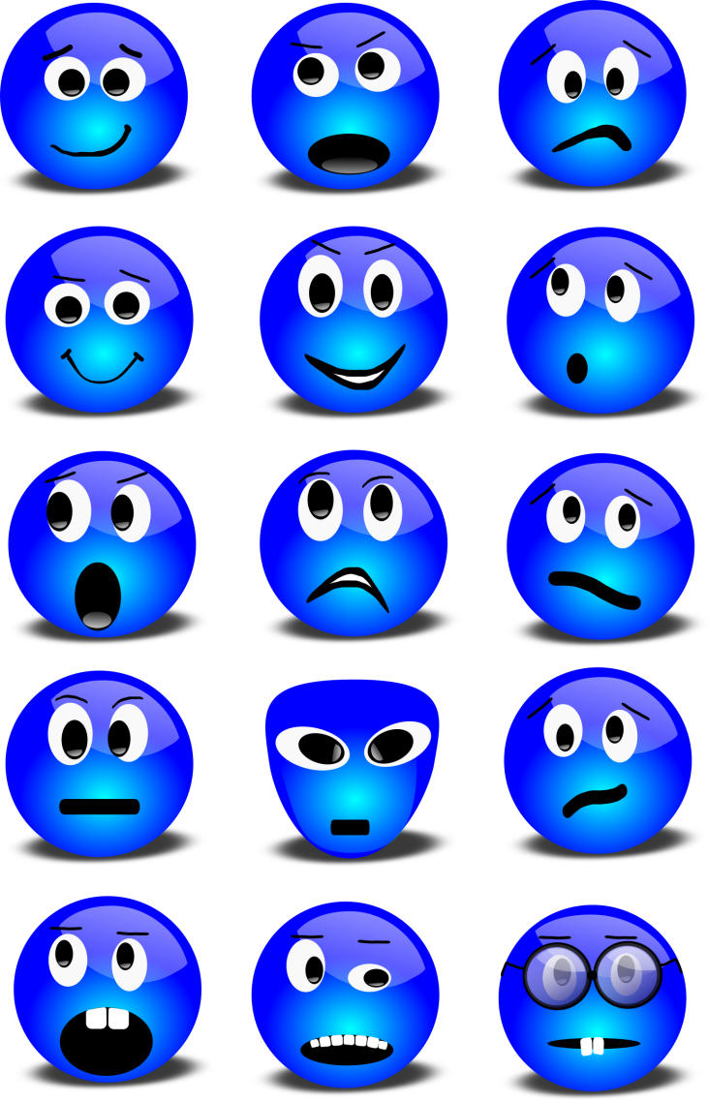
Patterns in Tone
Positive
Negative
Neutral
HAWKES LEARNING

Slide 23

Patterns in Tone Example
The dinner party was lovely. The food was exquisite and the company was delightful. I caught up with old friends and made many new ones. When Jeffree arrived, we had a bland conversation, and I remembered why we'll always be acquaintances rather than friends. At the end of the evening, Sasha and I ate the delicious Chantilly cake and laughed until we cried. I'm looking forward to the next gathering.
HAWKES LEARNING

Slide 24
Tone and Author’s Intention
Purpose
Audience
+
HAWKES LEARNING

Slide 25
Types of Informal Language
Exclusive Language
Slang
Contractions
HAWKES LEARNING

Slide 26
Slang
bromance
salty
rebound
drop the ball
HAWKES LEARNING

Slide 27
Contractions
y’all
can’t
she’ll
gonna
HAWKES LEARNING

Slide 28

Exclusive Language
lady doctor
male nurse
gay Frank
Indian Sara
HAWKES LEARNING

Slide 29

Avoid Exclusive Language
Offensive
+
Hurtful
HAWKES LEARNING

Slide 30
Sentence Structure
Suspense and anxiety
Short and Choppy
=
Long
=
Relaxing
HAWKES LEARNING

Slide 31

Sentence Structure Examples
She hit "send." She waited nervously. There was a quick response—not what she expected. She was satisfied. But not happy.
She hit "send" and waited nervously for a response. It came quickly and unexpectedly; though it was not the exact reply she was looking for, she was satisfied.
HAWKES LEARNING

Slide 32
Locate Patterns in the Details
What details did the author choose to include?
Why did the author feel it is important to include those details?
What details has the author chosen to ignore or exclude?
Why does the author feel these details are important?
HAWKES LEARNING

Slide 33


Sentence Structure
Negative Details
Negative Attitude
=
Positive Details
Positive Attitude
=
HAWKES LEARNING

Slide 34
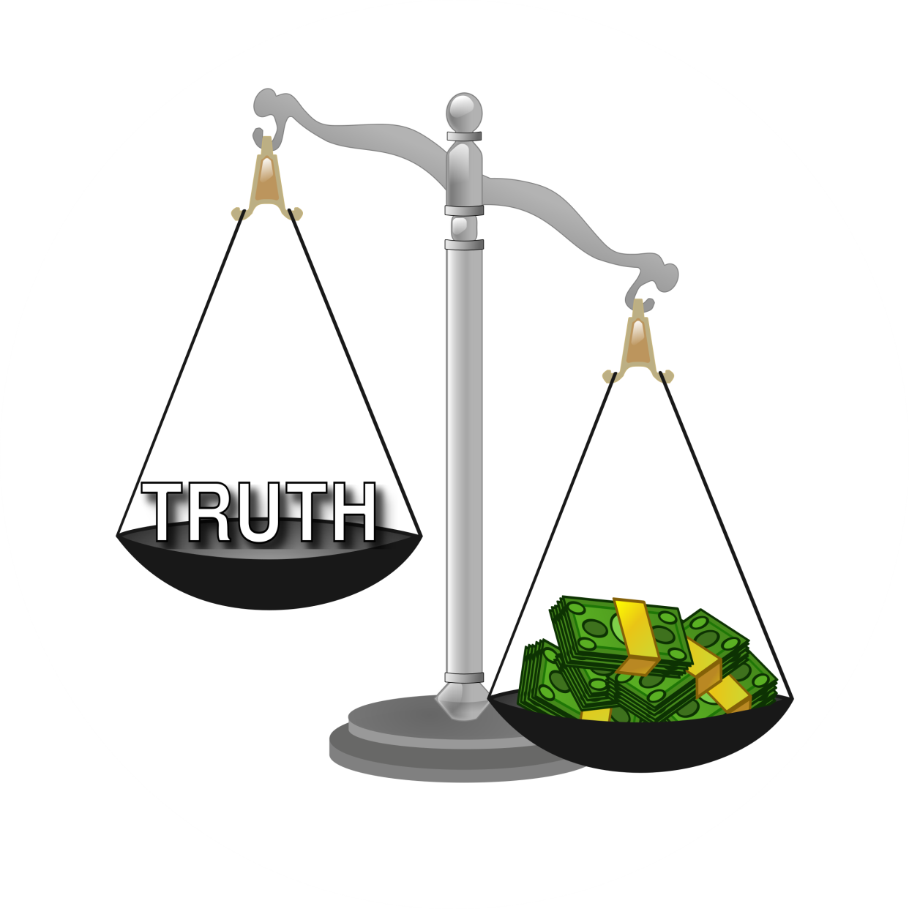
Signs of Bias
HAWKES LEARNING

Slide 35




HAWKES LEARNING

