Slide 1
HAWKES LEARNING
Combining Words or Sentences

Slide 2
Combining Words or Sentences
Rhythm
Flow
+
HAWKES LEARNING

Slide 3

Combining Words or Sentences
How to Combine Words
How to Combine Sentences
HAWKES LEARNING

Slide 4


Combining Words
Samantha cooked on her day off.
Samantha cooked and cleaned on her day off.
LeBron James played well in the finals.
LeBron James and Steph Curry played well in the finals.
HAWKES LEARNING

Slide 5
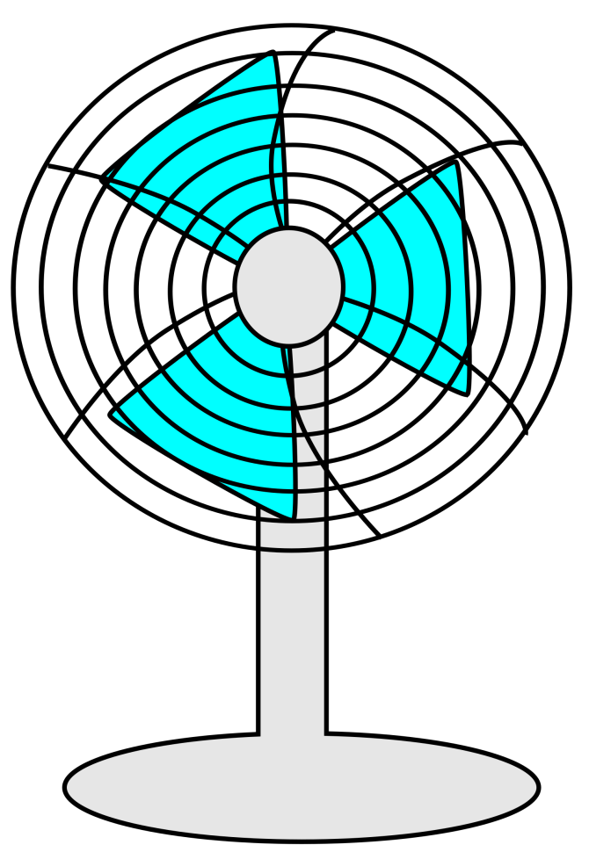
Coordinating Conjunctions
For
And
Nor
But
Or
Yet
So
HAWKES LEARNING

Slide 6




Combining Words
Nouns: Loggins and Messina were once a popular folk-rock act.
Adjectives: That pretzel was salty and delicious.
Adverbs: The tsunami struck Indonesia suddenly and unexpectedly.
Verbs: Dental hygienists clean and inspect patients’ teeth.
HAWKES LEARNING

Slide 7



Joining for Importance and Relevance
Janelle’s qualifications indicate that she has a master’s degree and a dog.
Janelle’s qualifications indicate that she has a master’s degree and a teaching certification.
HAWKES LEARNING

Slide 8



Combining to Compare and Contrast
Morning and night, the elderly couple sits together on the porch.
Johnson dribbles the ball gracefully and powerfully.
Demetria is the point of contact for all current and retired employees.
HAWKES LEARNING

Slide 9

Combining Words
Are the ideas related?
Are they of equal importance?
Do they indicate comparison or contrast?
Will combining them strengthen my idea?
HAWKES LEARNING

Slide 10
Correlative Conjunctions
both/and
either/or
not only/but also
neither/nor
whether/or
HAWKES LEARNING

Slide 11
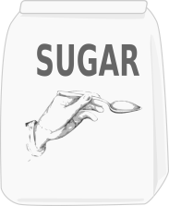
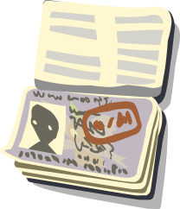

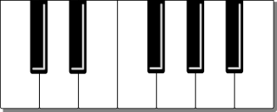
Correlative Conjunctions
Both sugar and carbohydrates can be damaging to one’s health.
You can present either your driver’s license or your passport.
She has neither the patience nor the temperament to work with children.
Whether you are playing keyboard or guitar, finger placement is essential.
HAWKES LEARNING

Slide 12
How to Combine Sentences
Clause
Subject
Verb
&
HAWKES LEARNING

Slide 13
Clauses
Independent Clause: can stand alone as complete sentence
Dependent Clause: cannot stand alone
HAWKES LEARNING

Slide 14


Clauses
The boy is hungry.
Because the boy is hungry.
HAWKES LEARNING

Slide 15
Joining Clauses to Make Sentence Patterns
Simple Sentences
Compound Sentences
Compound-complex Sentences
Complex Sentences
HAWKES LEARNING

Slide 16
Combining Clauses
Are the clauses related?
Are they of equal importance?
Do they indicate comparison or contrast?
Will combining them strengthen my idea?
HAWKES LEARNING

Slide 17
Simple Sentences
Predicate
(What the Subject Is or Does)
Subject
(Person, Place, Thing, Event)
Complete Thought
&
&
HAWKES LEARNING

Slide 18


Simple Sentences
Ralph ate the cat treats.
Wesley surfs on the weekends.
HAWKES LEARNING

Slide 19
Compound Sentences
Independent Clause
Independent Clause
+
Can Be Combined With:
Coordinating Conjunction
Correlative Conjunctions
Semicolon
HAWKES LEARNING

Slide 20

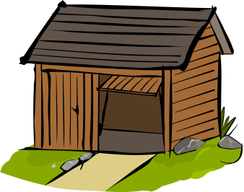

Compound Sentences
The leasing office was going to raise my rent, so I moved out of that apartment complex.
Either you clean up the garage, or I’m donating everything in it.
I am thrilled for her; I was honored to receive the baby shower invitation.
HAWKES LEARNING

Slide 21

Conjunctive Adverbs
I was thrilled for her; therefore, I was honored to receive the baby shower invitation.
HAWKES LEARNING

Slide 22
Conjunctive Adverbs
finally
furthermore
however
indeed
meanwhile
moreover
nevertheless
therefore
HAWKES LEARNING

Slide 23
Complex Sentences
Dependent Clause
Independent Clause
+
Can Be Combined With:
Subordinating Conjunctions
HAWKES LEARNING

Slide 24
Subordinating Conjunctions
after
although
as
because
even though
if
when
while
HAWKES LEARNING

Slide 25
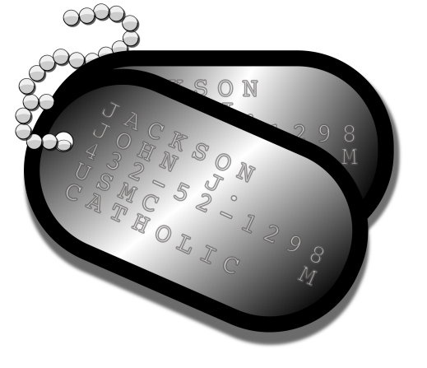
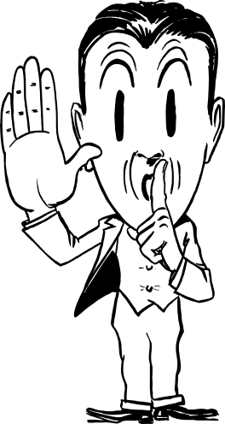
Comma Rules for Complex Sentences
Because of his military experience, he is qualified for the position.
Don’t mention your promotion until your coworkers know about it.
HAWKES LEARNING

Slide 26
Compound-Complex Sentences
Independent Clause
+
Independent Clause
+
Dependent Clause
HAWKES LEARNING

Slide 27


Compound-Complex Sentences
Even though he was tired, Quincy knew he had to finish the marathon, so he caught up to his running mates.
Although considered “unsinkable,” the Titanic struck an iceberg, and it sank to the bottom of the Atlantic Ocean in 1912.
HAWKES LEARNING

Slide 28




HAWKES LEARNING

