Slide 1
HAWKES LEARNING
Pre-writing

Slide 2
Lesson Goals
Why we pre-write
How we pre-write
How to transition from pre-writing to drafting
HAWKES LEARNING

Slide 3
What is Pre-writing?
Pre-writing is the first stage of the academic writing process.
Making decisions
&
Planning ideas
HAWKES LEARNING

Slide 4
Why Pre-write?
Makes the writing process faster & smoother
Generate ideas
Determine what you know & what you need to know
Identify connections between ideas
HAWKES LEARNING

Slide 5
How We Pre-write
Mind Mapping
Brainstorming
Block Structure Method
Free Writing
Questioning
HAWKES LEARNING

Slide 6
Brainstorming
Write down words, phrases, or ideas that come to mind as you think about a particular topic
Helps you assess what you already know about the topic
HAWKES LEARNING

Slide 7
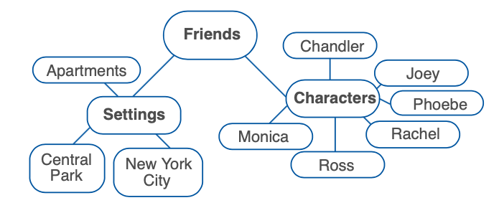
Mind Mapping
Create a simple diagram to show connections between key ideas
Help to identify what you know about your topic and visualize how different main ideas and supporting details relate to each other
HAWKES LEARNING

Slide 8
Free-Writing
Free Writing:
Write down everything that comes to mind for a set period of time, without editing your ideas
Focused Free Writing:
Begin by thinking about a specific topic
or
HAWKES LEARNING

Slide 9
Questioning
When you consider a topic from all angles so that you can determine what you need to learn
Who are the characters in Hamlet?
What are the central themes in Hamlet?
Why did Shakespeare write Hamlet?
Why is Hamlet considered such a great play?
HAWKES LEARNING

Slide 10
Block Structure Method
Organize topics and ideas visually, on note cards
Write one topic on each note card/piece of paper and relevant information
Once you’ve chosen a topic, repeat the process with ideas for body paragraphs
HAWKES LEARNING

Slide 11
How to Transition from Pre-writing to Drafting
Outlines help you to identify all the information you need to include in a writing project and to organize that information in the best possible way.
Working Outlines
Detailed Outlines
Working thesis
Main ideas
An overview of your supporting ideas
Working thesis
Main ideas
All your supporting ideas
Research you plan to include in your writing
or
HAWKES LEARNING

Slide 12




HAWKES LEARNING

