Slide 1
HAWKES LEARNING
The Final Draft

Slide 2
FINAL PRODUCTS
Blog post
Book
Paper
Video
Presentation
… or more!
HAWKES LEARNING

Slide 3
STEPS TO SUBMISSION
1: Reflect on the goals of a writing assignment
2: Choose a layout and design
3: Add visuals
4: Print or upload your work
HAWKES LEARNING

Slide 4
REFLECTING ON GOALS
SCHOOL → Instructor
OR
WORK → Supervisor
HAWKES LEARNING

Slide 5
ACADEMIC TASKS & GOALS
You are tasked with writing a detailed analysis of the most prominent themes in the novel Catch-22. When analyzing, break down parts of the text to examine how they interact with each other.
HAWKES LEARNING

Slide 6
LAYOUT & DESIGN
LAYOUT: the way your writing is arranged on the page or the screen
DESIGN: the colors, fonts, and images that you select
Genre
MLA
HAWKES LEARNING

Slide 7
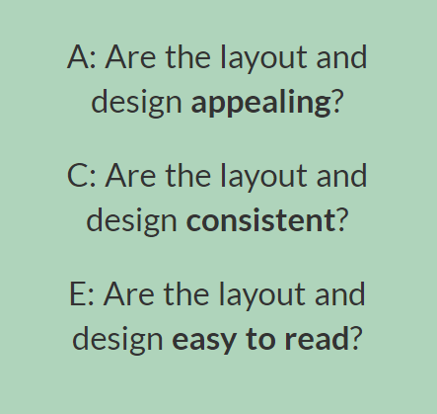
ACE
HAWKES LEARNING

Slide 8
APPEALING
FREE FROM MARKS AND STAINS
COVER PAGE OR FOLDER
ATTRACTIVE FONTS & COLORS
HAWKES LEARNING

Slide 9
CONSISTENCY
Using consistent design and layout makes your work more attractive and audience-friendly
If you use certain fonts or colors at the beginning, continue using them
&
HAWKES LEARNING

Slide 10
EASY TO READ
ACCOMPLISH YOUR PURPOSE
CLEAR FONTS
REASONABLE AMOUNT OF SPACING
HAWKES LEARNING

Slide 11
VISUALS
GENRE
PURPOSE
DESIGN
HAWKES LEARNING

Slide 12
PURPOSEFUL VISUALS
Presentations use images to catch the audience's attention and emphasize important points
Advertisements often use images to show the design and features of a product
&
Magazine articles will have specific rules about the types of images that can be used
Speeches may not have access to a projector or computer.
&
HAWKES LEARNING

Slide 13
IMAGE GUIDELINES
Appealing to your audience
Consistent with the overall design
Easy to see or understand
HAWKES LEARNING

Slide 14
QUESTIONS TO ASK:
Do these images all serve a purpose?
How do these images support my main idea?
Are these images appropriate for the intended audience?
HAWKES LEARNING

Slide 15

PRINT & SUBMIT
First, always schedule some extra time to print or submit. If a technical issue occurs, it will often be out of your control
HAWKES LEARNING

Slide 16
PRINT & SUBMIT
Second, you should also double-check your work once it's been printed or published
HAWKES LEARNING

Slide 17
PRINT & SUBMIT
Last, remember that even submitting your work does not always mean you’re completely finished with it
HAWKES LEARNING

Slide 18




HAWKES LEARNING

