Slide 1
HAWKES LEARNING
Analyzing Rhetoric through Visuals

Slide 2
Lesson Goals
Purpose
Composition
Argument
HAWKES LEARNING

Slide 3
Analyzing Rhetoric through Visuals
Visual rhetoric = the art of communicating a message through images and video
Once you interpret the meaning of a photo or video, you can decide how to respond.
HAWKES LEARNING

Slide 4
Purpose
Discuss
Respond
Argue
Describe
Context: how and when the image is presented to the viewer
HAWKES LEARNING

Slide 5
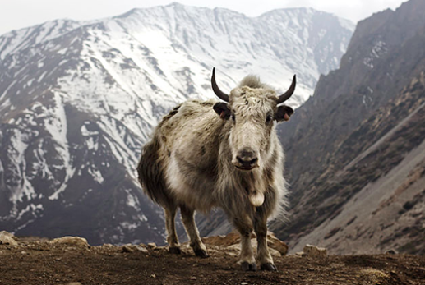
Purpose
HAWKES LEARNING

Slide 6
Purpose
The physical characteristics of yaks
The photographer’s recent trip to Nepal
Discuss
Respond
Nepal is an excellent tourist destination
Drinking yak milk for the first time
Argue
Describe

Slide 7
Purpose
actual
vs.
stated

Slide 8
Composition
How the contents have been selected and arranged
Details included
or
Details excluded

Slide 9

Composition
HAWKES LEARNING

Slide 10
Composition
Larger, brighter than the rest of the image
Smaller, lighter items
vs.

Slide 11
Composition
Composition
Interpret their meanings
→
HAWKES LEARNING

Slide 12
Argument
Argument
Ethos
(Credibility)
Logos
(Logic)
Pathos
(Emotion)

Slide 13
Appeal to Ethos
Emphasizes authority and trustworthiness (credibility)
Example: professional athletes who are photographed wearing a particular brand of shoe
HAWKES LEARNING

Slide 14
Appeal to Logos
Emphasizes logic and reasoning
Example: before-and-after photos
HAWKES LEARNING

Slide 15
Appeal to Pathos
Emphasizes emotion
Example: an image of a dog in a shelter
HAWKES LEARNING

Slide 16
Strength of Argument
Does the image use a legitimate expert to establish its appeal to ethos?
Does the appeal to logos make sense?
Does the image rely too heavily on appeals to pathos?
Do the argumentation strategies fit the purpose of the image?
HAWKES LEARNING

Slide 17




HAWKES LEARNING

