Slide 1
HAWKES LEARNING
Taking Notes and Annotating Texts

Slide 2
Lesson Goals
Note-taking strategies
Note-taking methods
Annotating texts
HAWKES LEARNING

Slide 3
Note-taking Strategies
Neat handwriting
Abbreviations and phrases
Your own words
Summarize important ideas

Slide 4
Taking Notes on Lectures or Presentations
Main Idea vs. Supporting Details: Don’t worry about fully explaining supporting details.
Screen vs. Speaker: Don’t try to write down everything on the screen.
Presentation vs. Analysis: Don’t rely only on the visual aid; consider analysis and discussion.
HAWKES LEARNING

Slide 5
Note-taking Strategies
Important
concepts
Key
terms
&
Main ideas & supporting details
Key vocabulary
Visual clues
Organization

Slide 6
Note-Taking Methods
Cornell notes
Outlines
Graphic organizers
HAWKES LEARNING

Slide 7
Outlines
A tool for organizing a text, usually as a multilevel list
Forms of Exercise
1. Endurance
a. Benefits
i. Circulation
ii. Fitness
b. Options
i. Jogging
ii. Dancing
2. Flexibility
a. Benefits
i. Stretched muscles
ii. Limber body
b. Options
i. Yoga
ii. Pilates
HAWKES LEARNING

Slide 8
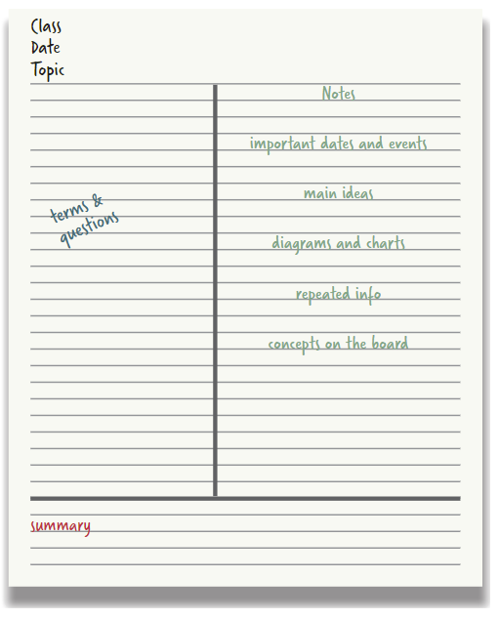
Cornell Notes
HAWKES LEARNING

Slide 9

Graphic Organizers
A note-taking template for visually demonstrating relationships between ideas
HAWKES LEARNING

Slide 10
Annotating Texts
Annotate = strategy for indicating key information in a text
Highlight, underline, circle, and/or label key vocabulary, main ideas, and major details
Add notes in the margin:
Define
concepts
Summarize ideas
Challenge ideas
Respond to ideas
Question yourself
HAWKES LEARNING

Slide 11




HAWKES LEARNING

