Slide 1
Section 10.2
Testing a Hypothesis about a Population Mean, Sigma Known

Slide 2

Example 1: Performing a Hypothesis Test for the Mean Cost of Textbooks—Slide 1
Suppose that the average amount of money a student spends on textbooks per semester at college campuses in the U.S. is $\$500$ with a standard deviation of $\$100$. A local university wants to know if its students are actually spending that amount on textbooks. The level of the test is to be set at 0.05. A random sample of 75 college students has been selected and the resulting average is $\$540$ with a sample standard deviation of $\$95$ spent per semester on textbooks.

Slide 3
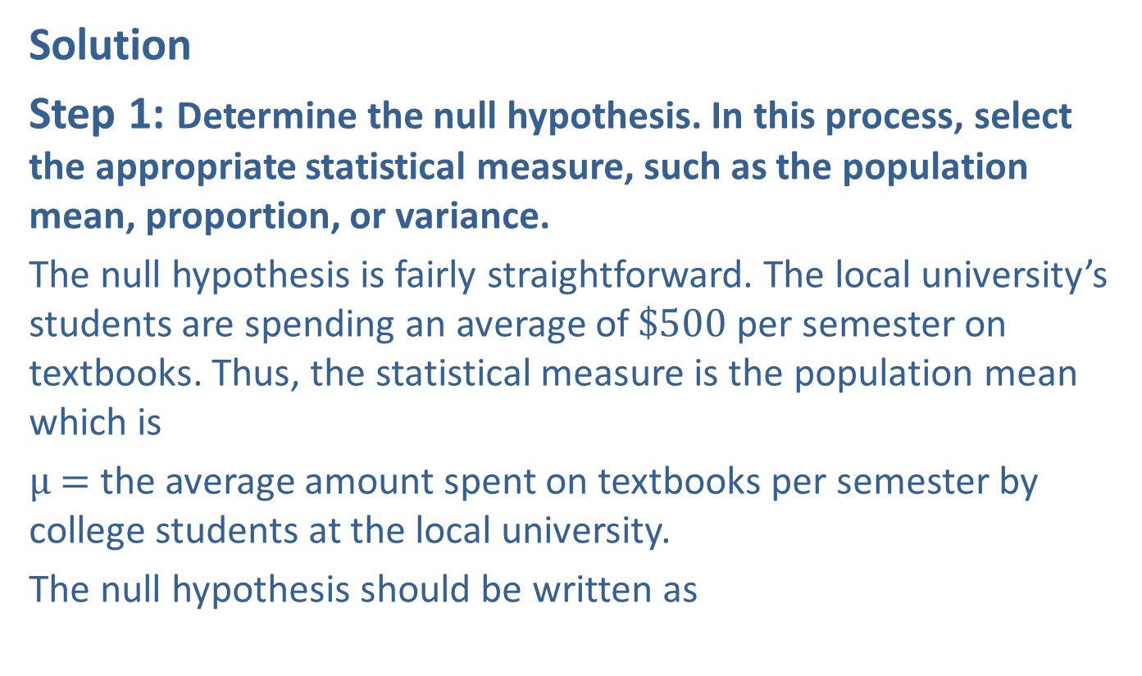
Example 1: Performing a Hypothesis Test for the Mean Cost of Textbooks—Slide 2
Solution
Step 1: Determine the null hypothesis. In this process, select the appropriate statistical measure, such as the population mean, proportion, or variance.
The null hypothesis is fairly straightforward. The local university’s students are spending an average of $\$500$ per semester on textbooks. Thus, the statistical measure is the population mean which is
μ$=$ the average amount spent on textbooks per semester by college students at the local university.
The null hypothesis should be written as

Slide 4
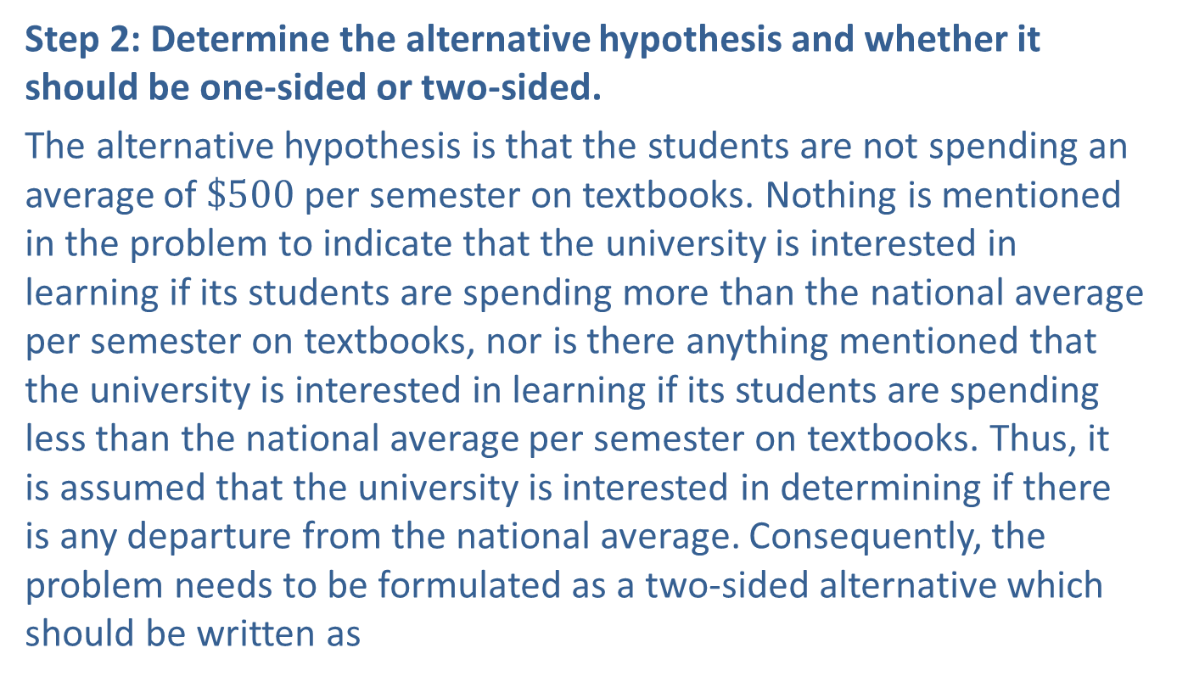
Example 1: Performing a Hypothesis Test for the Mean Cost of Textbooks—Slide 3
Step 2: Determine the alternative hypothesis and whether it should be one-sided or two-sided.
The alternative hypothesis is that the students are not spending an average of $\$500$ per semester on textbooks. Nothing is mentioned in the problem to indicate that the university is interested in learning if its students are spending more than the national average per semester on textbooks, nor is there anything mentioned that the university is interested in learning if its students are spending less than the national average per semester on textbooks. Thus, it is assumed that the university is interested in determining if there is any departure from the national average. Consequently, the problem needs to be formulated as a two-sided alternative which should be written as

Slide 5
Example 1: Performing a Hypothesis Test for the Mean Cost of Textbooks—Slide 4
Step 3: Select the appropriate test statistic based on the information at hand and the assumptions you are willing to make.
What we know about the population will affect the methods used to perform the test of the hypothesis. There are two key questions:
1. ​Is the standard deviation of the population known?
2. ​Is the distribution of the population normal or is the sample size sufficiently large?
Is the standard deviation of the population known?
In most instances, the standard deviation of the population will not be known.

Slide 6
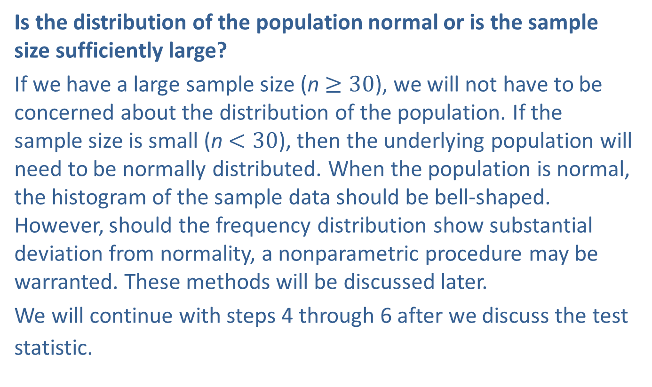
Example 1: Performing a Hypothesis Test for the Mean Cost of Textbooks—Slide 5
Is the distribution of the population normal or is the sample size sufficiently large?
If we have a large sample size (n$≥30$), we will not have to be concerned about the distribution of the population. If the sample size is small (n$<30$), then the underlying population will need to be normally distributed. When the population is normal, the histogram of the sample data should be bell-shaped. However, should the frequency distribution show substantial deviation from normality, a nonparametric procedure may be warranted. These methods will be discussed later.
We will continue with steps 4 through 6 after we discuss the test statistic.

Slide 7
Formula: z-Test Statistic
If the standard deviation of the population, σ, is known, then the test statistic is given by
where
n is the sample size,
μ ₀ is the hypothesized value of the population mean, and
σ is the known population standard deviation.
It should be noted that this formula is only valid if
distributed. That is,
is normally distributed if the data are collected
from a normal distribution or n is greater than or equal to 30.

Slide 8

What is the Rationale for the Test Statistic?—Slide 1
Although the true population mean is unknown, the Central Limit Theorem implies that the sample mean,
to the population mean, μ, if the sample data are representative of the population. If the null hypothesis is true, the value of the population mean is specified in the null hypothesis,
If the null is true, the sample mean
Another way of expressing this idea of closeness is to measure the difference between the sample mean and the hypothesized
The difference should be close to zero, if the null
hypothesis is true.​

Slide 9

What is the Rationale for the Test Statistic?—Slide 2
Conversely, a large distance between
would indicate that either an improbable value of
observed given that the null hypothesis is true, or that the null hypothesis is false and μ ₀ is not the actual value of the population mean.
Although this approach has intuitive appeal, the notion of close is too ambiguous to have practical value. Changing the unit of measure from inches to miles may affect one’s perception of closeness. What is needed is a statistic that will be the same regardless of the scale of measurement the sample data possess.

Slide 10
Definition: Critical Value
The critical value is the value to which the test statistic is compared to determine whether to reject or fail to reject the null hypothesis. Traditionally, if the absolute value of the test statistic is greater than the critical value, we reject the null hypothesis.

Slide 11
Example 1: Performing a Hypothesis Test for the Mean Cost of Textbooks—Slide 6
Step 4: Determine the critical value.
Determine the critical value of the test statistic. Two factors must be considered.
1. ​The type of alternative hypothesis: two-sided, one-sided left, one-sided right. If the alternative hypothesis is two-sided, the hypothesis test will be two-tailed. If the alternative hypothesis is one-sided left, the hypothesis test will be a left-tailed or lower-tailed test. If the alternative hypothesis is one-sided right, the hypothesis test will be a right-tailed or upper-tailed test.
2. ​The specification of α, the significance level of the test.
In determining the critical value of the test statistic, we must take into account whether the alternative hypothesis is one-sided or two-sided, the level of the test, and the distribution of the test statistic.

Slide 12
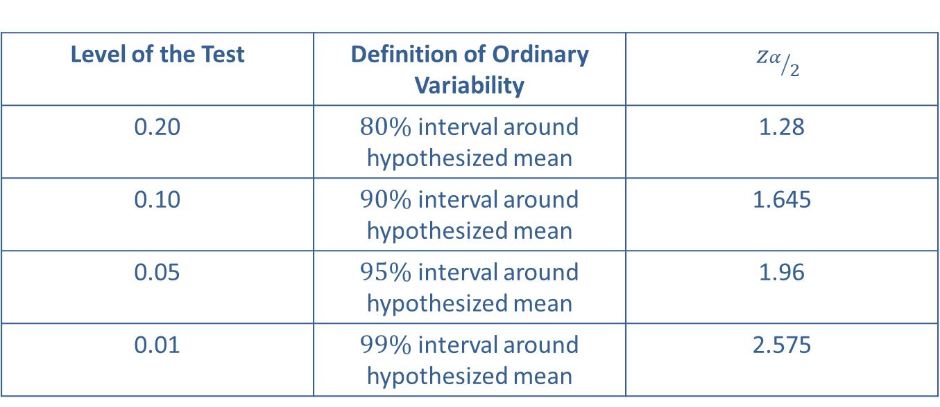
Example 1: Performing a Hypothesis Test for the Mean Cost of Textbooks—Slide 7
Table 1 - Critical Values of the z-Test Statistic for Two-Sided Alternatives
Level of the Test | Definition of Ordinary Variability | $$z_{α/2}$$
0.20 | $80\%$ interval around hypothesized mean | 1.28
0.10 | $90\%$ interval around hypothesized mean | 1.645
0.05 | $95\%$ interval around hypothesized mean | 1.96
0.01 | $99\%$ interval around hypothesized mean | 2.575

Slide 13
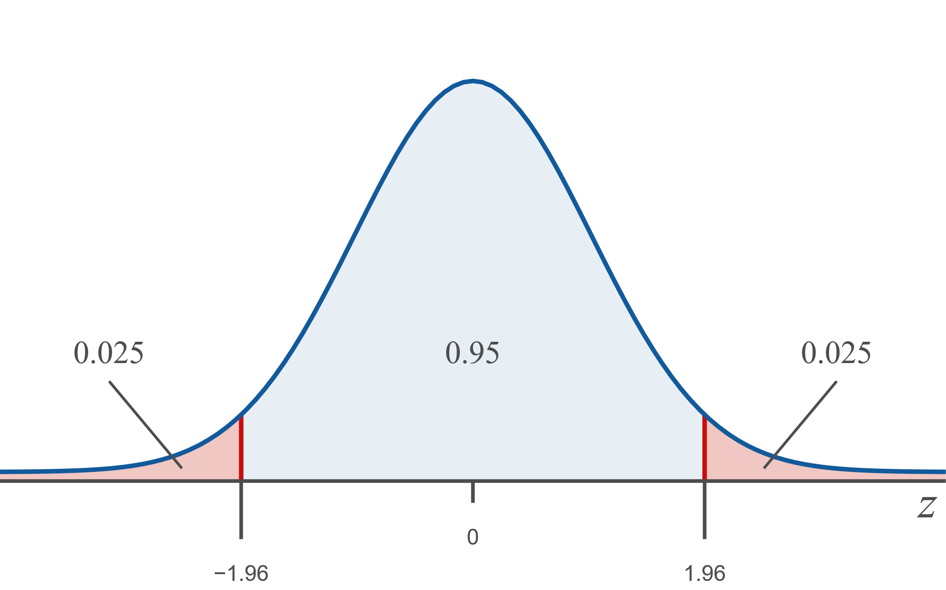
Example 1: Performing a Hypothesis Test for the Mean Cost of Textbooks—Slide 8
Figure 3

Slide 14
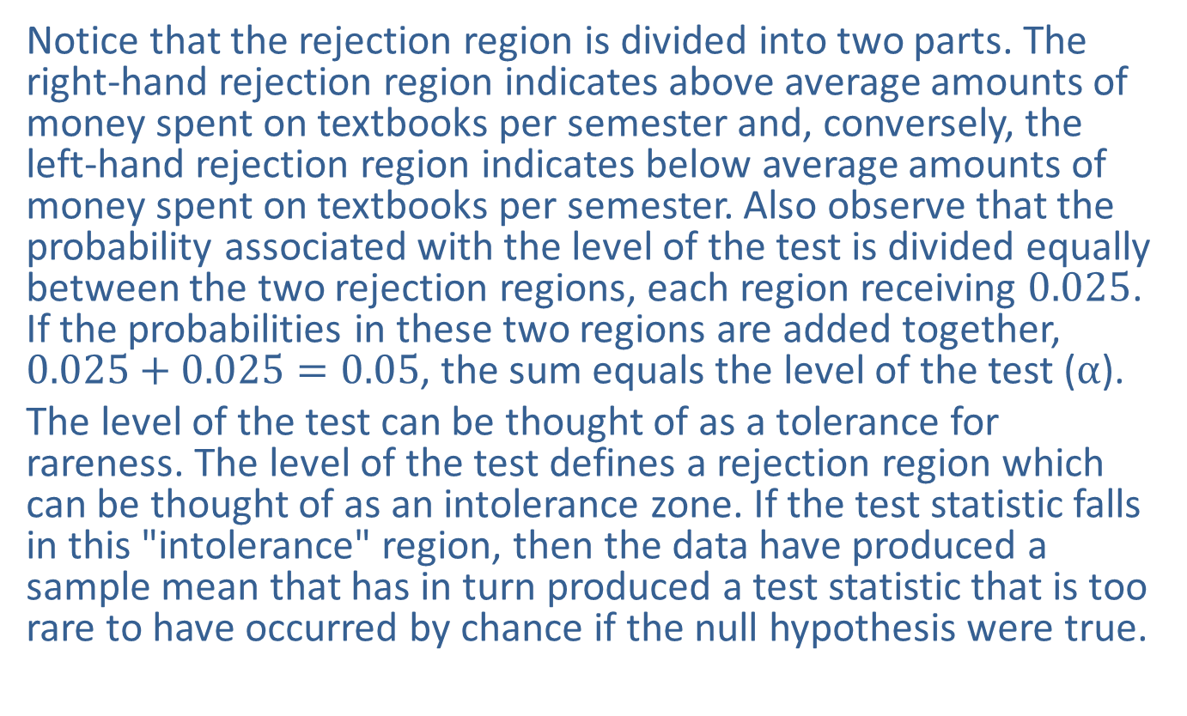
Example 1: Performing a Hypothesis Test for the Mean Cost of Textbooks—Slide 9
Notice that the rejection region is divided into two parts. The right-hand rejection region indicates above average amounts of money spent on textbooks per semester and, conversely, the left-hand rejection region indicates below average amounts of money spent on textbooks per semester. Also observe that the probability associated with the level of the test is divided equally between the two rejection regions, each region receiving 0.025. If the probabilities in these two regions are added together, $0.025+0.025=0.05$, the sum equals the level of the test (α).
The level of the test can be thought of as a tolerance for rareness. The level of the test defines a rejection region which can be thought of as an intolerance zone. If the test statistic falls in this "intolerance" region, then the data have produced a sample mean that has in turn produced a test statistic that is too rare to have occurred by chance if the null hypothesis were true.

Slide 15
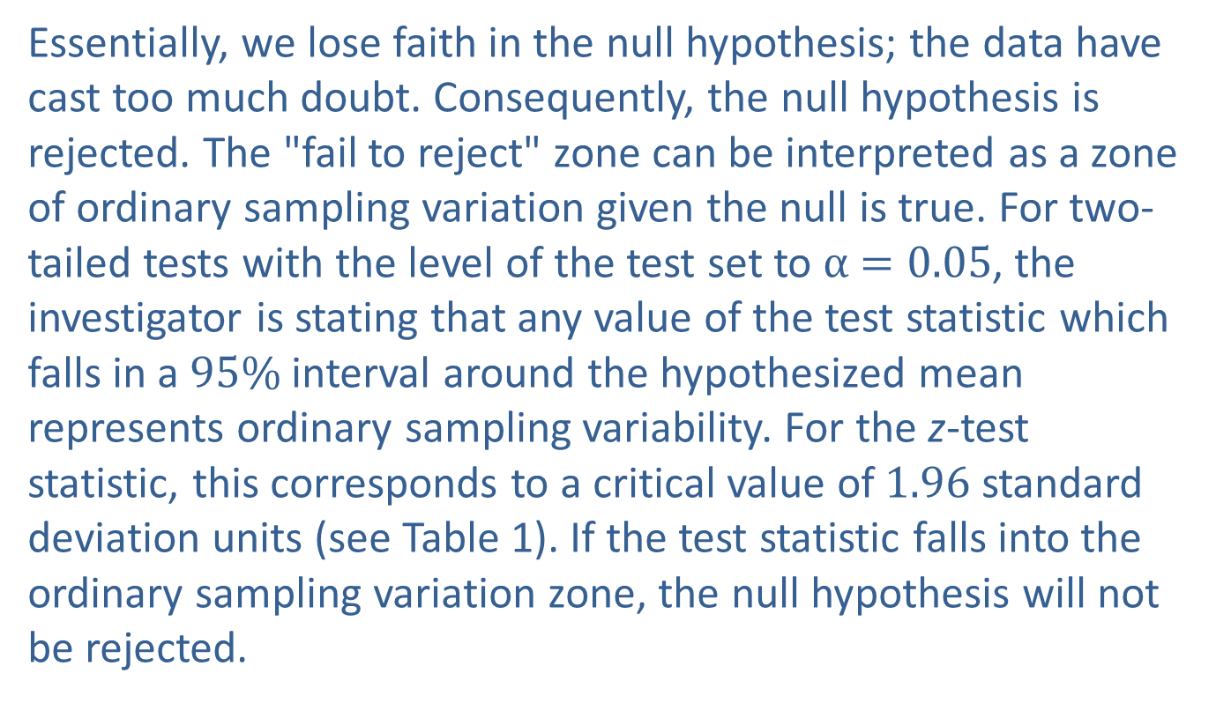
Example 1: Performing a Hypothesis Test for the Mean Cost of Textbooks—Slide 10
Essentially, we lose faith in the null hypothesis; the data have cast too much doubt. Consequently, the null hypothesis is rejected. The "fail to reject" zone can be interpreted as a zone of ordinary sampling variation given the null is true. For two-tailed tests with the level of the test set to α$=0.05$, the investigator is stating that any value of the test statistic which falls in a $95\%$ interval around the hypothesized mean represents ordinary sampling variability. For the z-test statistic, this corresponds to a critical value of 1.96 standard deviation units (see Table 1). If the test statistic falls into the ordinary sampling variation zone, the null hypothesis will not be rejected.

Slide 16
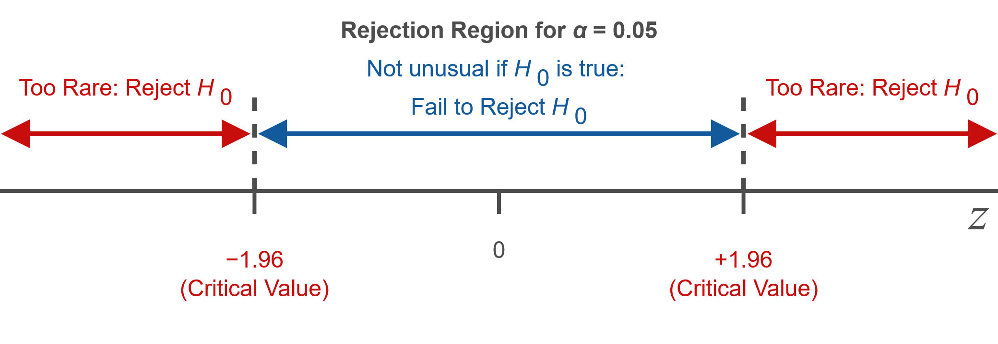
Example 1: Performing a Hypothesis Test for the Mean Cost of Textbooks—Slide 11

Slide 17
Example 1: Performing a Hypothesis Test for the Mean Cost of Textbooks—Slide 12
Step 5: Collect the sample data and compute the value of the test statistic.
​A random sample of 75 students revealed a mean of $540 per semester spent on textbooks at the local university. As discussed earlier, the z-statistic is given by
​
The sample mean is 3.46 standard deviations from the hypothesized value. Is the sample mean too far away from the value of the mean specified in the null hypothesis for us to believe that the null is true?

Slide 18
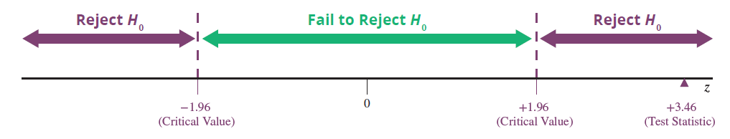
Example 1: Performing a Hypothesis Test for the Mean Cost of Textbooks—Slide 13
Step 6: Make the decision and state the conclusion in terms of the original question.
​The critical values of the test statistic are ±1.96. If the null hypothesis were true, observing a value of z equal to or larger in absolute value than 1.96 would occur only 5% of the time.
​

Slide 19
Example 1: Performing a Hypothesis Test for the Mean Cost of Textbooks—Slide 14
The test statistic z = 3.46 implies x is 3.46 standard deviation units from the mean which is substantially more than 1.96 standard deviations from the hypothesized value. The decision must be to reject H ₀. The sample mean is too far from the hypothesized value for us to believe the difference is caused by ordinary sampling variation. Essentially,
the tolerance for rareness that we have imposed by setting α = 0.05.
Conclusion and Interpretation: There is significant evidence at the 0.05 level that the students at the local university do not spend, on average, $500 per semester on textbooks. It would be tempting to conclude that the students at the local university spend more since the sample mean is greater than the national average. However, we did not test a hypothesis for spending more; we tested whether the students at the local university were spending more or less than the national average, and the conclusion must be consistent with the hypothesis tested.

Slide 20
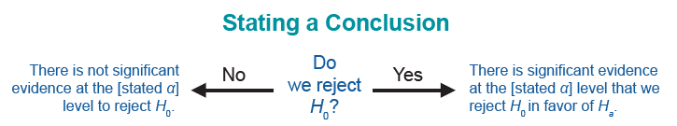
Stating a Conclusion
One temptation might be to reformulate the hypothesis and test to see if the students are spending more on textbooks with the same data. This would be practically unethical. If you already know the z-value for a given set of data, you should not formulate a hypothesis and use the data to “support” that hypothesis.
Part of every hypothesis test is arbitrary. The level of the test, α, is arbitrarily defined by the researcher. As you have seen (e.g., Table 1) in the last example, the level of the test affects the decision rule. Since the level of the test is arbitrarily set, the decision rule inherits the arbitrariness.

Slide 21
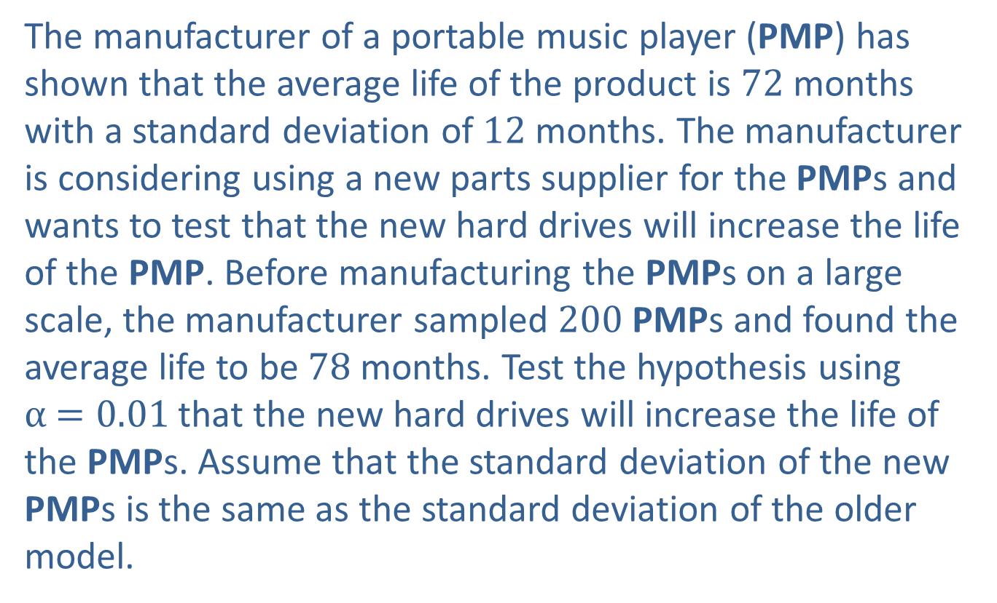
Example 2: Performing a Hypothesis Test for the Mean Life of a PMP—Slide 1
The manufacturer of a portable music player (PMP) has shown that the average life of the product is 72 months with a standard deviation of 12 months. The manufacturer is considering using a new parts supplier for the PMPs and wants to test that the new hard drives will increase the life of the PMP. Before manufacturing the PMPs on a large scale, the manufacturer sampled 200 PMPs and found the average life to be 78 months. Test the hypothesis using α$=0.01$ that the new hard drives will increase the life of the PMPs. Assume that the standard deviation of the new PMPs is the same as the standard deviation of the older model.

Slide 22
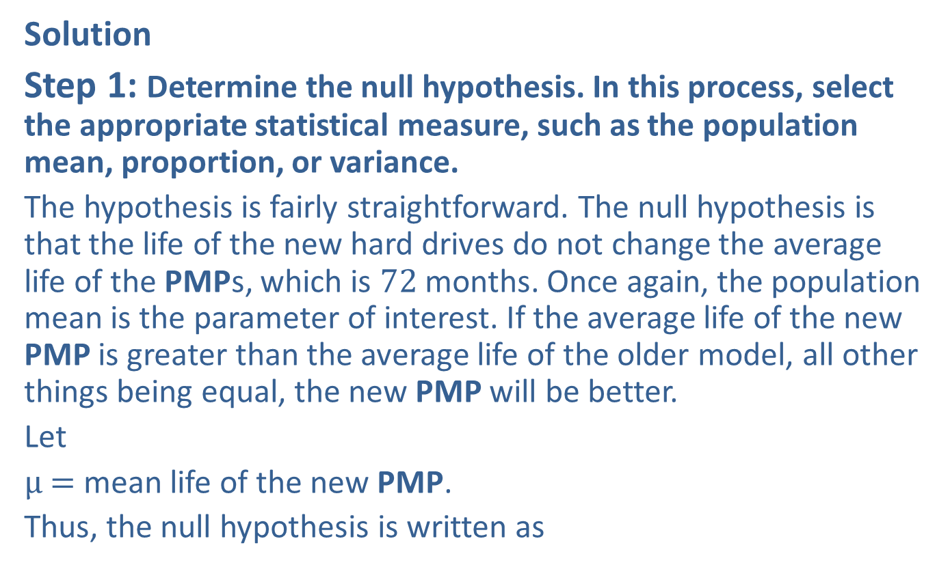
Example 2: Performing a Hypothesis Test for the Mean Life of a PMP—Slide 2
Solution
Step 1: Determine the null hypothesis. In this process, select the appropriate statistical measure, such as the population mean, proportion, or variance.
The hypothesis is fairly straightforward. The null hypothesis is that the life of the new hard drives do not change the average life of the PMPs, which is 72 months. Once again, the population mean is the parameter of interest. If the average life of the new PMP is greater than the average life of the older model, all other things being equal, the new PMP will be better.
Let
μ$=$ mean life of the new PMP.
Thus, the null hypothesis is written as

Slide 23
Example 2: Performing a Hypothesis Test for the Mean Life of a PMP—Slide 3
Step 2: Determine the alternative hypothesis and whether it should be one-sided or two-sided.
The alternative hypothesis is that the new hard drives increase the life of the PMPs. The goal is to determine if there is sufficient evidence to conclude that the new PMPs will last longer, on average, than the older model. The alternative hypothesis will be one-sided, and this will be a one-tailed test.
Thus, the alternative hypothesis is written as

Slide 24
Example 2: Performing a Hypothesis Test for the Mean Life of a PMP—Slide 4
Step 3: Select the appropriate test statistic based on the information at hand and the assumptions you are willing to make.
The problem states that the standard deviation of the new model is equivalent to the standard deviation of the older model, which is known. Therefore, the standard deviation of the new PMP’s life is assumed to be known. Since the sample is relatively large, the central limit theorem asserts that the distribution of
should be approximately normal.
Because the standard deviation is known and the sample size is greater than or equal to 30, the z-test statistic can be used.

Slide 25
Example 2: Performing a Hypothesis Test for the Mean Life of a PMP—Slide 5
Step 4: Determine the critical value of the test statistic. Two factors must be considered.
​1. The type of alternative hypothesis: two-sided, one-sided left, one-sided right.
​2. The specification of α, the significance level of the test.
Since the alternative hypothesis is one-sided, we want to know if there is evidence that μ (the mean life of the new PMP model) is greater than the hypothesized value, μ ₀ (72 months, which is the standard life of the existing PMP model).
(the mean life of the 200 PMP sample) is much larger
than μ ₀, that would suggest that H _{a} is a more reasonable choice than H ₀.

Slide 26
Example 2: Performing a Hypothesis Test for the Mean Life of a PMP—Slide 6
Of course, through ordinary sampling variation,
be larger than μ ₀. How much greater than μ ₀ does
have to be in order for us to believe that the mean life of the new PMP is greater than 72 months (H _{a}?) or locate the critical value of z for a one-sided "greater than" alternative, find the value of z that cuts off α worth of probability in the right-hand tail of the distribution. The critical values for "greater than" alternative hypotheses are given in Table 2 for typical values of α.

Slide 27
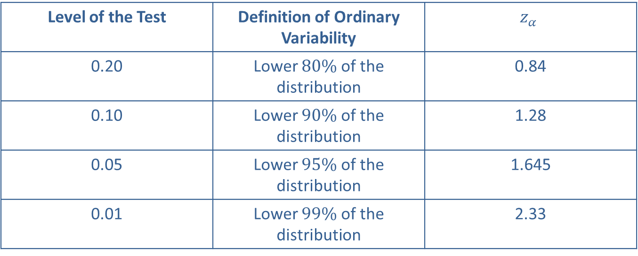
Example 2: Performing a Hypothesis Test for the Mean Life of a PMP—Slide 7
Table 2 - Critical Values of the z-Test Statistic for One-Sided (Greater Than) Alternatives
Level of the Test | Definition of Ordinary Variability | $$z_{α}$$
0.20 | Lower $80\%$ of the distribution | 0.84
0.10 | Lower $90\%$ of the distribution | 1.28
0.05 | Lower $95\%$ of the distribution | 1.645
0.01 | Lower $99\%$ of the distribution | 2.33

Slide 28
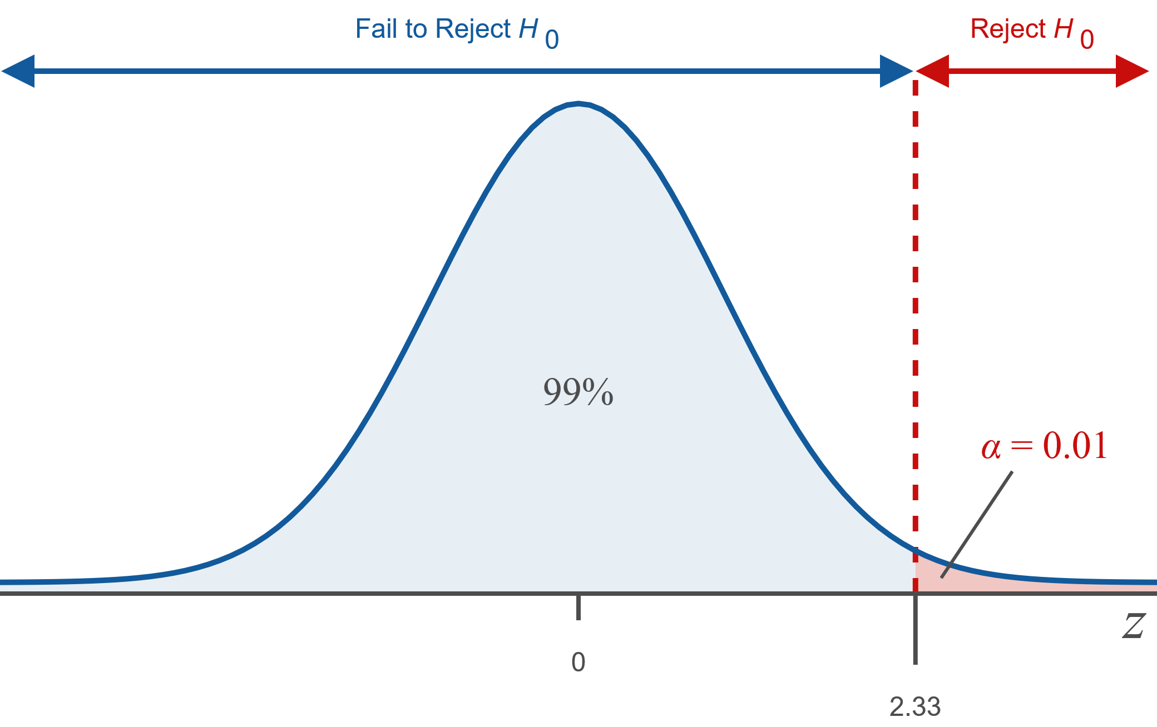
Example 2: Performing a Hypothesis Test for the Mean Life of a PMP—Slide 8
Figure 4

Slide 29

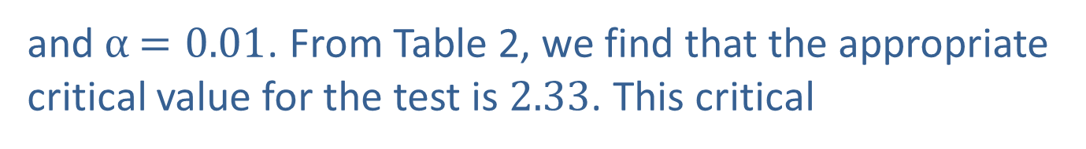
Example 2: Performing a Hypothesis Test for the Mean Life of a PMP—Slide 9
The z-test statistic has a standard normal distribution; so critical values are determined from the probability distribution of the standard normal distribution. The alternative hypothesis is one-sided
and α$=0.01$. From Table 2, we find that the appropriate critical value for the test is 2.33. This critical
value means that if
is 2.33 standard deviations larger
than μ ₀, then H ₀ should be rejected in favor of H _{a}. However, if H ₀ is true, ordinary variation would cause
to be greater than or equal to 2.33 about $1\%$ of the time. Thus, $1\%$ of the time H ₀ will be rejected when it is true, a Type I error.

Slide 30
Example 2: Performing a Hypothesis Test for the Mean Life of a PMP—Slide 10
Step 5: Collect the sample data and compute the value of the test statistic.
Suppose a random sample of 200 PMPs revealed a mean life of 78 months. The resulting z-test statistic is
indicating that the sample mean life of the new PMP model is more than 7 standard deviations larger than the life of the current PMP model. It is quite unlikely that ordinary sampling variation could have caused the sample mean to be more than 7 standard deviations from the hypothesized value.

Slide 31
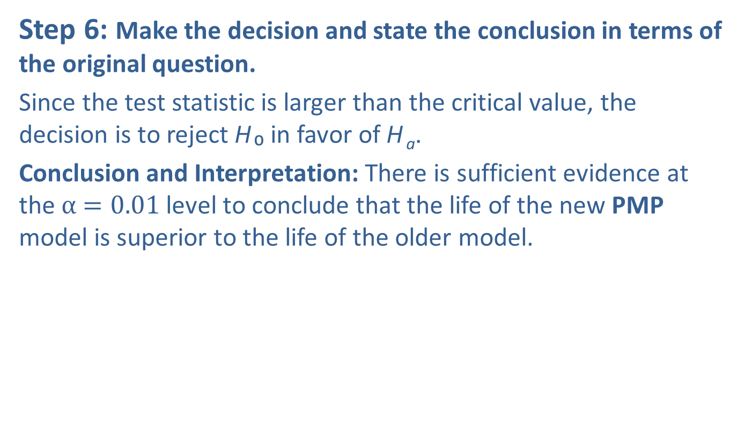
Example 2: Performing a Hypothesis Test for the Mean Life of a PMP—Slide 11
Step 6: Make the decision and state the conclusion in terms of the original question.
Since the test statistic is larger than the critical value, the decision is to reject H ₀ in favor of H _{a}.
Conclusion and Interpretation: There is sufficient evidence at the α$=0.01$ level to conclude that the life of the new PMP model is superior to the life of the older model.

Slide 32
Procedure: One-sided "Less Than" Alternatives—Slide 1
For tests that are based on a test statistic which has a standard normal distribution and a "less than" alternative, find the value of z that cuts off α worth of probability in the left-hand tail of the distribution. The critical values for "less than" alternative hypotheses are given in Table 3 for typical values of α.

Slide 33
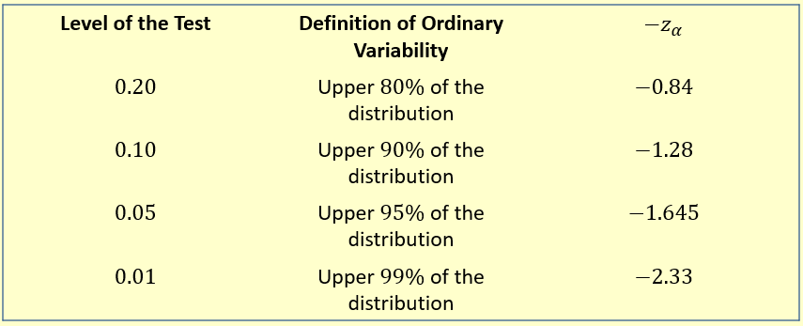
Procedure: One-sided "Less Than" Alternatives—Slide 2
Table 3 - Critical Values of the z-Test Statistic for One-Sided (Less Than) Alternatives

Slide 34
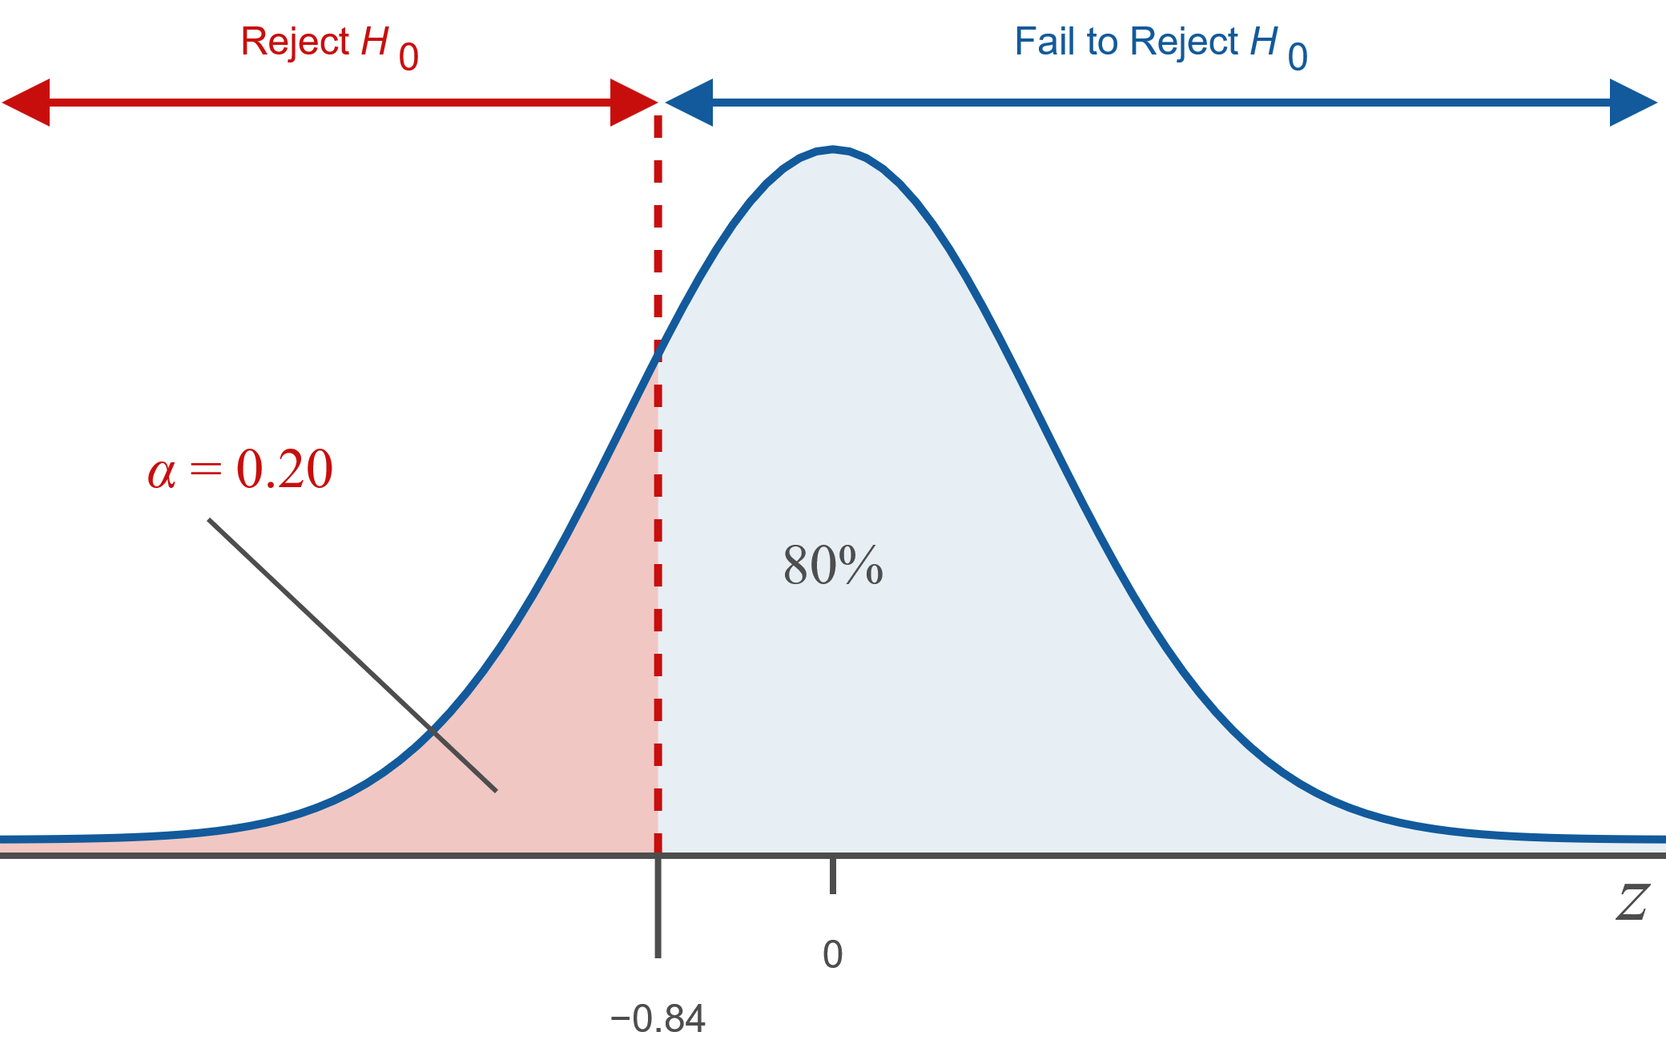
Procedure: One-sided "Less Than" Alternatives—Slide 3
Figure 6

Slide 35
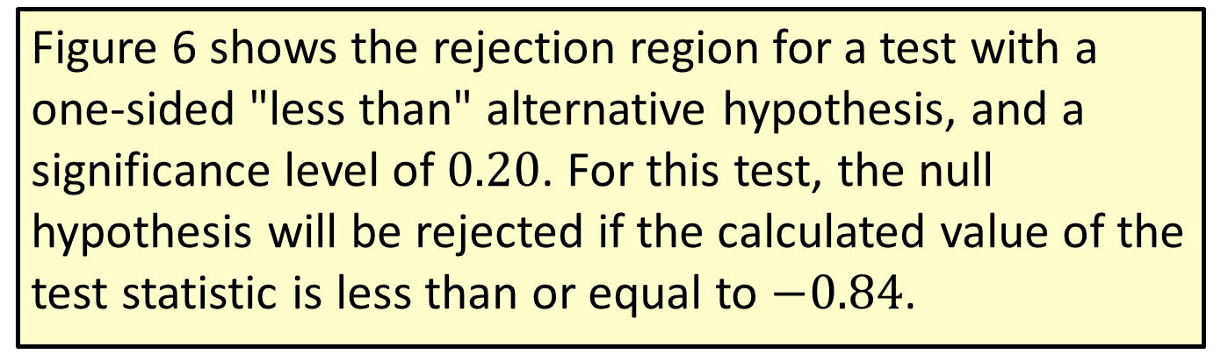
Procedure: One-sided "Less Than" Alternatives—Slide 4
Figure 6 shows the rejection region for a test with a one-sided "less than" alternative hypothesis, and a significance level of 0.20. For this test, the null hypothesis will be rejected if the calculated value of the test statistic is less than or equal to $−0.84$.

Slide 36
Definition: P-value
A P-value is the probability of observing a value of a test statistic as extreme or more extreme than the one observed, assuming the null hypothesis is true.

Slide 37
Procedure: Performing a Hypothesis Test Using P-Values
​If the computed P-value is less than or equal to α, reject the null hypothesis in favor of the alternative.
​If the computed P-value is greater than α, fail to reject the null hypothesis.

Slide 38
P-Values for a Two-Sided Hypothesis Test—Slide 1
So far, we have only discussed calculating a P-value for a one-tailed hypothesis test. To compute the P-value for a two-tailed test, simply double the tail probability of the test statistic. For example, suppose that we are testing the following hypotheses.
Further, suppose the computed test statistic is z = 2.31.

Slide 39
P-Values for a Two-Sided Hypothesis Test—Slide 2
For an upper one-tailed test
we would calculate the P-value as
However, for a two-tailed test, the P-value is calculated as
where z ₀ is the observed value of the test statistic.

Slide 40
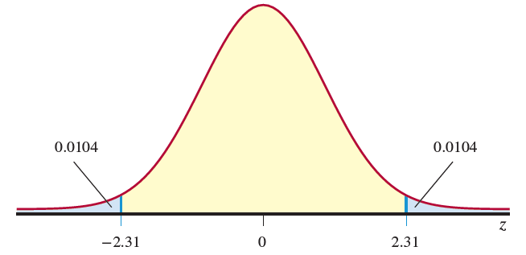
P-Values for a Two-Sided Hypothesis Test—Slide 3
Thus, to compute the P-value for a two-tailed test, we double the tail area.
Figure 8
The P-value of 0.0208 is the likelihood of observing a value of the test statistic greater than or equal to 2.31 or less than or equal to −2.31 given the null hypothesis is true.

Slide 41
Procedure: Steps in the Test of a Hypothesis Using the P-Value Approach—Slide 1
Step 1: Determine the null hypothesis. In this process, select the appropriate statistical measure, such as the population mean, proportion, or variance.
Step 2: Determine the alternative hypothesis and whether it should be one-sided or two-sided.
Step 3: Select the appropriate test statistic based on the information at hand and the assumptions you are willing to make.
Step 4: Collect the sample data and compute the value of the test statistic.

Slide 42
Procedure: Steps in the Test of a Hypothesis Using the P-Value Approach—Slide 2
Step 5: Calculate the P-value using the test statistic. For the sake of this setup, suppose we are performing a hypothesis test on the mean when σ is known. Thus, the observed value of the test statistic will be
The p-value will be found as follows:

Slide 43
Procedure: Steps in the Test of a Hypothesis Using the P-Value Approach—Slide 3
Note that in this example, we are performing a test on the population mean with σ known. If the parameter that is being tested changes so that the test statistic changes, then we would use the appropriate test statistic in the above probability statements.

Slide 44
Procedure: Steps in the Test of a Hypothesis Using the P-Value Approach—Slide 4
Step 6: Make the decision and state the conclusion in terms of the original question. The decision-making process is as follows.
​If the P-value is less than or equal to α, reject the null hypothesis in favor of the alternative hypothesis.
​If the P-value is greater than α, fail to reject the null hypothesis.

