Slide 1
Section 10.3
Testing a Hypothesis about a Population Mean, Sigma Unknown

Slide 2
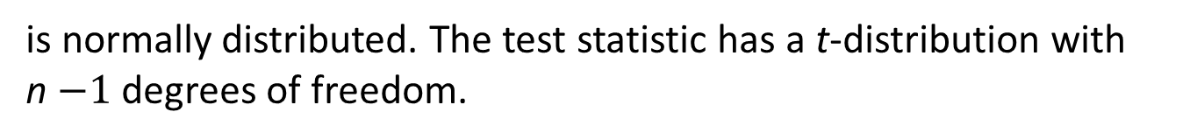
Formula: t-Test Statistic
If the standard deviation of the population is unknown, but the distribution of the population is assumed to be normal, then the test statistic is given by
where
n is the sample size,
μ ₀ is the hypothesized value of the population mean, and
s is the sample standard deviation.
It should be noted that this formula is only valid if
is normally distributed. The test statistic has a t-distribution with
n$−1$ degrees of freedom.

Slide 3
Example 1: Performing a Hypothesis Test for the Mean Time Spent On Websites—Slide 1
Ally Hirsch, a website developer, has indicated to potential clients that for the sites she has developed, visitors spend an average of 45 minutes per day on the sites. One of her potential clients conducted a survey of 35 visitors to several of the sites created by the website developer and found that the average time spent on the sites was 35 minutes with a standard deviation of 7 minutes. Determine if there is sufficient evidence to conclude that the average time spent on her sites is different from what she has indicated. Conduct the test at the 0.05 level.

Slide 4
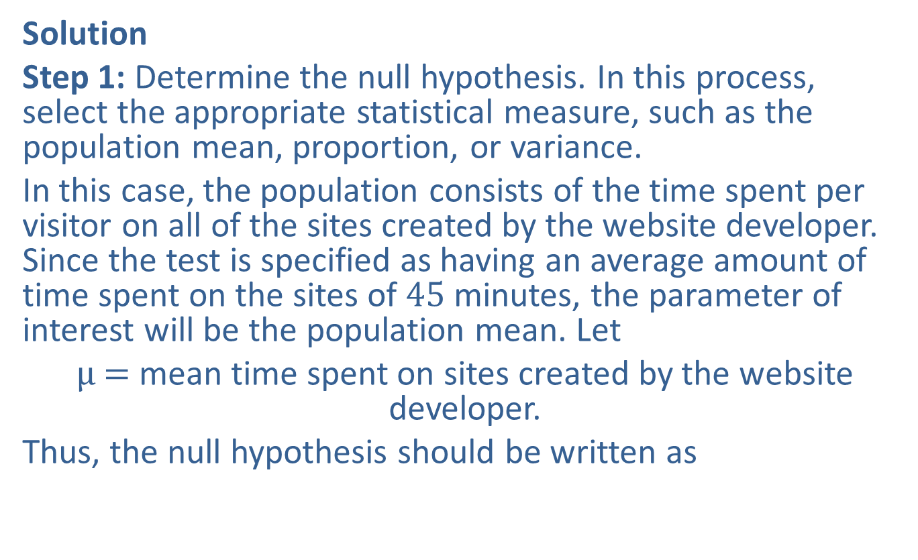

Example 1: Performing a Hypothesis Test for the Mean Time Spent On Websites—Slide 2
Solution
Step 1: Determine the null hypothesis. In this process, select the appropriate statistical measure, such as the population mean, proportion, or variance.
In this case, the population consists of the time spent per visitor on all of the sites created by the website developer. Since the test is specified as having an average amount of time spent on the sites of 45 minutes, the parameter of interest will be the population mean. Let
μ$=$ mean time spent on sites created by the website developer.
Thus, the null hypothesis should be written as
$\text{minutes}$ which states that the average time spent on the sites is 45 minutes.

Slide 5

Example 1: Performing a Hypothesis Test for the Mean Time Spent On Websites—Slide 3
Step 2: Determine the alternative hypothesis and whether it should be one-sided or two-sided.
From the information given, we must assume that the client is interested in learning if the time spent on the sites is either significantly longer than 45 minutes or significantly less than 45 minutes. Thus, the alternative hypothesis will be two-sided, and this will be a two-tailed test. The alternative hypothesis should be written as
$\text{minutes}$ which states that the
average time spent on the sites is not 45 minutes.

Slide 6
Example 1: Performing a Hypothesis Test for the Mean Time Spent On Websites—Slide 4
Step 3: Select the appropriate test statistic based on the information at hand and the assumptions you are willing to make.
Since the standard deviation of the population is not known, the t-test statistic is utilized. However, to know that the test statistic possesses a t-distribution, we must be willing to make the assumption that the population possesses a reasonably normal distribution.

Slide 7
Example 1: Performing a Hypothesis Test for the Mean Time Spent On Websites—Slide 5
Step 4: ​Determine the critical value of the test statistic. Two factors must be considered.
1. The type of alternative hypothesis: two-sided, one-sided left, one-sided right.
​2. The specification of α, the significance level of the test.
The level of the test is specified in the problem as 0.05.
The t-distribution has a parameter called degrees of freedom, which must be defined in order to utilize the distribution. Since 35 visitors were sampled, the degrees of freedom are

Slide 8
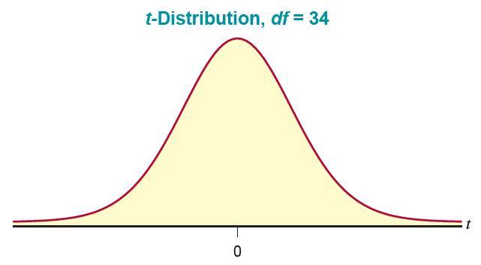
Example 1: Performing a Hypothesis Test for the Mean Time Spent On Websites—Slide 6
Figure 1

Slide 9
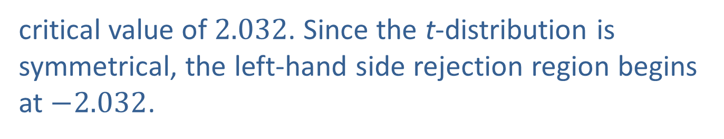
Example 1: Performing a Hypothesis Test for the Mean Time Spent On Websites—Slide 7
Since the alternative hypothesis (H _{a}) is two-sided, two tails of the distribution must be cut off as rejection regions. Each tail will receive half of the allotted level of the test.
The value of t which begins the right-hand side rejection region is
which corresponds to a
critical value of 2.032. Since the t-distribution is symmetrical, the left-hand side rejection region begins at $−2.032$.

Slide 10
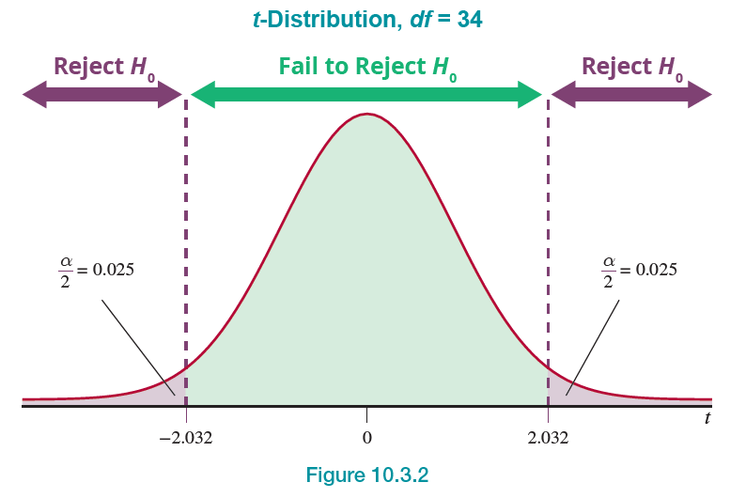
Example 1: Performing a Hypothesis Test for the Mean Time Spent On Websites—Slide 8
Figure 2

Slide 11

Example 1: Performing a Hypothesis Test for the Mean Time Spent On Websites—Slide 9
What the figure says is that it is unlikely (only occurs $5\%$ of the time) that ordinary sampling variability will cause
to differ as much as 2.032 standard deviation units from the hypothesized mean of 45.
Step 5: Collect the sample data and compute the value of the test statistic.
Since 35 visitors were sampled and the mean time spent on the sites was 35 minutes with a standard deviation of 7 minutes, the computed value of the test statistic is

Slide 12
Example 1: Performing a Hypothesis Test for the Mean Time Spent On Websites—Slide 10
The observed sample mean is more than 8 standard deviations less than the hypothesized mean. The value of the test statistic signifies a striking difference between
and the hypothesized value, μ ₀. It is very unlikely that the cause of such a difference would be ordinary sampling variation.
Step 6: Make the decision and state the conclusion in terms of the original question. Since the test statistic falls in the rejection region, we must reject H ₀ in favor of H _{a.}

Slide 13
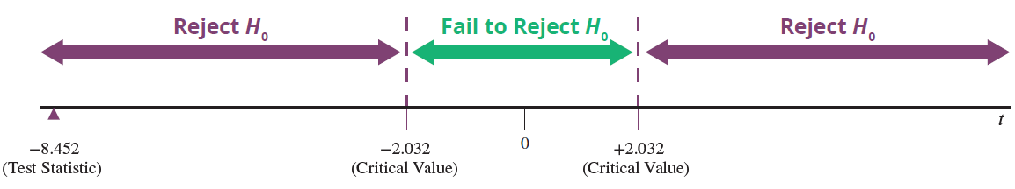
Example 1: Performing a Hypothesis Test for the Mean Time Spent On Websites—Slide 11

Slide 14
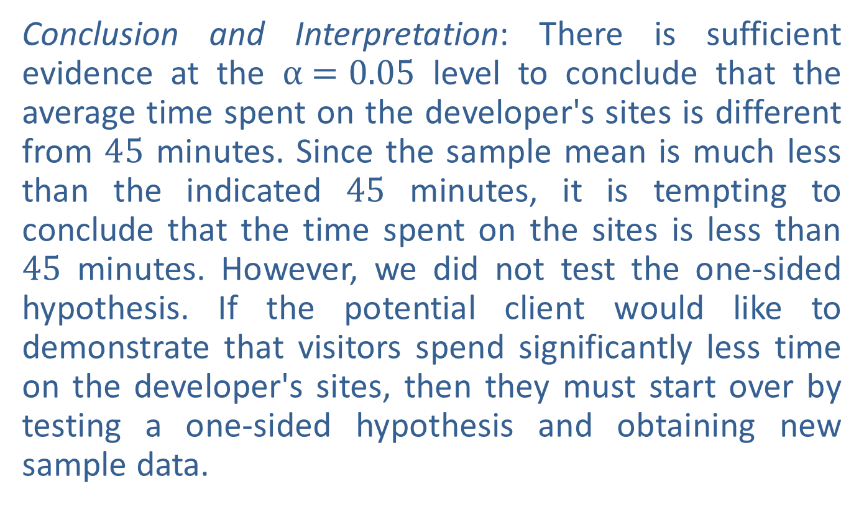
Example 1: Performing a Hypothesis Test for the Mean Time Spent On Websites—Slide 12
Conclusion and Interpretation: There is sufficient evidence at the α$=0.05$ level to conclude that the average time spent on the developer's sites is different from 45 minutes. Since the sample mean is much less than the indicated 45 minutes, it is tempting to conclude that the time spent on the sites is less than 45 minutes. However, we did not test the one-sided hypothesis. If the potential client would like to demonstrate that visitors spend significantly less time on the developer's sites, then they must start over by testing a one-sided hypothesis and obtaining new sample data.

Slide 15
Example 2: Performing a Hypothesis Test for the Mean Tensile Strength—Slide 1
The Alexander Bolt Company produces half-inch A-class stainless steel bolts. The specified quality standard is that they have a mean tensile strength of more than 4000 pounds per square inch (psi). These bolts are primarily used in the manufacturing of farm implements. The company is very concerned about quality and wants to be sure that its A-class product does not fall below the standard. A sample of 25 bolts is to be randomly selected from stock and tested for tensile strength. Design a test of hypothesis to determine if there is overwhelming evidence that the bolts meet the specified quality standard.

Slide 16
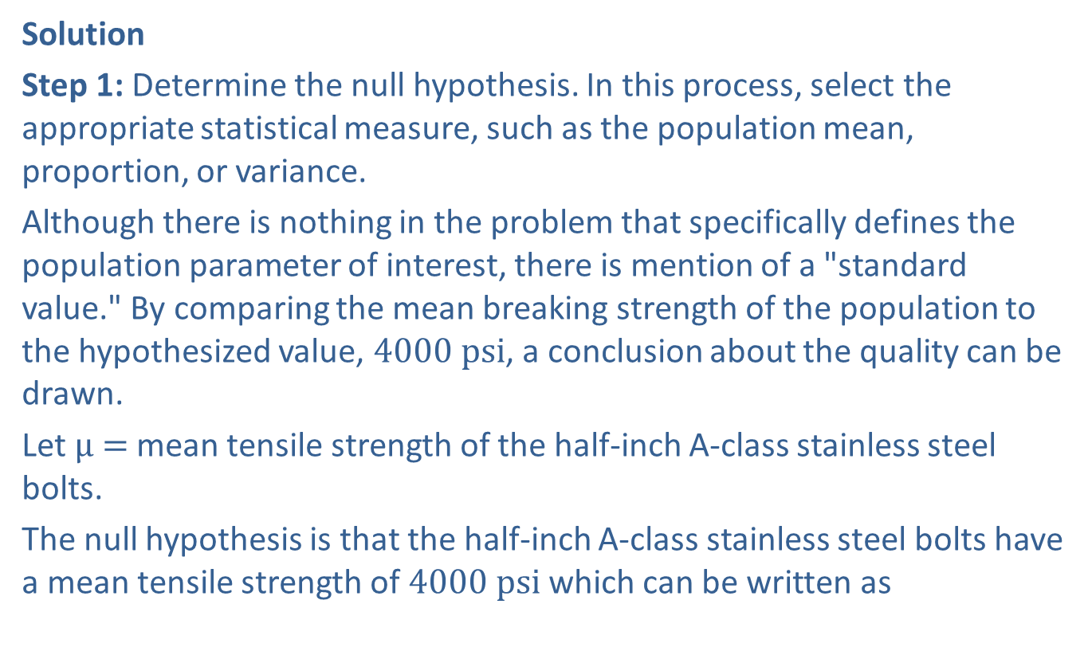
Example 2: Performing a Hypothesis Test for the Mean Tensile Strength—Slide 2
Solution
Step 1: Determine the null hypothesis. In this process, select the appropriate statistical measure, such as the population mean, proportion, or variance.
Although there is nothing in the problem that specifically defines the population parameter of interest, there is mention of a "standard value." By comparing the mean breaking strength of the population to the hypothesized value, $4000 psi$, a conclusion about the quality can be drawn.
Let μ$=$ mean tensile strength of the half-inch A-class stainless steel bolts.
The null hypothesis is that the half-inch A-class stainless steel bolts have a mean tensile strength of $4000 psi$ which can be written as

Slide 17
Example 2: Performing a Hypothesis Test for the Mean Tensile Strength—Slide 3
Step 2: Determine the alternative hypothesis and whether it should be one-sided or two-sided.
If the population mean is significantly above the hypothesized value, then there would be evidence that the desired quality is being produced. Thus, the alternative hypothesis will be one-sided, and this will be a one-tailed test. The alternative hypothesis can be written as
Step 3: Select the appropriate test statistic based on the information at hand and the assumptions you are willing to make.
The population standard deviation is unknown and will be estimated with the sample standard deviation. Assuming the distribution of the tensile strengths is reasonably normal, the t-test statistic is appropriate.

Slide 18
Example 2: Performing a Hypothesis Test for the Mean Tensile Strength—Slide 4
Step 4: Determine the critical value of the test statistic. Two factors must be considered.
1. ​The type of alternative hypothesis: two-sided, one-sided left, one-sided right.
2. The specification of α, the significance level of the test.
The level of the test is not stated in the problem, and thus the selection is left to the researcher. This is a typical predicament and, unfortunately, leaves us with what appears to be an arbitrary decision regarding the level of the test. What is a reasonable value for the level of the test?

Slide 19
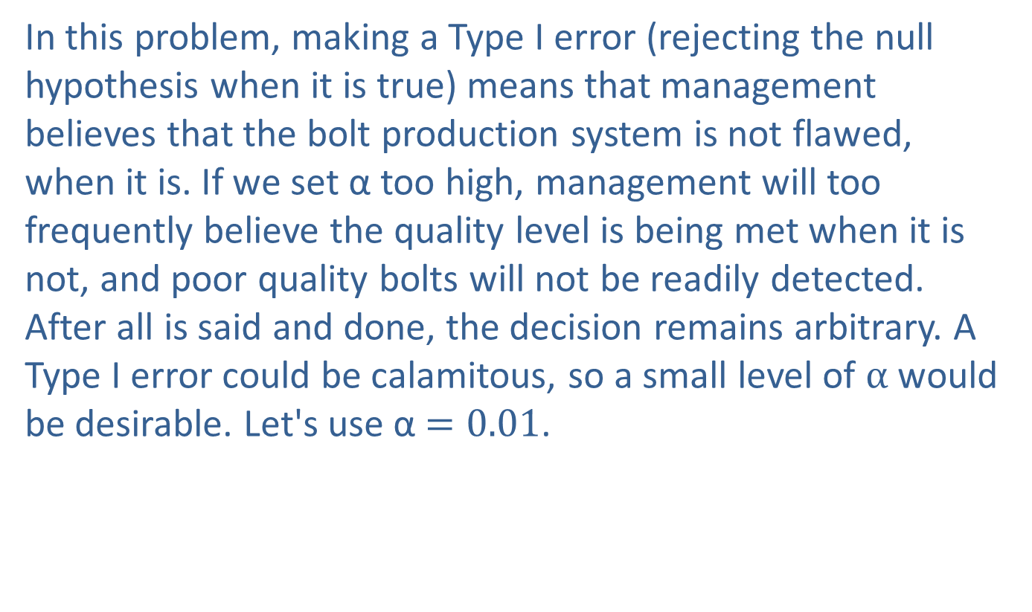
Example 2: Performing a Hypothesis Test for the Mean Tensile Strength—Slide 5
In this problem, making a Type I error (rejecting the null hypothesis when it is true) means that management believes that the bolt production system is not flawed, when it is. If we set α too high, management will too frequently believe the quality level is being met when it is not, and poor quality bolts will not be readily detected. After all is said and done, the decision remains arbitrary. A Type I error could be calamitous, so a small level of α would be desirable. Let's use α$=0.01$.

Slide 20
Example 2: Performing a Hypothesis Test for the Mean Tensile Strength—Slide 6
Since the alternative hypothesis implies that we are interested in discovering if the mean is above the hypothesized value, the rejection region will only be on the right-hand side of the sampling distribution. Because the level of the test has been chosen to be 0.01, the interval encompassing 0.01 of the area on the right-hand side of the curve will define the rejection region. Remember that the test statistic has a t-distribution.
To obtain the critical value, first determine the degrees of freedom.

Slide 21
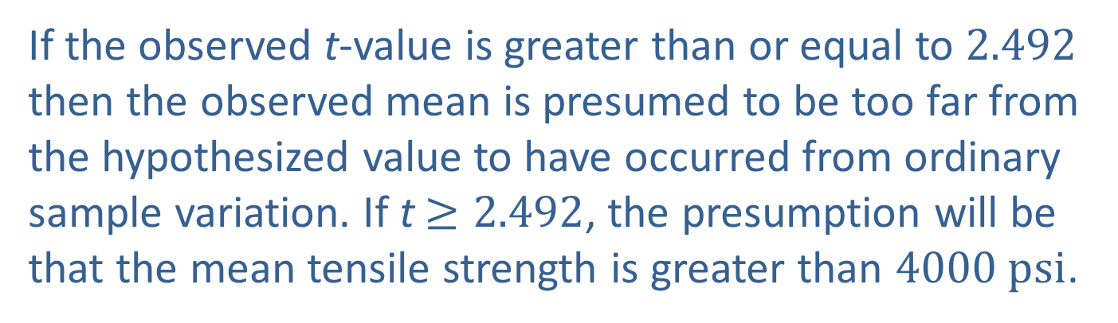
Example 2: Performing a Hypothesis Test for the Mean Tensile Strength—Slide 7
Using the table for critical values of t,
If the observed t-value is greater than or equal to 2.492 then the observed mean is presumed to be too far from the hypothesized value to have occurred from ordinary sample variation. If t$≥2.492$, the presumption will be that the mean tensile strength is greater than $4000 psi$.

Slide 22
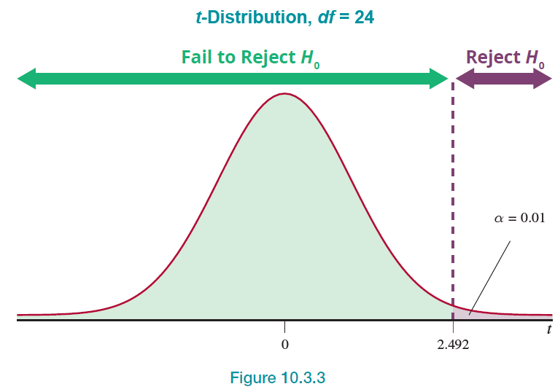
Example 2: Performing a Hypothesis Test for the Mean Tensile Strength—Slide 8
Figure 3

Slide 23
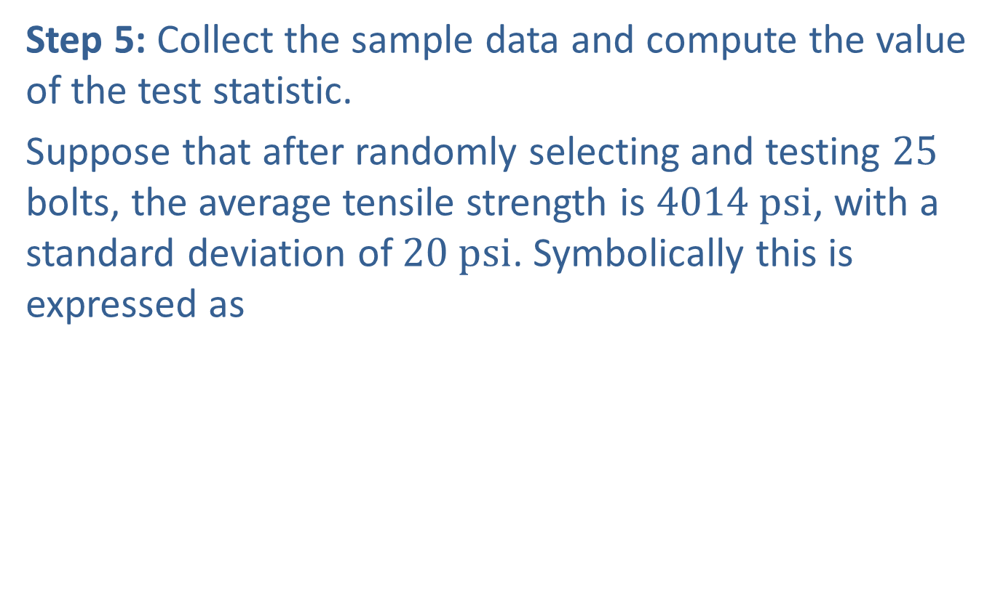
Example 2: Performing a Hypothesis Test for the Mean Tensile Strength—Slide 9
Step 5: Collect the sample data and compute the value of the test statistic.
Suppose that after randomly selecting and testing 25 bolts, the average tensile strength is $4014 psi$, with a standard deviation of $20 psi$. Symbolically this is expressed as
The resulting test statistic is

Slide 24
Example 2: Performing a Hypothesis Test for the Mean Tensile Strength—Slide 10
The sample mean is 3.5 standard deviations more than the hypothesized value of the mean. Is this difference caused by ordinary sampling variation, or is this evidence of a false null hypothesis? Keep in mind that rejecting the null hypothesis (H₀) will be a desirable outcome since the null hypothesis states that the bolts are below quality standards.

Slide 25
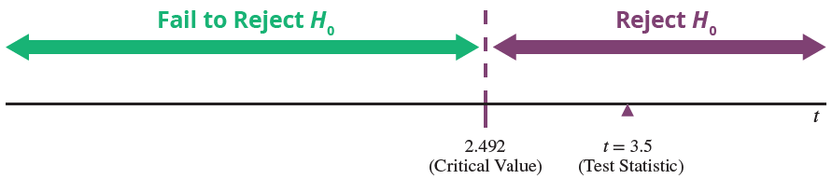
Example 2: Performing a Hypothesis Test for the Mean Tensile Strength—Slide 11

Slide 26
Example 2: Performing a Hypothesis Test for the Mean Tensile Strength—Slide 12
Step 6: Make the decision and state the conclusion in terms of the original question.
Since the test statistic falls in the rejection region, it indicates that the sample mean is too far from the hypothesized value to believe it is due to ordinary sampling variation. (In other words,
is a rare observation and has exceeded our tolerance for rareness.) The null hypothesis must be rejected in favor of the alternative hypothesis.

Slide 27
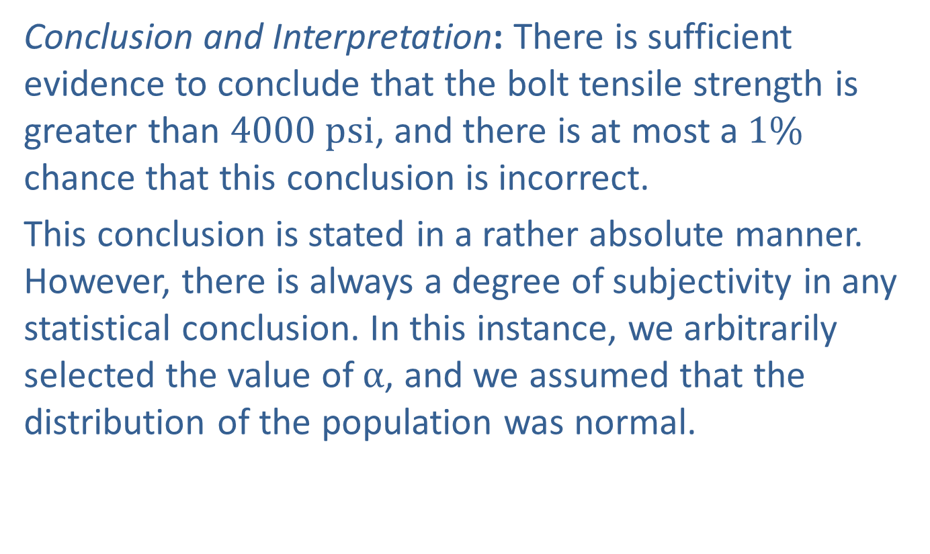
Example 2: Performing a Hypothesis Test for the Mean Tensile Strength—Slide 13
Conclusion and Interpretation: There is sufficient evidence to conclude that the bolt tensile strength is greater than $4000 psi$, and there is at most a $1\%$ chance that this conclusion is incorrect.
This conclusion is stated in a rather absolute manner. However, there is always a degree of subjectivity in any statistical conclusion. In this instance, we arbitrarily selected the value of α, and we assumed that the distribution of the population was normal.

Slide 28
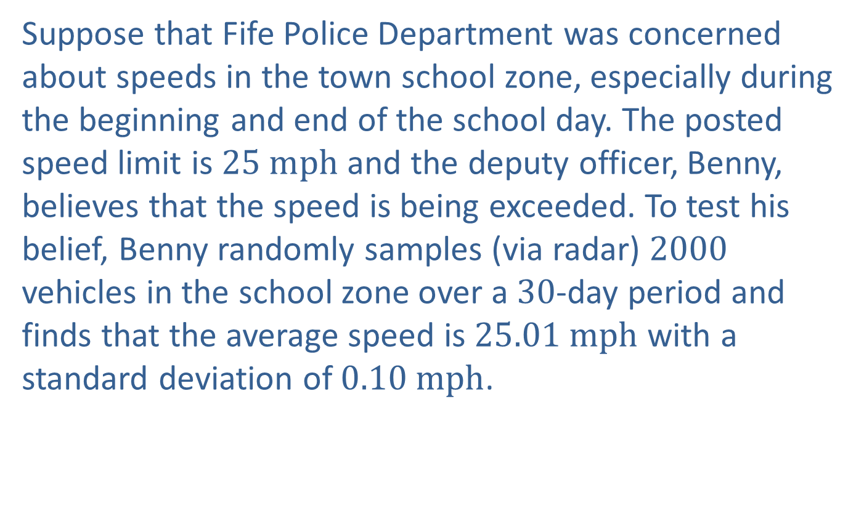
Example 3: Determining Practical vs. Statistical Significance—Slide 1
Suppose that Fife Police Department was concerned about speeds in the town school zone, especially during the beginning and end of the school day. The posted speed limit is $25 mph$ and the deputy officer, Benny, believes that the speed is being exceeded. To test his belief, Benny randomly samples (via radar) 2000 vehicles in the school zone over a 30-day period and finds that the average speed is $25.01 mph$ with a standard deviation of $0.10 mph$.

Slide 29
Example 3: Determining Practical vs. Statistical Significance—Slide 2
Solution
To test Benny's claim, the hypothesis test is carried out with the following hypotheses.
The resulting test statistic is

Slide 30

Example 3: Determining Practical vs. Statistical Significance—Slide 3
The P-value for this test is 0.000004 and suggests that the test statistic is extremely rare, if the null hypothesis is true. Considering that a test statistic this large would result from ordinary sampling variation in only about 4 in a million samples, we should reject the null hypothesis
in favor of the alternative. With Benny being a "strictly by the book" officer, he would conclude that the speeds are significantly higher than $25 mph$ in the school zone and the department should allocate extra resources in that area to reduce speeds. However, from a practical perspective, there isn’t much difference (other than random variation) between $25 mph$ and $25.01 mph$, and it isn't likely to be detected by radar. So, despite the "statistical significance" of the test, the practical significance is negligible.

