Slide 1
Section 10.4
The Relationship Between Confidence Interval Estimation and Hypothesis Testing

Slide 2
Procedure: Using a Confidence Interval to Test a Hypothesis—Slide 1
Step 1: If the hypothesis test is of the form
Step 2: Calculate the
If the population standard deviation, σ, is known, then the confidence interval for the population mean, μ, is given by
If the population standard deviation, σ , is unknown, then the confidence interval for the population mean, μ , is given by

Slide 3
Procedure: Using a Confidence Interval to Test a Hypothesis—Slide 2
Step 3: If μ ₀ falls within the interval, then we fail to reject the null hypothesis; however, if μ ₀ falls outside the calculated interval, then reject the null hypothesis in favor of the alternative.

Slide 4
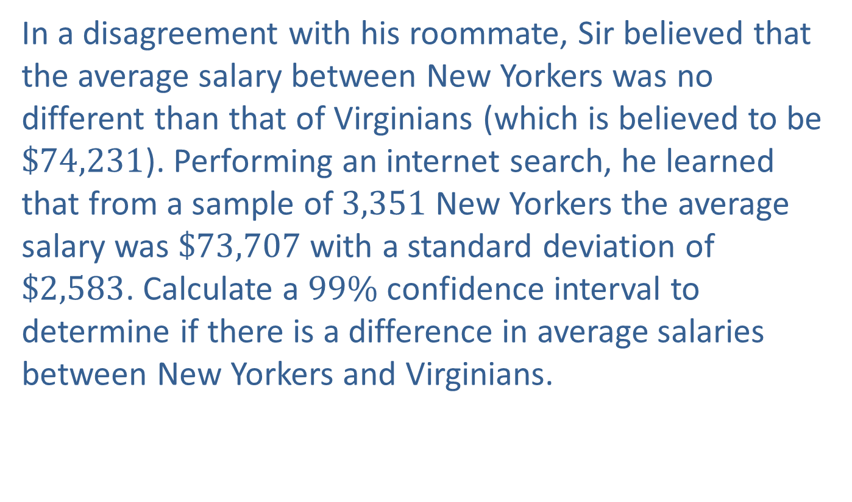
Example 1: Performing a Hypothesis Test Using a Confidence Interval on Average Income—Slide 1
In a disagreement with his roommate, Sir believed that the average salary between New Yorkers was no different than that of Virginians (which is believed to be $\$74,231$). Performing an internet search, he learned that from a sample of 3,351 New Yorkers the average salary was $\$73,707$ with a standard deviation of $\$2,583$. Calculate a $99\%$ confidence interval to determine if there is a difference in average salaries between New Yorkers and Virginians.

Slide 5
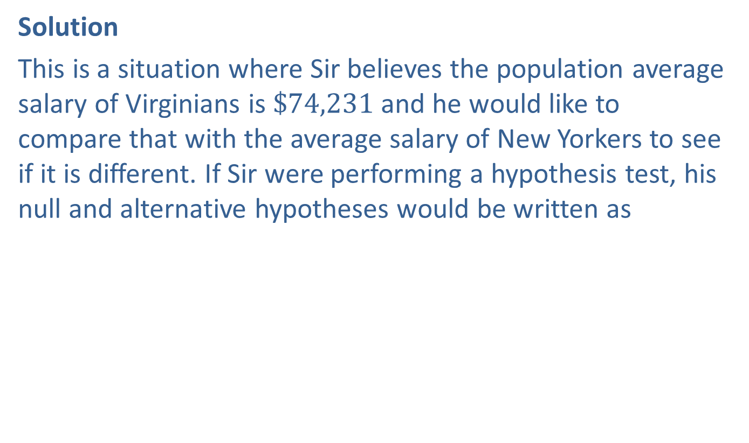

Example 1: Performing a Hypothesis Test Using a Confidence Interval on Average Income—Slide 2
Solution
This is a situation where Sir believes the population average salary of Virginians is $\$74,231$ and he would like to compare that with the average salary of New Yorkers to see if it is different. If Sir were performing a hypothesis test, his null and alternative hypotheses would be written as
At the $1\%$ level, a $99\%$ confidence interval for the mean New Yorker salary is obtained by

Slide 6

Example 1: Performing a Hypothesis Test Using a Confidence Interval on Average Income—Slide 3
We know that the sample size is 3,351, the sample mean,
and the sample standard
deviation is $\$2,583$. We also know that α$=0.01$. Thus,
Using these data, we find that the $99\%$ confidence interval is given by
Performing the calculations, you will get a confidence interval of

Slide 7

Example 1: Performing a Hypothesis Test Using a Confidence Interval on Average Income—Slide 4
Note that the hypothesized mean of $\$74,231$ does not fall in the confidence interval above. Thus, we reject the null hypothesis and conclude that the average salary of residents of New York is significantly different than the average salary of residents of Virginia.

