Slide 1
Section 10.5
Testing a Hypothesis about a Population Proportion

Slide 2
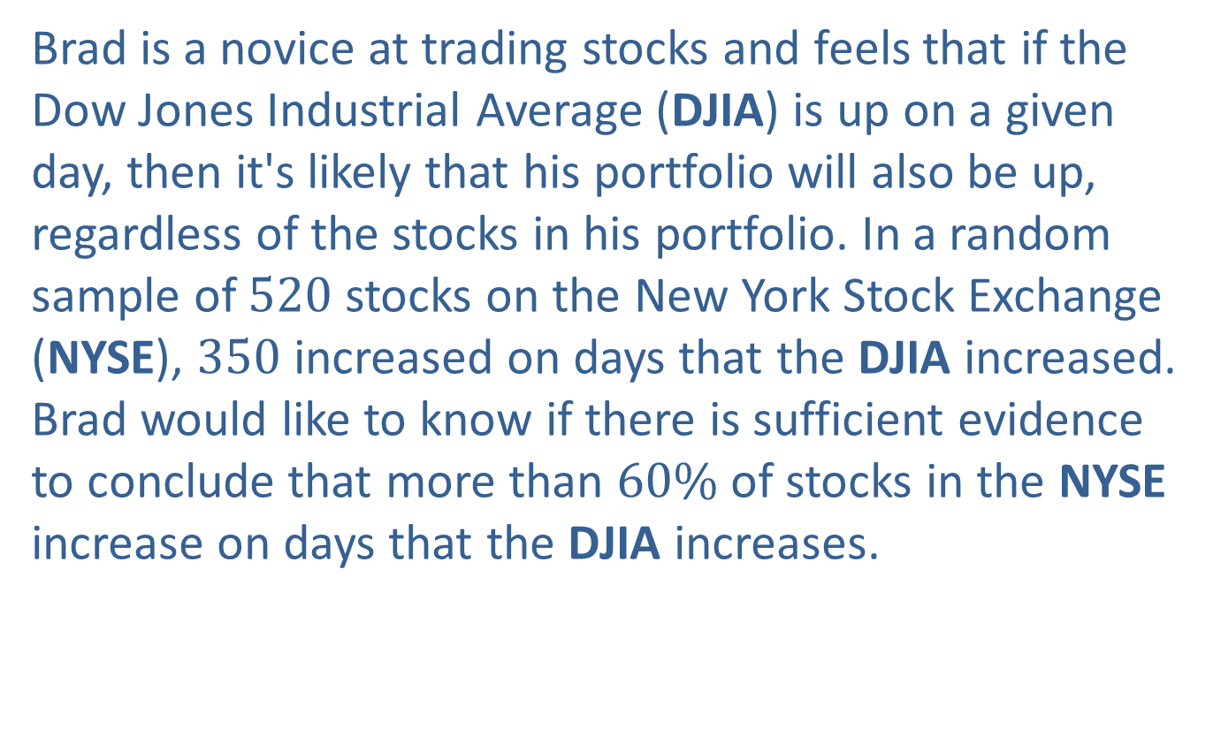
Example 1: Performing a Hypothesis Test for the Proportion of Stock Increases—Slide 1
Brad is a novice at trading stocks and feels that if the Dow Jones Industrial Average (DJIA) is up on a given day, then it's likely that his portfolio will also be up, regardless of the stocks in his portfolio. In a random sample of 520 stocks on the New York Stock Exchange (NYSE), 350 increased on days that the DJIA increased. Brad would like to know if there is sufficient evidence to conclude that more than $60\%$ of stocks in the NYSE increase on days that the DJIA increases.

Slide 3
Example 1: Performing a Hypothesis Test for the Proportion of Stock Increases—Slide 2
Solution
Step 1: Determine the null hypothesis.
In this process, select the appropriate statistical measure, such as the population mean, proportion, or variance. Since the problem concerns the percentage of stocks on the NYSE that increase on days that the DJIA increases, the appropriate statistical measure will be a proportion.

Slide 4



Example 1: Performing a Hypothesis Test for the Proportion of Stock Increases—Slide 3
Let p$=$ percentage of the stocks on the NYSE that increase on days when the DJIA increases.
The null hypothesis is that $60\%$ of the stocks on the NYSE increase on days when the DJIA increases. The null hypothesis can be written as
Note that p $=60\%$ is equivalent to p $=0.60$ so that the null hypothesis can be written as

Slide 5
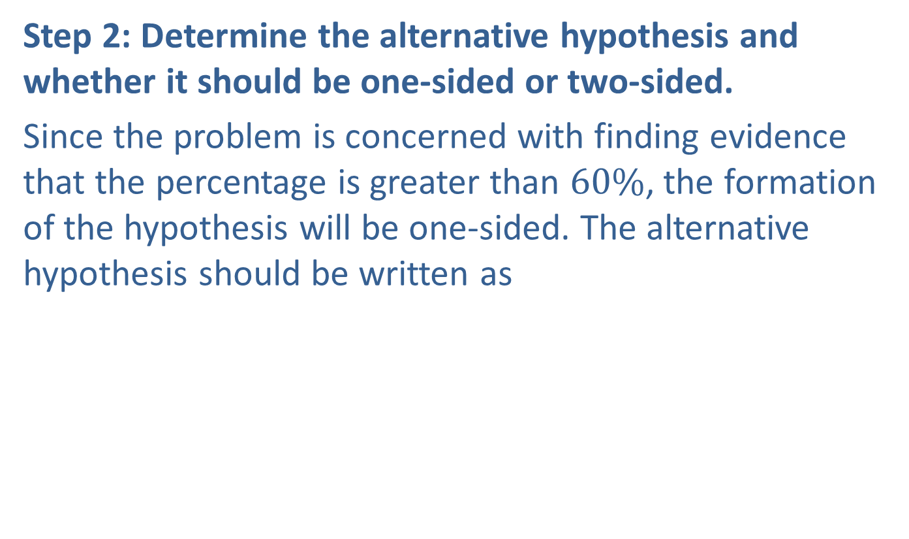

Example 1: Performing a Hypothesis Test for the Proportion of Stock Increases—Slide 4
Step 2: Determine the alternative hypothesis and whether it should be one-sided or two-sided.
Since the problem is concerned with finding evidence that the percentage is greater than $60\%$, the formation of the hypothesis will be one-sided. The alternative hypothesis should be written as
which represents that more than $60\%$ of the stocks increase on days when the DJIA increases.

Slide 6
Example 1: Performing a Hypothesis Test for the Proportion of Stock Increases—Slide 5
Step 3: Select the appropriate test statistic based on the information at hand and the assumptions you are willing to make.
the appropriate test statistic is given by
The test statistic measures how far the sample proportion,
is from the hypothesized value of the population proportion, p ₀, measured in standard deviation units. This is exactly the same concept used in testing hypotheses about a population mean.

Slide 7
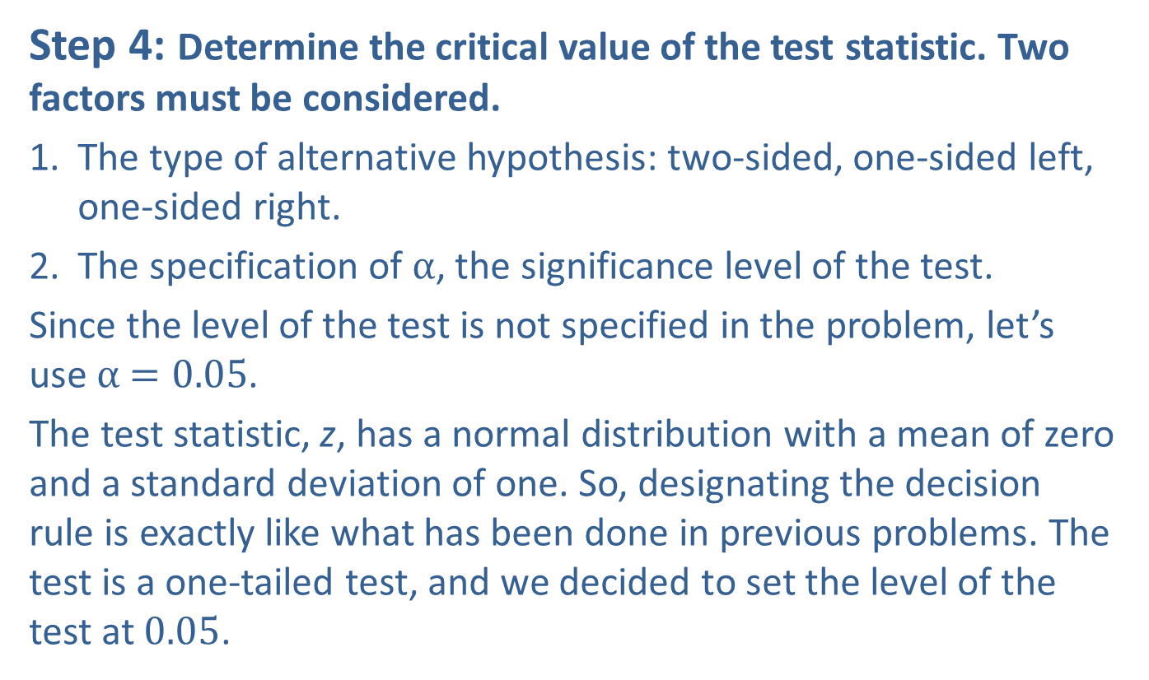
Example 1: Performing a Hypothesis Test for the Proportion of Stock Increases—Slide 6
Step 4: Determine the critical value of the test statistic. Two factors must be considered.
​1. The type of alternative hypothesis: two-sided, one-sided left, one-sided right.
2. The specification of α, the significance level of the test.
Since the level of the test is not specified in the problem, let’s use α$=0.05$.
The test statistic, z, has a normal distribution with a mean of zero and a standard deviation of one. So, designating the decision rule is exactly like what has been done in previous problems. The test is a one-tailed test, and we decided to set the level of the test at 0.05.

Slide 8
Example 1: Performing a Hypothesis Test for the Proportion of Stock Increases—Slide 7
The decision rule will be to reject
if the value of z is greater than or equal to 1.645. In essence, we are saying that ordinary sampling variation might account for a
up to 1.645 standard deviations
larger than the hypothesized value. But if a z-value is observed that is larger than 1.645, then we will lose faith in the null hypothesis because we have observed something that is too rare by the standards we have set for the level of the test.

Slide 9
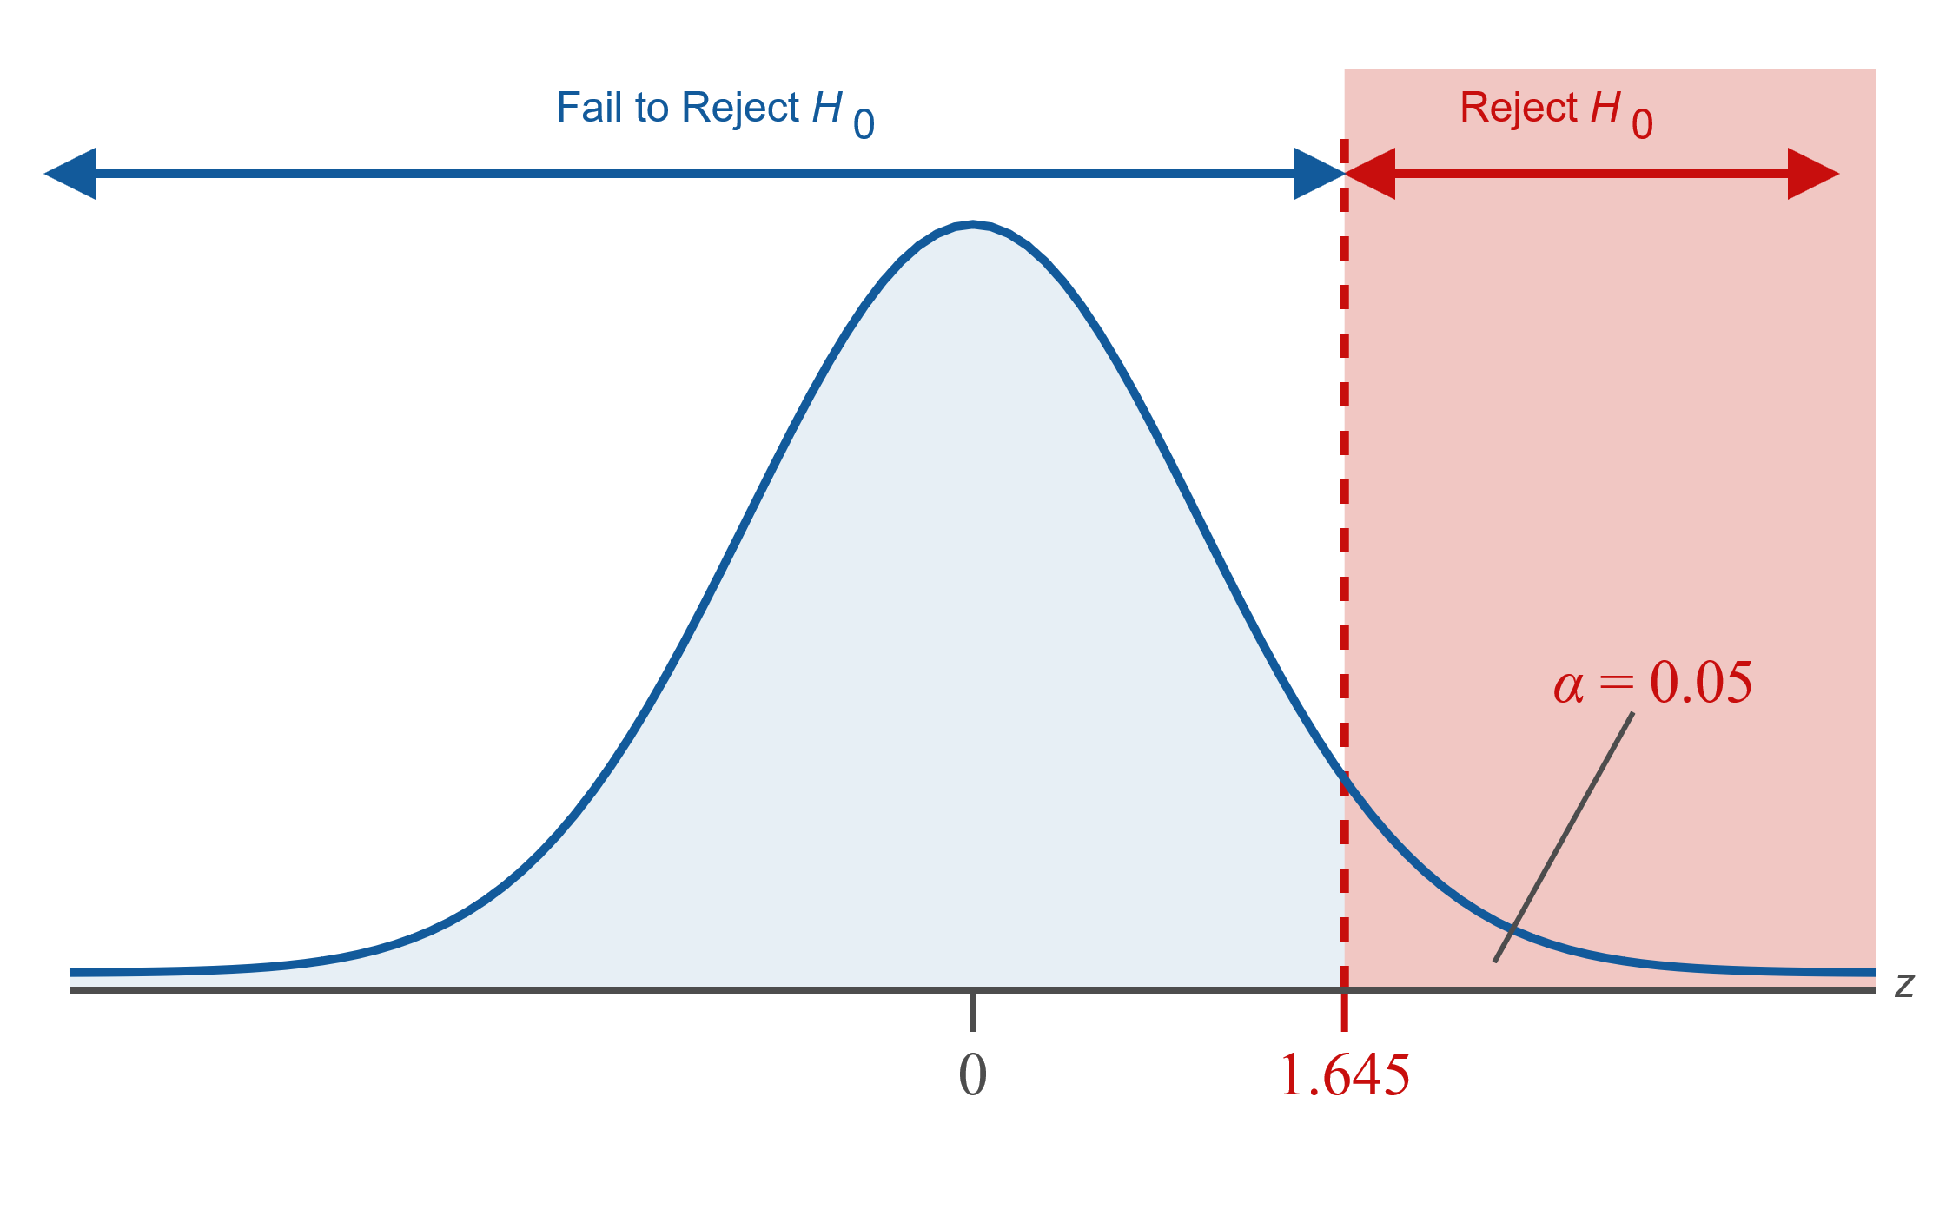
Example 1: Performing a Hypothesis Test for the Proportion of Stock Increases—Slide 8
Figure 1

Slide 10
Example 1: Performing a Hypothesis Test for the Proportion of Stock Increases—Slide 9
Step 5: Collect the sample data and compute the value of the test statistic.
In a random sample of 520 stocks on the NYSE, 350 increased on days that the DJIA increased. The value of
is given by
Because
and
we can use the z-test statistic.
Thus, the test statistic is calculated as follows.

Slide 11
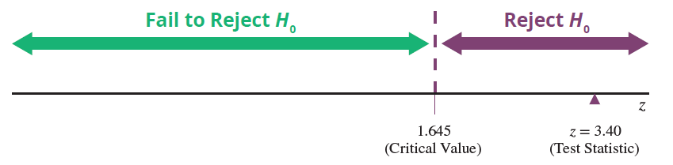
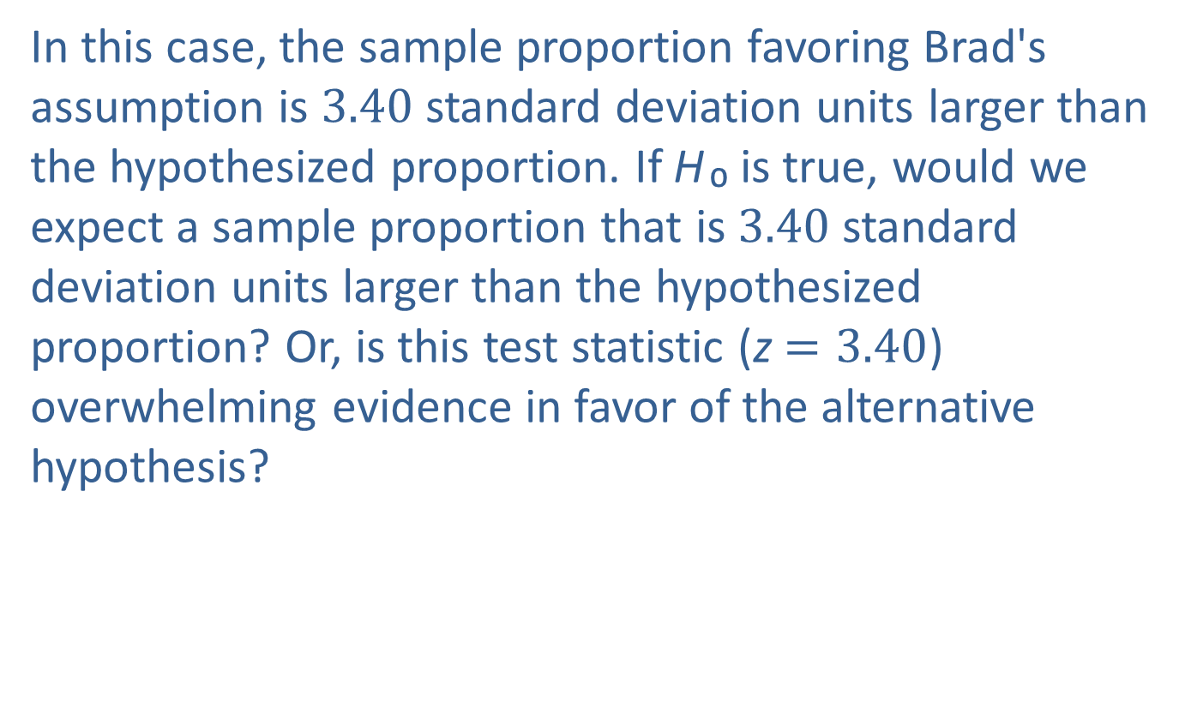
Example 1: Performing a Hypothesis Test for the Proportion of Stock Increases—Slide 10
In this case, the sample proportion favoring Brad's assumption is 3.40 standard deviation units larger than the hypothesized proportion. If H ₀ is true, would we expect a sample proportion that is 3.40 standard deviation units larger than the hypothesized proportion? Or, is this test statistic (z $=3.40$) overwhelming evidence in favor of the alternative hypothesis?

Slide 12

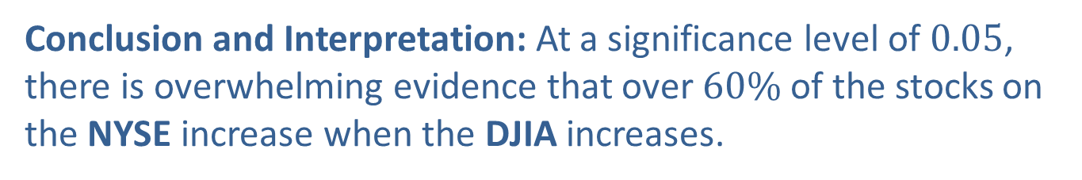
Example 1: Performing a Hypothesis Test for the Proportion of Stock Increases—Slide 11
Step 6: Make the decision and state the conclusion in terms of the original question.
The value of the test statistic, z $=3.40$, falls in the rejection region. According to the standard of rareness established in Step 4, the z-value is too rare to believe the null hypothesis
is true. The sample evidence contradicts the null hypothesis, and it will be rejected in favor of the alternative hypothesis,
Conclusion and Interpretation: At a significance level of 0.05, there is overwhelming evidence that over $60\%$ of the stocks on the NYSE increase when the DJIA increases.

Slide 13
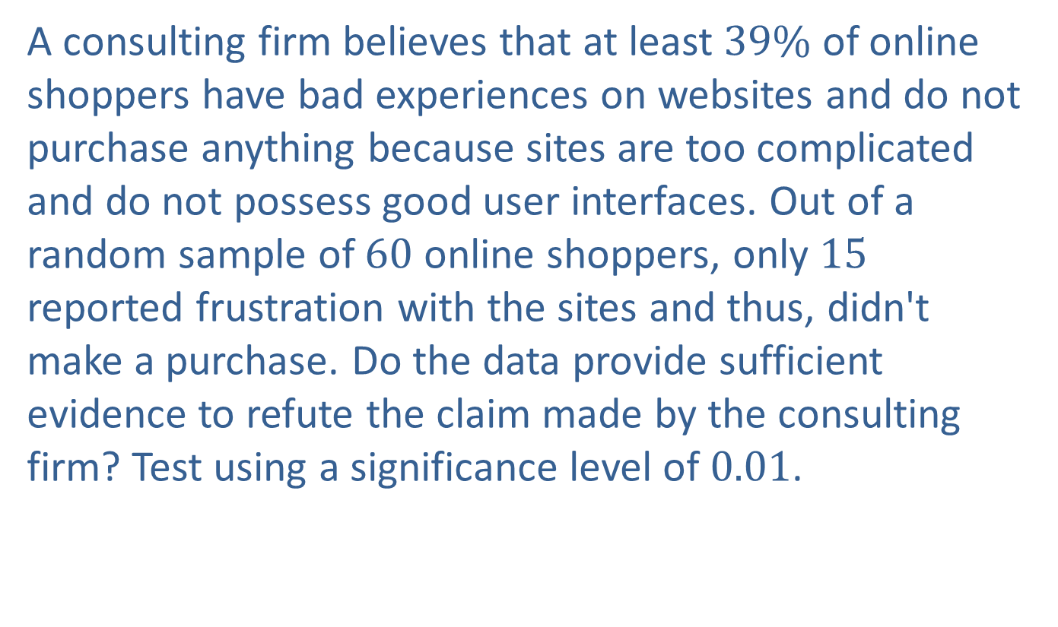
Example 2: Performing a Hypothesis Test for the Proportion of Online Shoppers—Slide 1
A consulting firm believes that at least $39\%$ of online shoppers have bad experiences on websites and do not purchase anything because sites are too complicated and do not possess good user interfaces. Out of a random sample of 60 online shoppers, only 15 reported frustration with the sites and thus, didn't make a purchase. Do the data provide sufficient evidence to refute the claim made by the consulting firm? Test using a significance level of 0.01.

Slide 14
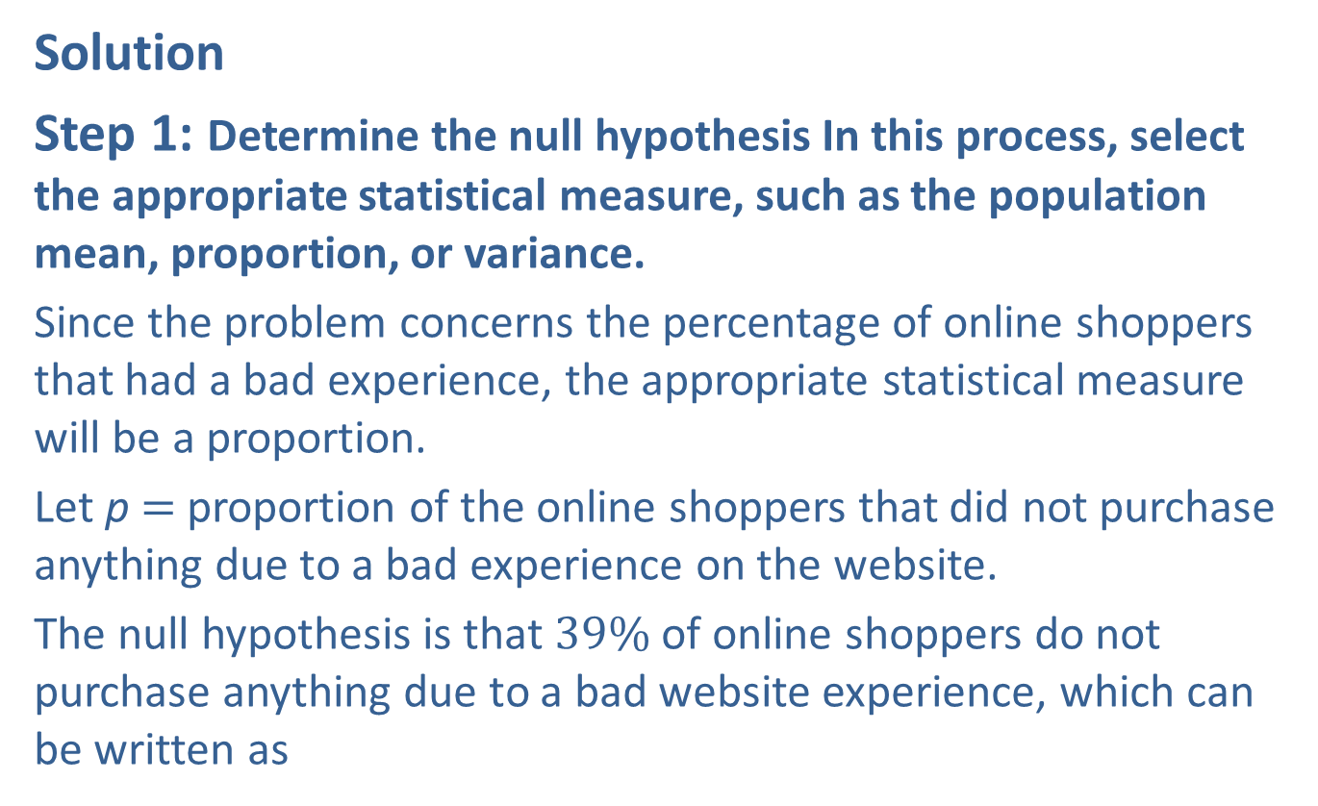
Example 2: Performing a Hypothesis Test for the Proportion of Online Shoppers—Slide 2
Solution
Step 1: Determine the null hypothesis In this process, select the appropriate statistical measure, such as the population mean, proportion, or variance.
Since the problem concerns the percentage of online shoppers that had a bad experience, the appropriate statistical measure will be a proportion.
Let p$=$ proportion of the online shoppers that did not purchase anything due to a bad experience on the website.
The null hypothesis is that $39\%$ of online shoppers do not purchase anything due to a bad website experience, which can be written as

Slide 15
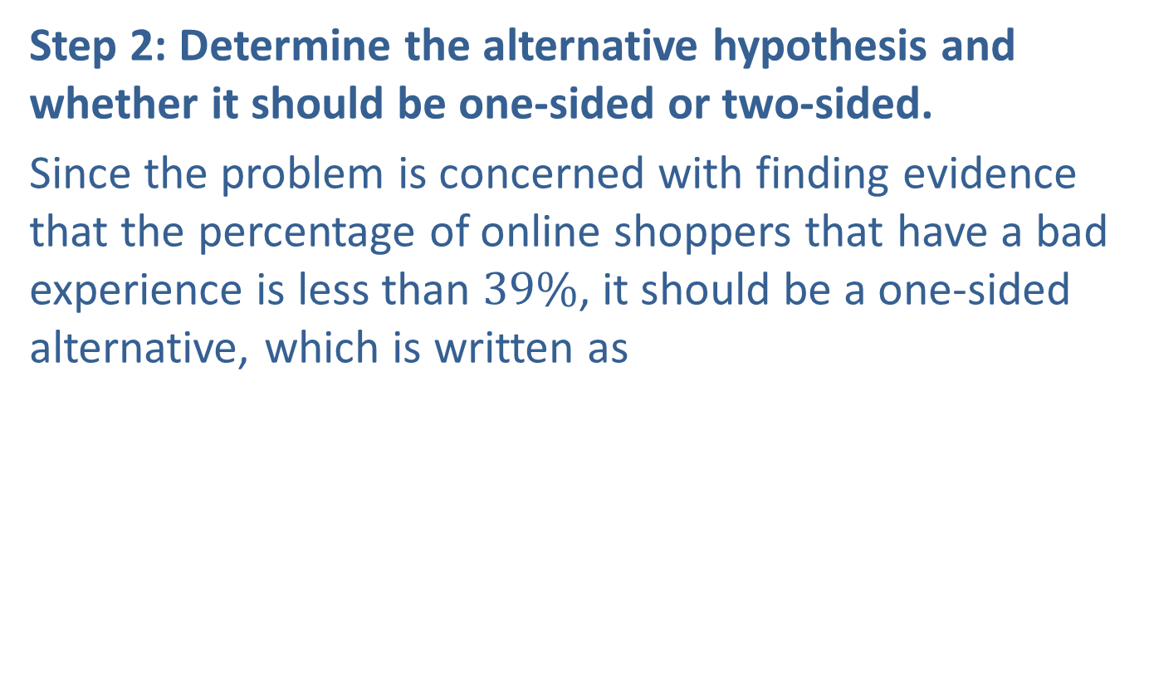
Example 2: Performing a Hypothesis Test for the Proportion of Online Shoppers—Slide 3
Step 2: Determine the alternative hypothesis and whether it should be one-sided or two-sided.
Since the problem is concerned with finding evidence that the percentage of online shoppers that have a bad experience is less than $39\%$, it should be a one-sided alternative, which is written as

Slide 16
Example 2: Performing a Hypothesis Test for the Proportion of Online Shoppers—Slide 4
Step 3: Select the appropriate test statistic based on the information at hand and the assumptions you are willing to make.
Because
are both greater than or equal to 5, the z-test statistic is appropriate.

Slide 17
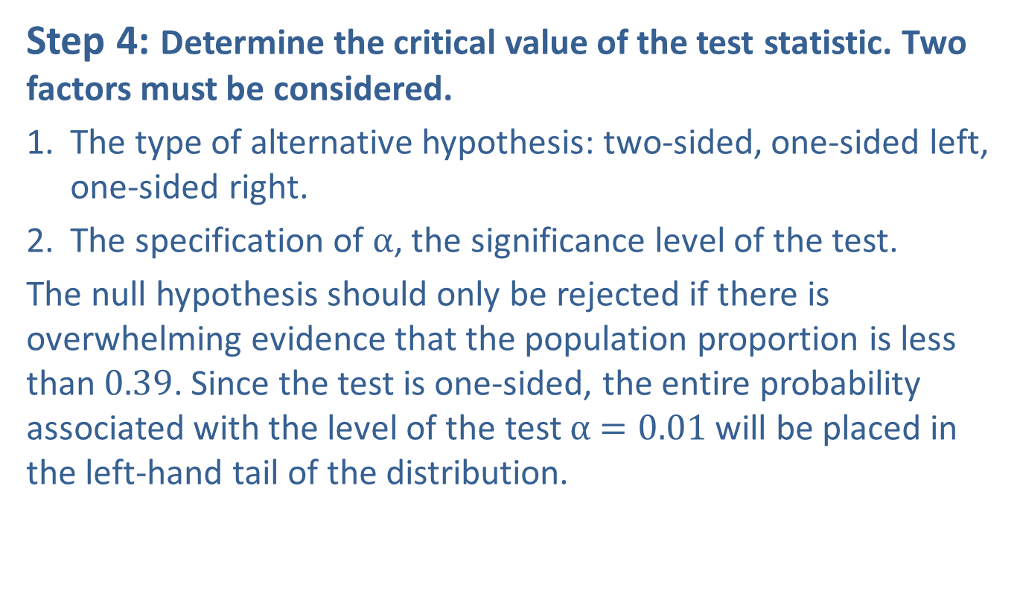
Example 2: Performing a Hypothesis Test for the Proportion of Online Shoppers—Slide 5
Step 4: Determine the critical value of the test statistic. Two factors must be considered.
​1. The type of alternative hypothesis: two-sided, one-sided left, one-sided right.
​2. The specification of α, the significance level of the test.
The null hypothesis should only be rejected if there is overwhelming evidence that the population proportion is less than 0.39. Since the test is one-sided, the entire probability associated with the level of the test α $=0.01$ will be placed in the left-hand tail of the distribution.

Slide 18
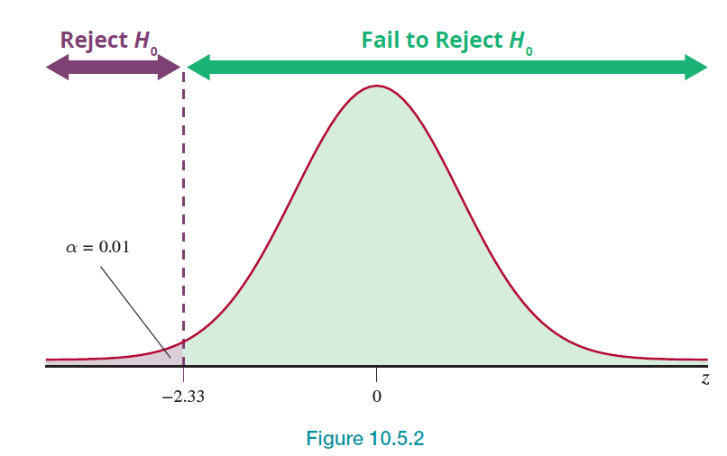
Example 2: Performing a Hypothesis Test for the Proportion of Online Shoppers—Slide 6
Figure 2

Slide 19
Example 2: Performing a Hypothesis Test for the Proportion of Online Shoppers—Slide 7
From Table 3, we know that the critical value of the test statistic is −2.33 (because it’s a lower one-sided alternative hypothesis). The rejection region is the shaded area in the above graph. The decision will be to reject the null hypothesis if the value of the test statistic is less than or equal to −2.33.

Slide 20
Example 2: Performing a Hypothesis Test for the Proportion of Online Shoppers—Slide 8
Step 5: Collect the sample data and compute the value of the test statistic.
In a random sample of 60 online shoppers, 15 indicated that they did not have a good experience with the sites and thus, did not purchase anything. The value of
is given by

Slide 21
Example 2: Performing a Hypothesis Test for the Proportion of Online Shoppers—Slide 9
The z-value indicates that the sample proportion is 2.22 standard deviation units below the hypothesized proportion. Could this have happened by ordinary sampling variation, or is this overwhelming evidence that the null hypothesis is not true, and the alternative should be selected?

Slide 22
Example 2: Performing a Hypothesis Test for the Proportion of Online Shoppers—Slide 10
Step 6: Make the decision and state the conclusion in terms of the original question.
Note that the value of z does not fall in the rejection region. Thus, we fail to reject
There is not sufficient evidence (at the 0.01 level) to reject the null hypothesis. Another way of thinking about this is that the sample proportion was not sufficiently rare to reject
Conclusion and Interpretation: At the 0.01 level of significance, there is not overwhelming evidence to conclude that shoppers' experiences during online shopping deterred them from making a purchase.

