Slide 1
Section 11.1
Comparing Two Population Means, Sigma 1 and Sigma 2 Known

Slide 2
Definition: Independent Experimental Design
When experimental units are randomly assigned to two different treatments where the variation between experimental units is small, the sampling design is called an independent experimental design.

Slide 3
Properties of the Sampling Distribution of x bar subscript 1 minus x bar subscript 2
1. If n₁ ≥ 30 and n₂ ≥ 30, the sampling distribution of
has an approximately normal distribution.
Note: Regardless of the sample size, if a sample of size n₁ and a sample of size n₂ are collected from two independent normal distributions, respectively, then
follows a normal distribution.

Slide 4
Formula: 100(1 − α)% Confidence Interval for μ subscript 1 minus μ subscript 2
The 100(1 − α)% confidence interval estimate for the difference in the population means of two independent populations is given by
if the population variances,
is the critical value of the standard normal
distribution with an area of
in the upper tail.

Slide 5
Formula: Test Statistic for a Hypothesis Test about μ subscript 1 minus μ subscript 2—Slide 1
If
are known then the value of the test
statistic for a hypothesis test about μ₁ − μ₂ is given by

Slide 6
Formula: Test Statistic for a Hypothesis Test about μ subscript 1 minus μ subscript 2—Slide 2
is the sample mean for Population 1, n₁ is the
where
sample size for Population 1, σ₁ is the standard
deviation of Population 1,
is the sample mean for
Population 2, n₂ is the sample size for Population 2, and σ₂ is the standard deviation of Population 2.
Note that (μ₁ − μ₂) represents the hypothesized difference between the two population means and that the z-statistic follows the standard normal distribution.

Slide 7
Example 1: Calculating a Confidence Interval and Performing a Hypothesis Test for the Difference in Means—Slide 1
A telecommunications analyst is interested in knowing if there is a significant difference in the average quality of service (QOS) between cable television subscribers and satellite television subscribers. She randomly selects 50 cable subscribers and 50 satellite subscribers for the study from normally distributed populations. She gives each subscriber a survey and asks them to complete it. She tallies the results of the survey and calculates a mean QOS for each service. The QOS is ranked on a scale of 1 – 10, with the higher value implying that subscribers are more satisfied with their service. The results of the study are shown in Table 1.

Slide 8
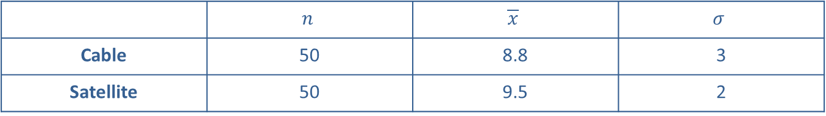
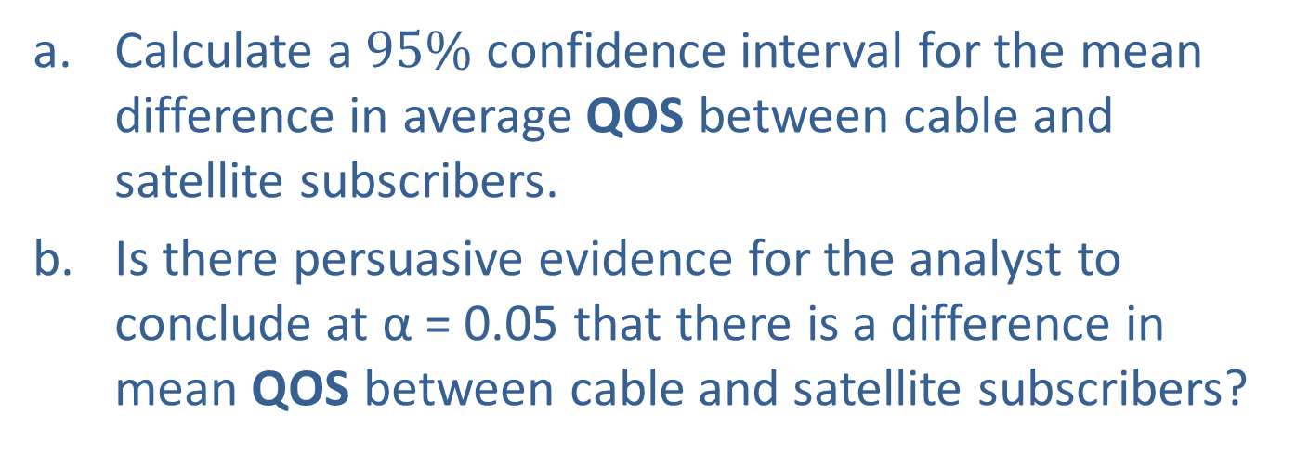
Example 1: Calculating a Confidence Interval and Performing a Hypothesis Test for the Difference in Means—Slide 2
Table 1 — QOS Scores for Subscribers
 | $$n$$ | $$\overline{x}$$ | $$σ$$
Cable | 50 | 8.8 | 3
Satellite | 50 | 9.5 | 2
a. Calculate a $95\%$ confidence interval for the mean difference in average QOS between cable and satellite subscribers.
b. ​Is there persuasive evidence for the analyst to conclude at α = 0.05 that there is a difference in mean QOS between cable and satellite subscribers?

Slide 9
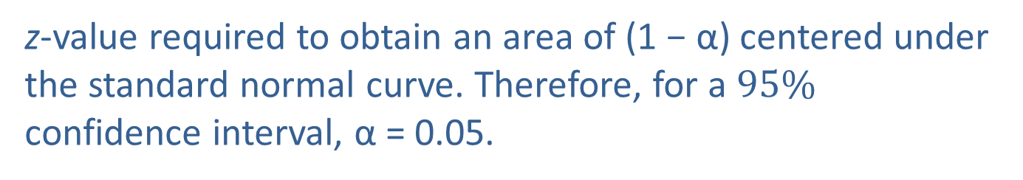
Example 1: Calculating a Confidence Interval and Performing a Hypothesis Test for the Difference in Means—Slide 3
Solution
​From the information given in the problem, we know the following.
We know that the population standard deviations are known and the data are collected from two normally distributed populations.
​Since we want a $95\%$ confidence interval, we need to find
z-value required to obtain an area of (1 − α) centered under the standard normal curve. Therefore, for a $95\%$ confidence interval, α = 0.05.

Slide 10
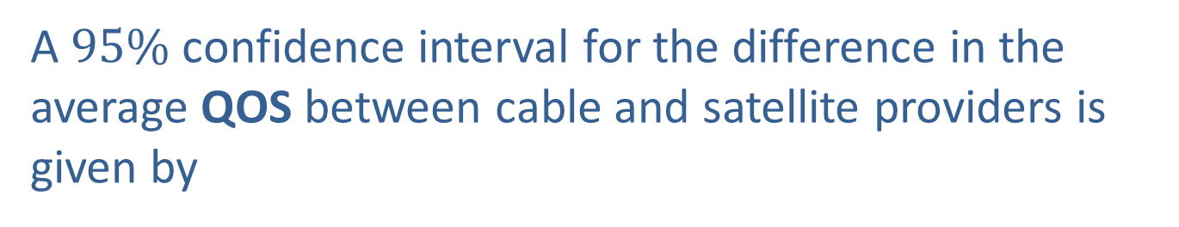
Example 1: Calculating a Confidence Interval and Performing a Hypothesis Test for the Difference in Means—Slide 4
​A $95\%$ confidence interval for the difference in the average QOS between cable and satellite providers is given by

Slide 11
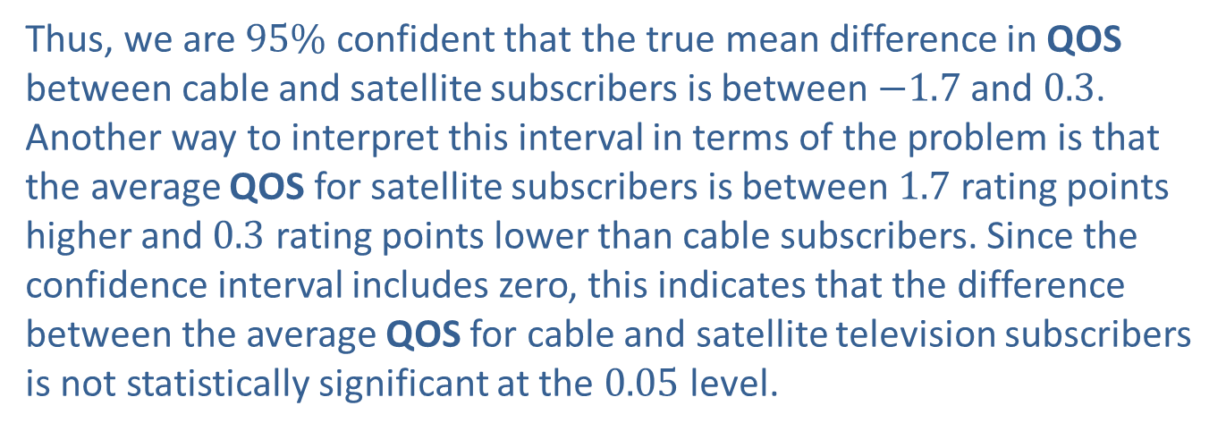
Example 1: Calculating a Confidence Interval and Performing a Hypothesis Test for the Difference in Means—Slide 5
​This gives,
Thus, we are $95\%$ confident that the true mean difference in QOS between cable and satellite subscribers is between $−1.7$ and 0.3. Another way to interpret this interval in terms of the problem is that the average QOS for satellite subscribers is between 1.7 rating points higher and 0.3 rating points lower than cable subscribers. Since the confidence interval includes zero, this indicates that the difference between the average QOS for cable and satellite television subscribers is not statistically significant at the 0.05 level.

Slide 12
Example 1: Calculating a Confidence Interval and Performing a Hypothesis Test for the Difference in Means—Slide 6
Solution
b. Step 1:Determine the null hypothesis. In this process, select the appropriate statistical measure, such as the population means, proportions, or variances.
    The premise of the problem is that there is no difference in average QOS between cable and satellite subscribers. Since the analyst is interested in comparing the average QOS between cable and satellite subscribers, the appropriate statistical measures are the following.
  μ₁ = the true mean QOS for cable subscribers
μ₂ = the true mean QOS for satellite subscribers
    Thus, the null hypothesis is that there is no difference in average QOS between cable and satellite subscribers which should be written as

Slide 13
Example 1: Calculating a Confidence Interval and Performing a Hypothesis Test for the Difference in Means—Slide 7
Step 2: Determine the alternative hypothesis and whether it should be one-sided or two-sided.
  The analyst is interested in whether or not there is a difference in the QOS between cable and satellite subscribers. Thus, the alternative hypothesis is two-sided, and the test is two-tailed and should be written as

Slide 14
Example 1: Calculating a Confidence Interval and Performing a Hypothesis Test for the Difference in Means—Slide 8
Step 3: Select the appropriate test statistic based on the information at hand and the assumptions you are willing to make.
The difference in sample means,
point estimate of the difference in population means, μ₁ − μ₂. The sampling distribution for the point estimate,
provides essential information for determining the test statistic.
Since the data are collected from a normal distribution and the variances for each population are known, the sampling distribution
follows a normal distribution with mean,

Slide 15
Example 1: Calculating a Confidence Interval and Performing a Hypothesis Test for the Difference in Means—Slide 9
Thus, the test statistic is a standard normal random variable which is calculated by using the familiar z-transformation. The test statistic is given by
If the null hypothesis is true, z has an approximately normal distribution. If the observed value of
smaller than μ₁ − μ₂ the hypothesized value of the difference, this will produce a large or small value of the test statistic, causing us to doubt whether or not the null hypothesis is in fact true. How large is large? The critical value of the test statistic specified in Step 4 will implicitly define the notion of "large".

Slide 16
Example 1: Calculating a Confidence Interval and Performing a Hypothesis Test for the Difference in Means—Slide 10
Step 4: Determine the critical value of the test statistic.
The significance level of the test is specified in the problem as α = 0.05.
The role of the critical value(s) in this test is exactly the same as for all of the hypothesis tests discussed earlier. It defines a range of values for the test statistic, the rejection region, that will be so rare that it is unlikely that the test statistic occurred from ordinary sampling variability, assuming the null is true. The level of the test defines the size of the rejection region. Should the computed value of the test statistic fall within the rejection region, the null hypothesis will be rejected.

Slide 17
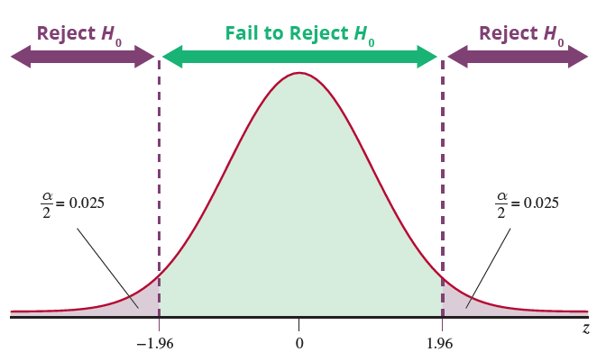
Example 1: Calculating a Confidence Interval and Performing a Hypothesis Test for the Difference in Means—Slide 11
If the null hypothesis is true, the test statistic has an approximately normal distribution. Thus the critical value is determined in the same way as for the other tests of hypothesis in which the test statistic had an approximately normal distribution. The rejection region for a two-tailed test with level of significance, α = 0.05, is displayed in Figure 1.
Figure 1

Slide 18
Example 1: Calculating a Confidence Interval and Performing a Hypothesis Test for the Difference in Means—Slide 12
The null hypothesis will be rejected if the computed value of the test statistic is greater than or equal to 1.96 or less than or equal to −1.96. In other words, we will reject the null hypothesis if the observed difference in the average QOS scores is at least 1.96 standard deviations above or below the hypothesized value of 0 (no difference in QOS between cable and satellite).

Slide 19
Example 1: Calculating a Confidence Interval and Performing a Hypothesis Test for the Difference in Means—Slide 13
Step 5: Collect the sample data and compute the value of the test statistic.
Based on the data in Table 1, the computed value of the test statistic is given by

Slide 20
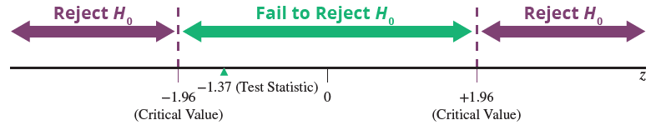
Example 1: Calculating a Confidence Interval and Performing a Hypothesis Test for the Difference in Means—Slide 14
Step 6: Make the decision and state the conclusion in terms of the original question.
Figure 2
As shown in Figure 2, the calculated value of the test statistic does not fall in the rejection region because −1.37 falls between the critical values −1.96 and 1.96. There is insufficient evidence to conclude that the difference between the observed value and the hypothesized value is due to anything other than ordinary sampling variation. Thus, we fail to reject the null hypothesis at
α = 0.05.

Slide 21
Example 1: Calculating a Confidence Interval and Performing a Hypothesis Test for the Difference in Means—Slide 15
Using the P-value approach, we want to find
You may recall that the decision rule when using the
P-value approach is that we reject the null hypothesis if the P-value is < α. Thus, since the P-value is 0.1706 which is greater than 0.05, we fail to reject the null hypothesis.
Conclusion and Interpretation: There is not sufficient evidence at the 0.05 level to conclude that the average QOS is significantly different between cable and satellite television subscribers.

