Slide 1
Section 11.2
Comparing Two Population Means, Sigma 1 and Sigma 2 Unknown

Slide 2
Assumptions for Inferences about μ subscript 1 minus μ subscript 2 when the Population Standard Deviations are Unknown
An independent experimental design is used.
​Both populations of interest are approximately normal.
​Both of the populations have approximately equal (but unknown) variances,

Slide 3
Definition: Pooled Variance
Since the variances are assumed to be equal, the pooled variance,
is an estimate of the common
variance with each variance being weighted by a function of its sample size. That is, the weight on
(n₁ − 1) and the weight on

Slide 4
Formula: 100(1 − α)% Confidence Interval for μ subscript 1 minus μ subscript 2 Assuming Equal Variances
Assuming equal variances, the 100(1 − α)% interval estimate for the difference between two population means if σ ₁ and σ ₂ are unknown is given by
sample variance of the data taken from the i ^{th} population
is the critical value of the t-distribution
with n₁ + n₂ − 2 degrees of freedom, capturing an area of
in the upper tail.

Slide 5
Formula: Inferences about μ subscript 1 minus μ subscript 2 Assuming Equal Variances
Test Statistic:
is the sample variance of the data taken from the
of the t-distribution with n₁ + n₂ − 2 degrees of freedom.

Slide 6
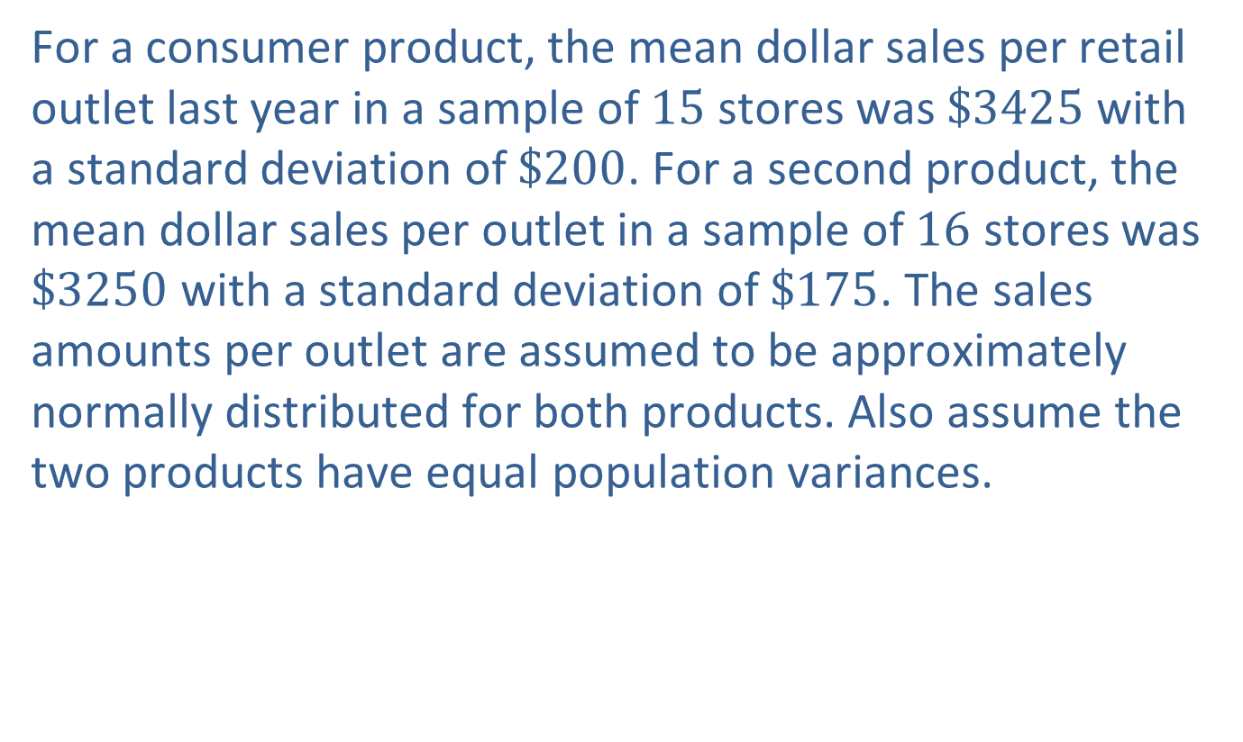
Example 1: Calculating a Confidence Interval and Performing a Hypothesis Test for Two Population Means with Equal Variances—Slide 1
For a consumer product, the mean dollar sales per retail outlet last year in a sample of 15 stores was $\$3425$ with a standard deviation of $\$200$. For a second product, the mean dollar sales per outlet in a sample of 16 stores was $\$3250$ with a standard deviation of $\$175$. The sales amounts per outlet are assumed to be approximately normally distributed for both products. Also assume the two products have equal population variances.

Slide 7
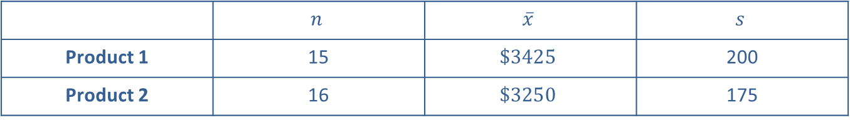
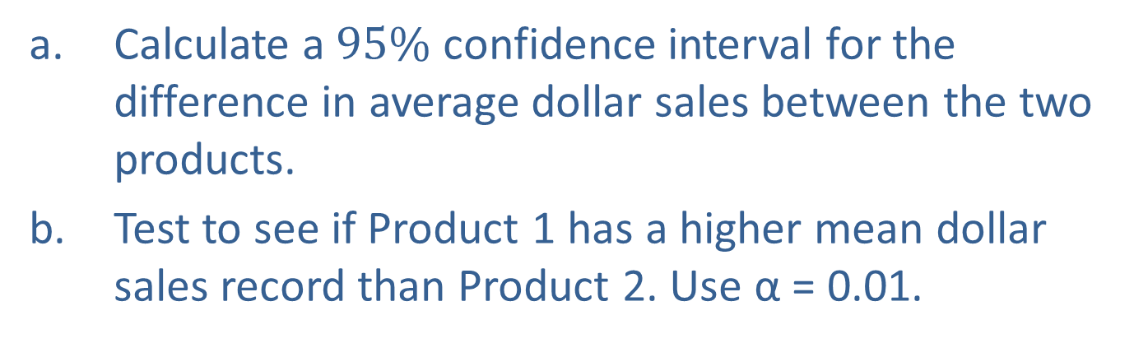
Example 1: Calculating a Confidence Interval and Performing a Hypothesis Test for Two Population Means with Equal Variances—Slide 2
Table 1 – Retail Sales (Dollars)
 | $$n$$ | $$\overline{x}$$ | $$s$$
Product 1 | 15 | $$\$3425$$ | 200
Product 2 | 16 | $$\$3250$$ | 175
a. Calculate a $95\%$ confidence interval for the difference in average dollar sales between the two products.
b. Test to see if Product 1 has a higher mean dollar sales record than Product 2. Use α = 0.01.

Slide 8
Example 1: Calculating a Confidence Interval and Performing a Hypothesis Test for Two Population Means with Equal Variances—Slide 3
Solution
​From the information given in the problem, we know that
With σ₁ and σ₂ unknown and assuming that the data follow a normal distribution with equal population variances, we estimate the population standard deviations with the sample standard deviations. Since we want a 95% confidence interval, we need to find the value of
Note that df = n₁ + n₂ − 2 = 15 + 16 − 2 = 29.
Thus,

Slide 9

Example 1: Calculating a Confidence Interval and Performing a Hypothesis Test for Two Population Means with Equal Variances—Slide 4
​A $95\%$ confidence interval for the difference in average dollar sales between the two products is given by

Slide 10
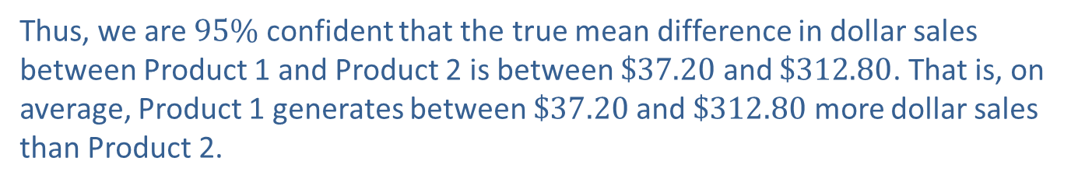
Example 1: Calculating a Confidence Interval and Performing a Hypothesis Test for Two Population Means with Equal Variances—Slide 5
​First we need to calculate
​The confidence interval is then calculated as follows.
Thus, we are $95\%$ confident that the true mean difference in dollar sales between Product 1 and Product 2 is between $\$37.20$ and $\$312.80$. That is, on average, Product 1 generates between $\$37.20$ and $\$312.80$ more dollar sales than Product 2.

Slide 11
Example 1: Calculating a Confidence Interval and Performing a Hypothesis Test for Two Population Means with Equal Variances—Slide 6
Step 1: Determine the null hypothesis. In this process, select the appropriate statistical measure, such as the population means, proportions, or variances.
Since the retailer is interested in comparing the average retail sales between the two products, the appropriate statistical measures are:
μ₁ = the true mean retail sales of Product 1
μ₂ = the true mean retail sales of Product 2.
The null hypothesis is that the average sales for Product 1 is equal to the average sales for Product 2 which should be written as

Slide 12
Example 1: Calculating a Confidence Interval and Performing a Hypothesis Test for Two Population Means with Equal Variances—Slide 7
Step 2: Determine the alternative hypothesis and whether it should be one-sided or two-sided.
The retailer is interested in whether the average sales of Product 1 is higher than the average sales of Product 2. Thus, the alternative hypothesis is one-sided and the test is one-tailed.
One way to state this in terms of the statistical measures is μ₁ > μ₂. But in order to perform the hypothesis test, this statement must be rewritten in a form for which we have a point estimate, or μ₁ − μ₂ > 0. The resulting alternative hypothesis is written as

Slide 13
Example 1: Calculating a Confidence Interval and Performing a Hypothesis Test for Two Population Means with Equal Variances—Slide 8
Step 3: Select the appropriate test statistic based on the information at hand and the assumptions you are willing to make.
To develop the appropriate test statistic, a random variable whose value will be used to make the decision to reject or fail to reject H₀ must be found. The sampling distribution
provides essential
information in assessing the rareness of the test statistic. If the assumptions previously outlined are
satisfied, the sampling distribution of
has a t-distribution. The t-test statistic is given by

Slide 14
Example 1: Calculating a Confidence Interval and Performing a Hypothesis Test for Two Population Means with Equal Variances—Slide 9

Slide 15
Example 1: Calculating a Confidence Interval and Performing a Hypothesis Test for Two Population Means with Equal Variances—Slide 10
In this hypothesis test, the population variances are assumed to be equal.
average of the two sample variances, is used to approximate the unknown population variance.
If the null hypothesis is true, t has a t-distribution with
n₁ + n₂ − 2 degrees of freedom. If the observed value of
is significantly larger than the hypothesized value of
the difference (H₀: μ₁ − μ₂ = 0), this will produce a large value of the test statistic, causing us to doubt whether the null hypothesis is in fact true. How large is large? The critical value of the test statistic specified in Step 4 will implicitly define the notion of "large."

Slide 16
Example 1: Calculating a Confidence Interval and Performing a Hypothesis Test for Two Population Means with Equal Variances—Slide 11
Step 4: Determine the critical value of the test statistic.
The significance level of the test is specified as α = 0.01. The role of the critical value in this test is exactly the same as for all of the hypothesis tests discussed earlier. It defines a range of values for the test statistic, the rejection region, that will be so rare that it is unlikely that it occurred from ordinary sampling variability if the null hypothesis is true. The level of the test defines the size of the rejection region. Should the computed value of the test statistic fall in the rejection region, we will presume that the value of the test statistic is too large to have occurred from ordinary sampling variation, and the null hypothesis will be rejected.

Slide 17
Example 1: Calculating a Confidence Interval and Performing a Hypothesis Test for Two Population Means with Equal Variances—Slide 12
If the null hypothesis is true, the test statistic has a
t-distribution. Thus, the critical value is determined in the same way as for the other tests of hypothesis where the test statistic had a t-distribution, except that the degrees of freedom are n₁ + n₂ − 2, or
15 + 16 − 2 = 29. The rejection region corresponding to the alternative hypothesis, H _{α}: μ₁ − μ₂ > 0, with
α = 0.01 for a t-test statistic with 29 degrees of freedom is given in Figure 3.

Slide 18
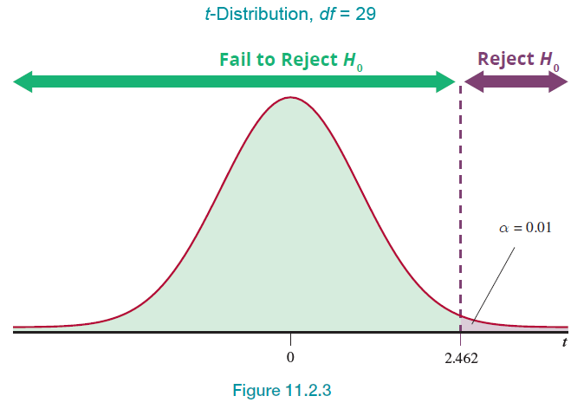
Example 1: Calculating a Confidence Interval and Performing a Hypothesis Test for Two Population Means with Equal Variances—Slide 13
Figure 3
We will reject the null hypothesis if the computed value of the test statistic is greater than or equal to 2.462.

Slide 19
Example 1: Calculating a Confidence Interval and Performing a Hypothesis Test for Two Population Means with Equal Variances—Slide 14
Step 5: Collect the sample data and compute the value of the test statistic.
Based on the data in Table 1, the computed value of the test statistic is given by

Slide 20
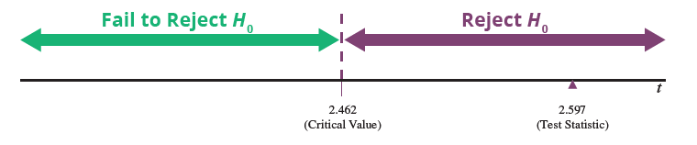
Example 1: Calculating a Confidence Interval and Performing a Hypothesis Test for Two Population Means with Equal Variances—Slide 15
Step 6: Make the decision and state the conclusion in terms of the original question.
Figure 4
As displayed in Figure 4, the value of the test statistic does fall in the rejection region. In fact, a test statistic of 2.597 says that the observed difference between the means is about 2.6 standard deviations higher than the hypothesized difference of zero. It is highly unlikely that the difference between the observed value and the hypothesized value is due to ordinary sampling variation. Thus, we reject the null hypothesis at α = 0.01.

Slide 21
Example 1: Calculating a Confidence Interval and Performing a Hypothesis Test for Two Population Means with Equal Variances—Slide 16
Using the P-value approach, we have
P-value = P(t > 2.597). For this problem, however, we cannot find the exact P-value when using the t-table. Instead, we need to put bounds on the P-value. Note that for this problem, we have 29 degrees of freedom (see the excerpt from the t-distribution table below). Thus, we look at the t-table at 29 degrees of freedom to find the values that bound the test statistic,
t = 2.597. Also, note that the values in the table for any degrees of freedom increase from left to right, whereas the α values across the top row of the table decrease from left to right.

Slide 22
Example 1: Calculating a Confidence Interval and Performing a Hypothesis Test for Two Population Means with Equal Variances—Slide 17
At 29 degrees of freedom, note that 2.597 falls between 2.462, which corresponds to the t-value with
which corresponds to the t-value with
We can now report the bound on the P-value for this test as 0.005 < P-value < 0.01. Since we performed the test using α = 0.01, the P-value is still less than α which leads us to reject the null hypothesis.

Slide 23
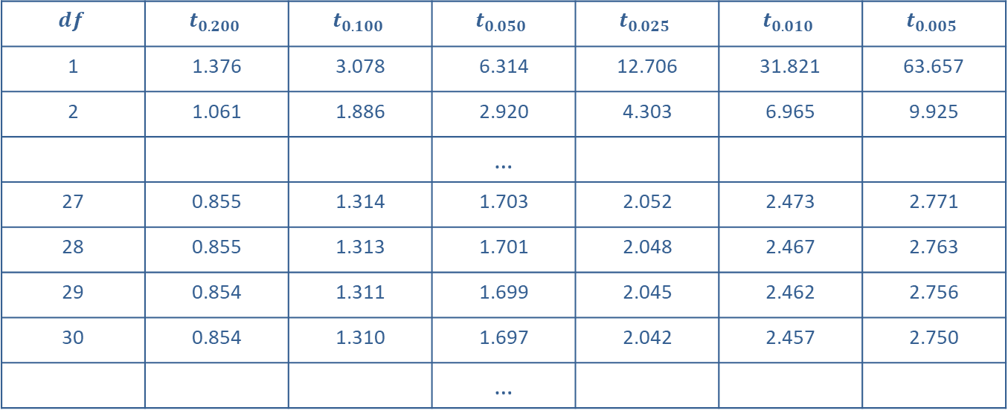
Example 1: Calculating a Confidence Interval and Performing a Hypothesis Test for Two Population Means with Equal Variances—Slide 18
Area to the Right of the Critical Value
$$df$$ | $$t_{0.200}$$ | $$t_{0.100}$$ | $$t_{0.050}$$ | $$t_{0.025}$$ | $$t_{0.010}$$ | $$t_{0.005}$$
1 | 1.376 | 3.078 | 6.314 | 12.706 | 31.821 | 63.657
2 | 1.061 | 1.886 | 2.920 | 4.303 | 6.965 | 9.925
 |  |  | …
27 | 0.855 | 1.314 | 1.703 | 2.052 | 2.473 | 2.771
28 | 0.855 | 1.313 | 1.701 | 2.048 | 2.467 | 2.763
29 | 0.854 | 1.311 | 1.699 | 2.045 | 2.462 | 2.756
30 | 0.854 | 1.310 | 1.697 | 2.042 | 2.457 | 2.750
 |  |  | …
Conclusion and Interpretation: There is sufficient evidence at the 0.01 level to conclude that the average sales for Product 1 is significantly higher than the average sales for Product 2.

Slide 24
Formula: Inferences about μ subscript 1 minus μ subscript 2 Assuming Unequal Variances—Slide 1
Confidence Interval:
Test Statistic:

Slide 25
Formula: Inferences about μ subscript 1 minus μ subscript 2 Assuming Unequal Variances—Slide 2
which follows a t-distribution with degrees of freedom equal to:
The calculation for df should be rounded down to the nearest integer. Remember, these formulas should only be used if σ₁ and σ₂ are unknown, the data follow a normal distribution, and the population variances are assumed to be unequal.

Slide 26
Example 2: Performing a Hypothesis Test for Two Population Means with Unequal Variances—Slide 1
Consumers have long been interested in the difference in gas mileage between hybrid model vehicles and traditional gasoline engine models. The data below represent miles per gallon from two models of the Porsche Cayenne—one hybrid model and one gasoline model. The miles per gallon (MPG) readings are from ten vehicles that were deployed at rental agencies for everyday, normal use.

Slide 27
Example 2: Performing a Hypothesis Test for Two Population Means with Unequal Variances—Slide 2
Porsche Cayenne Hybrid Model (MPG)
Porsche Cayenne Gas Model (MPG)
25 | 21
32 | 24
25 | 24
25 | 24
27 | 23
30 | 19
23 | 25
24 | 23
32 | 23
34 | 22

Slide 28
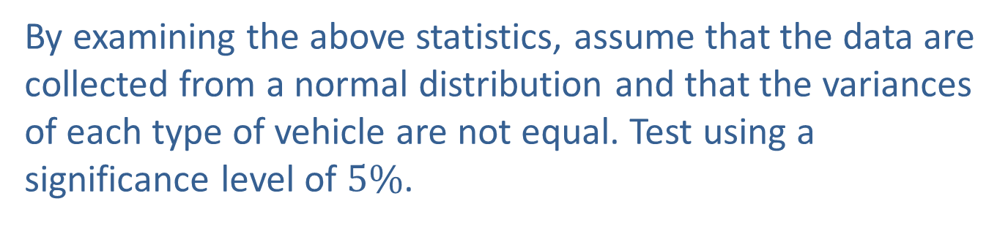
Example 2: Performing a Hypothesis Test for Two Population Means with Unequal Variances—Slide 3
We want to test that the average MPG for the gasoline vehicle is the same as the hybrid vehicle. The summary statistics for this data are in the following table.
 | Hybrid | Gasoline
n | 10 | 10
Mean MPG | 27.70 | 22.80
Variance | 15.57 | 3.07
By examining the above statistics, assume that the data are collected from a normal distribution and that the variances of each type of vehicle are not equal. Test using a significance level of $5\%$.

Slide 29
Example 2: Performing a Hypothesis Test for Two Population Means with Unequal Variances—Slide 4
Solution
Step 1: Determine the null hypothesis. In this process, select the appropriate statistical measure, such as the population means, proportions, or variances.
We want to compare the average MPG for each of the vehicle models. Thus, the statistical measure is the population mean MPG for the Porsche Cayenne Hybrid model (μ₁) and the population mean MPG of the Porsche Cayenne Gas model (μ₂). The null hypothesis is that there is no difference in average MPG between the Porsche Cayenne Hybrid and the Porsche Cayenne Gas models which should be written as

Slide 30
Example 2: Performing a Hypothesis Test for Two Population Means with Unequal Variances—Slide 5
Step 2: Determine the alternative hypothesis and whether it should be one-sided or two-sided.
The alternative hypothesis contradicts the null hypothesis. There is nothing to indicate that we are interested in whether one model gets better gas mileage than the other. Thus, our research hypothesis is that there is a difference in average MPG between the Porsche Cayenne Hybrid and the Porsche Cayenne Gas models. The alternative hypothesis is two-sided and should be written as

Slide 31
Example 2: Performing a Hypothesis Test for Two Population Means with Unequal Variances—Slide 6
Step 3: Select the appropriate test statistic based on the information at hand and the assumptions you are willing to make.
Assuming that the data from each of the populations follow a normal distribution and that the population variances are not equal, the test statistic will be

Slide 32
Example 2: Performing a Hypothesis Test for Two Population Means with Unequal Variances—Slide 7
which follows a t-distribution with the degrees of freedom equal to
Note that it is unlikely that the degrees of freedom will be an integer, thus, we will round the df to the nearest integer.

Slide 33
Example 2: Performing a Hypothesis Test for Two Population Means with Unequal Variances—Slide 8
Step 4: Determine the critical value of the test statistic.
Since we have a two-tailed alternative hypothesis and a significance level of 5% (i.e., α = 0.05), the critical value
where the degrees of freedom is calculated
as follows.

Slide 34
Example 2: Performing a Hypothesis Test for Two Population Means with Unequal Variances—Slide 9
We will use 12 degrees of freedom for this t-test which
yields a critical value of
We will reject the null hypothesis if the test statistic is greater than or equal to 2.179 or if the test statistic is less than or equal to −2.179.

Slide 35
Example 2: Performing a Hypothesis Test for Two Population Means with Unequal Variances—Slide 10
Step 5: Collect the sample data and compute the value of the test statistic.
Using the values in the table above, the test statistic is
Step 6: Make the decision and state the conclusion in terms of the original question.
The critical values of the test statistic are ±2.179. Thus, since the test statistic, t, is greater than 2.179 we reject the null hypothesis in favor of the alternative.

Slide 36
Example 2: Performing a Hypothesis Test for Two Population Means with Unequal Variances—Slide 11
Using the Technology Instructions for conducting the Two-Sample t-Test, we get P-value = 0.0035. Since we are performing the test using a significance level of 0.05, the
P-value approach still leads us to reject the null hypothesis in favor of the alternative.
Conclusion and Interpretation: This indicates that there is evidence to conclude that the average miles per gallon between the Porsche Cayenne Hybrid model and the Porsche Cayenne Gas model are significantly different.
Note that we did not test whether the average miles per gallon for one model was more or less than the other, thus, the conclusion remains consistent with the stated hypotheses.

