Slide 1
Section 11.3
Paired Difference Test

Slide 2
Definition: Paired Difference Experimental Design
A paired difference experimental design, sometimes called matched-pairs samples, is when the samples are paired (before or after measurements on the same subject) or somehow matched (i.e., you divide a set of homogeneous subjects into two groups).

Slide 3
Assumptions for the Paired Difference Experimental Design
​Experimental units can be paired such that they are more alike within the pair than within the population as a whole.
​The differences have an approximately normal distribution.

Slide 4
Formula: 100(1 − α)% Confidence Interval for μ subscript d
A 100(1 − α)% confidence interval for the mean difference is given by
is the sample mean of the differences, n _{d} is
the number of differences,
is the critical value of the t-distribution with
in the upper tail with n _{d} − 1 degrees of
freedom (df).

Slide 5
Formula: Inferences about μ subscript d
Test Statistic:
is the sample mean of the differences, n _{d} is
the number of differences,
is the critical value of the t-distribution with
in the upper tail with n _{d} − 1 degrees of
freedom (df).

Slide 6
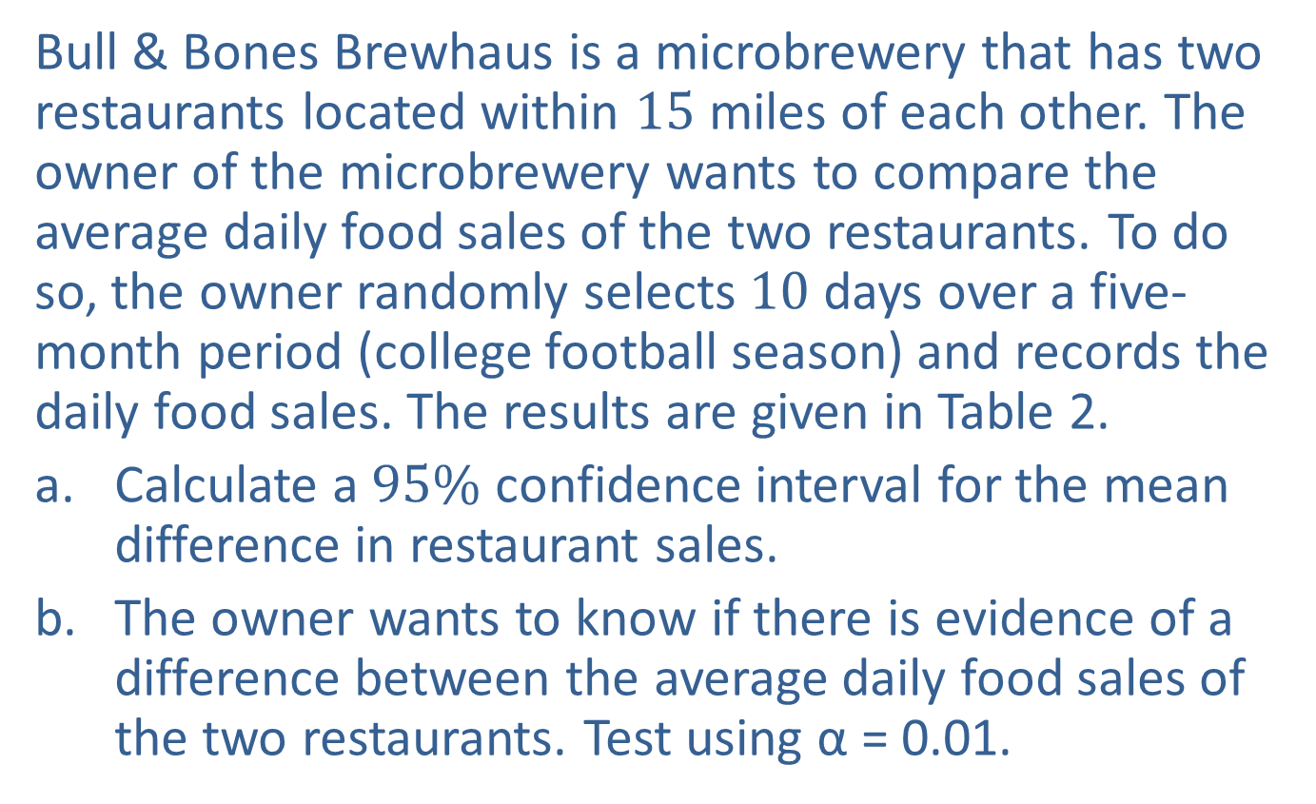
Example 1: Calculating a Confidence Interval and Performing a Hypothesis Test for the Mean Difference—Slide 1
Bull & Bones Brewhaus is a microbrewery that has two restaurants located within 15 miles of each other. The owner of the microbrewery wants to compare the average daily food sales of the two restaurants. To do so, the owner randomly selects 10 days over a five-month period (college football season) and records the daily food sales. The results are given in Table 2.
​Calculate a $95\%$ confidence interval for the mean difference in restaurant sales.
​The owner wants to know if there is evidence of a difference between the average daily food sales of the two restaurants. Test using α = 0.01.

Slide 7
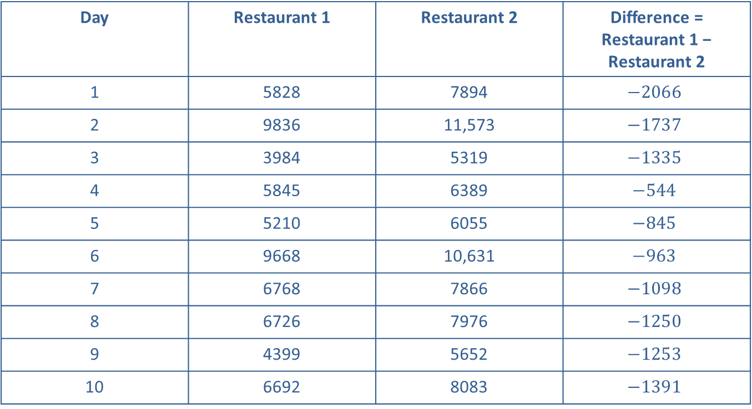
Example 1: Calculating a Confidence Interval and Performing a Hypothesis Test for the Mean Difference—Slide 2
Table 2 — Daily Food Sales for Two Restaurants ($)
Day | Restaurant 1 | Restaurant 2 | Difference = Restaurant 1 − Restaurant 2
1 | 5828 | 7894 | $$−2066$$
2 | 9836 | 11,573 | $$−1737$$
3 | 3984 | 5319 | $$−1335$$
4 | 5845 | 6389 | $$−544$$
5 | 5210 | 6055 | $$−845$$
6 | 9668 | 10,631 | $$−963$$
7 | 6768 | 7866 | $$−1098$$
8 | 6726 | 7976 | $$−1250$$
9 | 4399 | 5652 | $$−1253$$
10 | 6692 | 8083 | $$−1391$$

Slide 8
Example 1: Calculating a Confidence Interval and Performing a Hypothesis Test for the Mean Difference—Slide 3
Solution
a. ​From the information given, we know that n = 10 and α = 0.05. We now need to calculate the mean and standard deviation of the differences,
and s _{d}, respectively.

Slide 9

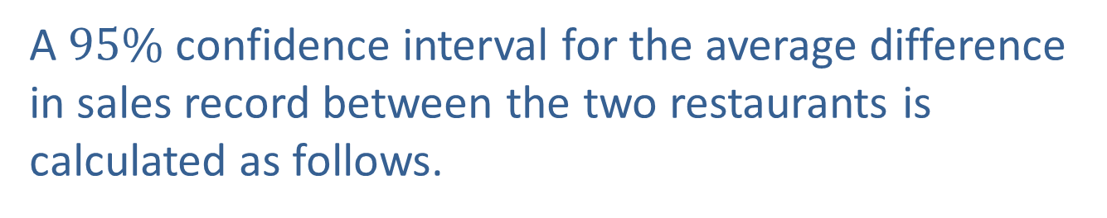
Example 1: Calculating a Confidence Interval and Performing a Hypothesis Test for the Mean Difference—Slide 4
​Since we want a $95\%$ confidence interval, we need to find the value of
Note that df = n _{d} − 1 = 9. Thus,
​A $95\%$ confidence interval for the average difference in sales record between the two restaurants is calculated as follows.

Slide 10
Example 1: Calculating a Confidence Interval and Performing a Hypothesis Test for the Mean Difference—Slide 5
​​We are 95% confident that the true mean difference in sales between Restaurant 1 and Restaurant 2 is between −$1558.90 and −$937.50. That is, on average, Restaurant 2 averages between $937.50 and $1558.90 more in sales.

Slide 11
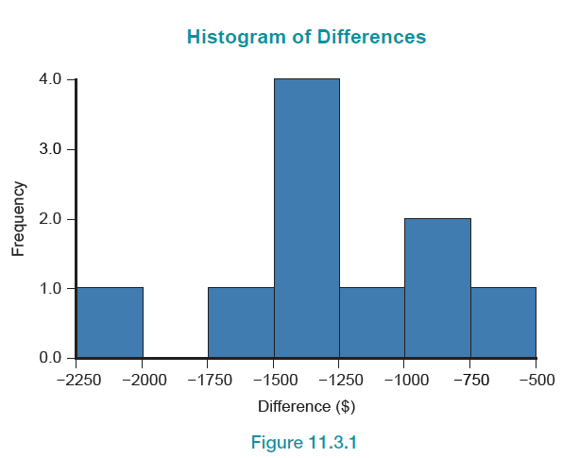
Example 1: Calculating a Confidence Interval and Performing a Hypothesis Test for the Mean Difference—Slide 6
​Before performing the hypothesis test, we need to ensure that the assumption that the differences have a normal distribution is reasonable for the sales data. A histogram of differences is provided in Figure 1. Based on this histogram, it appears that the differences are approximately normal and it is safe to proceed with the paired difference test.
​
Figure 1

Slide 12
Example 1: Calculating a Confidence Interval and Performing a Hypothesis Test for the Mean Difference—Slide 7
Step 1: Determine the null hypothesis. In this process, select the appropriate statistical measure, such as the population mean, proportion, or variance.
In a paired difference experimental design, the population parameter of interest is the population mean of the differences. Thus, the appropriate statistical measure is given by
μ _{d} = the average of the differences in daily sales between the two restaurants.
The null hypothesis is that there is no difference in the average sales between the two restaurants on a given day. Which should be written as

Slide 13
Example 1: Calculating a Confidence Interval and Performing a Hypothesis Test for the Mean Difference—Slide 8
Step 2: Determine the alternative hypothesis and whether it should be one-sided or two-sided.
Since the owner is interested in whether or not the average daily sales are different between the two restaurants, the alternative hypothesis will be two-sided and this will be a two-tailed test.
The alternative hypothesis is that there is a difference in average daily sales between the two restaurants and should be written as

Slide 14
Example 1: Calculating a Confidence Interval and Performing a Hypothesis Test for the Mean Difference—Slide 9
Step 3: Select the appropriate test statistic based on the information at hand and the assumptions you are willing to make.
To develop the appropriate test statistic, a random variable whose value will be used to make the decision to reject or fail to reject H ₀ must be developed. It is interesting to notice that by evaluating the differences of the paired data, we have effectively reduced the two-sample problem into a small, one-sample t-test for a population mean. The point estimate for the population mean of the differences, μ _{d}, is
the sample mean of the differences.
Hence, the sampling distribution for
provides essential information
for testing the hypothesis. If the differences are normally distributed
and the null hypothesis is assumed to be true, the sampling distribution
has a t-distribution with n _{d} − 1 degrees of freedom. Note that
Note that n _{d} represents the number of differences. The t-test statistic is given by

Slide 15
Example 1: Calculating a Confidence Interval and Performing a Hypothesis Test for the Mean Difference—Slide 10
where s _{d} is the sample standard deviation of the differences.
If the observed value of
is significantly smaller or
larger than μ _{d}, this will produce a large negative (or positive) value of the test statistic, causing us to question whether the null hypothesis is in fact true. How large is large? This is answered by the critical value of the test statistic specified in Step 4.

Slide 16
Example 1: Calculating a Confidence Interval and Performing a Hypothesis Test for the Mean Difference—Slide 11
Step 4: Determine the critical value of the test statistic.
The significance level of the test is specified in the problem to be α = 0.01.
The role of the critical value in this test is exactly the same as for all of the hypothesis tests discussed earlier. It defines a range of values for the test statistic, the rejection region, that will be so rare that it is unlikely that it occurred from ordinary sampling variability. The level of the test defines the size of the rejection region. Should the computed value of the test statistic fall in the rejection region, its value will be presumed to be too rare to have occurred because of ordinary sampling variation, and the null hypothesis will be rejected.

Slide 17
Example 1: Calculating a Confidence Interval and Performing a Hypothesis Test for the Mean Difference—Slide 12
If the null hypothesis is true, the test statistic has a
t-distribution with n _{d} − 1 degrees of freedom. Thus, the critical value is determined in the same way as for the other tests of hypothesis where the test statistic had a t-distribution, except that the degrees of freedom are
n _{d} − 1 = 10 − 1 = 9. The rejection region for the alternative hypothesis, H _{α}: μ _{d} ≠ 0, with α = 0.01 and 9 degrees of freedom is displayed in Figure 2. Because we have a two-sided hypothesis, we reject H₀ if the test statistic is less than or equal to −3.250 or if it is greater than or equal to 3.250.

Slide 18
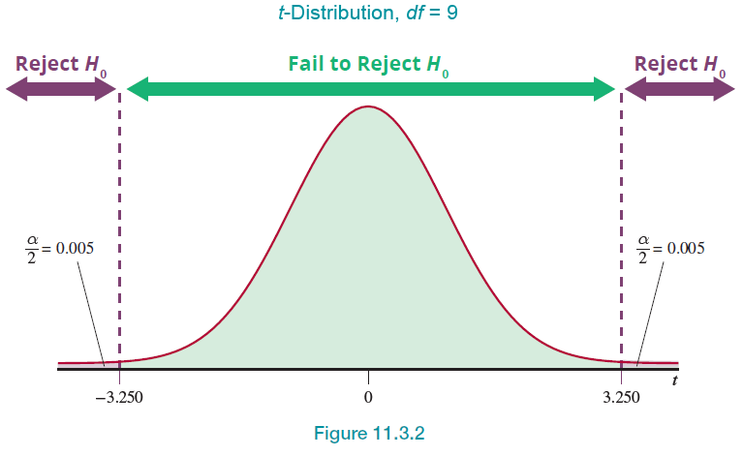
Example 1: Calculating a Confidence Interval and Performing a Hypothesis Test for the Mean Difference—Slide 13
Figure 2

Slide 19
Example 1: Calculating a Confidence Interval and Performing a Hypothesis Test for the Mean Difference—Slide 14
Step 5: Collect the sample data and compute the value of the test statistic.
Based on the data in Table 2,
the computed value of the test statistic is as follows.

Slide 20
Example 1: Calculating a Confidence Interval and Performing a Hypothesis Test for the Mean Difference—Slide 15
Step 6: Make the decision and state the conclusion in terms of the original question.
As shown in Figure 3, the value of the test statistic falls in the rejection region to the left. The test statistic indicates that the observed average daily sales are more than 9 standard deviations below the hypothesized value of 0. It is highly unlikely that the difference between the observed value and the hypothesized value is due to ordinary sampling variation. Thus, the null hypothesis is rejected at
α = 0.01.

Slide 21
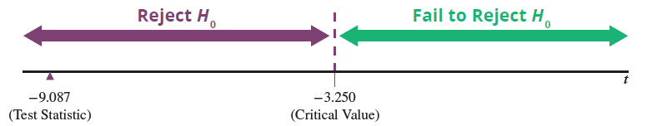
Example 1: Calculating a Confidence Interval and Performing a Hypothesis Test for the Mean Difference—Slide 16
Figure 3
To find the P-value for this test, we use the same methodology as in Example 1. The P-value is given by

Slide 22
Example 1: Calculating a Confidence Interval and Performing a Hypothesis Test for the Mean Difference—Slide 17
We cannot use the t-table to find P (t > 9.087); we can only put bounds on the probability. Thus, at 9 degrees of freedom, the largest value in the respective row is 3.250. The best information that we can gain from the t-table is that P (t > 9.087) < 0.005. Since we need to multiply the probability by 2, we have P-value < 0.01.
Since we are performing the test at α = 0.01, we reject the null hypothesis because the P-value is less than α—the same decision we made using the rejection region approach.
Conclusion and Interpretation: There is sufficient evidence for the owner to conclude at the α = 0.01 level that the average daily sales between the two restaurants are significantly different.

