Slide 1
Section 11.4
Comparing Two Population Proportions

Slide 2
Assumptions for Comparing Two Population Proportions
​An independent experimental design is used.
​The samples are large enough such that
are the sample proportion and
sample size, respectively, from the first population
are the sample proportion and
sample size, respectively, from the second population.

Slide 3
Formula: 100 (1 − α)% Confidence Interval for p subscript 1 minus p subscript 2
We can construct a 100(1 − α)% confidence interval estimate for the difference between two population proportions using the following:
are the sample proportion and sample
size, respectively, from the first population
the sample proportion and sample size, respectively, from
the second population,
is the critical value for the
z-distribution that captures an area of

Slide 4

Formula: Inferences about p subscript 1 minus p subscript 2
Test Statistic:
are the sample proportion and sample
size, respectively, from the first population,
the sample proportion and sample size, respectively, from
the second population,
is the critical value for the
z-distribution, and
is the weighted average of the
two sample proportion estimates,

Slide 5
Example 1: Calculating a Confidence Interval and Performing a Hypothesis Test for the Difference in Two Proportions—Slide 1
A cell phone executive has recently been bombarded with complaints from his customers about defective phones. He has two plants that produce the cell phones, and he is not sure where the defective phones are coming from. In the past, the plants have had good control over the number of defective phones produced. Because of the recent flurry of complaints, he thinks that one of the plants may have lost control over its production process. To test this theory, he randomly selects 200 phones from each of the plants and counts the number of defective phones. The results of the survey are displayed in Table 1.

Slide 6
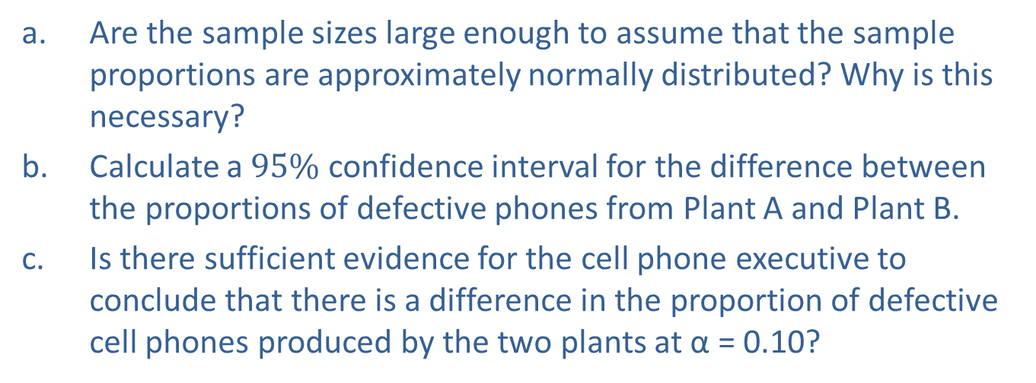
Example 1: Calculating a Confidence Interval and Performing a Hypothesis Test for the Difference in Two Proportions—Slide 2
Table 1 – Cell Phone Survey Data
 | Number Sampled | Number of Defectives
Plant A | 200 | 8
Plant B | 200 | 10
a. Are the sample sizes large enough to assume that the sample proportions are approximately normally distributed? Why is this necessary?
b. Calculate a $95\%$ confidence interval for the difference between the proportions of defective phones from Plant A and Plant B.
c. ​Is there sufficient evidence for the cell phone executive to conclude that there is a difference in the proportion of defective cell phones produced by the two plants at α = 0.10?

Slide 7
Example 1: Calculating a Confidence Interval and Performing a Hypothesis Test for the Difference in Two Proportions—Slide 3
Solution
a. Let
the sample proportion of defective phones produced by Plant A
the sample proportion of defective phones produced by Plant B,
​x₁ = the sample number of defective phones produced in Plant A,
x₂ = the sample number of defective phones produced in Plant B,
n₁ = the number of phones sampled from Plant A, and
n₂ = the number of phones sampled from Plant B.

Slide 8
Example 1: Calculating a Confidence Interval and Performing a Hypothesis Test for the Difference in Two Proportions—Slide 4
​Before we can determine a confidence interval or perform a hypothesis test for the difference between the population proportions, we need to be sure that the sample sizes are large enough. You may recall that when dealing with single samples of proportions, the sample size, n must be large enough such that the sampling distribution of the sample proportion will be approximately normal. To determine whether the sample sizes are large enough, we need to show that
than or equal to 5.

Slide 9
Example 1: Calculating a Confidence Interval and Performing a Hypothesis Test for the Difference in Two Proportions—Slide 5
If both samples are large enough, then we know that the sampling distribution of the difference between the sample proportions is approximately normal, and we can proceed with constructing the confidence interval and performing the hypothesis test. First, we need to calculate the sample proportions for the defective phones produced in Plant A and Plant B.

Slide 10
Example 1: Calculating a Confidence Interval and Performing a Hypothesis Test for the Difference in Two Proportions—Slide 6
​Now, we can use the sample proportions along with the sample sizes to verify that the samples are large enough such that the sampling distribution of the difference between the sample proportions is approximately normal.

Slide 11
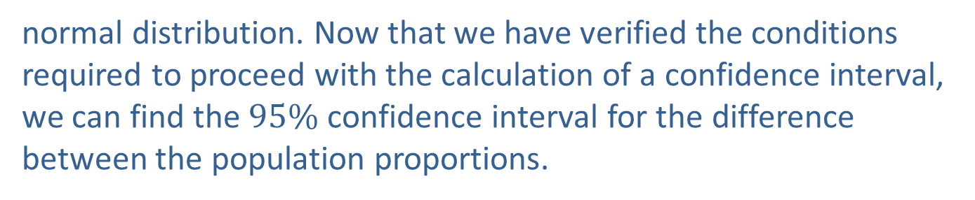
Example 1: Calculating a Confidence Interval and Performing a Hypothesis Test for the Difference in Two Proportions—Slide 7
equal to 5, we can conclude that
has an approximately
normal distribution. Now that we have verified the conditions required to proceed with the calculation of a confidence interval, we can find the $95\%$ confidence interval for the difference between the population proportions.

Slide 12

Example 1: Calculating a Confidence Interval and Performing a Hypothesis Test for the Difference in Two Proportions—Slide 8
b. We know that n₁ = n₂ = 200, x₁ = 8, and x₂ = 10. With the information given, we can calculate the sample proportions.
For a 95% confidence interval, α = 0.05 and
​Therefore, the $95\%$ confidence interval is calculated as follows.

Slide 13
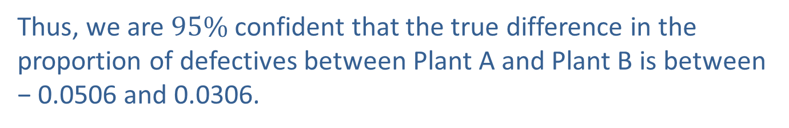
Example 1: Calculating a Confidence Interval and Performing a Hypothesis Test for the Difference in Two Proportions—Slide 9
Thus, we are $95\%$ confident that the true difference in the proportion of defectives between Plant A and Plant B is between − 0.0506 and 0.0306.

Slide 14
Example 1: Calculating a Confidence Interval and Performing a Hypothesis Test for the Difference in Two Proportions—Slide 10
C. Step 1: Determine the null hypothesis. In this process, select the appropriate statistical measure, such as the population means, proportions, or variances.
  Since the executive is interested in comparing the proportion of defective cell phones produced at Plant A to the proportion of defective cell phones produced at Plant B, the appropriate statistical measures are as follows.
  p₁ = the true proportion of defective phones produced at Plant A
  p₂ = the true proportion of defective phones produced at Plant B
  Thus, the null hypothesis is that there is no difference in the proportion of defective cell phones produced at the two plants and should be written as follows.
H₀: p₁ − p₂ = 0

Slide 15
Example 1: Calculating a Confidence Interval and Performing a Hypothesis Test for the Difference in Two Proportions—Slide 11
Step 2: Determine the alternative hypothesis and whether it should be one-sided or two-sided.
The executive's interest is in whether or not there is a difference in the proportion of defective phones produced by the two plants. Thus, the alternative hypothesis is two-sided and this is a two-tailed test which should be written as follows:
H _{α}: p₁ − p₂ ≠ 0

Slide 16
Example 1: Calculating a Confidence Interval and Performing a Hypothesis Test for the Difference in Two Proportions—Slide 12
Step 3: Select the appropriate test statistic based on the information at hand and the assumptions you are willing to make.
To develop the appropriate test statistic, a random variable whose value will be used to help make the decision to reject or fail to reject H₀ must be found. The point estimate of p₁ − p₂ is
will be used in determining the critical values of the test statistic. If the assumptions previously outlined are met, and we assume the null hypothesis is true, the sampling
distribution of
has an approximately normal
distribution with mean 0 and standard deviation

Slide 17
Example 1: Calculating a Confidence Interval and Performing a Hypothesis Test for the Difference in Two Proportions—Slide 13
Note that
is the weighted average of the two sample
proportion estimates,
In hypothesis tests
comparing two population proportions, we will always assume that the hypothesized difference between the two proportions is zero.

Slide 18
Example 1: Calculating a Confidence Interval and Performing a Hypothesis Test for the Difference in Two Proportions—Slide 14
If the null hypothesis is assumed to be true, then
p₁ − p₂ = 0, which implies that p₁ = p₂ .
estimating the same quantity.
pooled to derive a better estimate of the population proportion. The test statistic is a standard normal random variable given by

Slide 19
Example 1: Calculating a Confidence Interval and Performing a Hypothesis Test for the Difference in Two Proportions—Slide 15
If the null hypothesis is true, z has an approximately normal distribution. If the observed value of
significantly larger or smaller than 0, this will produce a large or small value of the test statistic, causing us to question whether the null hypothesis is true. How large is large? This is answered by the critical value of the test statistic specified in Step 4.

Slide 20
Example 1: Calculating a Confidence Interval and Performing a Hypothesis Test for the Difference in Two Proportions—Slide 16
Step 4: Determine the critical value of the test statistic.
The significance level of the test is specified in the problem to be α = 0.10.
The role of the critical value in this test is exactly the same as for all of the hypothesis tests discussed earlier. It defines a range of values for the test statistic, the rejection region, that will be so rare that it is unlikely that it occurred from ordinary sampling variability, assuming H₀ is true. The level of the test defines the size of the rejection region. Should the computed value of the test statistic fall in the rejection region, the null hypothesis will be rejected.

Slide 21
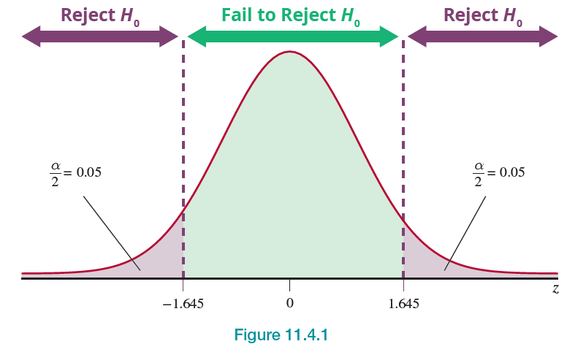
Example 1: Calculating a Confidence Interval and Performing a Hypothesis Test for the Difference in Two Proportions—Slide 17
If the null hypothesis is true, the test statistic has a standard normal distribution. Thus the critical value is determined in the same way as for other tests of hypothesis where the test statistic had a standard normal distribution. The rejection region for a two-tailed test with α = 0.10 is displayed in Figure 1. We will reject the null hypothesis if the computed value of the test statistic is larger than 1.645 or smaller than −1.645.
Figure 1

Slide 22
Example 1: Calculating a Confidence Interval and Performing a Hypothesis Test for the Difference in Two Proportions—Slide 18
Step 5: Collect the sample data and compute the value of the test statistic.
Based on the data in Table 1, the computed value of the test statistic is given by

Slide 23
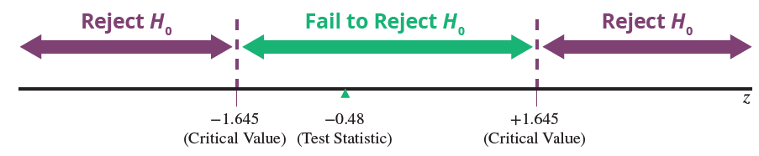
Example 1: Calculating a Confidence Interval and Performing a Hypothesis Test for the Difference in Two Proportions—Slide 19
Step 6: Make the decision and state the conclusion in terms of the original question.
Figure 2
As displayed in Figure 2, the value of the test statistic does not fall in the rejection region because −1.645 < −0.48 < 1.645. Thus, the difference between the observed value and the hypothesized value is likely due to ordinary sampling variation. We fail to reject the null hypothesis at α = 0.10.

Slide 24
Example 1: Calculating a Confidence Interval and Performing a Hypothesis Test for the Difference in Two Proportions—Slide 20
Using the P-value approach, we want to find
You may recall that
the decision rule when using the P-value approach is that we reject the null hypothesis if the P-value is less than α. Thus, since the P-value is 0.6312 which is greater than 0.10, we fail to reject the null hypothesis.
Conclusion and Interpretation: There is insufficient evidence at α = 0.10 for the cell phone executive to conclude that the proportion of defective phones produced differs between the two plants.

