Slide 1
Section 11.5
Comparing Two Population Variances

Slide 2
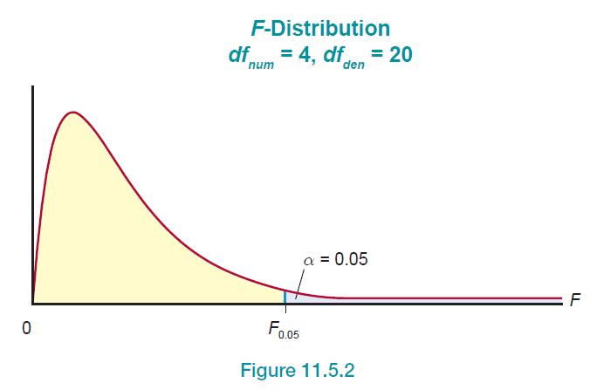
Example 1: Finding an F-Critical Value—Slide 1
Find a value on the F-distribution with df _{num} = 4 and df _{den} = 20 such that 0.05 of the area lies to the right of this value, as shown in the following Figure 2.
Figure 2

Slide 3
Example 1: Finding an F-Critical Value—Slide 2
Solution
Use the F-table corresponding to α = 0.05. The leftmost column of the table corresponds to the degrees of freedom in the denominator, while the top row of the table corresponds to the degrees of freedom in the numerator. Looking up the critical value in the 0.05 table corresponding to df _{num} = 4 and df _{den} = 20 produces an F-value of 2.8661.

Slide 4
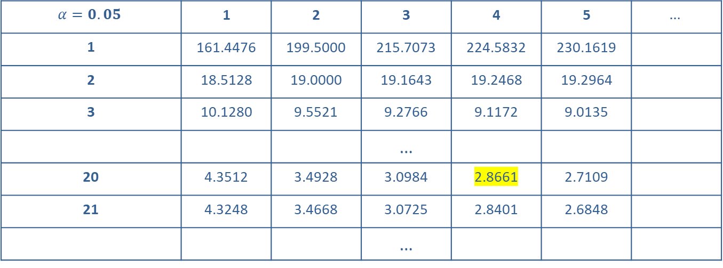
Example 1: Finding an F-Critical Value—Slide 3
Numerator Degrees of Freedom
$$α=0.05$$ | 1 | 2 | 3 | 4 | 5 | $$…$$
1 | 161.4476 | 199.5000 | 215.7073 | 224.5832 | 230.1619
2 | 18.5128 | 19.0000 | 19.1643 | 19.2468 | 19.2964
3 | 10.1280 | 9.5521 | 9.2766 | 9.1172 | 9.0135
 |  |  | …
20 | 4.3512 | 3.4928 | 3.0984 | 2.8661 | 2.7109
21 | 4.3248 | 3.4668 | 3.0725 | 2.8401 | 2.6848
 |  |  | …
Denominator Degrees of Freedom

Slide 5
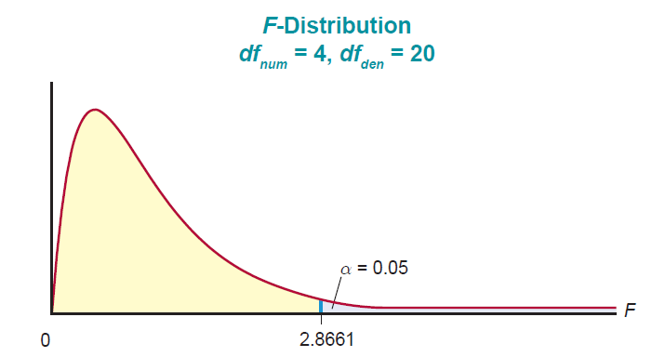
Example 1: Finding an F-Critical Value—Slide 4
Figure 3

Slide 6
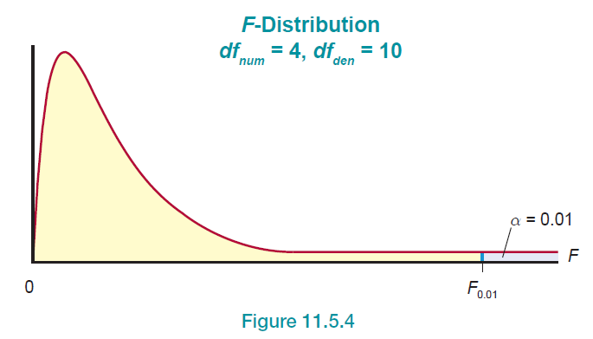
Example 2: Finding an F-Critical Value—Slide 5
Find a value on the F-distribution with 4 numerator degrees of freedom and 10 denominator degrees of freedom such that 0.01 of the area lies to the right.
Figure 4

Slide 7
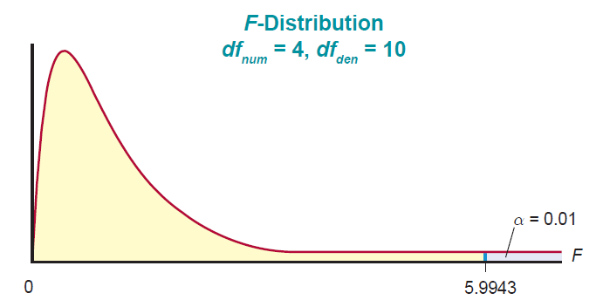

Example 2: Finding an F-Critical Value—Slide 6
Solution
Using the F-table for α = 0.01 corresponding to df _{num}$=4$ and df _{den}$=10$ results in an F-value of 5.9943.
Figure 5

Slide 8
Definition: Confidence Interval for
A
confidence interval for
the ratio of two
population variances, is given by
are the two sample variances, and
These F-values can be found in the F-distribution table in Appendix A Table H. Also note that the data are collected from two independent, normally distributed populations.

Slide 9
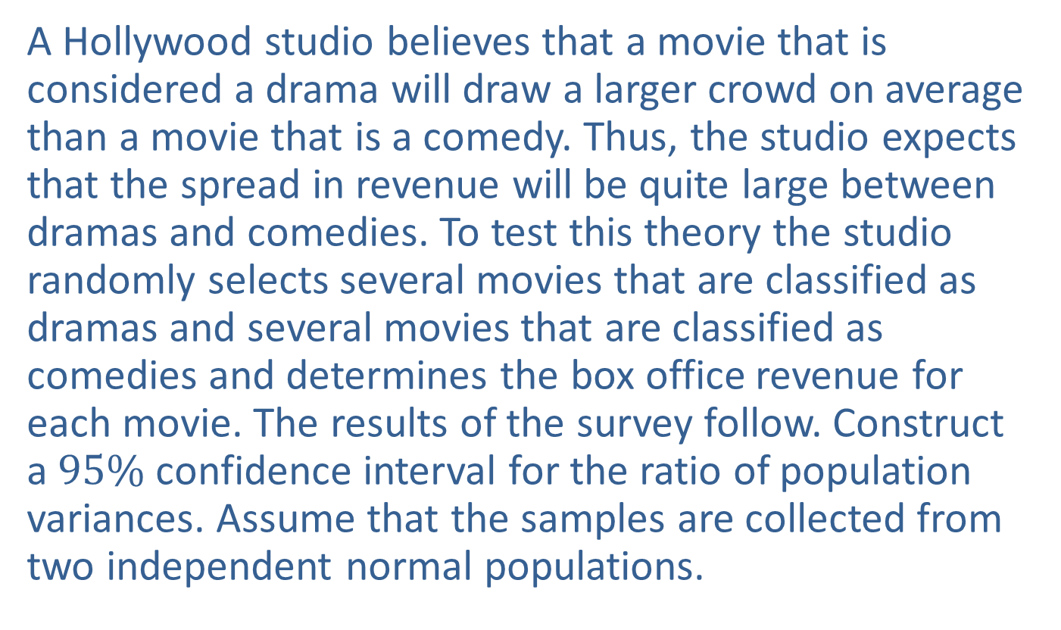
Example 3: Constructing a Confidence Interval for the Ratio of Variation in Box Office Revenues—Slide 1
A Hollywood studio believes that a movie that is considered a drama will draw a larger crowd on average than a movie that is a comedy. Thus, the studio expects that the spread in revenue will be quite large between dramas and comedies. To test this theory the studio randomly selects several movies that are classified as dramas and several movies that are classified as comedies and determines the box office revenue for each movie. The results of the survey follow. Construct a $95\%$ confidence interval for the ratio of population variances. Assume that the samples are collected from two independent normal populations.

Slide 10
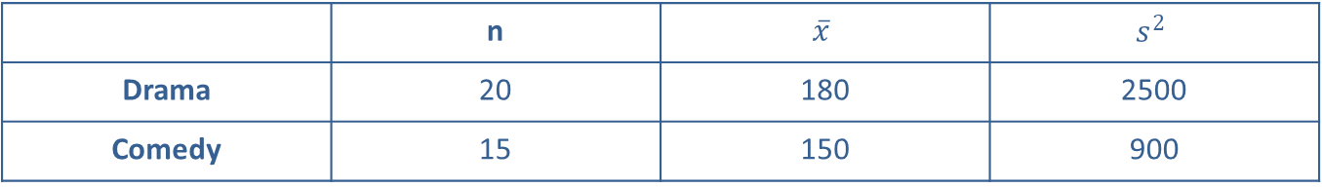
Example 3: Constructing a Confidence Interval for the Ratio of Variation in Box Office Revenues—Slide 2
Box Office Revenues (Millions of Dollars)
 | n | $$\overline{x}$$ | $$s^{2}$$
Drama | 20 | 180 | 2500
Comedy | 15 | 150 | 900
Solution
Before solving the problem, let
and let
Also note that the sample variances
are estimates of
the population variances
The point estimate for the
ratio of the two population variances is the ratio of the sample variances and would be calculated as

Slide 11
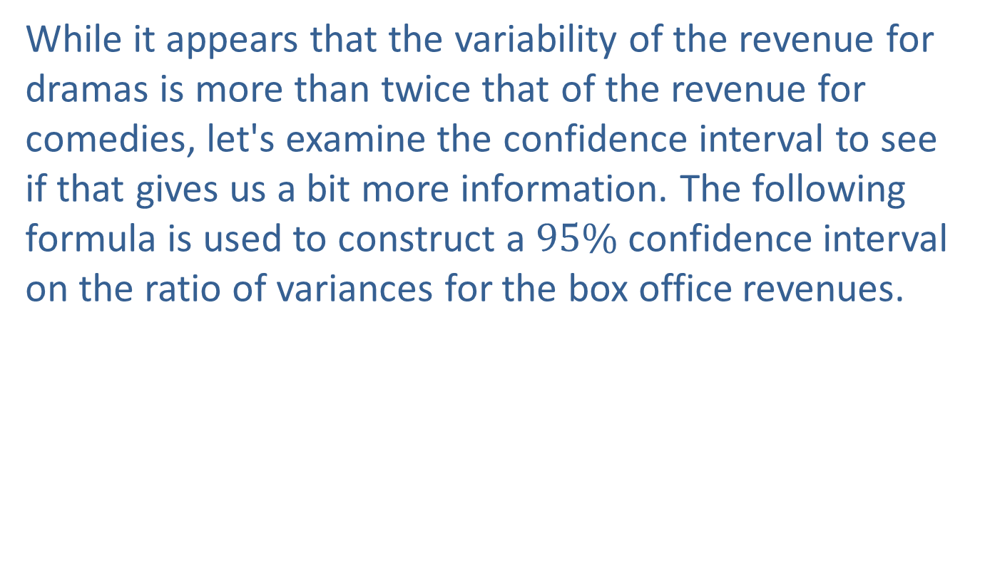
Example 3: Constructing a Confidence Interval for the Ratio of Variation in Box Office Revenues—Slide 3
While it appears that the variability of the revenue for dramas is more than twice that of the revenue for comedies, let's examine the confidence interval to see if that gives us a bit more information. The following formula is used to construct a $95\%$ confidence interval on the ratio of variances for the box office revenues.

Slide 12
Example 3: Constructing a Confidence Interval for the Ratio of Variation in Box Office Revenues—Slide 4
We will let drama be Population 1 and comedy be Population 2, so that
Given the different sample sizes, we can find
Since α = 0.05, we need to find the F - table values that correspond to

Slide 13
Example 3: Constructing a Confidence Interval for the Ratio of Variation in Box Office Revenues—Slide 5
Using these two F values, the confidence interval is as follows:
Thus, we are 95% confident that the ratio of the two population variances is between 0.9710 and 7.3525. Note that the interval (0.9710, 7.3525) includes 1. This means that the ratio of the two variances is not significantly different from 1. Therefore, there is insufficient evidence of a difference between the population variances.

Slide 14
Definition: Inferences about
Test Statistic:
are the sample variances from the two
samples of sizes n₁ and n₂ respectively, collected from two independent normally distributed populations. The degrees of freedom for the F-test are df _{num} = n₁ − 1 and df _{den} = n₂ − 2.

Slide 15
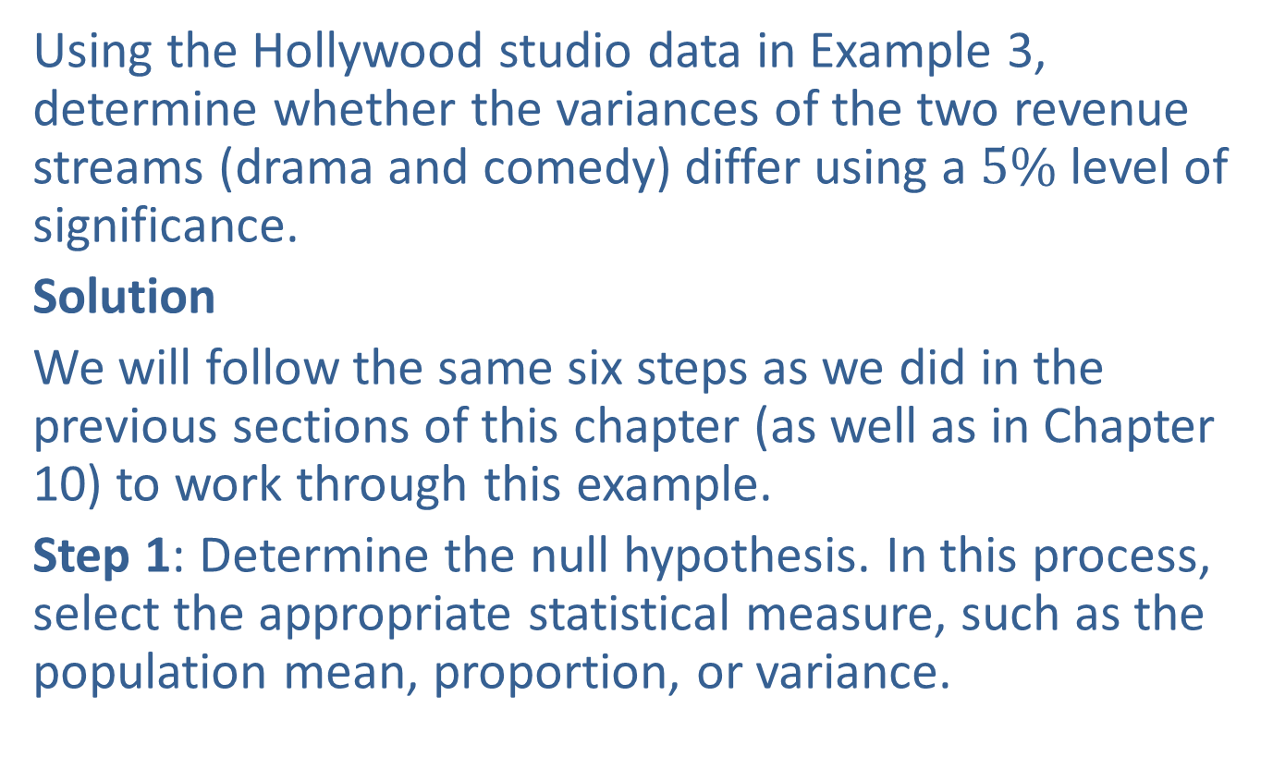
Example 4: Performing a Hypothesis Test of Variances for Box Office Revenues—Slide 1
Using the Hollywood studio data in Example 3, determine whether the variances of the two revenue streams (drama and comedy) differ using a $5\%$ level of significance.
Solution
We will follow the same six steps as we did in the previous sections of this chapter (as well as in Chapter 10) to work through this example.
Step 1: Determine the null hypothesis. In this process, select the appropriate statistical measure, such as the population mean, proportion, or variance.

Slide 16
Example 4: Performing a Hypothesis Test of Variances for Box Office Revenues—Slide 2
The population consists of all revenue generated from movies that were dramas and comedies. The test specifies that we want to compare the population variance in revenues generated from movies that were dramas to the population variance of revenues generated from movies that were comedies. The parameters of interest in this case are
The null hypothesis should be written as
which is equivalent to
Please note
that we will let
(the variance associated with
revenue from dramas) and let
(the variance
associated with revenue from comedies).

Slide 17
Example 4: Performing a Hypothesis Test of Variances for Box Office Revenues—Slide 3
Step 2: Determine the alternative hypothesis and whether it should be one-sided or two-sided.
From the information provided, we are interested in whether the variances are different, thus, the alternative hypothesis should be
two-sided and written as
Step 3: Select the appropriate test statistic based on the information at hand and the assumptions you are willing to make.
Understanding that the data are collected from two independent normally distributed observations and that we are testing the ratio of two variances, the test statistic is given by

Slide 18
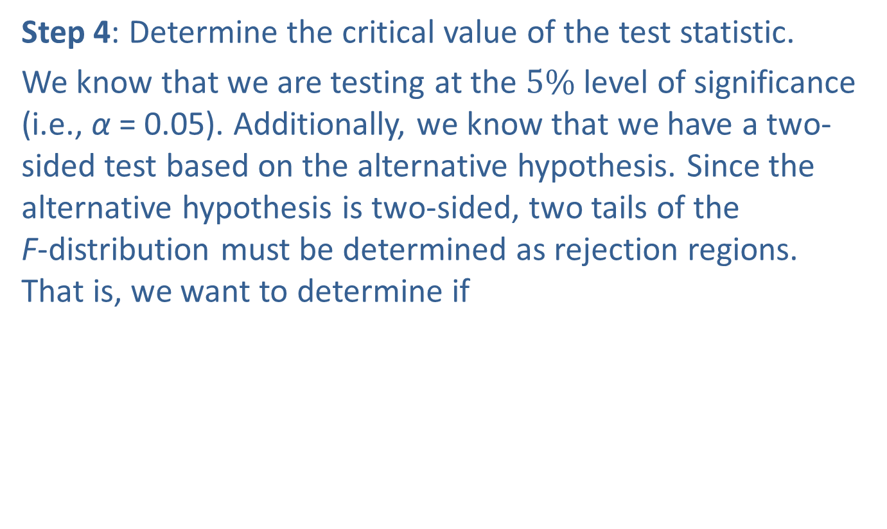
Example 4: Performing a Hypothesis Test of Variances for Box Office Revenues—Slide 4
Step 4: Determine the critical value of the test statistic.
We know that we are testing at the $5\%$ level of significance (i.e., α = 0.05). Additionally, we know that we have a two-sided test based on the alternative hypothesis. Since the alternative hypothesis is two-sided, two tails of the F-distribution must be determined as rejection regions. That is, we want to determine if
. These critical values are

Slide 19
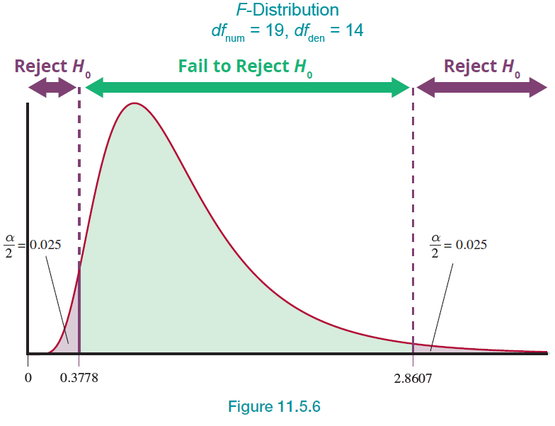
Example 4: Performing a Hypothesis Test of Variances for Box Office Revenues—Slide 5
The rejection region is that we will reject the null hypothesis if the F-test statistic is less than or equal to 0.3778, or if the F test statistic is greater than or equal to 2.8607.
Figure 6

Slide 20
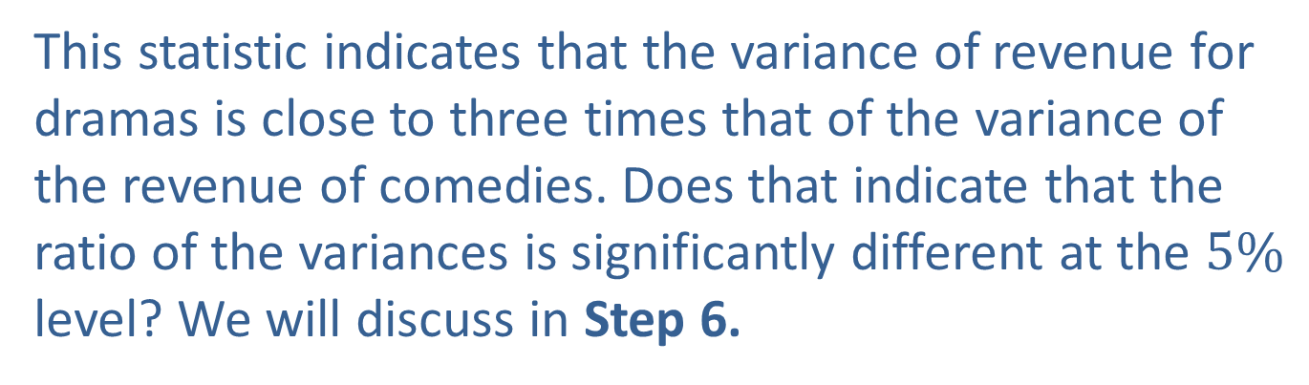
Example 4: Performing a Hypothesis Test of Variances for Box Office Revenues—Slide 6
Step 5: Collect sample data and compute the value of the test statistic.
The test statistic is given by
This statistic indicates that the variance of revenue for dramas is close to three times that of the variance of the revenue of comedies. Does that indicate that the ratio of the variances is significantly different at the $5\%$ level? We will discuss in Step 6.

Slide 21
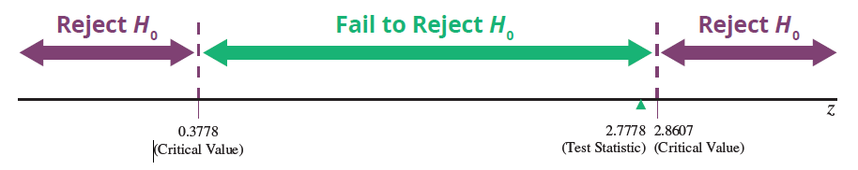
Example 4: Performing a Hypothesis Test of Variances for Box Office Revenues—Slide 7
Step 6: Make the decision and state the conclusion in terms of the original question.
Figure 7
Since the test statistic does not fall in the rejection region, we fail to reject the null hypothesis.

Slide 22
Example 4: Performing a Hypothesis Test of Variances for Box Office Revenues—Slide 8
Using the P-value approach, we want to find
since this is a two-tailed test. This results in a P-value of 0.0564. Since the P-value is greater than the significance level of 0.05, we fail to reject the null hypothesis.
Conclusion and Interpretation: We conclude that there is insufficient evidence to indicate that the variances in revenue between dramas and comedies are significantly different.
Please note that the methods presented in this section work very poorly when the normality assumption is violated. It is very important to validate the assumption of normality before developing confidence intervals or performing hypothesis tests on the ratio of the variances.

