Slide 1
Section 12.1
Introduction to Analysis of Variance (ANOVA)

Slide 2
Introduction to Analysis of Variance (ANOVA)
In comparing population means, a natural question arises: is there a significant difference between the means? A preliminary answer to this question can be obtained by drawing a random sample from each of the populations of interest and computing the sample means.
The larger the differences between the sample means, the more likely it would seem that there is a difference among the population means. How large is large enough to conclude that a difference is significant? Since a sample has been drawn from each of the populations, we must decide whether or not the observed differences between the sample means are simply due to random variation among the sample observations or to a real difference in the population means. Often, we wish to perform a hypothesis test to determine if a difference among population means can be attributed to some treatment.

Slide 3
Analysis of Variance (ANOVA)
Analysis of variance (ANOVA) deals with differences between or among population means. You may recall that you were restricted to testing the difference between two population means when using the t-test in Chapter 11. Unlike the t-test, analysis of variance does not restrict the number of means. Instead of asking whether two means differ, we ask if three, four, five, etc., means differ. ANOVA allows us to deal with two or more independent variables simultaneously, asking not only about the effects of each variable separately, but also about how two or more variables interact. In studying ANOVA, we will analyze the differences in means by breaking apart the total variation. The total variation will be separated into two pieces: sum of squares for treatments, SST (the variation attributed to the treatments) and sum of squares for error, SSE (the variation not explained by the treatments).

Slide 4
Definition: Experimental Units
Individuals or objects on which the experiment is performed are called experimental units.

Slide 5
Definition: Treatment
An experimental condition applied to the units is called a treatment.

Slide 6
Definition: Analysis of Variance
Analysis of variance is a statistical test to determine differences among three or more independent population means.

Slide 7
Formula: Sample Variance
where
is the sample mean of all the observations (the grand
mean),
n _{j} is the number of observations in the j ^{th} treatment,
k is the number of treatments, and
n _{T} is the total number of observations in all samples.

Slide 8
Formula: Sum of Squares for Treatments
The mathematical expression for the sum of squares for treatments is given by
where
n _{j} is the number of observations in the j ^{th} treatment,
is the sample mean of the observations in the j ^{th}
treatment, and
is the grand mean.

Slide 9
Formula: Sum of Squares for Error
The mathematical expression for the sum of squares for error is given by the following formula.

Slide 10
Formula: Sum of Squares and Degrees of Freedom
Sum of Squares
TSS = SST + SSE
Degrees of Freedom

Slide 11
Formula: ANOVA Formulas—Slide 1
Grand Mean:
Sum of Squares for Treatments:
Mean Square for Treatments:

Slide 12
Definition: ANOVA Formulas—Slide 2
Sum of Squares for Error:
Mean Square for Error:
Total Sum of Squares:

Slide 13
Example 1: Performing an ANOVA on Media Screen Time Usage by Tweens, Teens, and Adults—Slide 1
Data were collected to study the use of media by three age groups – tweens (8–12 years old), teens (13–18 years old), and adults (over 18 years old). A sample of 50 participants in each age group was asked how frequently they engaged in activities such as time spent on cell phones, watching online videos, watching television, and playing mobile games.
The data are in the following table.

Slide 14
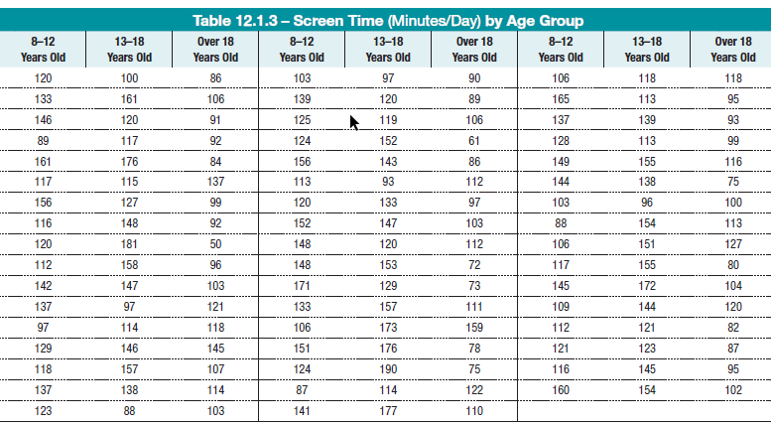
Example 1: Performing an ANOVA on Media Screen Time Usage by Tweens, Teens, and Adults—Slide 2
Table 3 – Screen Time (Minutes/Day) by Age Group

Slide 15
Example 1: Performing an ANOVA on Media Screen Time Usage by Tweens, Teens, and Adults—Slide 3
A summary table showing the sample size, the average time spent on devices, and the standard deviation of the data by age group is given below.
Test to determine if there is a significant difference between average time spent on devices between age groups.
Table 4 - Summary of Screen Time by Age Group
 | 8–12 Years Old | 13–18 Years Old | Over 18 Years Old
n | 50 | 50 | 50
Mean | 128 | 137.48 | 100.12
Standard Deviation | 20.90 | 25.57 | 20.32
Test to determine if there is a significant difference between average time spent on devices between age groups.

Slide 16
Example 1: Performing an ANOVA on Media Screen Time Usage by Tweens, Teens, and Adults—Slide 4
Solution
Let
μ₁ = population mean time spent on devices for participants 8–12 years old
μ₂ = population mean time spent on devices for participants 13–18 years old
μ₃ = population mean time spent on devices for participants over 18 years old
Thus, the null and alternative hypotheses for this scenario should be written as
H₀: μ₁ = μ₂ = μ₃
H _{α}: At least one μ _{i} is different, for i = 1, 2, 3.
Assuming that the variances of time spent on devices are equal, the figure below shows the JMP output for a one-way ANOVA comparing means.

Slide 17
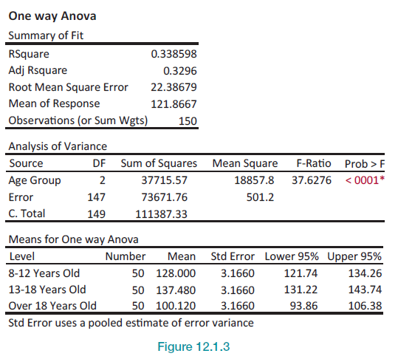
Example 1: Performing an ANOVA on Media Screen Time Usage by Tweens, Teens, and Adults—Slide 5
Figure 3

Slide 18
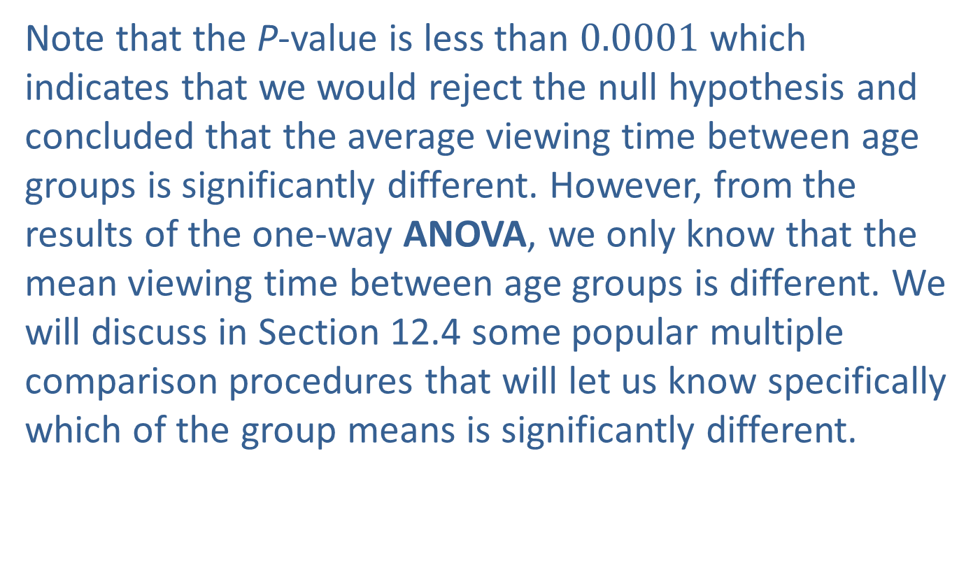
Example 1: Performing an ANOVA on Media Screen Time Usage by Tweens, Teens, and Adults—Slide 6
Note that the P-value is less than $0.0001$ which indicates that we would reject the null hypothesis and concluded that the average viewing time between age groups is significantly different. However, from the results of the one-way ANOVA, we only know that the mean viewing time between age groups is different. We will discuss in Section 12.4 some popular multiple comparison procedures that will let us know specifically which of the group means is significantly different.

