Slide 1
Section 12.3
The F-Distribution and the F-Test

Slide 2
F-Distribution—Slide 1
The F-distribution, named after the English statistician Sir Ronald Fisher, is a continuous distribution. It will be used to analyze variation in test statistics formed as ratios of two random variables. The F-distribution is not symmetrical; rather, it is skewed to the right. Like the t-distribution, its parameters are degrees of freedom. F-distributions are associated with test statistics that are quotients. What distinguishes the F-distribution is that it has a pair of values for its degrees of freedom. The number of degrees of freedom associated with the numerator is df num and the number of degrees of freedom associated with the denominator is df den.

Slide 3
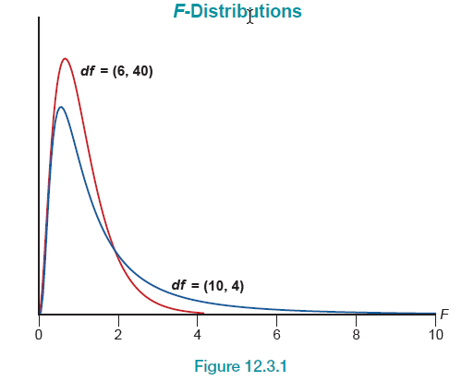
F-Distribution—Slide 2
Figure 1

Slide 4
Procedure: F-Test—Slide 1
A summary of the F-test is given below.
Hypotheses:
H₀:μ₁ = μ₂ = ⋯ = μ _{k} The k population means are equal.
H _{a}: At least one μ _{i} is different.
Test Statistic:

Slide 5
Procedure: F-Test—Slide 2
Assumptions:
The k populations of interest are normally distributed with equal variances, and independent, random samples are drawn from each population.
Rejection Region:
H₀ will be rejected for large values of
In particular, we will reject H₀ if F ≥ F _{α} with (k − 1) numerator degrees of freedom and (n _{T} − k) denominator degrees of freedom.

Slide 6
Formula: Computational Formulas for MST and MSE
Let k be the total number of treatments and n _{T} = n ₁ + n ₂ + ⋯ + n _{k} be the total number of observations. Then the computational formulas are as follows.

Slide 7
Example 1: Comparing Selling Prices by Salespersons Using ANOVA—Slide 1
You have just been promoted to sales manager of a company that manufactures robots used to assemble automobiles. Although your sales force is given a suggested price at which to sell the robots, they have considerable leeway in negotiating the final price. Past sales records indicate that sometimes there is a large difference in the selling prices that different sales reps are able to negotiate. You are interested in knowing if this difference is significant, possibly because of a more effective negotiating strategy or exceptional interpersonal skills, or whether this observed difference in selling prices is just due to random variation. You decide to randomly select four sales over the last year for each of your three sales representatives and observe the actual selling prices of the robot. Table 1 shows the amounts at which the robots sold in thousands of dollars.

Slide 8
Example 1: Comparing Selling Prices by Salespersons Using ANOVA—Slide 2
Table 1 – Selling Prices (Thousands of Dollars)
 | Salesperson 1 | Salesperson 2 | Salesperson 3
 | 10 | 11 | 11
 | 14 | 16 | 13
 | 13 | 14 | 12
 | 12 | 15 | 15
Total | 49 | 56 | 51
Based on the results of your survey, can you conclude that there is a significant difference among the average selling prices that the three sales reps have been able to negotiate? Use α = 0.05.

Slide 9
Example 1: Comparing Selling Prices by Salespersons Using ANOVA—Slide 3
Solution
Step 1: Determine the null hypothesis. In this process, select the appropriate statistical measure, such as the population mean, proportion, or variance.
The hypotheses are fairly straightforward since you are interested in comparing the average selling prices for the three sales reps, the population parameters of interest are the true mean selling prices for the three sales reps.
μ₁ = true mean selling price for sales person 1
μ₂ = true mean selling price for sales person 2
μ₃ = true mean selling price for sales person 3
The null hypothesis is written as H₀: μ₁ = μ₂ = μ₃ which implies that the mean selling prices are the same for all three sales reps.

Slide 10
Example 1: Comparing Selling Prices by Salespersons Using ANOVA—Slide 4
Step 2: Determine the alternative hypothesis and whether it should be one-sided or two-sided.
The alternative hypothesis states that there is a difference among the average selling prices for the three sales reps. Based on the way the test statistic is constructed, we will reject the null hypothesis for large values of the test statistic, meaning that the variability among the sample means is much larger than the variability within the sample observations. The F-test is always a one-tailed test. The alternative hypothesis should be written as

Slide 11
Example 1: Comparing Selling Prices by Salespersons Using ANOVA—Slide 5
Step 3: Select the appropriate test statistic based on the information at hand and the assumptions you are willing to make.
There are three key questions we must ask.
1. Are the selling prices for each sales rep normally distributed?
2. Do the selling prices for each sales rep have approximately equal variances?
​3. Were the sample selling prices for each sales rep collected in an independent and random fashion?
Based on prior studies, you have reason to believe that the selling prices of the robots for each of the sales reps have an approximately normal distribution and that the variances of the three distributions are approximately equal. Also, you used random sampling to collect your data. Thus, the appropriate test statistic is the F-statistic.

Slide 12
Example 1: Comparing Selling Prices by Salespersons Using ANOVA—Slide 6
Step 4: Determine the critical value of the test statistic.
The level of the test is specified in the problem as
α = 0.05.
The level of the test is α = 0.05, and there are (k − 1) = (3 − 1) = 2 numerator degrees of freedom and (n _{T} − k) = (12 − 3) = 9 denominator degrees of freedom. Thus, the critical value is F _{0.05} = 4.2565. We will reject H₀ if the computed value of the test statistic is greater than or equal to 4.2565. Figure 2 displays the rejection region.

Slide 13
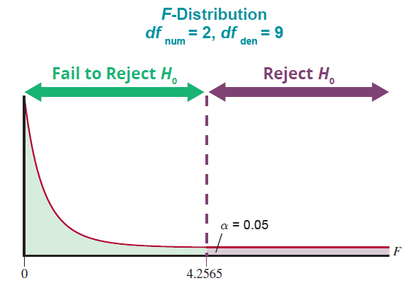
Example 1: Comparing Selling Prices by Salespersons Using ANOVA—Slide 7
Figure 2

Slide 14
Example 1: Comparing Selling Prices by Salespersons Using ANOVA—Slide 8
Step 5: Collect sample data and compute the value of the test statistic.
Using the computational formulas presented previously, we have the following.

Slide 15
Example 1: Comparing Selling Prices by Salespersons Using ANOVA—Slide 9
The resulting calculated value of the test statistic is as follows.

Slide 16
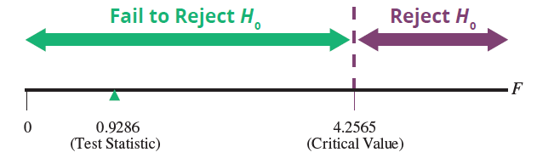
Example 1: Comparing Selling Prices by Salespersons Using ANOVA—Slide 10
Step 6: Make the decision and state the conclusion in terms of the original question.
Since the resulting value of the test statistic, 0.9286, is less than the critical value of 4.2565, we fail to reject the null hypothesis as shown in Figure 3.
Figure 3

Slide 17
Example 1: Comparing Selling Prices by Salespersons Using ANOVA—Slide 11
Conclusion and Interpretation: There is not sufficient evidence at α = 0.05 to reject the null hypothesis. Thus, we cannot conclude that there is a difference among the average selling prices for the three sales reps.
It is often more convenient to use statistical software (rather than the computational formulas) to perform an analysis of variance such as the one in this example. The summary output from Microsoft Excel is given in Figure 4.

Slide 18
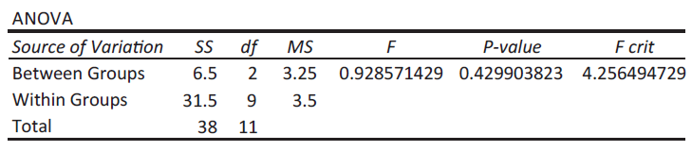
Example 1: Comparing Selling Prices by Salespersons Using ANOVA—Slide 12
Figure 4
Note that the F-statistic is approximately 0.9286 and the P-value associated with the test is approximately 0.4299. Since 0.4299 > 0.05, there is not sufficient evidence to conclude that there is a difference between the selling prices negotiated by the three salespersons.

