Slide 1
Section 12.5
Two-Way ANOVA: The Randomized Block Design

Slide 2
Definition: Completely Randomized Design
A completely randomized design is a design that randomly assigns treatments to each of the study participants so that each participant has an equal chance of being assigned to each treatment.

Slide 3
Definition: Randomized Block Design
A randomized block design is a design that uses blocks such that the experimental units within the blocks are as alike as possible. The experimental units within each block are then randomly assigned to the treatments of interest.

Slide 4
The Randomized Block Design
In a randomized block design, we use blocks such that the experimental units within the blocks are as much alike as possible. Then we randomly assign the experimental units within each block to the k populations or treatments of interest. Finally, we compare the response of the experimental units to each of the treatments of interest within each of the blocks. In this way, we eliminate possible variation due to some of the extraneous factors that are unrelated to the treatments.

Slide 5
Procedure: Two-Way ANOVA: Randomized Block Design—Slide 1
Hypotheses:
Test Statistic:
Where SSE = TSS − SST − SSBL

Slide 6
Procedure: Two-Way ANOVA: Randomized Block Design—Slide 2
Assumptions:
The differences in observed responses to treatments for blocked units are normally distributed with equal variances.
Rejection Region:
H ₀ will be rejected for large values of
In particular, we will reject H ₀ if F ≥ F _{α} with (k − 1) numerator degrees of freedom and (k − 1)(b − 1) denominator degrees of freedom.

Slide 7
Definition: Two-way Analysis of Variance
A two-way analysis of variance is an experiment or study in which the means of two independent factors are compared.

Slide 8
Example 1: Performing an ANOVA Test with Blocking on Media Type—Slide 1
Suppose that in addition to studying screen time by age group (Tweens, Teens, and Adults), data were also collected indicating the particular media type on which the participants spend their time. For this experiment, five participants were randomly assigned to each age group-media type combination. There were seven media types (watching tv, gaming, listening to music, reading, browsing websites, using social media, and video chatting) used.

Slide 9
Example 1: Performing an ANOVA Test with Blocking on Media Type—Slide 2
However, we are more interested in just the screen time and consider the media type as a nuisance parameter. That is, the media type may add unnecessary variation to the model. One approach to reducing the effect of media type on the screen time is to use blocking. Our interest is still in comparing the average screen time between age groups which will serve as our treatments. Based on the data in Table 3, can you conclude that there is a significant difference in average screen time among the age groups? Use a significance level of 0.05.

Slide 10
Example 1: Performing an ANOVA Test with Blocking on Media Type—Slide 3
Table 3 – Screen Time by Age Group and Media Type (minutes per day)
 |  | Age Group
Media Type | 8–12 Years Old | 13–18 Years Old | Over 18 Years Old
 | 135 | 99 | 94
 | 112 | 100 | 84
Watching TV | 138 | 129 | 109
 | 142 | 127 | 92
 | 105 | 121 | 97
 | 98 | 149 | 63
 | 136 | 155 | 90
Gaming | 100 | 136 | 126
 | 156 | 129 | 88
 | 141 | 127 | 122

Slide 11
Example 1: Performing an ANOVA Test with Blocking on Media Type—Slide 4
Table 3 – Screen Time by Age Group and Media Type (minutes per day)
 |  | Age Group
Media Type | 8–12 Years Old | 13–18 Years Old | Over 18 Years Old
 | 150 | 155 | 107
 | 116 | 84 | 101
Listening to Music | 136 | 195 | 81
 | 165 | 113 | 105
 | 141 | 101 | 115
 | 107 | 164 | 98
 | 124 | 162 | 127
Reading | 138 | 121 | 126
 | 111 | 147 | 112
 | 106 | 209 | 97

Slide 12
Example 1: Performing an ANOVA Test with Blocking on Media Type—Slide 5
Table 3 – Screen Time by Age Group and Media Type (minutes per day)
 |  | Age Group
Media Type | 8–12 Years Old | 13–18 Years Old | Over 18 Years Old
 | 120 | 118 | 79
 | 130 | 143 | 98
Browsing Websites | 110 | 143 | 102
 | 146 | 165 | 122
 | 145 | 148 | 106
 | 155 | 135 | 120
 | 144 | 131 | 99
Using Social Media | 165 | 125 | 100
 | 137 | 125 | 66
 | 142 | 144 | 103

Slide 13
Example 1: Performing an ANOVA Test with Blocking on Media Type—Slide 6
Table 3 – Screen Time by Age Group and Media Type (minutes per day)
 |  | Age Group
Media Type | 8–12 Years Old | 13–18 Years Old | Over 18 Years Old
 | 83 | 126 | 132
 | 165 | 134 | 101
Video Chatting | 145 | 138 | 110
 | 151 | 106 | 90
 | 109 | 159 | 113

Slide 14
Example 1: Performing an ANOVA Test with Blocking on Media Type—Slide 7
Solution
The null and alternative hypotheses will be the same as in Example 1 given by
The test statistic appears to be exactly the same as that used for the F-test which is

Slide 15
Example 1: Performing an ANOVA Test with Blocking on Media Type—Slide 8
However, the denominator of the F-statistic is calculated differently because it takes into account the fact that we will eliminate some of the variation among our samples by blocking the experimental units. The total sum of squares (TSS) and the degrees of freedom will be partitioned as SST (sum of squares treatments), SSBL (sum of squares for blocks), and SSE (sum of squares for error). The partitioning of the sum of squares and degrees of freedom are shown.

Slide 16
Example 1: Performing an ANOVA Test with Blocking on Media Type—Slide 9
Sum of Squares: TSS = SST + SSBL + SSE
Degrees of Freedom:
where n = kb = total number of observations,
k = number of treatments, and b = number of blocks. However, in situations where there is replication (i.e., we have more than one observation for each treatment-block combination), represented by r, the degrees of freedom are partitioned as follows:

Slide 17
Example 1: Performing an ANOVA Test with Blocking on Media Type—Slide 10
Degrees of Freedom with Replication:
Where n = rkb.
We used JMP to obtain the output in the table.

Slide 18
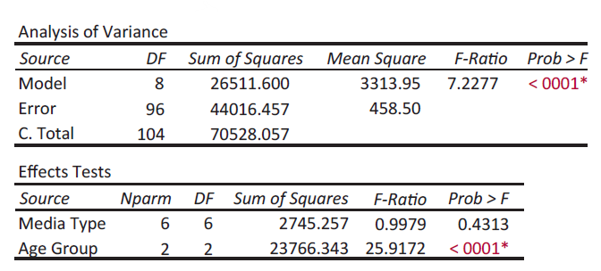
Example 1: Performing an ANOVA Test with Blocking on Media Type—Slide 11
Figure 4

Slide 19
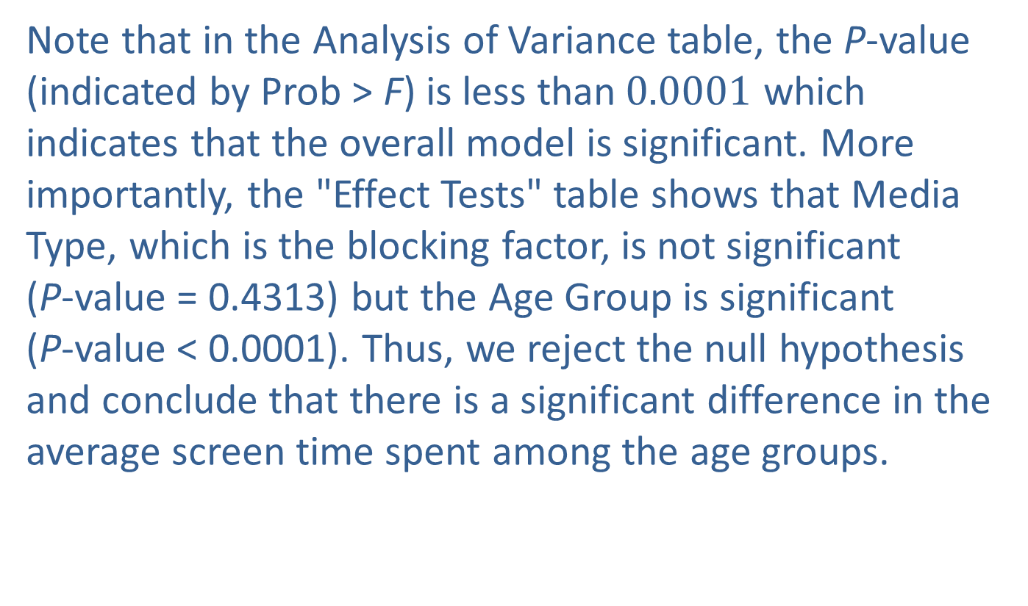
Example 1: Performing an ANOVA Test with Blocking on Media Type—Slide 12
Note that in the Analysis of Variance table, the P-value (indicated by Prob > F) is less than$0.0001$ which indicates that the overall model is significant. More importantly, the "Effect Tests" table shows that Media Type, which is the blocking factor, is not significant
(P-value = 0.4313) but the Age Group is significant
(P-value < 0.0001). Thus, we reject the null hypothesis and conclude that there is a significant difference in the average screen time spent among the age groups.

Slide 20
Example 1: Performing an ANOVA Test with Blocking on Media Type—Slide 13
Now that we know that we have rejected the null hypothesis and know that there is a difference in screen time among the age groups, the natural question is Which of the three age groups is different? This is where we use multiple comparison procedures. For this particular example, the JMP Output below uses Tukey's HSD to compare the average screen time of the three age groups.

Slide 21
Example 1: Performing an ANOVA Test with Blocking on Media Type—Slide 14
JMP produces a connected letters report to compare means. Levels (or age groups in our example) that are not connected by the same letter are significantly different. Thus, we see that the 8–12 Years Old and the 13–18 Years Old age groups have the letter A, indicating that they are not significantly different. However, the Over 18 Years Old age group has the letter B, indicating that this age group is significantly different from the other two age groups.

Slide 22
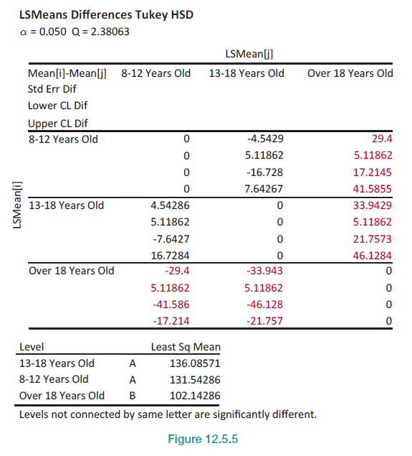
Example 1: Performing an ANOVA Test with Blocking on Media Type—Slide 15
Figure 5

