Slide 1
Section 12.6
Two-Way ANOVA: The Factorial Design

Slide 2
The Factorial Design—Slide 1
The techniques that we discussed for a randomized block design can be extended to the situation where there are two factors of interest. A director of personnel might be interested in relating average salary to two factors: age and experience. A supervisor at a manufacturing plant might be interested in relating the average number of defective products to two factors: operator and machine. A doctor might be interested in relating the increase in average patient heart rate to two factors: medication and age.

Slide 3
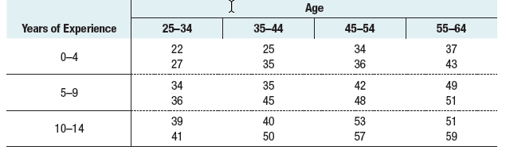
The Factorial Design—Slide 2
In order for the director of personnel to evaluate the relationship between average salary, age, and experience, he chooses the following experimental design. He selects four different age groups and three different experience levels and observes two salaries for each of the possible combinations of age and experience.
Table 1 – Salaries (Thousands of Dollars)

Slide 4
The Factorial Design—Slide 3
This type of design involves a two-way analysis of variance because there are two classifications. It is called a complete factorial experiment since there is at least one observation for every possible combination of age and years of experience. Factorial experiments provide valuable information by enabling the interaction between the two variables to be estimated.

Slide 5
Definition: Complete Factorial Experiment
A complete factorial experiment is an experiment involving at least two factors with at least one observation for every possible combination of the factor levels.

Slide 6
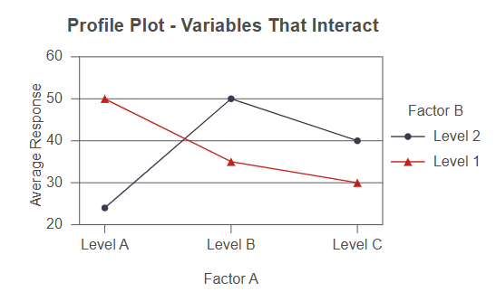
The Factorial Design—Slide 4
Interaction between the two variables means that the average salary is affected by the combination of age and experience. An example of two variables that interact is shown in Figure 1. This is called a profile plot (or interaction plot) which plots the means by factors.
Figure 1

Slide 7
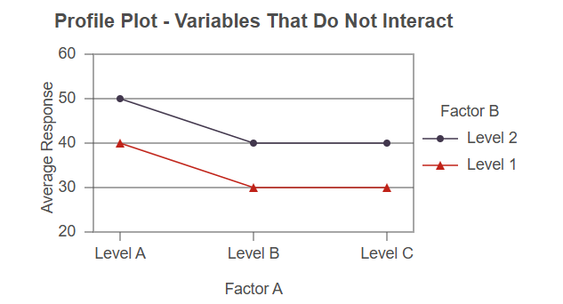
The Factorial Design—Slide 5
If there is no interaction at all between two variables, the lines in the profile plot will be perfectly parallel. An example of two variables that do not interact is shown in Figure 2.
Figure 2

Slide 8
The Factorial Design—Slide 6
There are three effects on average salary that will interest the personnel director. The first is the effect that the interaction between age and experience has on average salary, called the main effect for interaction. The second is the effect that experience has on average salary, called the main effect for experience (Factor A). The third is the effect that age has on average salary, called the main effect for age (Factor B).

Slide 9
The Factorial Design—Slide 7
The test procedure is somewhat different than those we have discussed previously because of the potential presence of interaction between the two variables. Of primary importance is determining whether there is any interaction between the two variables. If there is interaction, we will not be able to separate out the effects that age and experience have on average salary, and the hypothesis testing procedure is halted. If there is not interaction, then it is possible to proceed with the hypothesis testing procedure and determine the effect that age has on average salary and the effect that experience has on average salary.

Slide 10
Procedure: Test for Interaction Between Factors
Hypotheses:
H ₀: There is no interaction between Factor A and Factor B.
H _{a}: There is interaction between Factor A and Factor B.
Test Statistic:
Rejection Region:
Reject the null hypothesis if
degrees of freedom and
denominator degrees of freedom.
Note: If the null hypothesis is rejected, then interaction exists. Do not proceed with the main effects tests for Factor A and Factor B if this is the case.

Slide 11
Procedure: Test for Main Effects for Factor A
Hypotheses:
H ₀ : Factor A has no effect on average response.
H _{a} : Factor A has an effect on average response.
Test Statistic:
Rejection Region:
Reject the null hypothesis if
numerator degrees of freedom and
degrees of freedom.

Slide 12
Procedure: Test for Main Effects for Factor B
Hypotheses:
H ₀ : Factor B has no effect on average response.
H _{a} : Factor B has an effect on average response.
Test Statistic:
Rejection Region:
Reject the null hypothesis if
numerator degrees of freedom and
degrees of freedom.

Slide 13
Example 1: Performing a Two-Way ANOVA with Interaction—Slide 1
The analysis in Example 1 of section 12.5 (using blocking) is equivalent to a two-way ANOVA without interaction. The added variability of the Media Type on screen time reduced the variability of screen time on Age Group. In this example, we will use the same data of Example 1 of section 12.5 but we will perform a two-way ANOVA with interaction. That is, we are now interested if there is a relationship (i.e., interaction) between the Age Group and Media Type factors.

Slide 14
Example 1: Performing a Two-Way ANOVA with Interaction—Slide 2
Solution
It's important to see the means that are being compared and the associated hypotheses. The table below should prove helpful. Note that μ _{ij}, the cells within the table represent the population mean of the
i ^{th} row and the j ^{th} column. If replication exists (r > 1; in this example, we have 5 replications so r = 5), the estimate of μ _{ij} is the sample mean of the observations in the i ^{th} row and j ^{th} column which is given by

Slide 15
Example 1: Performing a Two-Way ANOVA with Interaction—Slide 3
Where x _{i j k} is the k ^{th} observation in the i ^{th} row and j ^{th} column.
Similarly, the estimate of the row means μ _{i} and column means μ _{j} can be obtained by taking the average of the observations in each row and column, respectively.

Slide 16
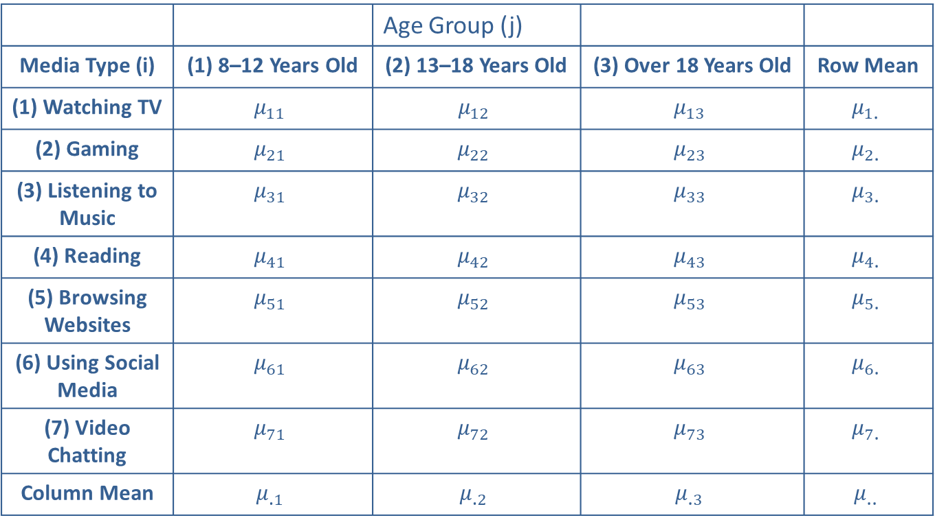
Example 1: Performing a Two-Way ANOVA with Interaction—Slide 4
Table 3 Two-way Table Showing Means
 |  | Age Group (j)
Media Type (i) | (1) 8–12 Years Old | (2) 13–18 Years Old | (3) Over 18 Years Old | Row Mean
(1) Watching TV | $$μ_{11}$$ | $$μ_{12}$$ | $$μ_{13}$$ | $$μ_{1\text{.}}$$
(2) Gaming | $$μ_{2⁣1}$$ | $$μ_{22}$$ | $$μ_{23}$$ | $$μ_{2\text{.}}$$
(3) Listening to Music | $$μ_{3⁣1}$$ | $$μ_{32}$$ | $$μ_{33}$$ | $$μ_{3\text{.}}$$
(4) Reading | $$μ_{4⁣1}$$ | $$μ_{42}$$ | $$μ_{43}$$ | $$μ_{4\text{.}}$$
(5) Browsing Websites | $$μ_{5⁣1}$$ | $$μ_{52}$$ | $$μ_{53}$$ | $$μ_{5\text{.}}$$
(6) Using Social Media | $$μ_{6⁣1}$$ | $$μ_{62}$$ | $$μ_{63}$$ | $$μ_{6\text{.}}$$
(7) Video Chatting | $$μ_{7⁣1}$$ | $$μ_{72}$$ | $$μ_{73}$$ | $$μ_{7\text{.}}$$
Column Mean | $$μ_{\text{.}1}$$ | $$μ_{\text{.}2}$$ | $$μ_{\text{.}3}$$ | $$μ_{\text{..}}$$

Slide 17
Example 1: Performing a Two-Way ANOVA with Interaction—Slide 5
We have three hypotheses that need to be tested: a test for interaction and a test for each of the main effects. The null and alternative hypotheses for the test for interaction is given by
H ₀: The interaction of Media Type and Age
Group is zero.
H _{a}: The interaction of Media Type and Age Group is
not zero.
The test statistic for the interaction effect is given by

Slide 18
Example 1: Performing a Two-Way ANOVA with Interaction—Slide 6
which follows an F-distribution with
Where a is the number of levels of Media Type, b is the number of levels of Age Group, and r is the number of replications.
The critical value, using a significance level of α = 0.05, for
this test statistic is
Thus, we reject
the null hypothesis that there is an interaction effect if the F-statistic is greater than 1.8693.

Slide 19
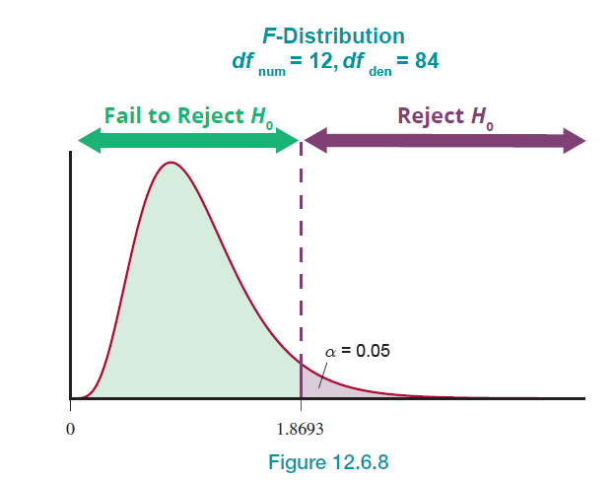
Example 1: Performing a Two-Way ANOVA with Interaction—Slide 7
Figure 8

Slide 20
Example 1: Performing a Two-Way ANOVA with Interaction—Slide 8
If the interaction term is insignificant, we then perform the test for main effects. That is, we test to see if there are significant differences in average screen time by Age Group and test to see if there are significant differences in average screen time by Media Type. If the interaction term is significant, then concern over the main effects is lost because any significance in the main effects could be masked by the significant interaction term. Masking is when the significant interaction term hides (or masks) the variation of the main effects or that there is little value in proceeding with testing the main effects.
The hypotheses for testing the Media Type effect are given by

Slide 21
Definition: Masking
Masking occurs when a significant interaction term in an ANOVA hides (or masks) the variation in the main effects.

Slide 22
Example 1: Performing a Two-Way ANOVA with Interaction—Slide 9
The test statistic is
which follows an F-distribution with
where a is the number of levels of Media Type.
The critical value, using a significance level of α = 0.05, for
this test statistic is
Thus, we reject the
null hypothesis that there is no media type effect if the
F-statistic is greater than 2.2086.

Slide 23
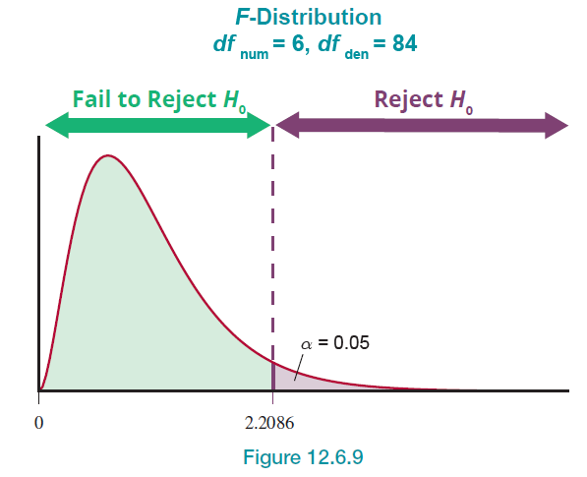
Example 1: Performing a Two-Way ANOVA with Interaction—Slide 10
Figure 9

Slide 24
Example 1: Performing a Two-Way ANOVA with Interaction—Slide 11
Similarly, the hypotheses for testing the Age Group effect is given by:
The test statistic is
which follows an F-distribution with
The critical value, using a significance level of $α=0.05$, for
this test statistic is
Thus, we reject the
null hypothesis that there is an age group effect if the
F-statistic is greater than 3.1052.

Slide 25
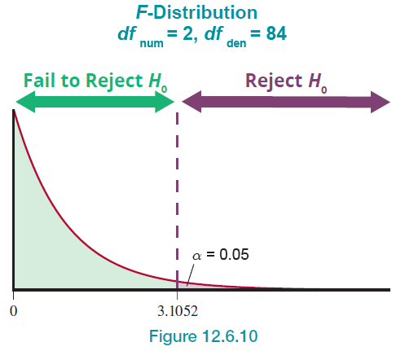
Example 1: Performing a Two-Way ANOVA with Interaction—Slide 12
Figure 10

Slide 26
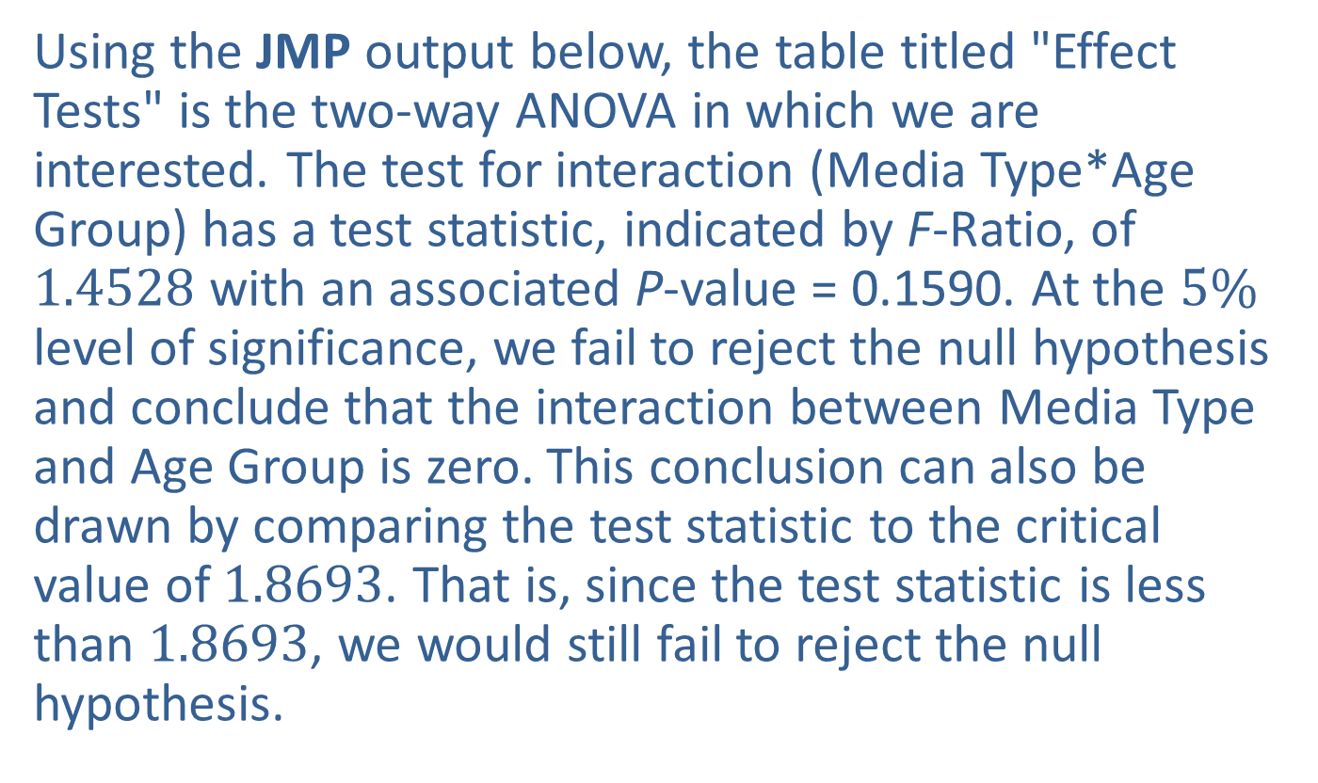
Example 1: Performing a Two-Way ANOVA with Interaction—Slide 13
Using the JMP output below, the table titled "Effect Tests" is the two-way ANOVA in which we are interested. The test for interaction (Media Type*Age Group) has a test statistic, indicated by F-Ratio, of 1.4528 with an associated P-value = 0.1590. At the $5\%$ level of significance, we fail to reject the null hypothesis and conclude that the interaction between Media Type and Age Group is zero. This conclusion can also be drawn by comparing the test statistic to the critical value of 1.8693. That is, since the test statistic is less than 1.8693, we would still fail to reject the null hypothesis.

Slide 27
Example 1: Performing a Two-Way ANOVA with Interaction—Slide 14
Now that the interaction term is insignificant, we can focus our attention on the main effects. Referring to the "Effect Tests" table, we see that the test statistic for Media Type is 1.0544 with an associated P-value of 0.3966 indicating that we would fail to reject the null hypothesis and conclude that there is no evidence to indicate that the average screen time between Media Types is different. We would also draw this conclusion when comparing the test statistic F = 1.0544 to the critical value of 2.2086.

Slide 28
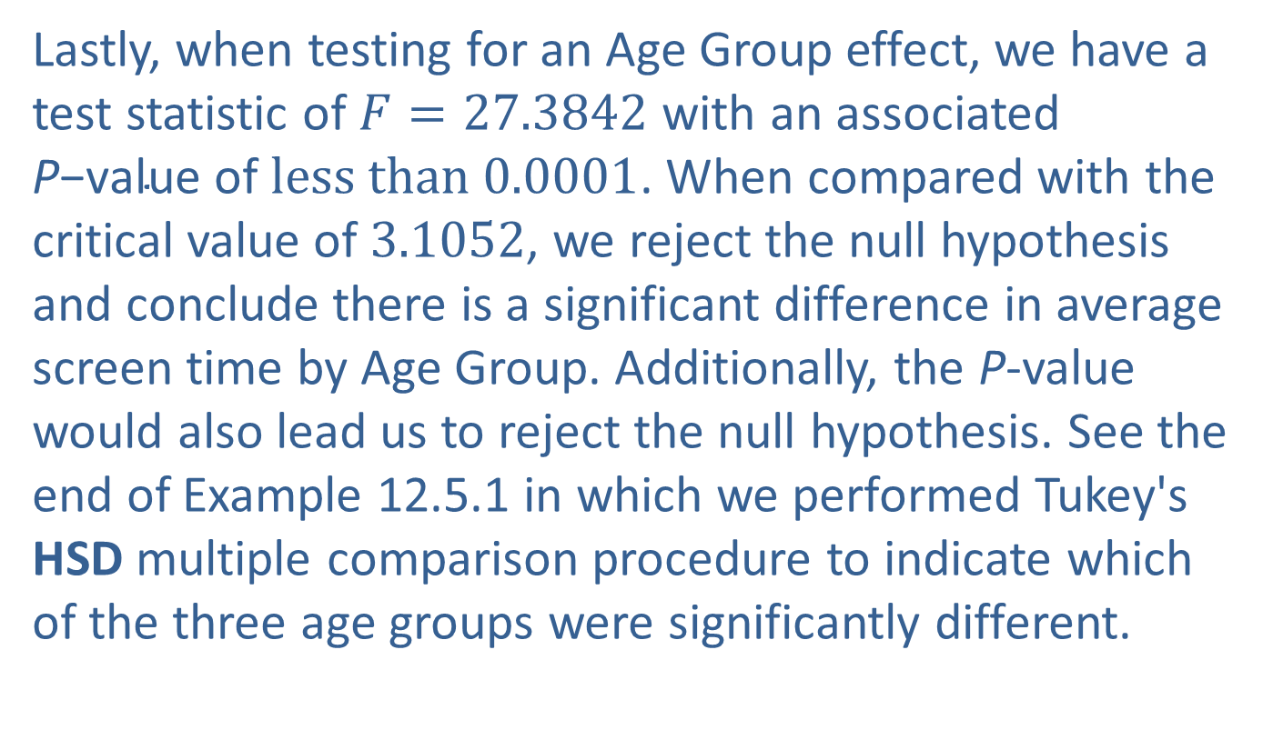
Example 1: Performing a Two-Way ANOVA with Interaction—Slide 15
Lastly, when testing for an Age Group effect, we have a test statistic of $F=27.3842$ with an associated P$\text{−}\text{value} \text{of} less than 0.0001$. When compared with the critical value of 3.1052, we reject the null hypothesis and conclude there is a significant difference in average screen time by Age Group. Additionally, the P-value would also lead us to reject the null hypothesis. See the end of Example 12.5.1 in which we performed Tukey's HSD multiple comparison procedure to indicate which of the three age groups were significantly different.

Slide 29
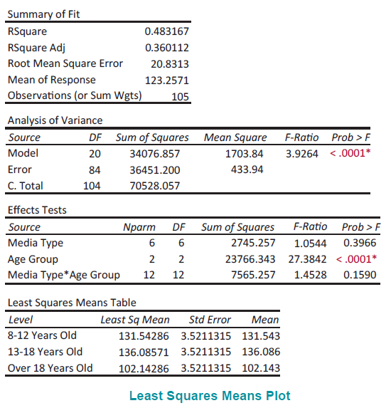
Example 1: Performing a Two-Way ANOVA with Interaction—Slide 16

Slide 30
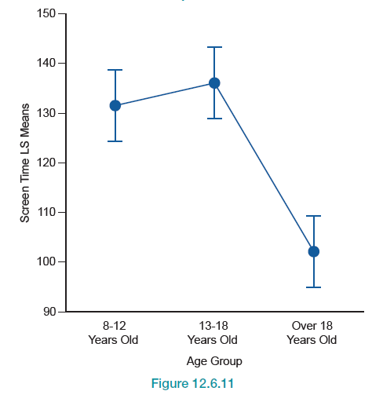
Example 1: Performing a Two-Way ANOVA with Interaction—Slide 17
Figure 11

