Slide 1
Section 13.1
The Simple Linear Regression Model

Slide 2
Definition: Regression Analysis Terms
Regression analysis is a statistical technique that describes the relationship between a dependent variable and one or more independent variables.
The dependent variable (or response variable) in a regression analysis is the variable that we want to predict.
An independent variable (or predictor variable) in a regression analysis is a variable that will be used to make predictions about the dependent variable.
Simple linear regression is the statistical technique used to study the relationship between the dependent variable and one independent variable.

Slide 3
The Simple Linear Regression Model—Slide 1
Consider the problem of deciding how long to study for an upcoming test.
Suppose, for example, the relationship between test score and study time was given by the following linear equation.
Test Score = 45 + 3.8(Hours of Study Time)

Slide 4
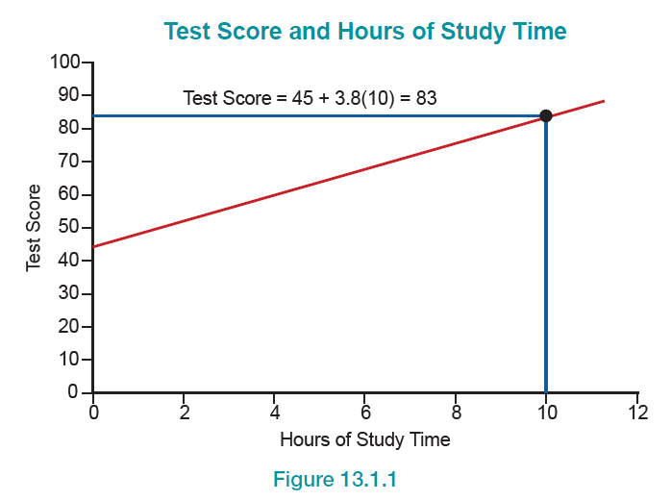
The Simple Linear Regression Model—Slide 2
Figure 1

Slide 5
The Simple Linear Regression Model—Slide 3
But suppose a model were available which, although imperfect, fairly reliably predicted test scores based on hours studied.
Test Score = 45 + 3.8(Hours of Study Time) + Error
The new model introduces the error term. Now, if someone studies 10 hours, the model would predict
Test Score = 45 + 3.8(10) + Error = 83 + Error.

Slide 6
The Simple Linear Regression Model—Slide 4
If a model admits the possibility of an error, then gauging the expected magnitude of the error is essential in determining the model’s usefulness.
The model-building process begins with a desire to find a relationship between two or more variables. A straight line is the simplest relationship between two variables. This straight-line relationship is modeled by the simple linear regression model given by the following linear equation.

Slide 7
Formula: Simple Linear Regression Model
The simple linear regression model is given by the linear equation
where
β₀ is the y-intercept for the population data,
β₁ is the slope coefficient for the population data,
x _{i} is the value of the independent (or predictor) variable for observation i,
ε _{i} is the random error in y for observation i, and
y _{i} is the value of the dependent (or response) variable for observation i.

Slide 8
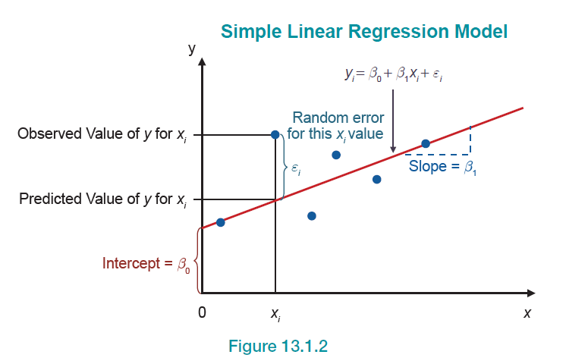
The Simple Linear Regression Model—Slide 5
Figure 2

Slide 9
The Simple Linear Regression Model—Slide 6
The slope and the intercept, β₀ and β₁, respectively, are the parameters of the simple linear regression model. If a linear relationship exists, the data will have some general tendency to move together, or in opposite directions, as in Figure 3.

Slide 10
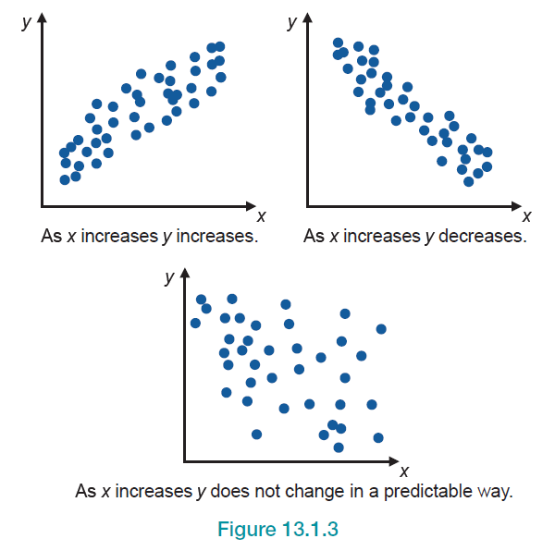
The Simple Linear Regression Model—Slide 7
Figure 3

Slide 11
The Simple Linear Regression Model—Slide 8
More often than not, bivariate data for an entire population are not available. Therefore, we must estimate the simple linear regression model using sample data. Using the data collected from the sample, we can estimate the coefficients of the simple linear regression equation and use this model for estimation and prediction.

Slide 12
Formula: Estimated Simple Linear Regression Equation
The estimated simple linear regression equation is
where b₀ and b₁ are estimates of their population counterparts. Specifically, b₀ is an estimate of β₀, and b₁ is an estimate of β₁.
is the predicted value of y for a given value of x _{i},
and is pronounced y-hat. The symbol y _{i} is reserved for the observed value of y.

Slide 13
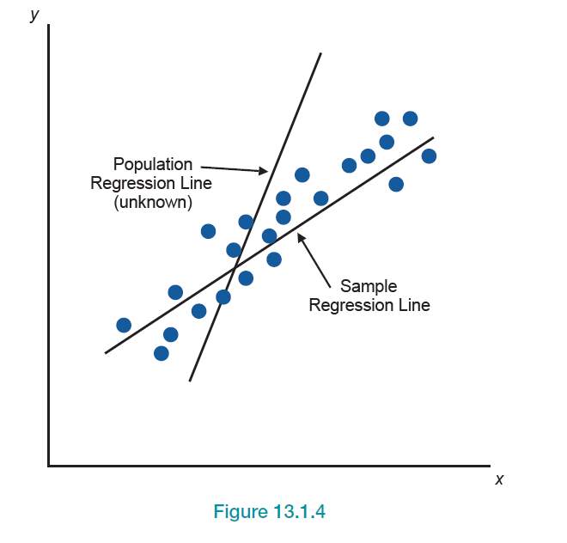
The Simple Linear Regression Model—Slide 9
Figure 4

Slide 14
Defining a Linear Relationship—Slide 1
What does it mean to specify a linear relationship between two variables? Suppose we model the relationship between two variables using
The estimated regression equation is given by
For example, letting b₀ = 3 and b₁ = 2 specifies the line
Figure 5 shows this relationship.

Slide 15
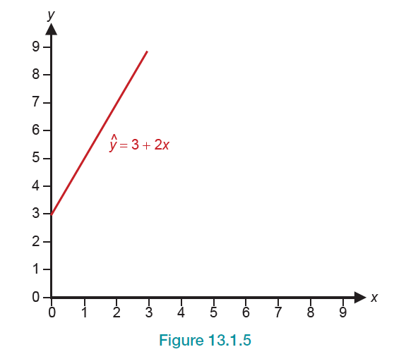
Defining a Linear Relationship—Slide 2
Figure 5

Slide 16
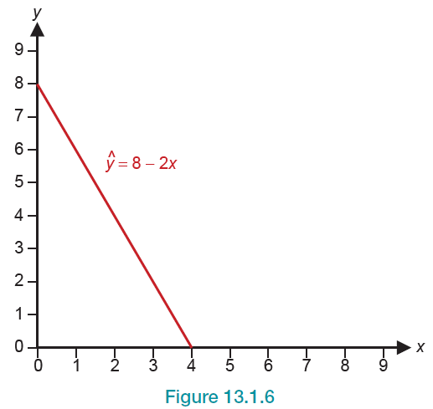
Defining a Linear Relationship—Slide 3
Letting b₀ = 8 and b₁ = −2 specifies the line
Figure 6 shows this relationship.
Figure 6

Slide 17
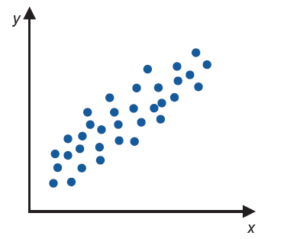
Defining a Linear Relationship—Slide 4
Consider the data plotted in Figure 7.
Figure 7

Slide 18
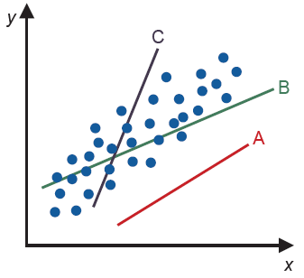
Defining a Linear Relationship—Slide 5
The data in Figure 7 seem to be related. Specifying the relationship between x and y with a linear model means finding a line that best fits the data in some way. The problem is that there are many lines that could be interpreted as fitting the data.
Figure 8

Slide 19
Defining a Linear Relationship—Slide 6
To find the best line, we must develop a method of summarizing how close each line is to the data. The closeness measure can then be used as a criterion to choose between various lines.

Slide 20
How Do We Measure How Close a Line Is to the Data?—Slide 1
One possible method of choosing the best fitting line is to use the line to predict the y-value for each observation. The superior line is the one that does the best job of predicting the observed y-values. Let’s look at a small data set.

Slide 21
How Do We Measure How Close a Line Is to the Data?—Slide 2
We plotted these data in Figure 9 and then tried to draw a line through the points. There are infinitely many lines that can be fitted to the data. However, there is no straight line that passes through all of the data points. One line that seems to fit the data reasonably well is:

Slide 22
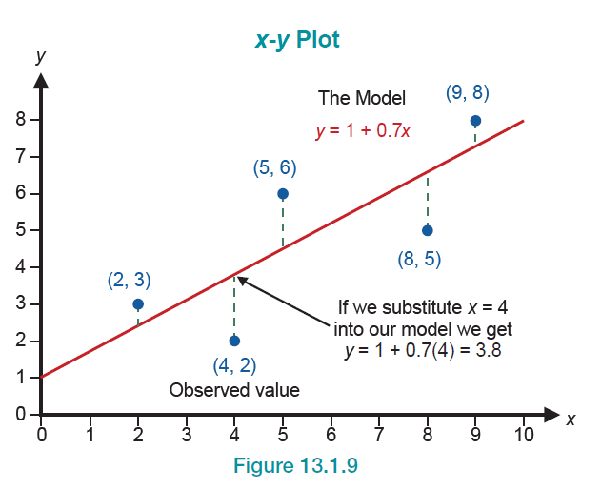
How Do We Measure How Close a Line Is to the Data?—Slide 3
Figure 9

Slide 23
Formula: Residual
A residual is calculated by

Slide 24
Formula: Sum of Squared Errors (SSE)
The sum of squared errors (SSE) is given by

Slide 25
Definition: Least Squares Line
The least squares line is the line of best fit to a set of data that results in a line with the smallest sum of squared errors (SSE).

Slide 26
Formula: Slope and y-Intercept of the Least Squares Line—Slide 1
The equation for finding the slope is given by
where
and

Slide 27
Slope and y-Intercept of the Least Squares Line—Slide 2
The slope can also be calculated using
The estimate of the intercept is given by
The x _{i} and y _{i} referred to in the expressions are the observed data values of x and y, respectively.

Slide 28
Example 1: Estimating the Slope and Intercept—Slide 1
Table 2 contains data on the number of items produced during 10 randomly selected weeks in a production factory and the total production costs. It seems obvious that in a production operation there is a relationship between the number of items produced (the independent variable, x) and the total production cost (the dependent variable, y). Using the data in Table 2 and the summary statistics below, answer the following questions.

Slide 29
Example 1: Estimating the Slope and Intercept—Slide 2
a. ​Calculate the slope and intercept for the simple linear regression equation to predict total production cost.
b. ​Create a scatter plot of the data and include the estimated regression line.
c. ​Using the estimated regression model, calculate the predicted cost for weeks 1 through 10, and the associate errors and squared errors for weeks 1 through 10.
d. Interpret the estimate of the intercept and the estimate of the slope.

Slide 30
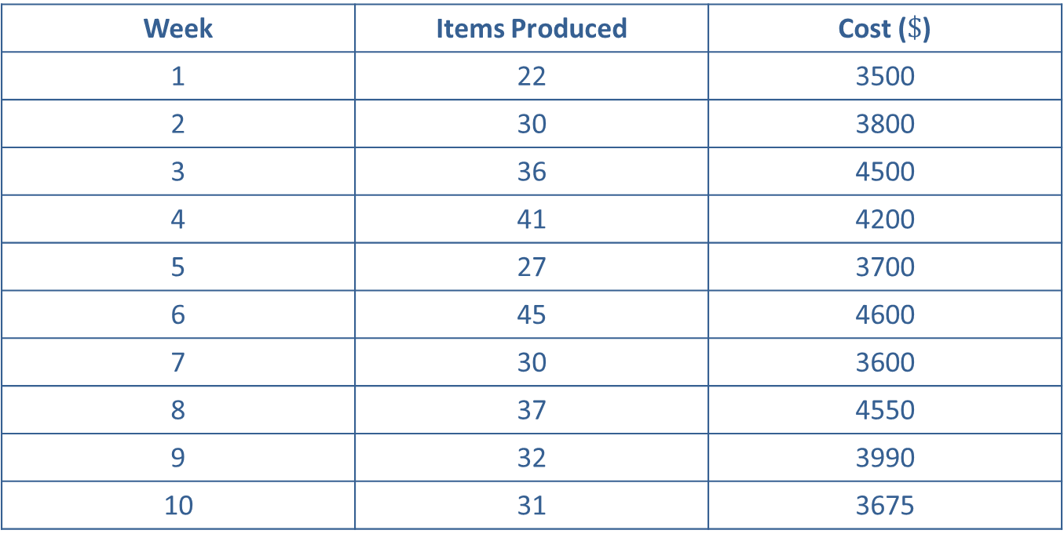
Example 1: Estimating the Slope and Intercept—Slide 3
Table 2 - Weekly Production
Week | Items Produced | Cost ($\$$)
1 | 22 | 3500
2 | 30 | 3800
3 | 36 | 4500
4 | 41 | 4200
5 | 27 | 3700
6 | 45 | 4600
7 | 30 | 3600
8 | 37 | 4550
9 | 32 | 3990
10 | 31 | 3675

Slide 31
Example 1: Estimating the Slope and Intercept—Slide 4
Some summary statistics are given below.

Slide 32
Example 1: Estimating the Slope and Intercept—Slide 5
Solution
a. ​Using the least squares equations and the summary calculations given above, we can estimate the following coefficients:
​
​

Slide 33
Example 1: Estimating the Slope and Intercept—Slide 6
​and
​
Therefore, the model to estimate the total production cost is as follows.

Slide 34
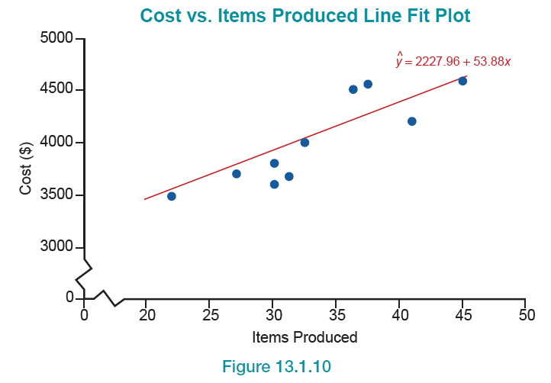
Example 1: Estimating the Slope and Intercept—Slide 7
b. Figure 10 shows a graph of this model using the estimated coefficients.
​
Figure 10

Slide 35
Example 1: Estimating the Slope and Intercept—Slide 8
​This model has a smaller SSE for these data than any other line.
c. ​In Table 3 we examine the errors produced by the least squares model. Note that the sum of the errors equals zero.

Slide 36
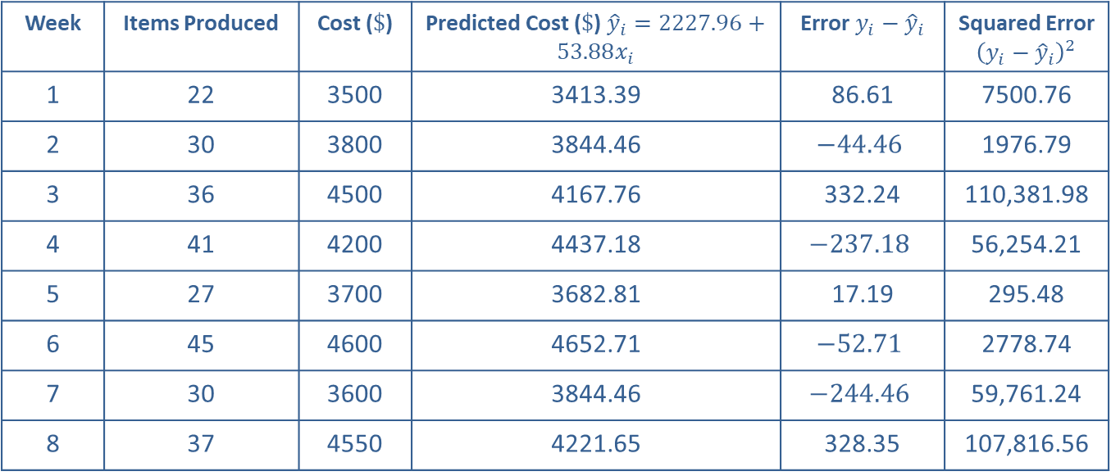
Example 1: Estimating the Slope and Intercept—Slide 9
Table 3–Errors Produced by the Least Squares Model
Week | Items Produced | Cost ($\$$) | Predicted Cost ($\$$) ${\hat{y}}_{i}=2227.96+53.88x_{i}$ | Error $y_{i}−{\hat{y}}_{i}$ | Squared Error ${\left(y_{i}−{\hat{y}}_{i}\right)}^{2}$
1 | 22 | 3500 | 3413.39 | 86.61 | 7500.76
2 | 30 | 3800 | 3844.46 | $$−44.46$$ | 1976.79
3 | 36 | 4500 | 4167.76 | 332.24 | 110,381.98
4 | 41 | 4200 | 4437.18 | $$−237.18$$ | 56,254.21
5 | 27 | 3700 | 3682.81 | 17.19 | 295.48
6 | 45 | 4600 | 4652.71 | $$−52.71$$ | 2778.74
7 | 30 | 3600 | 3844.46 | $$−244.46$$ | 59,761.24
8 | 37 | 4550 | 4221.65 | 328.35 | 107,816.56

Slide 37
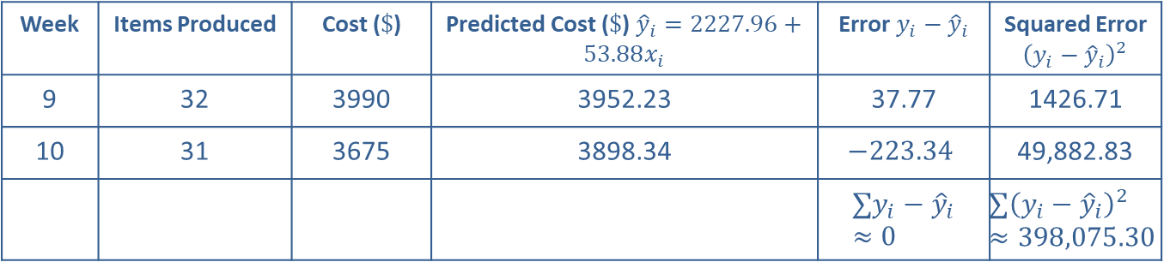
Example 1: Estimating the Slope and Intercept—Slide 10
Table 3–Errors Produced by the Least Squares Model
Week | Items Produced | Cost ($\$$) | Predicted Cost ($\$$) ${\hat{y}}_{i}=2227.96+53.88x_{i}$ | Error $y_{i}−{\hat{y}}_{i}$ | Squared Error ${\left(y_{i}−{\hat{y}}_{i}\right)}^{2}$
9 | 32 | 3990 | 3952.23 | 37.77 | 1426.71
10 | 31 | 3675 | 3898.34 | $$−223.34$$ | 49,882.83
 |  |  |  | $$∑y_{i}−{\hat{y}}_{i}≈0$$ | $$∑{\left(y_{i}−{\hat{y}}_{i}\right)}^{2}≈398,075.30$$

Slide 38
Example 1: Estimating the Slope and Intercept—Slide 11
​As you can see, in the building of the linear model, there is potential for a great deal of calculation. For most problems you will use some type of statistical analysis package or spreadsheet to compute the least squares coefficients as well as related statistics and diagnostic measures. These packages will compute a wealth of summary and diagnostic measures concerning the estimated model.

Slide 39
Example 1: Estimating the Slope and Intercept—Slide 12
d. ​Using the data and the estimated regression model, if the number of items produced is 0, then the predicted cost of production would be $2227.96, the value of b₀.

Slide 40
Example 1: Estimating the Slope and Intercept —Slide 13
​The value of b ₀ is always interpreted as the average value of the dependent variable, in this case, the total production cost, when the independent variable is set equal to zero. Since b ₁ is the estimated slope of the line, it is interpreted as the average change in the dependent variable (total production cost) for a one-unit change in the independent variable (items produced).

Slide 41
Example 1: Estimating the Slope and Intercept—Slide 14
​In our example, the independent variable is expressed in units. Therefore, for every additional unit, the total production cost is expected to increase by $53.88. If this interpretation is correct, the model's predicted cost for 27 items should be $53.88 more than that for 26 items.

Slide 42
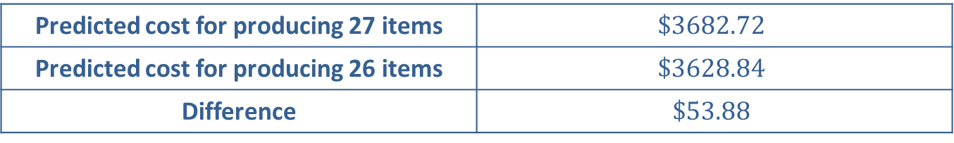
Example 1: Estimating the Slope and Intercept—Slide 15
​If 27 items are produced, then x = 27, and
​
​
If 26 items are produced, then x = 26, and
According to the model, the difference in cost between producing 27 items and 26 items is exactly equal to the slope.
Table 4 – Difference in Production Cost
Predicted cost for producing 27 items | $$\$3682.72$$
Predicted cost for producing 26 items | $$\$3628.84$$
Difference | $$\$53.88$$

Slide 43
Definition: Interpretation of the Regression Coefficients
The intercept coefficient, b₀, is the average value of the dependent variable, y, when the independent variable, x, is equal to zero.
The slope coefficient, b₁, is the average change in the dependent variable, y, for a one-unit change in the independent variable, x.

Slide 44
Formula: Mean Square Error
The variance of the error terms is also known as the mean square error and is given by:

Slide 45
Assumptions about the Error Term in the Linear Model
1. ​The average response at each value of the independent variable is a linear function. That is, there is a linear relationship between x and y.
2. ​The errors, ε _{i}, are assumed to be independent of each other.
3. ​The errors, ε _{i}, at each value of x _{i} are normally distributed.
4. ​The errors, ε _{i}, at each value of x _{i} have equal variances,

