Slide 1
Section 13.2
Residual Analysis

Slide 2
Residual Analysis—Slide 1
When performing regression analysis, residual analysis is a useful technique to help us determine if the model we are using is appropriate. By studying the estimated errors (i.e., the residuals), we can check the underlying assumptions of the regression model.

Slide 3
Residual Analysis—Slide 2
All estimates, intervals, and hypothesis tests in regression analysis are based on assuming that the model is correct. If the model is not correct (i.e., at least one of the assumptions is not valid), the formulas and methods will also be incorrect.
Validating the assumptions of the simple linear regression model revolve around the error term (ε). You may recall that the assumptions of the simple linear regression model are: ​

Slide 4
Residual Analysis—Slide 3
1. The average response at each value of the independent variable is a linear function. That is, there is a linear relationship between x and y.
2. The errors, ε _{i}, are assumed to be independent of each other.
3. The errors, ε _{i}, at each value of x _{i} are normally distributed.
4. The errors, ε _{i}, at each value of x _{i} have equal variances,

Slide 5
Residual Analysis—Slide 4
One method of validating the assumptions is by performing a graphical analysis of the residuals. The most frequently used graph is that of the residuals (e _{i} ) vs. the fitted values
In Figure 1, (a) is a scatterplot of the raw data, y vs. x, with a simple linear regression line fit through the data. Note that the scatterplot is somewhat curvilinear.

Slide 6
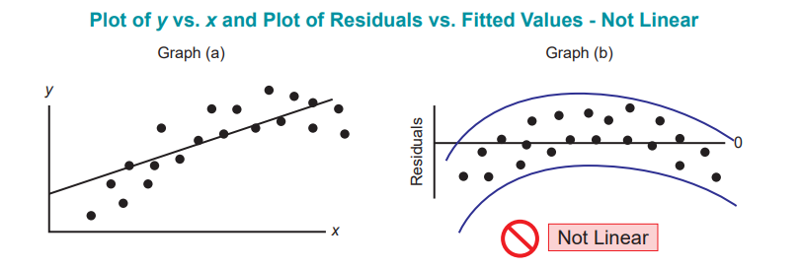
Residual Analysis—Slide 5
Figure 1

Slide 7
Residual Analysis—Slide 6
In general, a well-behaved residual plot will have data points that are randomly scattered around the zero line if the data follow a linear pattern.

Slide 8
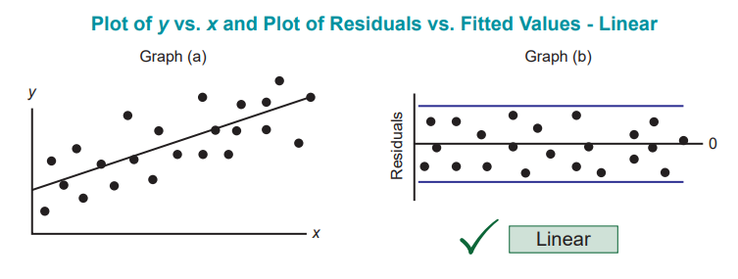
Residual Analysis—Slide 7
Figure 2

Slide 9
Residual Analysis—Slide 8
We can also look at the residual plots to determine if the errors are independent. Figure 3 is a plot of the residuals vs. x and shows a random scatter of the observations about the horizontal line y = 0. Given that there is no pattern associated with the residual plot, it is an indication that the errors are independent of each other, upholding the independence assumption.

Slide 10
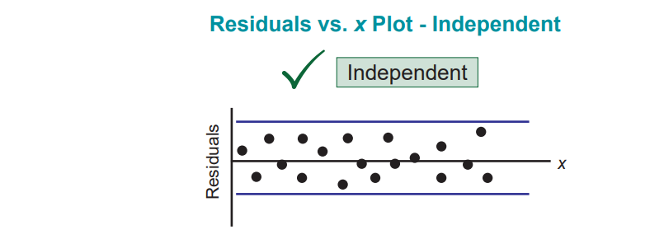
Residual Analysis—Slide 9
Figure 3

Slide 11
Residual Analysis—Slide 10
Figure 4, however, shows two residual plots that indicate the existence of a pattern. Figure 4(a) shows that there is a linear trend between the residuals and the independent variable, x. If a pattern exists, this is an indication that there is a relationship between the independent variable and the residual which violates the assumption of independence. Similarly, Figure 4(b) also shows a sigmoidal relationship between the residuals and the independent variable—another example of a violation of the assumption of independence.

Slide 12
Definition: Sigmoidal Relationship
A sigmoidal relationship exists between two variables if a scatterplot of the variables looks S-shaped.

Slide 13
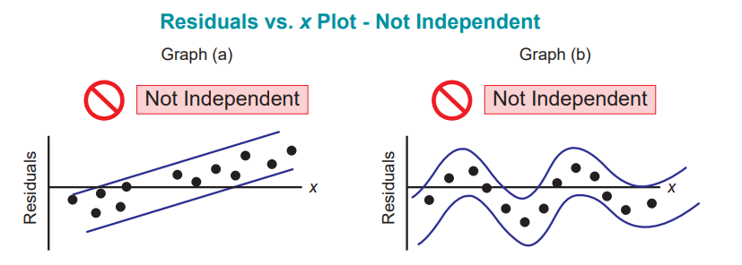
Residual Analysis—Slide 11
Figure 4

Slide 14
Residual Analysis—Slide 12
The third assumption listed above is that for each value of the independent variable, x _{i} , the errors are normally distributed. There are several techniques that we can employ to verify the assumption of normality. We could do the following:
Examine the stem-and-leaf display of the residuals
Examine the boxplot of the residuals
Examine the histogram of the residuals
Construct a normal probability plot of the residuals
Perform a formal test in JMP called the Shapiro-Wilk W Test

Slide 15
Definition: Normal Probability Plot
A normal probability plot is a graphical technique used to identify significant departures from normality. The data are plotted against a theoretical normal distribution. The points should form an approximate straight line if they are normally distributed.

Slide 16
Residual Analysis—Slide 13
One of the most common graphical techniques, and the one that we will employ in this section, is that of the normal probability plot. A normal probability plot is a plot of the theoretical percentiles of the normal distribution versus the observed sample percentiles.

Slide 17
Residual Analysis—Slide 14
When examining a normal probability plot, it should be approximately linear. Given that we are interested in the normality of the residuals, we create a plot of the residuals. Figure 5 which is an example of a normal probability plot. The residuals vs. percentiles nearly fall on a straight line and thus the assumption of normality is upheld.

Slide 18
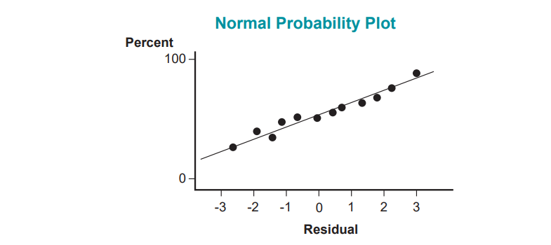
Residual Analysis—Slide 15
Figure 5

Slide 19
Residual Analysis—Slide 16
The last assumption listed above is the equality of variance. Figure 6 contains a plot of the raw data (y vs. x) as well as a plot of the residuals vs. x. The assumption is that for each value of x _{i} , the variance of the error term is constant. The plot in Figure 6 shows that as the independent variable x increases, the spread of the responses (y) also increases. This is an indication that the variance is not constant across all values of x, thus violating the equal variance assumption.

Slide 20
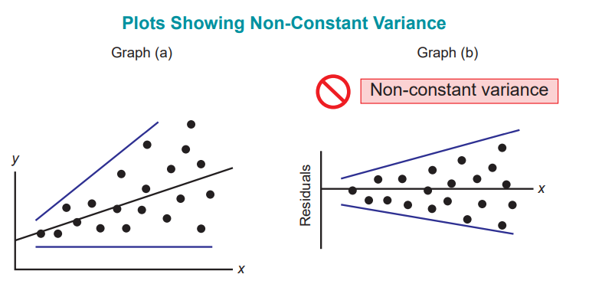
Residual Analysis—Slide 17
Figure 6

Slide 21
Residual Analysis—Slide 18
Figure 7 contains a plot of the raw data (y vs. x) and a plot of the residuals vs. x. Note that in both plots, as x increases, the spread is constant which indicates that the variance is constant. Thus, the assumption of equal variance across all values of x is not violated.

Slide 22
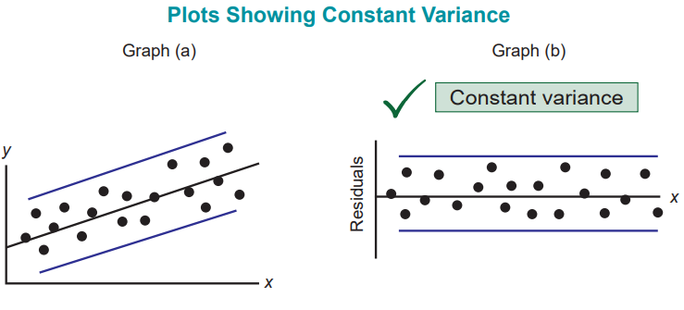
Residual Analysis—Slide 19
Figure 7

Slide 23
Example 1: Simple Linear Regression of Age by Screen Time—Slide 1
Please recall the examples in Chapter 12 regarding media use by tweens, teens, and adults. The data in the table below shows the age and the amount of time spent on cell phones, watching online videos, watching television, and playing mobile video games. Using the data in the table, answer the following questions.

Slide 24
Example 1: Simple Linear Regression of Age by Screen Time—Slide 2
a. ​Create a scatterplot of age versus screen time. By examining the scatterplot, do you believe that the data follow a straight line?
b.​ Determine the least squares line and plot it on the scatterplot.
c.​ Perform residual analysis to check the assumptions of linearity, independence, normality, and equal variance. Are any of the assumptions violated? Justify your answer.

Slide 25
Example 1: Simple Linear Regression of Age by Screen Time—Slide 3
Table 1 – Screen Time Comparison Data
Age Group | Age | Screen Time (in Minutes)
8–12 Years Old | 10 | 135
8–12 Years Old | 11 | 112
8–12 Years Old | 10 | 138
8–12 Years Old | 8 | 142
8–12 Years Old | 10 | 105
 | …
Over 18 Years Old | 59 | 113

Slide 26
Example 1: Simple Linear Regression of Age by Screen Time—Slide 4
Solution
a. ​Figure 8 shows the scatterplot of the data along with the least squares line. The scatterplot appears to be linear in that as the age of the respondent increases, the amount of time spent on mobile devices decreases. Thus, the scatterplot shows that fitting a straight line to the data is appropriate.
​

Slide 27
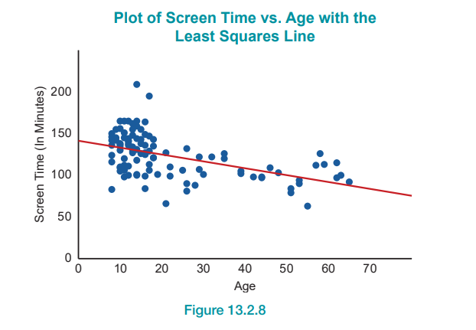
Example 1: Simple Linear Regression of Age by Screen Time—Slide 5
Figure 8

Slide 28
Example 1: Simple Linear Regression of Age by Screen Time—Slide 6
b.​ Figure 9 is the JMP output containing the estimates of the slope and intercept. The fitted regression line is
Screen Time = 141.39 − 0.82 Age.
​
Least Squares Estimates of the Slope and Intercept Parameter Estimates
Term | Estimate | Std Error | t ratio | Prob >|t|
Intercept | 141.38892 | 3.811268 | 37.10 | <.0001*
Age | -0.824529 | 0.141103 | -5.84 | <.0001*
Figure 9

Slide 29
Example 1: Simple Linear Regression of Age by Screen Time—Slide 7
​Additionally, the P-value associated with the hypotheses
​
is < 0.0001 which implies that we reject the null hypothesis and conclude that the slope is significantly different from zero. Rejecting this hypothesis implies that fitting a straight line through the data is appropriate.

Slide 30
Example 1: Simple Linear Regression of Age by Screen Time—Slide 8
c. ​To test the assumptions of the regression analysis, we must check for linearity, independence of the errors, normality of the errors, and equal variance. First of all, the scatterplot in part a. shows that the data follow a linear pattern which validates the linearity assumption. Also, if we examine the residual plot of Age vs. Screen Time (in Minutes) Residuals in Figure 10, it shows a random scatter which is an indication that the straight-line fit to the data is appropriate, upholding the linearity assumption.
​

Slide 31
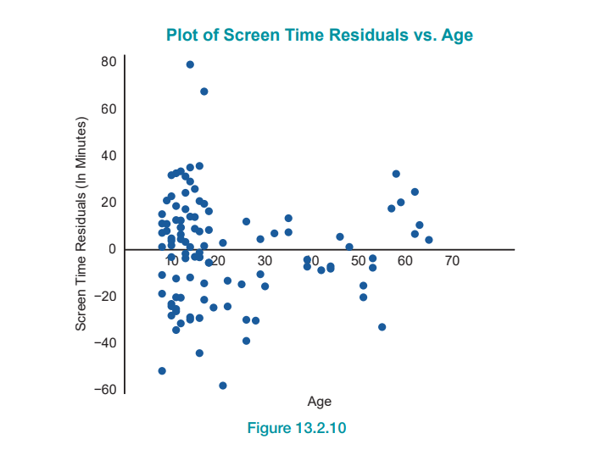
Example 1: Simple Linear Regression of Age by Screen Time—Slide 9
Figure 10

Slide 32
Example 1: Simple Linear Regression of Age by Screen Time—Slide 10
​Given that the residual plot in Figure 10 does not follow a pattern, it also upholds the assumption that the data are independent (i.e., the errors at each value of age are independent).
​The normal probability plot of the residuals (Screen Time (in Minutes) Residuals) is given in Figure 11. Note that almost all of the data fall on the diagonal line, which is an indication that the errors are normally distributed.
​

Slide 33
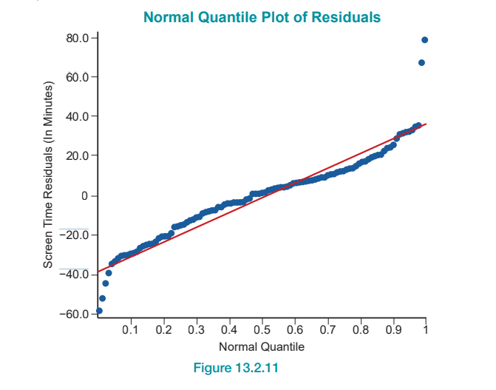
Example 1: Simple Linear Regression of Age by Screen Time—Slide 11
Figure 11

Slide 34
Example 1: Simple Linear Regression of Age by Screen Time—Slide 12
​Lastly, we need to examine the equal variance assumption. Examining the residual plot (Figure 10), there appears to be random scatter above and below the zero-line. The nonexistence of a pattern between the independent variable (Age) and the residuals leads us to conclude that the variance is constant across the values of the independent variable.

Slide 35
Example 1: Simple Linear Regression of Age by Screen Time—Slide 13
It is important to validate the assumptions when performing a regression analysis. Depending on which assumption is violated, the results may still be meaningful. Note that hypothesis tests, confidence intervals, and prediction intervals are sensitive to departures from independence and departures from equal variance. Hypothesis tests and confidence intervals for the slope and intercept are robust against departures from normality. Lastly, prediction intervals are very sensitive to departures from normality.

