Slide 1
Section 13.3
Evaluating the Fit of the Linear Regression Model

Slide 2
Evaluating the Fit of the Linear Regression Model—Slide 1
The goal in constructing most linear models is to use the independent variable, x, to explain or predict the dependent variable, y. The question we want to consider is, how much of the variation in y can be explained with the model? Before determining how much variation the model explains, it will be necessary to evaluate how much variability exists in the
y-variable. This quantity is called the total sum of squares (TSS) and represents the total variation in the dependent variable, y.

Slide 3
Formula: Total Sum of Squares (TSS)
The total variation in y is given by the total sum of squares (TSS).

Slide 4
Evaluating the Fit of the Linear Regression Model—Slide 2
If you think TSS looks a great deal like the numerator of the formula for the sample variance, you are right. TSS is the sum of the squared deviations about the mean of the dependent variable, y. If TSS were divided by n − 1 it would be the sample variance of y.

Slide 5
Evaluating the Fit of the Linear Regression Model—Slide 3
What is an Error?
An error
represents the model’s inability to
predict the variation in the dependent variable, y. Adding all of the squared errors accumulates the total of all unexplained variation.
The variation in y can be divided into two categories, unexplained and explained. Total variation must equal unexplained variation plus explained variation.

Slide 6
Evaluating the Fit of the Linear Regression Model—Slide 4
TSS = Unexplained Variation + Explained Variation
or
TSS = SSE + Explained Variation
Denoting explained variation as SSR (sum of squares of regression) produces
TSS = SSE + SSR (TSS is the total unexplained and explained variation in y).
Solving this equation for SSR results in SSR = TSS − SSE.

Slide 7
Formula: Sum of Squares of Regression (SSR)
The explained variation in y is given by the sum of squares of regression, which is equal to the total variation minus the unexplained variation.
SSR = TSS − SSE

Slide 8
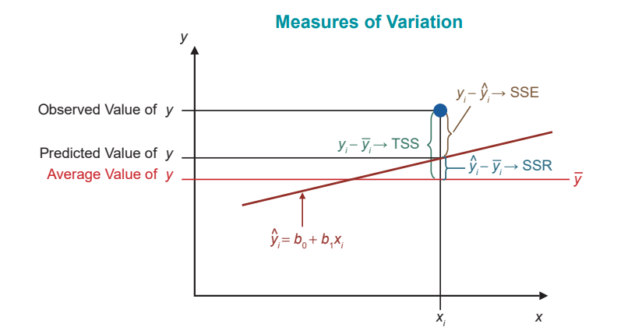
Evaluating the Fit of the Linear Regression Model—Slide 5
Figure 1

Slide 9
Formula: Coefficient of Determination—Slide 1
The coefficient of determination, R², is given by
The coefficient of determination is a value between 0 and 1, inclusive. That is, 0 ≤ R² ≤ 1.

Slide 10
Example 1: Explaining Variation in a Linear Model—Slide 1
An entrance exam given at a private college has been used for years as a predictor of academic success. If these test scores are predictors of academic success, they should be positively related to the grade point average upon graduation. Thirty graduates of the college were sampled and their grade point averages (GPA) upon graduation and entrance exam test scores reported upon admission are recorded in the following table.

Slide 11
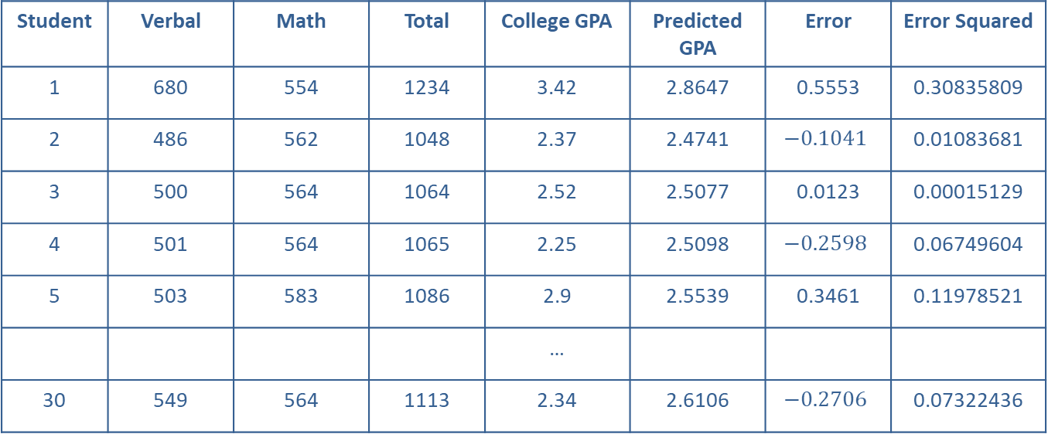
Example 1: Explaining Variation in a Linear Model—Slide 2
Table 1 – Test Scores and Graduating GPA
Student | Verbal | Math | Total | College GPA | Predicted GPA | Error | Error Squared
1 | 680 | 554 | 1234 | 3.42 | 2.8647 | 0.5553 | 0.30835809
2 | 486 | 562 | 1048 | 2.37 | 2.4741 | $$−0.1041$$ | 0.01083681
3 | 500 | 564 | 1064 | 2.52 | 2.5077 | 0.0123 | 0.00015129
4 | 501 | 564 | 1065 | 2.25 | 2.5098 | $$−0.2598$$ | 0.06749604
5 | 503 | 583 | 1086 | 2.9 | 2.5539 | 0.3461 | 0.11978521
 |  |  |  | …
30 | 549 | 564 | 1113 | 2.34 | 2.6106 | $$−0.2706$$ | 0.07322436

Slide 12
Data
The Test Scores and Graduating GPA data set can be found on stat.hawkeslearning.com under Discovering Business Statistics, Second Edition → Data Sets → Test Scores and Graduating GPA.

Slide 13
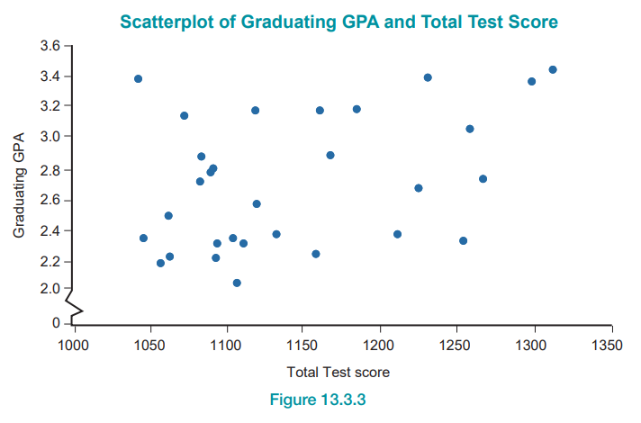
Example 1: Explaining Variation in a Linear Model—Slide 3
Figure 3

Slide 14
Example 1: Explaining Variation in a Linear Model—Slide 4
The scatterplot in Figure 3 suggests that as test scores increase the GPA tends to increase, although there is a substantial amount of variability in the relationship. The upward sloping pattern of the data suggests a linear model could be constructed. However, a great deal of variation in the model's errors should be expected. What percent of the variation in final grade point average can be explained by the model relating total test score to graduating GPA?

Slide 15
Example 1: Explaining Variation in a Linear Model—Slide 5
Solution
Using the least squares method, the estimated model is given by
Estimate Graduating GPA = 0.2733 + 0.0021(Total Test Score).

Slide 16
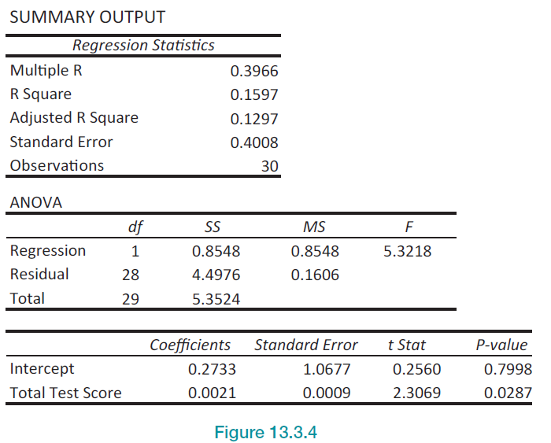
Example 1: Explaining Variation in a Linear Model—Slide 6
Figure 4

Slide 17
Example 1: Explaining Variation in a Linear Model—Slide 7
When we studied the production model, a list of predicted values and errors for each observed value was given. Instead of providing a list of the errors for each of the observed values in the GPA model, let's summarize the errors from the model. In particular,

Slide 18
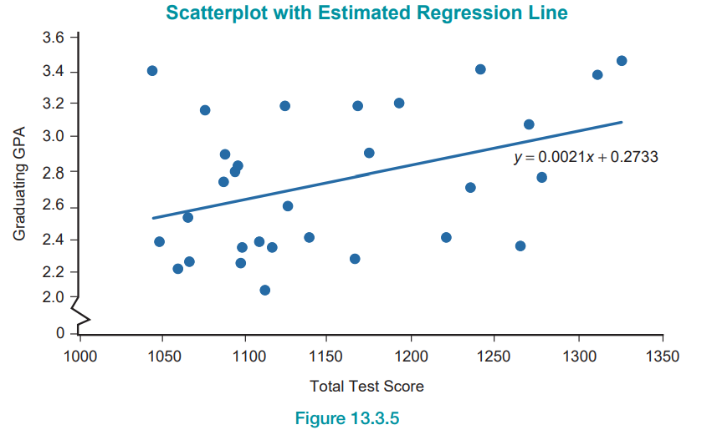
Example 1: Explaining Variation in a Linear Model—Slide 8
Figure 5

Slide 19
Example 1: Explaining Variation in a Linear Model—Slide 9
One of the differences in the production model and the GPA model is the manner in which the models seem to fit the data. In the production model, the data seemed to fit closely around the line, while in the GPA model the data are loosely clustered about the line.

Slide 20
Example 1: Explaining Variation in a Linear Model—Slide 10
While tight and loose are interesting portrayals of the relative fit of the models to the data, it would be desirable to have a numerical measure to describe fit. R² is such a measure.
Thus, approximately 16% of the variation in graduating GPA is explained by the linear model.

Slide 21
Formula: Coefficient of Determination—Slide 2
The coefficient of determination, R², can be calculated using the equation

