Slide 1
Section 13.4
Fitting a Linear Time Trend

Slide 2
Definition: Linear Time Trend Model
A linear time trend model is a linear model used to model the changes in some phenomenon over time; the independent variables is always a time index.

Slide 3
Example 1: Modeling Data with a Linear Time Trend—Slide 1
Many analysts believe that college tuition prices may soon be in the same situation as housing prices were when the housing bubble burst (causing home prices to drop significantly). Table 1 contains data for the Tuition Consumer Price Index (TCPI) from 1978 to 2020. Use a linear time trend to model the data.

Slide 4
Example 1: Modeling Data with a Linear Time Trend—Slide 2
Table 1 – Tuition Consumer Price Index, 1978-2020
Year | TCPI
1978 | 59.9
1979 | 64.7
1980 | 70.8
1981 | 79.6
… | …
2020 | 877.3

Slide 5
Data
This data set can be found on stat.hawkeslearning.com under Discovering Business Statistics, Second
Edition → Data Sets → Tuition Consumer Price Index.

Slide 6
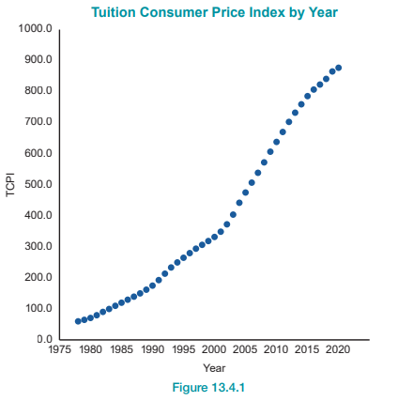
Example 1: Modeling Data with a Linear Time Trend—Slide 3
Solution
Figure 1

Slide 7
Example 1: Modeling Data with a Linear Time Trend—Slide 4
A graph of the data reveals an upward trend in the tuition consumer price index. The data appear to be a nonstationary time series with an upward trend. To describe the data, we will model the trend by fitting a line through the data with the notion of capturing how fast (on average) the series is changing over time. Estimating the slope of the line will provide the average rate of change per year in the TCPI. The line is fitted using least squares estimates in exactly the same way as other regression models have been constructed.

Slide 8
Example 1: Modeling Data with a Linear Time Trend—Slide 5
The independent variable in a linear trend model is always time. In this case, the dependent variable is TCPI.
The estimated least squares equation is
Estimated TCPI = −41295.44 + 20.8547 (Year)
The JMP output for the problem is given in Figure 2.

Slide 9
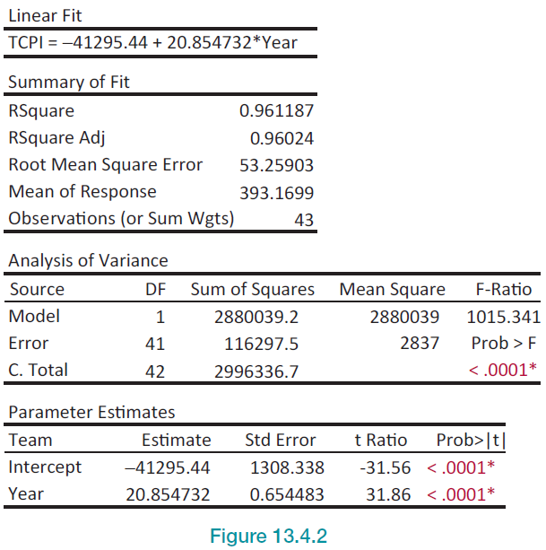
Example 1: Modeling Data with a Linear Time Trend—Slide 6
Figure 2

Slide 10
Example 1: Modeling Data with a Linear Time Trend—Slide 7
The estimate of the slope, 20.8547, tells us that on average the TCPI is increasing at a rate of 20.8547 per year. Given how well the line fits the data (R² ≈ 0.9612), the trend line is a good descriptor of the data.

Slide 11
Example 1: Modeling Data with a Linear Time Trend—Slide 8
The trend line can also be used for short-term prediction. Suppose you wanted to estimate the TCPI for 2021. If the data are not available, the trend model can be used.
(Prediction of the TCPI for 2021)

