Slide 1
Section 13.5
Inference Concerning the Slope

Slide 2
Inference Concerning the Slope—Slide 1
The Confidence Interval for β₁
Developing a confidence interval for β₁ requires thinking about the estimate b₁ as a random variable. Each random sample from the population will produce different data and hence different estimates of b₀ and b₁. The confidence interval will serve two purposes: to place bounds on the location of β₁ and to provide information about the quality of the point estimate, b₁. The form of the confidence interval is familiar.

Slide 3
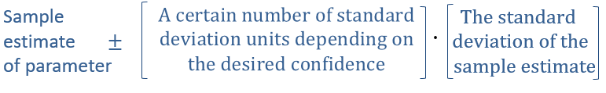
Inference Concerning the Slope—Slide 2
The sample estimate of β₁ is b₁. The variance of b₁ is given by
but like all population measurements,
usually has to be estimated from the data.

Slide 4
Inference Concerning the Slope—Slide 3
Notice that the denominator of the expression above is equal to the variance of x, multiplied by the sample size, n. This indicates that the variance of b₁ is reduced if the variance of the error terms decreases, the sample size increases, or the variance of x increases.

Slide 5
Inference Concerning the Slope—Slide 4
The sample estimate of the variance of b₁ is given by

Slide 6
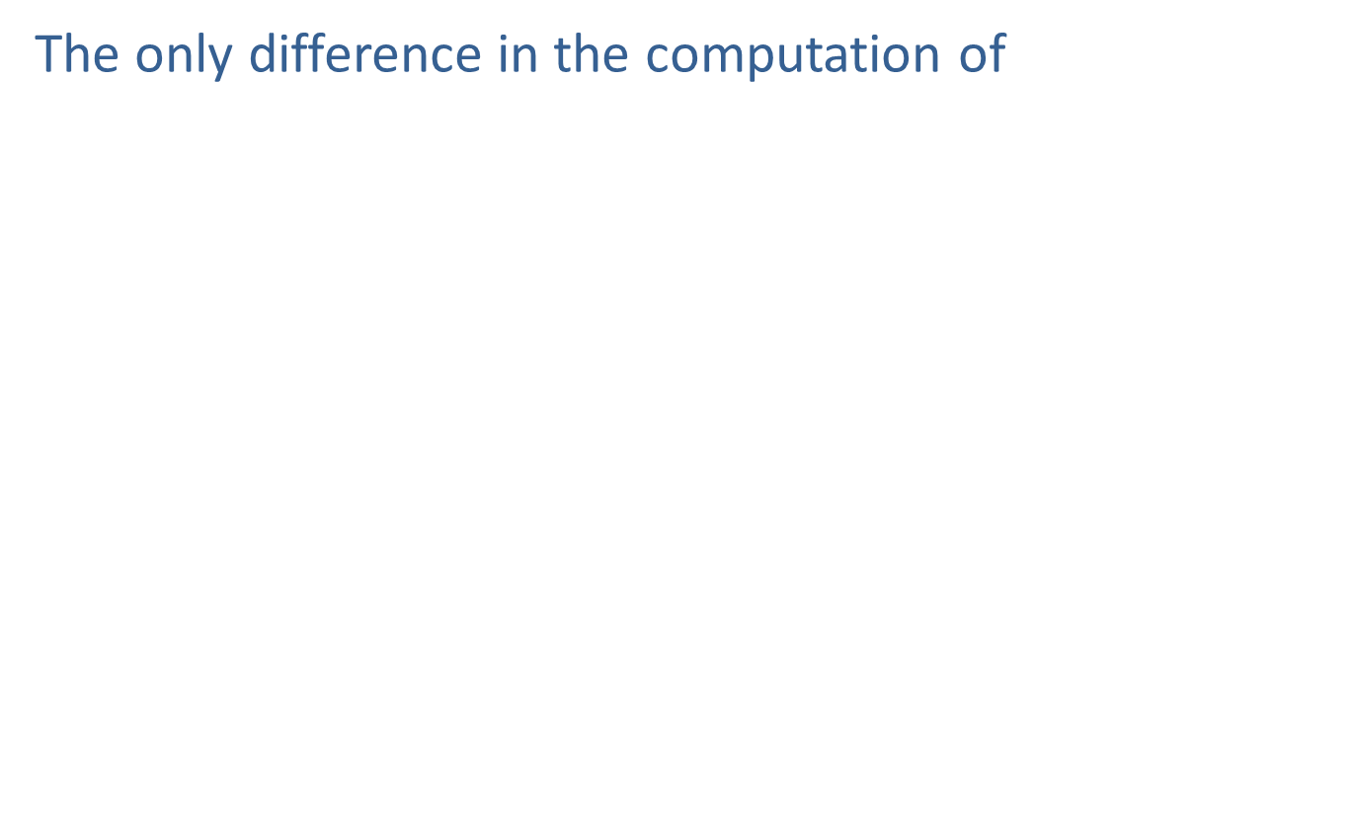
Inference Concerning the Slope—Slide 5
The only difference in the computation of
is the replacement of the population variance of the
error terms
with the corresponding sample
statistic,
The standard deviation (standard error) of
the sample estimate b₁ is

Slide 7

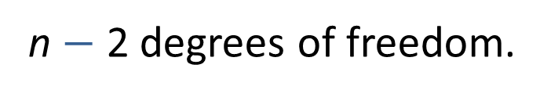
Formula: 100(1 $−$ α)% Confidence Interval for β₁
The 100(1 − α)% Confidence Interval for β₁ is given by
Where
is the critical value for a t-distribution with
n $−$ 2 degrees of freedom.

Slide 8

Inference Concerning the Slope—Slide 6
The expression
creates the following
interval.
The expression
relates the width of the interval to
the amount of confidence required.

Slide 9

Inference Concerning the Slope—Slide 7
Recall that the t-distribution is very similar to the
z-distribution. To use the t-distribution requires that its degrees of freedom be specified. In this case the degrees of freedom are df = n $−$ 2.

Slide 10

Inference Concerning the Slope—Slide 8
If a 95% confidence interval is desired, then 1 $−$ α = 0.95,
which implies α = 0.05 and
Suppose the sample size is n = 20. Using the tables for
the t-distribution in Appendix A,
would be

Slide 11
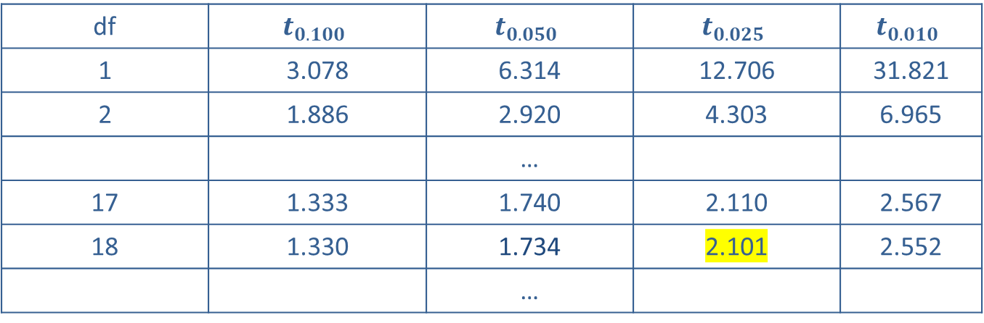
Inference Concerning the Slope—Slide 9
df | $$t_{0.100}$$ | $$t_{0.050}$$ | $$t_{0.025}$$ | $$t_{0.010}$$
1 | 3.078 | 6.314 | 12.706 | 31.821
2 | 1.886 | 2.920 | 4.303 | 6.965
 |  | …
17 | 1.333 | 1.740 | 2.110 | 2.567
18 | 1.330 | 1.734 | 2.101 | 2.552
 |  | …
Hence, to be 95% confident in capturing the true value of β₁ in the confidence interval will require placing the interval endpoints 2.101 standard deviation units from the point estimate, b₁.

Slide 12
Example 1: Estimating a Confidence Interval for the Slope—Slide 1
Table 1 Weekly Production
Week | Items Produced | Cost ($)
1 | 22 | 3500
2 | 30 | 3800
3 | 36 | 4500
4 | 41 | 4200
5 | 27 | 3700
6 | 45 | 4600
7 | 30 | 3600
8 | 37 | 4550
9 | 32 | 3990
10 | 31 | 3675

Slide 13
Example 1: Estimating a Confidence Interval for the Slope—Slide 2
In Section 13.1, a model relating the number of items produced to total cost was constructed.
Cost = β₀ + β₁ (Items Produced) + ε _{i}
If the relationship is to be applicable for the entire production process, then a substantial amount of data will be required, more than we could hope to collect.

Slide 14
Example 1: Estimating a Confidence Interval for the Slope—Slide 3
If the data given in Table 1 are considered a random sample of weekly production, then a relationship can be constructed from the sample data. Specifically, the estimated least squares regression line relating items produced to total cost is
Estimated Cost = $2227.96 + $53.88(Items Produced),
Where
b₀ = $2227.96 (the sample estimate of β₀ the y-intercept), and
b₁ = $53.88 (the sample estimate of β₁, the slope).

Slide 15
Example 1: Estimating a Confidence Interval for the Slope—Slide 4
Note: Both estimates were determined using Microsoft Excel and rounded to the nearest hundredth.

Slide 16
Example 1: Estimating a Confidence Interval for the Slope—Slide 5
To draw conclusions about the relationship between items produced and total cost for the entire population, statistical inference must be applied. We will begin by estimating a 95% confidence interval for β₁.

Slide 17
Example 1: Estimating a Confidence Interval for the Slope—Slide 6
Solution
Three pieces of information are required to calculate a confidence interval for β₁.
1.​ A sample estimate of β₁
2.​ A t-value corresponding to the level of confidence and the degrees of freedom associated with the data used to estimate the model
3.​ A sample estimate of the standard deviation of
b₁,
Estimating the least squares line from the sample data produces b₁ = 53.88.

Slide 18
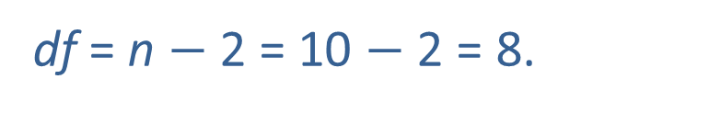
Example 1: Estimating a Confidence Interval for the Slope—Slide 7
Since 95% confidence is required, α = 0.05, and
Degrees of freedom will be
df = n $−$ 2 = 10 $−$ 2 = 8.
Thus,
The remaining piece of missing information is the standard deviation of b₁,

Slide 19
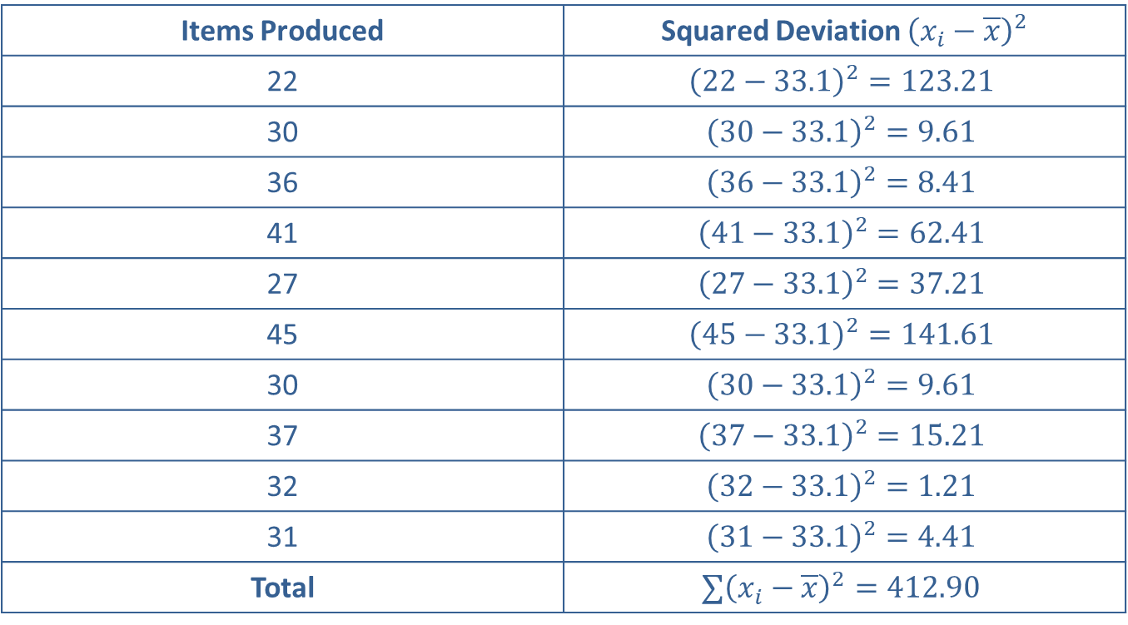
Example 1: Estimating a Confidence Interval for the Slope—Slide 8
Table 2 Squared Deviation
Items Produced | Squared Deviation ${\left(x_{i}−\overline{x}\right)}^{2}$
22 | $${\left(22−33.1\right)}^{2}=123.21$$
30 | $${\left(30−33.1\right)}^{2}=9.61$$
36 | $${\left(36−33.1\right)}^{2}=8.41$$
41 | $${\left(41−33.1\right)}^{2}=62.41$$
27 | $${\left(27−33.1\right)}^{2}=37.21$$
45 | $${\left(45−33.1\right)}^{2}=141.61$$
30 | $${\left(30−33.1\right)}^{2}=9.61$$
37 | $${\left(37−33.1\right)}^{2}=15.21$$
32 | $${\left(32−33.1\right)}^{2}=1.21$$
31 | $${\left(31−33.1\right)}^{2}=4.41$$
Total | $$∑{\left(x_{i}−\overline{x}\right)}^{2}=412.90$$

Slide 20
Example 1: Estimating a Confidence Interval for the Slope—Slide 9
Determining
will require the knowledge of two
quantities: the mean square error,
and the sum of
the squared deviations of the independent variable,
The mean square error was computed in Section 13.1 as follows.

Slide 21
Example 1: Estimating a Confidence Interval for the Slope—Slide 10
The sum of the squared deviations of the independent variable (items produced),
is given in Table 2.
Thus, the standard deviation of b₁ is calculated as follows.

Slide 22
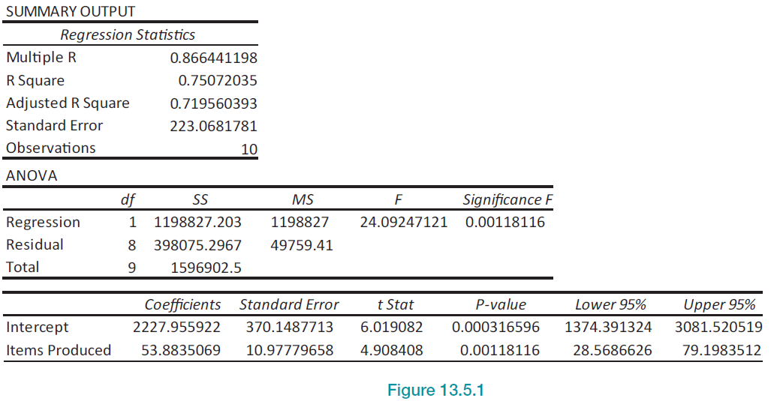
Example 1: Estimating a Confidence Interval for the Slope—Slide 11
Figure 1

Slide 23
Example 1: Estimating a Confidence Interval for the Slope—Slide 12
The manual calculation of
is tedious. Virtually every
statistical analysis program that performs regression
analysis calculates
The summary output from
Microsoft Excel is given in Figure 1.

Slide 24
Example 1: Estimating a Confidence Interval for the Slope—Slide 13
Most software packages will automatically include a confidence interval for β₁ or it will include the pieces required to compute a confidence interval. Microsoft Excel automatically displays the 95% confidence interval for β₁ and is capable of displaying an interval for any level of confidence you choose.

Slide 25
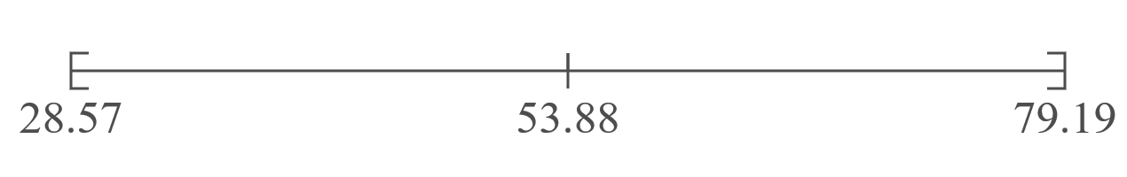
Example 1: Estimating a Confidence Interval for the Slope—Slide 14
95% Confidence Interval for β₁

Slide 26
Example 1: Estimating a Confidence Interval for the Slope—Slide 15
Putting the pieces together results in an interval which spans from $28.57 to $79.19. We are 95% confident that this interval contains the true value of β₁. There are two possible interpretations of this interval.
1.​ We are 95% confident that the true increase in total cost from producing one additional item is between $28.57 and $79.19.
2.​ We are 95% confident the maximum error of the point estimate (b₁ = 53.88) in estimating the unknown β₁ (the true increase in total cost from producing one additional item) is at most $25.31.

Slide 27
Example 1: Estimating a Confidence Interval for the Slope—Slide 16
Notes: The "confidence" we are discussing is in the procedure, not in the specific interval 28.57 to 79.19. Since the hand calculation of the confidence interval for β₁ used values that were rounded, the interval varies slightly from what is reported by Microsoft Excel. Using unrounded values in Excel, the confidence interval for β₁ is given as 28.57 to 79.20, rounded to two decimal places (see Figure 1).

Slide 28
Example 2: Constructing a Confidence Interval for the Slope—Slide 1
Construct a 99% confidence interval for β₁ using the model described in Example 1.

Slide 29

Example 2: Constructing a Confidence Interval for the Slope—Slide 2
Solution
The difference between a 95% confidence interval and a 99% confidence interval is expressed in the value of
For 99% confidence, 1 $−$ α = 0.99, which implies
that α = 0.01.
Hence,
The degrees of freedom will remain df = 10 $−$ 2 = 8.
The appropriate t-value is

Slide 30
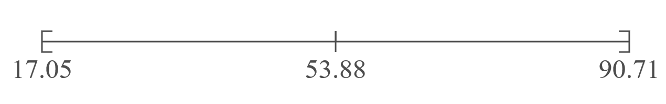
Example 2: Constructing a Confidence Interval for the Slope—Slide 3
99% Confidence Interval for β₁
Note: The confidence interval in this example was calculated using rounded values from the summary output. Microsoft Excel calculates the confidence interval using unrounded values as 17.05 to 90.72.

Slide 31
Example 3: Constructing a Confidence Interval for the Slope in the GPA Model—Slide 1
In Example 1 we examined a model relating entrance exam test scores to graduating GPA.
Table 1 Test Scores and Graduating GPA
Student | Verbal | Math | Total | Graduating GPA
1 | 680 | 554 | 1234 | 3.42
2 | 486 | 562 | 1048 | 2.37
3 | 500 | 564 | 1064 | 2.52
4 | 501 | 564 | 1065 | 2.25
5 | 503 | 583 | 1086 | 2.9
 |  | …
30 | 549 | 564 | 1113 | 2.34

Slide 32
Data
The full data set is available on stat.hawkeslearning.com under Discovering Business Statistics, Second Edition → Data Sets → Test Scores and Graduating GPA.

Slide 33
Example 3: Constructing a Confidence Interval for the Slope in the GPA Model—Slide 2
Assuming the goal is to estimate a model that could be applied to all students that have graduated from college during the last five years, the population under consideration would be quite large, too large to obtain all the measurements. If we assume the data is a sample, then we can estimate a model using the sample data and make inferences about the population.

Slide 34
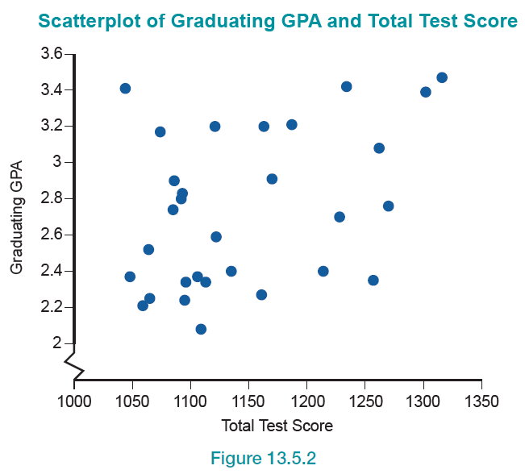
Example 3: Constructing a Confidence Interval for the Slope in the GPA Model—Slide 3
Figure 2

Slide 35
Example 3: Constructing a Confidence Interval for the Slope in the GPA Model—Slide 4
The population regression model to be estimated is
Graduating GPA = β₀ + β₁ ⋅ (Total Test Score).
We will begin by making an inference concerning β₁. Construct a 95% confidence interval for β₁.

Slide 36
Example 3: Constructing a Confidence Interval for the Slope in the GPA Model—Slide 5
Solution
The paired data on test score and graduating GPA are taken from a random sample of students. The scatterplot does not show an overwhelming linear pattern, but a slight linear trend is apparent.
Using Excel’s statistical analysis package to estimate the linear regression model, the output is given in Figure 3.

Slide 37
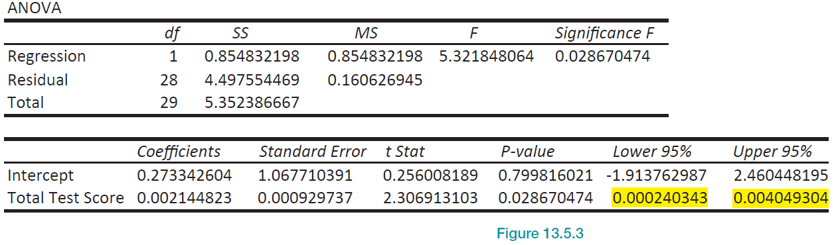
Example 3: Constructing a Confidence Interval for the Slope in the GPA Model—Slide 6
Figure 3

Slide 38
Example 3: Constructing a Confidence Interval for the Slope in the GPA Model—Slide 7
Using the computer output will make the job of calculating a confidence interval easy. Two of the three pieces of information required to calculate a confidence interval by hand are given in the output.
​The sample estimate of β₁ is given in the Coefficients column associated with the variable Total Test Score. That is, b₁ is estimated 0.0021.
​The standard deviation of b₁ is given in the Standard Error column associated with the variable Total Test Score. That is,
is 0.00093.

Slide 39

Example 3: Constructing a Confidence Interval for the Slope in the GPA Model—Slide 8
The missing piece of information is the value of
Determining
requires the calculation of
and the
degrees of freedom. Since the level of confidence is
specified to be 95%, α = 0.05 and
The degrees of freedom are
df = n $−$ 2 = 30 $−$ 2 = 28.
Consequently, using technology

Slide 40
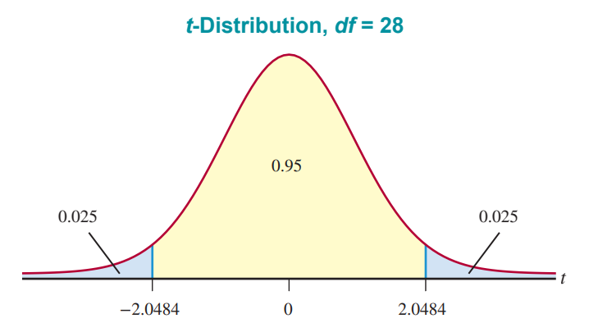
Example 3: Constructing a Confidence Interval for the Slope in the GPA Model—Slide 9
Figure 4

Slide 41
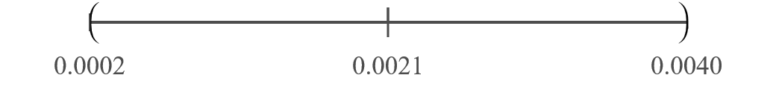

Example 3: Constructing a Confidence Interval for the Slope in the GPA Model—Slide 10
Now, let's assemble all the pieces. The 100(1 $−$ α)% confidence interval for β₁ is

Slide 42
Example 3: Constructing a Confidence Interval for the Slope in the GPA Model—Slide 11
We are 95% confident that the interval contains the true value of β₁. There are two possible interpretations of this interval.
1.​ We are 95% confident that the true increase in GPA for a one-point increase in Total Test score is between 0.0002 and 0.0040.
2.​ We are 95% confident the maximum error of the point estimate (b₁ = 0.0021) in estimating the unknown β₁ (the true increase in GPA for a one-point increase in Test score) is at most 0.001905.

Slide 43
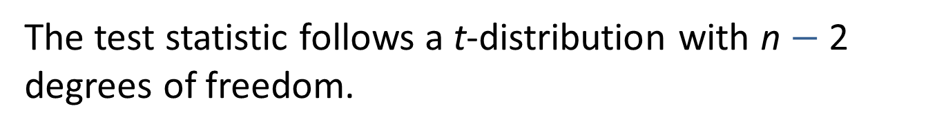
Formula: Test Statistic for Testing the Hypothesis β₁ ≠ 0
The test statistic for testing the hypothesis β₁ ≠ 0 is given by
The test statistic follows a t-distribution with n $−$ 2 degrees of freedom.

Slide 44
Example 4: Conducting a Hypothesis Test of the Slope—Slide 1
Using the data in Example 1, determine if there is overwhelming evidence at the α = 0.05 significance level of a relationship between the number of items produced and the total production cost.

Slide 45
Example 4: Conducting a Hypothesis Test of the Slope—Slide 2
Solution
Step 1: Determine the null hypothesis.
The assertion is that there is not a linear relationship between the number of items produced and total production cost. The null hypothesis is written as
H₀: β₁ = 0.

Slide 46
Example 4: Conducting a Hypothesis Test of the Slope—Slide 3
Step 2: Determine the alternative hypothesis and whether it should be one-sided or two-sided.
The alternative hypothesis states that there is a linear relationship between the number of items produced and total production cost which is a two-sided alternative since we are only concerned with whether the slope is different from zero. The alternative hypothesis is written as H _{a}: β₁ ≠ 0.

Slide 47
Example 4: Conducting a Hypothesis Test of the Slope—Slide 4
Step 3: Select the appropriate test statistic based on the information at hand and the assumptions you are willing to make.
The test statistic is similar in nature to the other test statistics developed in Chapter 10. It measures how far b₁ is from the hypothesized value of β₁, which is 0. This distance is measured in standard deviation units.

Slide 48
Example 4: Conducting a Hypothesis Test of the Slope—Slide 5
If t is close to 0, then b₁ is close to 0 and H₀: β₁ = 0 is the more reasonable conclusion. However, if t is far from zero, then b₁ is far from its hypothesized value and H _{a}: β₁ ≠ 0 would seem more reasonable. This criterion is defined by the critical value of the test statistic.

Slide 49
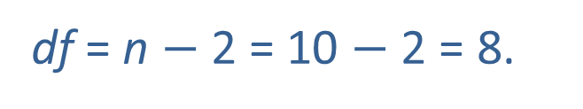
Example 4: Conducting a Hypothesis Test of the Slope—Slide 6
Step 4: Determine the critical value of the test statistic.
The test is two-tailed and the significance level of the test is specified to be 0.05, which implies
The test statistic has a t-distribution with
df = n $−$ 2 = 10 $−$ 2 = 8.
The critical value corresponds to

Slide 50
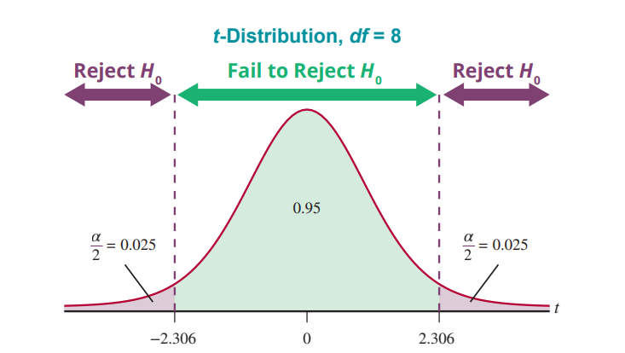
Example 4: Conducting a Hypothesis Test of the Slope—Slide 7
Figure 5

Slide 51
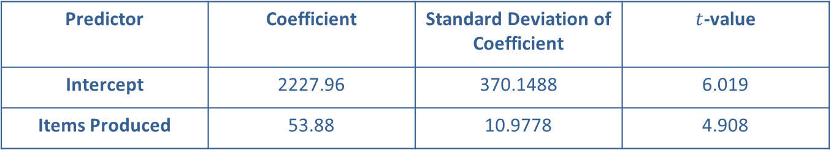
Example 4: Conducting a Hypothesis Test of the Slope—Slide 8
Step 5: Collect the sample data and compute the value of the test statistic.
Table 3 – Regression Results
Predictor | Coefficient | Standard Deviation of Coefficient | $t$-value
Intercept | 2227.96 | 370.1488 | 6.019
Items Produced | 53.88 | 10.9778 | 4.908

Slide 52
Example 4: Conducting a Hypothesis Test of the Slope—Slide 9
The estimated value of b₁ is almost five standard deviations above zero. This is very persuasive evidence that β₁ ≠ 0.

Slide 53
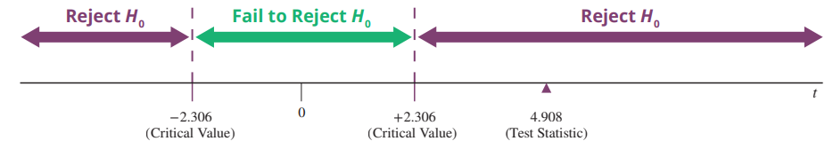
Example 4: Conducting a Hypothesis Test of the Slope—Slide 10
Step 6: Make the decision and state the conclusion in terms of the original question.
Since the value of the test statistic falls into the rejection region, reject the null hypothesis in favor of the alternative.

Slide 54
Example 4: Conducting a Hypothesis Test of the Slope—Slide 11
Conclusion and Interpretation: There is overwhelming evidence at the 0.05 significance level that β₁ ≠ 0 so we reject the null hypothesis in favor of the alternative. This implies that it is reasonable to believe (at the 0.05 level) that there is a linear relationship between the number of items produced and total cost.

Slide 55
Example 4: Conducting a Hypothesis Test of the Slope—Slide 12
In fact, there appears to be a positive linear relationship between items produced and production cost. However, our hypothesis test did not address the issue of a positive relationship, so we cannot make this conclusion.

