Slide 1
Section 13.6
Inference Concerning the Model's Prediction

Slide 2
The Regression Line as the Mean Value of y Given x—Slide 1
Examining the production data in Table 1 reveals two weeks in which 30 items were produced. For a given value of items produced (say 30) the costs of producing 30 items were $3800 and $3600. For anyone who has observed a production process, price variation is not unexpected.

Slide 3

The Regression Line as the Mean Value of y Given x—Slide 2
If you use the model
Estimated Cost $=$ $2227.96 + $53.88 ⋅ (Items Produced)
for predictive purposes, then the predicted cost of producing 30 items will be

Slide 4
The Regression Line as the Mean Value of y Given x—Slide 3
Using this model, producing 30 items will have a predicted cost of $3844.36. Since the actual cost of producing 30 items varies, how do you interpret the predicted cost of $3844.36, which happens to be above the two observed values? The model’s predicted value when 30 items are produced is considered to be the average cost of producing 30 items. In other words, it is the mean value of y (cost) when x (items produced) equals 30. But wait a minute!

Slide 5
The Regression Line as the Mean Value of y Given x—Slide 4
The costs of producing 30 items were $3800 and $3600, and the average of these numbers is not $3844.36. What kind of average is this?

Slide 6
The Regression Line as the Mean Value of y Given x—Slide 5
What we are essentially saying is that if we are willing to acknowledge that the relationship between x and y is linear, then all data (not just the data for x = 30) will be useful in establishing the estimated relationship. Once the relationship is established it will be used to estimate the mean value of y for any given x. In fact, if items produced = 35, the predicted cost would be
which would be interpreted to be the average cost of producing 35 items.

Slide 7
The Regression Line as the Mean Value of y Given x—Slide 6
The entire regression line can be considered a collection of means of y for different values of x. Unfortunately, the true linear relationship is unknown since all the data in the population will not be available. Since only the estimated model is available, only estimated values of the mean value of y for some given x will be available.

Slide 8
The Regression Line as the Mean Value of y Given x—Slide 7
How good are these estimates? How good is the estimate of a mean value of y = $4113.76 when x = 35? To answer this question, we will once again rely on the notion of a confidence interval.

Slide 9
Formula: 100(1 − α)% Confidence Intervals for the Mean Value of y Given x—Slide 1
If x _{p} is a value of x for which we wish to know the mean value of y, then the 100(1 − α)% confidence interval is given by

Slide 10
Formula: 100(1 − α)% Confidence Intervals for the Mean Value of y Given x—Slide 2
is the predicted value of y when x = x _{p},
is the t-value associated with 100(1 − α)%
confidence (the same t used in constructing
confidence intervals for β₁),
s _{e} is the standard deviation of the error terms,
and

Slide 11
Formula: 100(1 − α)% Confidence Intervals for the Mean Value of y Given x—Slide 3
measures how far x _{p} is from
in relation to
the total variation of x. The further x _{p} is from
the larger this ratio will be, resulting
in a wider the confidence interval.

Slide 12
Example 1: Calculating a Confidence Interval for the Average Cost—Slide 1
For the production model, calculate the 95% confidence interval for the average cost of producing 35 items.

Slide 13
Example 1: Calculating a Confidence Interval for the Average Cost—Slide 2
Solution
Four pieces of information are required to calculate the 95% confidence interval for the mean value of y given x = x _{p}.
Use the estimated regression line to calculate
for the value given for x = x _{p}.
2. ​Find a t-value corresponding to the level of confidence and the degrees of freedom associated with the data used to estimate the model.

Slide 14
Example 1: Calculating a Confidence Interval for the Average Cost—Slide 3
3.​ Determine the standard deviation of the error terms.
4.​ Compute the term

Slide 15
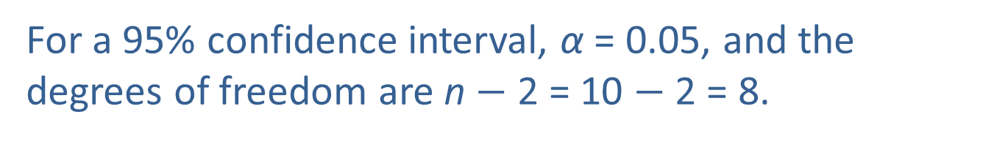
Example 1: Calculating a Confidence Interval for the Average Cost—Slide 4
In Example 1,
Estimated Cost = $2227.96 + $53.88 ⋅ (Items Produced), x _{p} = 35, and the predicted value for y for this given x is
For a 95% confidence interval, α = 0.05, and the degrees of freedom are n $−$ 2 = 10 $−$ 2 = 8.
Thus,

Slide 16
Example 1: Calculating a Confidence Interval for the Average Cost—Slide 5
The standard deviation of the error terms is found in the output in Figure 1. In particular,
s _{e} ≈ 223.0682. Note that s _{e} can also be computed by taking the square root of the mean square error,
which was computed in Section 13.5.
The last piece of information is the quotient
Table 1 contains the calculation for the sum of the squared deviations,

Slide 17
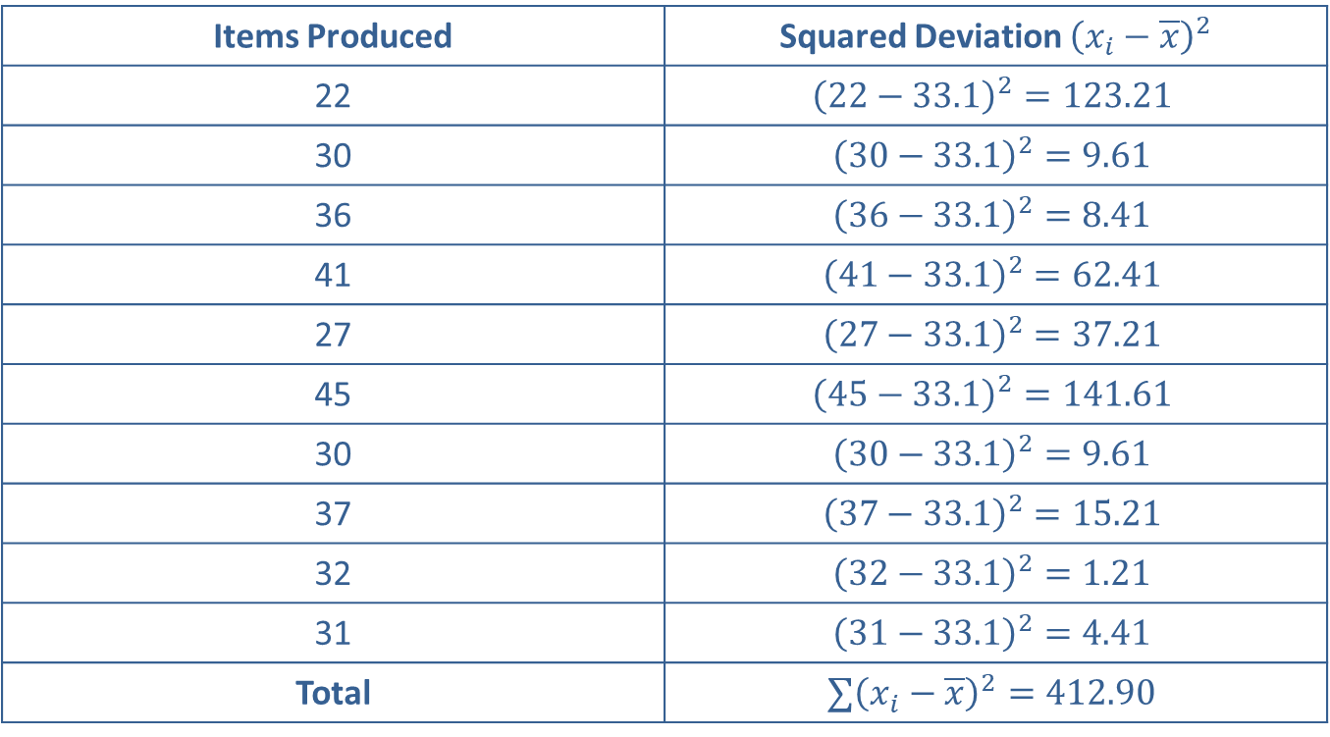
Example 1: Calculating a Confidence Interval for the Average Cost—Slide 6
Table 1 – Squared Deviation
Items Produced | Squared Deviation ${\left(x_{i}−\overline{x}\right)}^{2}$
22 | $${\left(22−33.1\right)}^{2}=123.21$$
30 | $${\left(30−33.1\right)}^{2}=9.61$$
36 | $${\left(36−33.1\right)}^{2}=8.41$$
41 | $${\left(41−33.1\right)}^{2}=62.41$$
27 | $${\left(27−33.1\right)}^{2}=37.21$$
45 | $${\left(45−33.1\right)}^{2}=141.61$$
30 | $${\left(30−33.1\right)}^{2}=9.61$$
37 | $${\left(37−33.1\right)}^{2}=15.21$$
32 | $${\left(32−33.1\right)}^{2}=1.21$$
31 | $${\left(31−33.1\right)}^{2}=4.41$$
Total | $$∑{\left(x_{i}−\overline{x}\right)}^{2}=412.90$$

Slide 18
Example 1: Calculating a Confidence Interval for the Average Cost—Slide 7
Assembling the pieces for the 95% confidence interval we have the following.

Slide 19

Example 1: Calculating a Confidence Interval for the Average Cost—Slide 8
95% Confidence Interval for the Mean Value of y Given x = 35

Slide 20
Example 1: Calculating a Confidence Interval for the Average Cost—Slide 9
The confidence interval can be interpreted in two ways.
1.​ We are 95% confident that the average cost of producing 35 items is between $3944.17 and $4283.35. (Note that like all confidence intervals, the confidence is in the method not in a particular interval.)
2. We are 95% confident that the maximum error of estimation for the average cost of producing 35 items is $169.59.

Slide 21
Example 1: Calculating a Confidence Interval for the Average Cost—Slide 10
Figure 1 shows the fitted line plot of the production data along with the 95% confidence interval. Notice that as you approach the edges of the data, the confidence interval gets wider. This illustrates why it is important to only make predictions within the scope of the sample data.

Slide 22
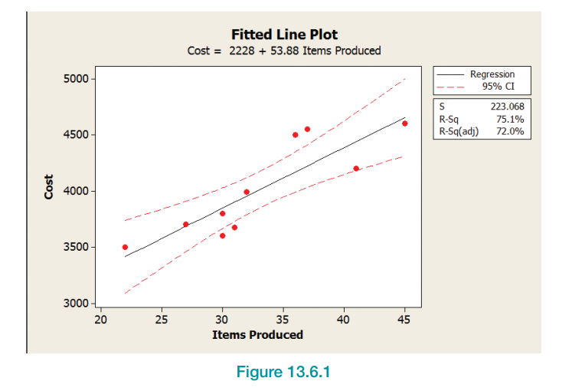
Example 1: Calculating a Confidence Interval for the Average Cost—Slide 11
Figure 1

Slide 23
Example 1: Calculating a Confidence Interval for the Average Cost—Slide 12
Many statistical analysis packages compute a confidence interval for the mean value of y for a given value of x. Figure 2 is an example of a Minitab output. The output uses the estimated production model when items produced = 35. The value labeled “Fit” is the predicted value of y when x = 35.

Slide 24
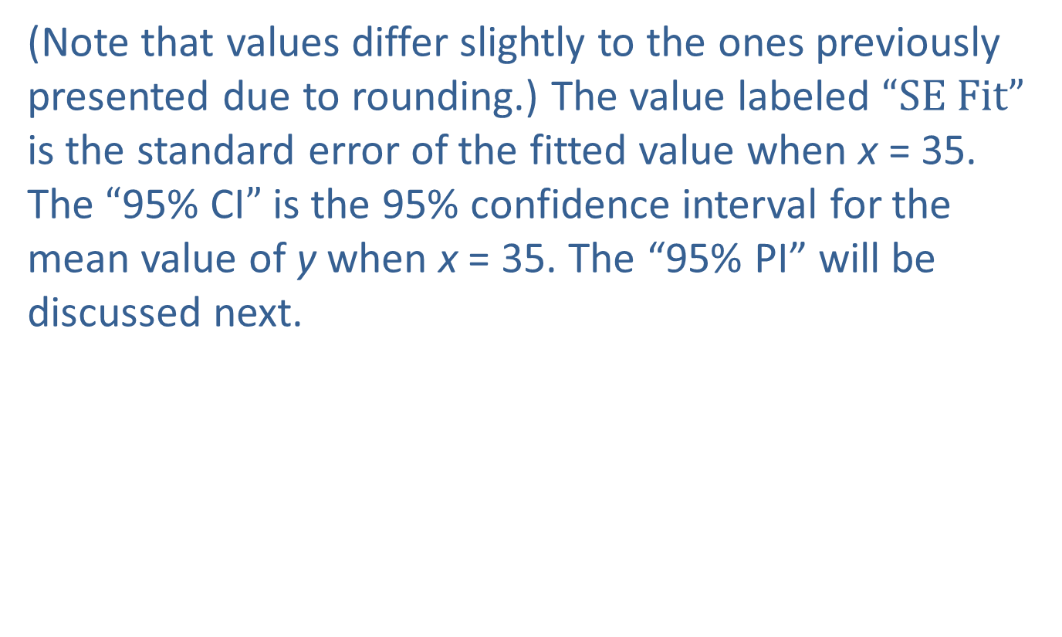
Example 1: Calculating a Confidence Interval for the Average Cost—Slide 13
(Note that values differ slightly to the ones previously presented due to rounding.) The value labeled “SE Fit” is the standard error of the fitted value when x = 35. The “95% CI” is the 95% confidence interval for the mean value of y when x = 35. The “95% P I” will be discussed next.

Slide 25
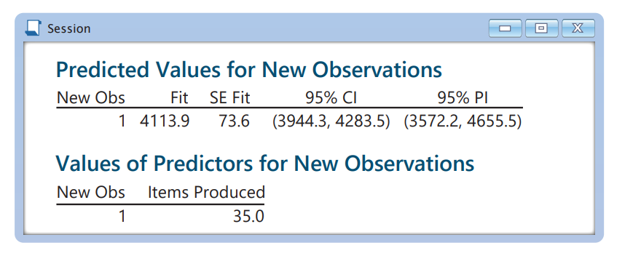
Example 1: Calculating a Confidence Interval for the Average Cost—Slide 14
Figure 2

Slide 26
Confidence Intervals for the Predicted Value of y Given x—Slide 1
We previously discussed confidence intervals for the mean value of y given x, rather than individual outcomes. Suppose you wish to produce 35 items, and you wish to predict the total cost of production and compute a 95% confidence interval for the total cost.

Slide 27
Confidence Intervals for the Predicted Value of y Given x—Slide 2
Using the model,
for producing 35 items. The actual cost of producing 35 items in a particular week may be above or below average, the model has no way of knowing.

Slide 28
Confidence Intervals for the Predicted Value of y Given x—Slide 3
Consequently, the actual cost will likely be different from the average value, and that difference will be an error in the model’s prediction. That error needs to be accounted for in the confidence interval for the predicted value of y given x.

Slide 29
Confidence Intervals for the Predicted Value of y Given x—Slide 4
The expression for the confidence interval for a predicted value is very similar to the confidence interval for the mean value of y given x. However, instead of calling this interval a confidence interval (which it is), let’s call it a prediction interval to distinguish the interval from the confidence interval for the mean value of y given x.

Slide 30
Formula: 100(1 − α)% Prediction Interval for the Value of y Given x
A 100(1 − α)% confidence interval for the predicted value of y given x, also known as a prediction interval, is given by

Slide 31
Confidence Intervals for the Predicted Value of y Given x—Slide 5
Since the only difference between the prediction interval and the confidence interval for the mean value of y given x is the “1” inside the square root, the same information is required to compute the interval. However, since many statistical analysis packages will compute the prediction interval, you may not have to perform the computations very often.

Slide 32
Example 2 Calculating a Prediction Interval for the Total Cost—Slide 1
Suppose you, as the production manager, wish to produce 35 items this week. Compute the 95% prediction interval for the total cost of production.

Slide 33
Example 2: Calculating a Prediction Interval for the Total Cost—Slide 2
Solution
The predicted cost of producing 35 items is given by
Computing the interval we have the following.

Slide 34
Example 2: Calculating a Prediction Interval for the Total Cost—Slide 3
95% Prediction Interval for y Given x = 35

Slide 35
Example 2: Calculating a Prediction Interval for the Total Cost—Slide 4
We are 95% confident that the actual cost of production will be within $541.63 of the average price for producing 35 items ($4113.76). Specifically, we are 95% confident that the production cost will be between $3572.13 and $4655.39.

Slide 36
Example 2: Calculating a Prediction Interval for the Total Cost—Slide 5
Figure 3 shows a fitted line plot of the production data along with the 95% prediction interval. Notice the difference between the plots of the 95% confidence interval (in Figure 1) and the 95% prediction interval.

Slide 37
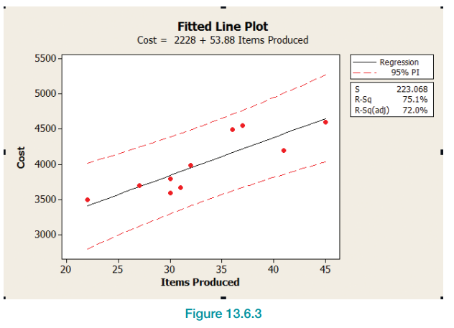
Example 2: Calculating a Prediction Interval for the Total Cost—Slide 6
Figure 3

Slide 38
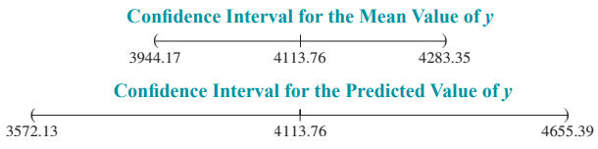
Example 2: Calculating a Prediction Interval for the Total Cost—Slide 7
The graphs below compare the confidence intervals for the mean value of y given x = 35 and the predicted value of y given x = 35.

Slide 39
Example 2: Calculating a Prediction Interval for the Total Cost—Slide 8
The prediction interval is more than three times wider than the confidence interval for the average value. A high price has been paid in order to account for individual variability.

Slide 40
Example 2: Calculating a Prediction Interval for the Total Cost—Slide 9
Using the model for prediction outside the range of x values used to create the model can be dangerous. The nature of the relationship may not be linear outside of the range of x used to define the model. In the production example, the range of x-values spans from 22 to 45 items produced.

Slide 41
Example 2: Calculating a Prediction Interval for the Total Cost—Slide 10
Using the model to predict the cost of producing 100 items would no doubt have a sizable error. Inferential methods are not valid outside the range of x. Figure 4 illustrates the uncertainty associated with the regression line outside the range of the data.

Slide 42
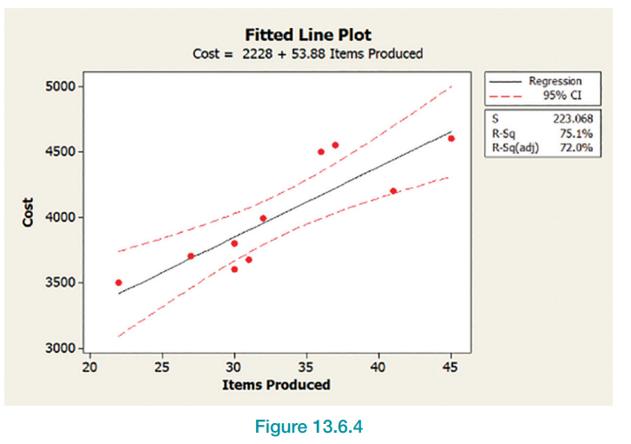
Example 2: Calculating a Prediction Interval for the Total Cost—Slide 11
Figure 4

