Slide 1
Section 14.1
The Multiple Regression Model

Slide 2
Formula: Multiple Regression Model
The multiple regression model is given by
where
are the model's parameters. (They are
unknown constants that will require estimation.)
are independent variables which are
measured without error.
ε _{i} is a random error which is normally distributed with a mean of zero and a standard deviation σ_{ε}. (The errors are independent of each other.)

Slide 3
Formula: Estimated Multiple Regression Equation
The estimated multiple regression equation is
where
are estimates of their
population counterparts. Specifically, b₀ is an estimate of β₀ , b ₁ is an estimate of β ₁, b ₂ is an estimate of β ₂, etc.
is the predicted value of y for given values of
and is pronounced y-hat. The symbol y _{i}
is reserved for the observed value of y.

Slide 4
Example 1: Modeling Pizza Delivery Time—Slide 1
A pizza delivery manager is analyzing the delivery routes in her system. She is interested in predicting the amount of time required for the driver to deliver the pizzas on a specific route. The driver has to make several stops on the route because the manager doesn't want to send several vehicles/drivers to cover the same area/route. Fit a multiple linear regression model using the data in Table 1 to predict delivery time.

Slide 5
Example 1: Modeling Pizza Delivery Time—Slide 2
Table 1 – Pizza Delivery Time Data
Observation | Delivery Time (Minutes) | Number of Pizzas | Distance (Miles)
1 | 16.68 | 7 | 5.60
2 | 11.50 | 3 | 2.20
3 | 12.03 | 3 | 3.40
4 | 14.88 | 8 | 0.80
5 | 13.75 | 6 | 1.50
6 | 18.11 | 7 | 3.30
7 | 8.00 | 2 | 1.10
8 | 17.83 | 7 | 2.10
9 | 79.24 | 30 | 14.60
10 | 21.50 | 5 | 6.05

Slide 6
Example 1: Modeling Pizza Delivery Time—Slide 3
Table 1 – Pizza Delivery Time Data
Observation | Delivery Time (Minutes) | Number of Pizzas | Distance (Miles)
11 | 40.33 | 16 | 6.88
12 | 21.00 | 10 | 2.15
13 | 13.50 | 4 | 2.55
14 | 19.75 | 6 | 4.62
15 | 24.00 | 9 | 4.48
16 | 29.00 | 10 | 7.76
17 | 15.35 | 6 | 2.00
18 | 19.00 | 7 | 1.32
19 | 9.50 | 3 | 0.36
20 | 35.10 | 17 | 7.70

Slide 7
Example 1: Modeling Pizza Delivery Time—Slide 4
Table 1 – Pizza Delivery Time Data
Observation | Delivery Time (Minutes) | Number of Pizzas | Distance (Miles)
21 | 17.90 | 10 | 1.40
22 | 52.32 | 26 | 8.10
23 | 18.75 | 9 | 4.50
24 | 19.83 | 8 | 6.35
25 | 10.75 | 4 | 1.50

Slide 8
Data
This data set can be found at stat.hawkeslearning.com undar Discovering Business Statistics, Second Edition → Data Sets → Pizza Delivery Time.

Slide 9
Example 1: Modeling Pizza Delivery Time—Slide 5
Solution
The linear multiple regression model is as follows.
Delivery Time = β₁ + β ₂ (Number of Pizzas) + β ₂ (Distance) + ε _{i}
To have a useful model, the parameters β₀, β ₁, and β ₂ must be estimated. Estimating these parameters requires the collection of historical data on pizza delivery times.

Slide 10
Example 1: Modeling Pizza Delivery Time—Slide 6
If inferences concerning the model's predicted values or parameters are desired, then random sampling methods must be used during data collection. Assume that the data in Table 1 have been collected using random sampling techniques. The summary output from JMP is given in Figure 1.

Slide 11
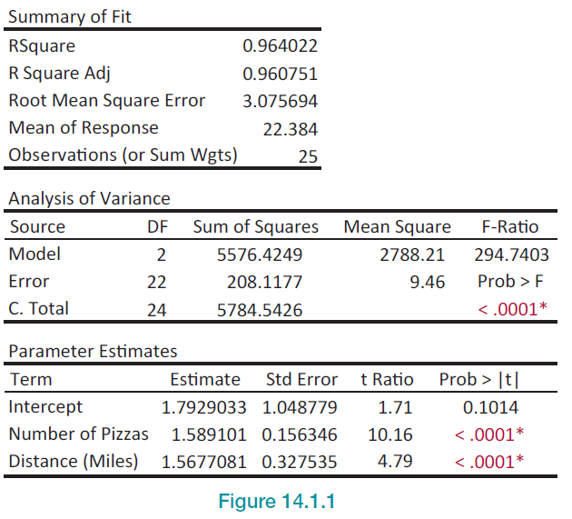
Example 1: Modeling Pizza Delivery Time—Slide 7
Figure 1

Slide 12
Example 1: Modeling Pizza Delivery Time—Slide 8
The estimated model parameters are b₀ = 1.7929,
b₁ = 1.5891, and b₂ = 1.5677. The estimated multiple regression model is as follows.
Estimated Delivery Time
= 1.7929 + 1.5891 (Number of Pizza) + 1.5677 (Distance)

Slide 13
Example 1: Modeling Pizza Delivery Time—Slide 9
There are numerous questions that could be asked about the multiple regression model in Example 1.
Can the model explain a substantial portion of the variation in delivery times? If not, it will not be very useful.
Do the signs and magnitudes of the estimated coefficients appear to be reasonable?

Slide 14
Example 1: Modeling Pizza Delivery Time—Slide 10
Are the estimates of the coefficients reliable or do the estimates have substantial sampling variation?
Are both independent variables necessary? Do any of the variables not contribute to the explanation of delivery times? This question will be addressed using the familiar hypothesis testing procedure.

Slide 15
Example 1: Modeling Pizza Delivery Time—Slide 11
Are there other independent variables that could be included that would enhance the model’s ability to accurately predict delivery times?
Can the model make a useful prediction of delivery time? How much confidence can be placed in the prediction?
We will address these questions as we continue to discuss multiple regression throughout this chapter.

