Slide 1

Section 14.2
The Coefficient of Determination and Adjusted $R$-squared

Slide 2
Formula: Coefficient of Determination
The coefficient of determination, R², is given by
where SSR = the sum of squares of regression, TSS = the total sum of squares, and SSE = the sum of squared errors. R² represents the proportion of variation in the dependent variable explained by the set of independent variables in a multiple regression model.

Slide 3
Formula: Adjusted R²
The adjusted R² statistic takes into account the number of independent variables in the model by dividing each sum of squares by its associated degrees of freedom.
where n is the number of observations and k is the number of independent variables in the model.

Slide 4
Example 1: Assessing the Fit of the Pizza Delivery Time Model using R² and Adjusted R²—Slide 1
a. ​Using the data in Table 1, fit a simple linear regression model using just Number of Pizzas as the independent variable and Delivery Time as the dependent variable. What is the value of R² and what does it mean?
b. ​Fit a multiple regression model with both Number of Pizzas and Distance. What are the values of R² and
and what do they mean?
c. ​Did the addition of Distance improve the model fit? Explain your answer.

Slide 5
Example 1: Assessing the Fit of the Pizza Delivery Time Model using R² and Adjusted R²—Slide 2
Solution
a. Fitting a simple linear regression model to pizza delivery time using only number of pizzas as the independent variable yields the output provided in Figure 1.
​

Slide 6
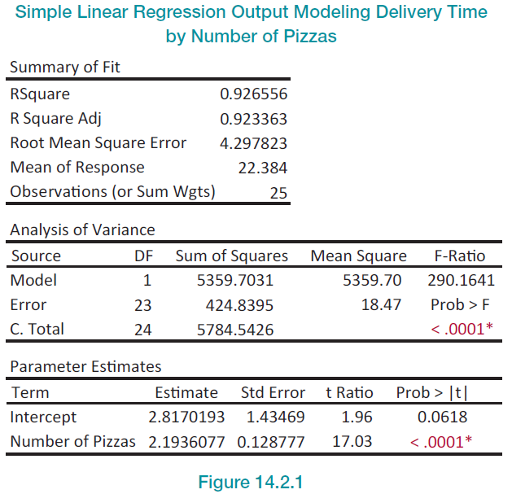
Example 1: Assessing the Fit of the Pizza Delivery Time Model using R² and Adjusted R²—Slide 3
Figure 1

Slide 7
Example 1: Assessing the Fit of the Pizza Delivery Time Model using R² and Adjusted R²—Slide 4
​Given the output in Figure 1, we see that the
Note that the adjusted R² value does not have much meaning in simple linear regression. The value of R² implies that 92.66% of the variation in delivery time can be explained by the number of pizzas that the driver has to deliver.

Slide 8
Example 1: Assessing the Fit of the Pizza Delivery Time Model using R² and Adjusted R²—Slide 5
b. When we add the distance independent variable to the model, the JMP output is given in Figure 1 in Section 14.1.
With the addition of the independent variable, distance, to the model, we have

Slide 9
Example 1: Assessing the Fit of the Pizza Delivery Time Model using R² and Adjusted R²—Slide 6
Similar to what was stated above, the value of R² implies that 96.40% of the variability in delivery time can be explained by the number of pizzas being delivered and the distance that is driven. The interpretation of
is the same—96.08% of the variation in delivery time is explained by the two independent variables in the model.

Slide 10
Example 1: Assessing the Fit of the Pizza Delivery Time Model using R² and Adjusted R²—Slide 7
c. ​With both number of pizzas and distance in the model, the value of R² increased by 0.0374, indicating that adding the variable distance to the model helped explain more variability in delivery times. The value of
increased by slightly more (0.0375). Using both variables in the model explained nearly 4% more variability in delivery time.

Slide 11
Example 1: Assessing the Fit of the Pizza Delivery Time Model using R² and Adjusted R²—Slide 8
​As the number of independent variables increases, the difference between the R² and adjusted R² values also increases.
is commonly used as a method of comparison
between multiple regression models when one is attempting to find the model that best fits the data.

Slide 12
Example 1: Assessing the Fit of the Pizza Delivery Time Model using R² and Adjusted R²—Slide 9
Unlike the R² value, the adjusted coefficient of determination may actually become smaller when another independent variable is added to the model. Thus, the adjusted R² value is most useful when comparing multiple regression models with different numbers of independent variables.

