Slide 1
Section 14.3
Inference Concerning the Multiple Regression Model and Its Coefficients

Slide 2
Formula: F-Statistic
The F-statistic is the test statistic used to test the hypothesis H _{a}: At least one β _{i} ≠ 0.
The F-statistic is a ratio which compares the variation explained by the model (SSR) to the unexplained variation (SSE). The sum of squares of regression (SSR) and the sum of squared errors (SSE) were discussed in Section 13.3. The symbol k represents the number of independent variables in the model and n represents the number of observations.

Slide 3
Definition: Mean Square Regression (MSR)
MSR is the sum of squares associated with the regression term in the model divided by the degrees of freedom associated with the regression term. The degrees of freedom for the regression term is k which represents the number of independent variables in the model.

Slide 4
Definition: Mean Square Error (MSE)
MSE is the sum of squares associated with the error term in the model divided by the degrees of freedom associated with the error term. The degrees of freedom for the error term is n – (k + 1).

Slide 5
Example 1: Determining the Significance of a Multiple Regression Model—Slide 1
For the pizza delivery model from Section 14.1, determine if there is sufficient evidence at the 0.05 significance level that the overall model is useful in explaining the variation in delivery times.

Slide 6
Example 1: Determining the Significance of a Multiple Regression Model—Slide 2
Solution
Step 1: Determine the null hypothesis.
The null hypothesis states that using number of pizzas and distance in the model is not useful in explaining the variation in delivery times. The null hypothesis is written as

Slide 7
Example 1: Determining the Significance of a Multiple Regression Model—Slide 3
Step 2: Determine the alternative hypothesis.
The alternative hypothesis states that the overall model with number of pizzas and distance is useful in explaining the variation in delivery times. The alternative hypothesis is written as
H _{a}: At least one β _{i} ≠ 0.
If some of the model's independent variables are useful predictors of y, then the coefficients (β _{i}) of these variables will have nonzero values.

Slide 8
Example 1: Determining the Significance of a Multiple Regression Model—Slide 4
Step 3: Select the appropriate test statistic.
We will use the F-statistic as the test statistic for this hypothesis test.

Slide 9
Example 1: Determining the Significance of a Multiple Regression Model—Slide 5
Step 4: Determine the critical value of the test statistic.
Since there are two independent variables (number of pizzas and distance) in the model, the degrees of freedom are
The critical value for F at the 0.05 level with 2 numerator degrees of freedom and 22 denominator degrees of freedom is 3.4434.

Slide 10
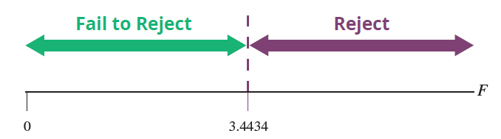
Example 1: Determining the Significance of a Multiple Regression Model—Slide 6
An F-value larger than 3.4434 will indicate a value of F that is too rare to have occurred by chance if the null were true, and thus we will reject the null hypothesis.

Slide 11
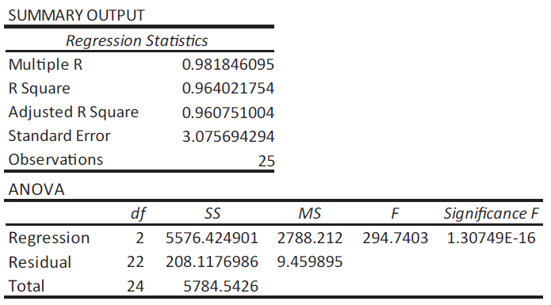
Example 1: Determining the Significance of a Multiple Regression Model—Slide 7
Step 5: Compute the test statistic.
The ANOVA table for the pizza delivery model is given in Figure 1. The value of F is given to be approximately 294.7403.
Figure 1

Slide 12
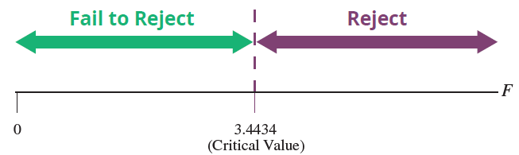
Example 1: Determining the Significance of a Multiple Regression Model—Slide 8
Step 6: Make the decision and state the conclusion in terms of the original question.
Since the value of F, 294.7403, falls in the rejection region, the null hypothesis will be rejected in favor of the alternative.

Slide 13
Example 1: Determining the Significance of a Multiple Regression Model—Slide 9
The P-value associate with this test is indicated to be < 0.0001 which is less than α = 0.05, thus, we also reject the null hypothesis in favor of the alternative.

Slide 14
Example 1: Determining the Significance of a Multiple Regression Model—Slide 10
Conclusion and Interpretation: The null hypothesis is rejected in favor of the alternative, which states that at least one of the independent variables is useful in explaining the variation in delivery times.

Slide 15
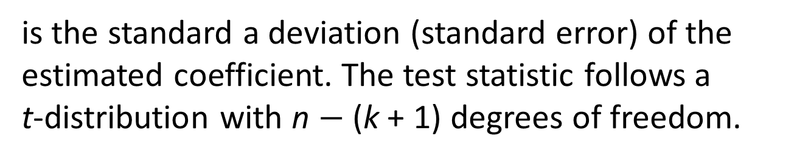
Formula: Test Statistic for Testing the Hypothesis β_{i} ≠ 0
In a test of hypothesis about an individual coefficient, β _{i} , the test statistic is computed as
where b _{i} is the estimated coefficient and
is the standard a deviation (standard error) of the estimated coefficient. The test statistic follows a t-distribution with n $−$ (k + 1) degrees of freedom.

Slide 16
Example 2: Determining the Significance of Coefficients in a Multiple Regression Model—Slide 1
For the pizza delivery model,
Delivery Time = β₀ + β₁ (Number of Pizzas) +
β₁(Distance) + ε _{i}.
Is the distance variable a useful predictor of delivery time? Use α = 0.05 as the level of significance.

Slide 17
Example 2: Determining the Significance of Coefficients in a Multiple Regression Model—Slide 2
Solution
Step 1: Determine the null hypothesis.
The null hypothesis is that distance is not a useful predictor of delivery time. The null hypothesis should be written as

Slide 18
Example 2: Determining the Significance of Coefficients in a Multiple Regression Model—Slide 3
Step 2: Determine the alternative hypothesis and whether it should be one-sided or two-sided.
The alternative hypothesis, which contradicts the null hypothesis, is that distance is a useful predictor of delivery time. For the pizza delivery model, if distance is not a useful predictor of delivery time, then its coefficient in the model (β₂) will equal 0.

Slide 19
Example 2: Determining the Significance of Coefficients in a Multiple Regression Model—Slide 4
The sample estimate of β₂, namely b₂, will be used to evaluate the reasonableness of the null hypothesis. The alternative hypothesis should be written as
The alternative hypothesis is two-sided since the relationship between distance and delivery time can be positive or negative. Thus, we will conduct a two-tailed test.

Slide 20
Example 2: Determining the Significance of Coefficients in a Multiple Regression Model—Slide 5
Step 3: Select the appropriate test statistic based on the information at hand and the assumptions you are willing to make.
The test statistic is
The test statistic is identical in form to the test statistic used in Section 13.5 for the simple linear model. If the value of the test statistic is near zero, then there is evidence that the distance variable is not a significant predictor of delivery time.

Slide 21
Example 2: Determining the Significance of Coefficients in a Multiple Regression Model—Slide 6
Step 4: Determine the critical value of the test statistic.
Since the test is two-tailed and the level of significance is specified to be α = 0.05,
The test statistic has a t-distribution with
The critical values correspond

Slide 22
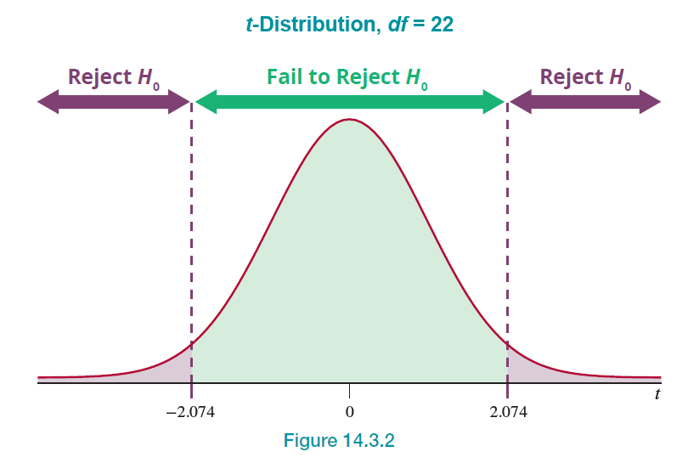
Example 2: Determining the Significance of Coefficients in a Multiple Regression Model—Slide 7
Figure 2

Slide 23
Example 2: Determining the Significance of Coefficients in a Multiple Regression Model—Slide 8
Step 5: Compute the test statistic
The summary output for the pizza delivery model is given in Figure 3.

Slide 24
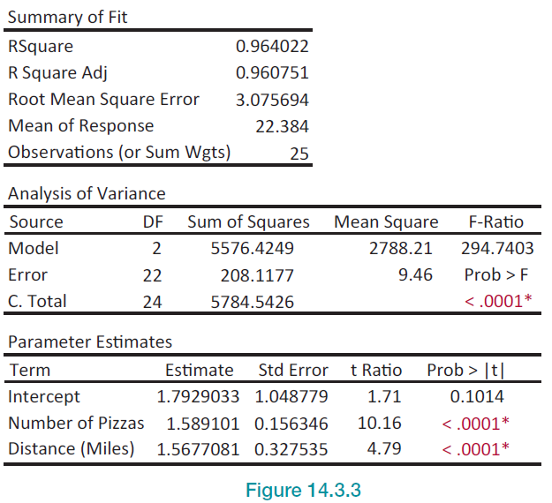
Example 2: Determining the Significance of Coefficients in a Multiple Regression Model—Slide 9
Figure 3

Slide 25
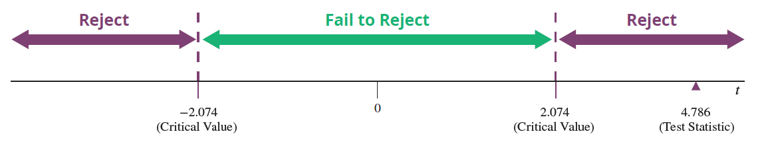
Example 2: Determining the Significance of Coefficients in a Multiple Regression Model—Slide 10
Using the values of b₂ and the standard error of b₂ from the summary output,
The estimated value of b₂ is approximately 4.786 standard deviations from zero. Is this persuasive evidence that β₂ ≠ 0?

Slide 26
Example 2: Determining the Significance of Coefficients in a Multiple Regression Model—Slide 11
Step 6: Make the decision and state the conclusion in terms of the original question.
Since the value of the test statistic falls into the rejection region, we reject the null hypothesis,
The P-value is less than 0.0001 (which is less than the significance level of α = 0.05) and leads us to also reject the null hypothesis.

Slide 27
Example 2: Determining the Significance of Coefficients in a Multiple Regression Model—Slide 12
Conclusion and Interpretation: Since we rejected the null hypothesis,
the distance variable is a significant predictor of delivery time, given that the other variable currently in the model (number of pizzas) is constant.

Slide 28
Example 2: Determining the Significance of Coefficients in a Multiple Regression Model—Slide 13
We can apply the exact same t-test to the other variable in the model. The estimated coefficient of the number of pizzas variable, b₁, is also significant (t = 10.164) with a P-value less than 0.0001, which is less than the significance level of α = 0.05. This suggests that the two-variable model is a reasonable model to use to predict delivery times.

Slide 29
Formula: 100(1 − α)% Confidence Interval for an Individual Coefficient, β _{i}
The 100(1 − α)% confidence interval for each coefficient, β _{i}, in a multiple regression model is given by

Slide 30
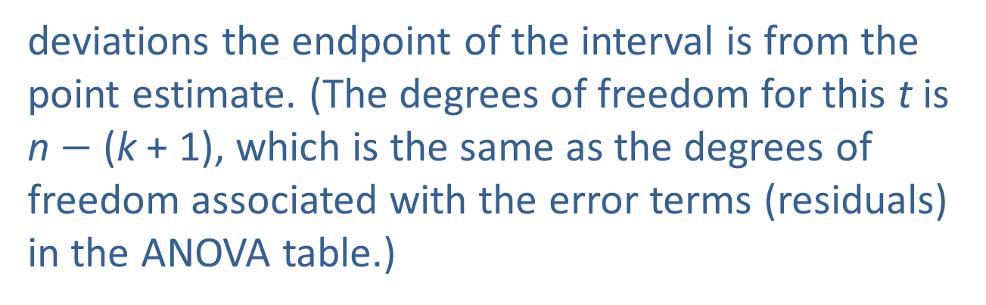
Confidence Intervals for Individual Coefficients
The computation of the confidence interval requires three pieces of information:
1. An estimate of the coefficient β _{i}, namely b _{i}.
2. The standard deviation of the estimate
Both b _{i} and
are reported in the summary output.
3. The value of
which is the number of standard
deviations the endpoint of the interval is from the point estimate. (The degrees of freedom for this t is n $−$ (k + 1), which is the same as the degrees of freedom associated with the error terms (residuals) in the ANOVA table.)

Slide 31
Example 3: Calculating a Confidence Interval for a Coefficient in the Regression Model—Slide 1
Compute and interpret the 95% confidence interval for β₁ in the pizza delivery model.

Slide 32
Example 3: Calculating a Confidence Interval for a Coefficient in the Regression Model—Slide 2
Solution
The β₁ model coefficient relates to the number of pizzas variable in the pizza delivery model. The JMP output in Figure 4 provides the information necessary to develop a confidence interval for β₁.

Slide 33
Example 3: Calculating a Confidence Interval for a Coefficient in the Regression Model—Slide 3
Parameter Estimates
Term | Estimate | Std Error | t Ratio | Prob >|t| | Lower 95% | Upper 95%
Intercept | 1.7929033 | 1.048779 | 1.71 | 0.1014 | -0.382131 | 3.9679381
Number of Pizzas | 1.589101 | 0.156346 | 10.16 | <0001* | 1.2648599 | 1.9133421
Distance (Miles) | 1.5677081 | 0.327535 | 4.79 | <0001* | 0.8884431 | 2.2469731
Figure 4
b₁ is given in the output to be 1.5891.
is given in the output to be 0.1563.

Slide 34

Example 3: Calculating a Confidence Interval for a Coefficient in the Regression Model—Slide 4
In order to compute the t-value, the degrees of freedom must be determined.
For a 95% confidence interval,
will be
The resulting confidence interval will be
1.5891 $±$ 2.074(0.1563)
1.5891 $±$ 0.3242
1.2649 to 1.9133

Slide 35
Example 3: Calculating a Confidence Interval for a Coefficient in the Regression Model—Slide 5
We are 95% confident that the true value of β₁, the increase in the delivery time for each additional pizza (given that distance is held constant), will be between 1.2649 and 1.9133 minutes.

Slide 36
Example 3: Calculating a Confidence Interval for a Coefficient in the Regression Model—Slide 6
Notice that JMP automatically generates confidence intervals for each individual coefficient. The endpoints for the 95% confidence intervals are given in the Lower 95% and Upper 95% columns of the output. Compare the upper and lower limits given by JMP to the ones just calculated by hand. JMP has the ability to calculate confidence intervals for individual coefficients for any level of significance.

