Slide 1
Section 14.4
Inference Concerning the Model's Prediction

Slide 2

Inference Concerning the Model’s Prediction—Slide 1
Many regression models are developed solely to predict the dependent variable. To use the multiple regression model for prediction, insert the values of the independent variables in the model and calculate the predicted value. Recall the estimated multiple regression equation for our pizza delivery model:

Slide 3
Inference Concerning the Model’s Prediction—Slide 2
For 5 pizzas being delivered 6 miles away, the model would predict the delivery time to be
This is the point estimate. How good is this estimate? The answer to this question depends on what you are trying to predict. Are you trying to predict the average delivery time for delivering 5 pizzas 6 miles away, or are you trying to predict the delivery time for a particular order?

Slide 4
Confidence Interval for the Mean Value of y Given x—Slide 1
In Section 13.6, we discussed a confidence interval for the mean value of y given x = x _{p} for the simple regression model. In our multiple regression model, the point estimate, 19.1446 minutes, is the average value of y given x₁ = 5 and x₂ = 6.

Slide 5
Confidence Interval for the Mean Value of y Given x—Slide 2
In other words, the delivery time of 19.1446 minutes is the estimated average delivery time for all deliveries of 5 pizzas to locations 6 miles away. Since we do not have all the deliveries in the sample, the predicted average delivery time of 19.1446 is only an estimate of the true mean value. How good is the estimate? For multiple regression, the expression for the confidence interval of the mean value of y given x is beyond the scope of this text.

Slide 6
Confidence Interval for the Mean Value of y Given x—Slide 3
Fortunately, statistical analysis programs such as Minitab will compute a confidence interval for the mean value of y given x for the multiple regression model. (Figure 1.)

Slide 7
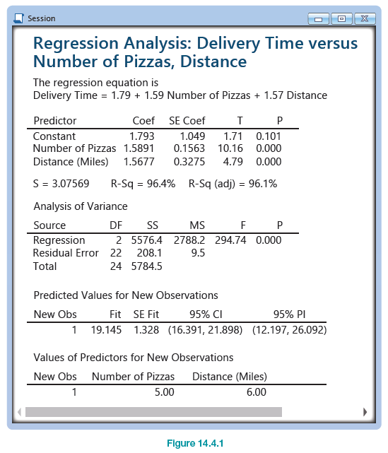
Confidence Interval for the Mean Value of y Given x—Slide 4
Figure 1

Slide 8

Confidence Interval for the Mean Value of y Given x—Slide 5
According to the Minitab output given in Figure 1, the 95% confidence interval for the mean delivery time for 5 pizzas being delivered 6 miles away is 16.391 minutes to 21.898 minutes.

Slide 9
Confidence Interval for the Mean Value of y Given x—Slide 6
A caller asks to speak to the manager of the pizza restaurant. The caller wants to know how long it would take to deliver five pizzas to his specific location, which is six miles away. As the manager, you would like to guarantee how long it will take to make this delivery of 5 pizzas to this customer.

Slide 10
Confidence Interval for the Mean Value of y Given x—Slide 7
You are not especially interested in the average delivery time for such a delivery. Instead, it would be preferable to create a confidence interval for the time it is going to take for this particular order to be delivered.

Slide 11
Confidence Interval for the Mean Value of y Given x—Slide 8
Once again, for multiple regression, the expression for the prediction interval is beyond the scope of this text. Fortunately, statistical analysis programs such as Minitab will also produce a prediction interval.

Slide 12
Confidence Interval for the Mean Value of y Given x—Slide 9
Using the output shown in Figure 1, the 95% prediction interval for the delivery of 5 pizzas to a location 6 miles away is 12.197 minutes to 26.092 minutes. As we observed in Section 13.6, to account for individual variation, the prediction interval for y given x is substantially wider than the confidence interval for the mean value of y given x.

Slide 13
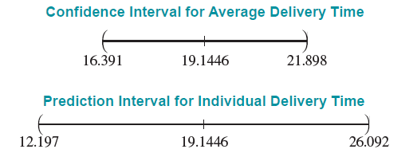
Confidence Interval for the Mean Value of y Given x—Slide 10
Can the model make a useful prediction of the delivery time? Although the model has an R² of 0.9640, the prediction interval is fairly wide. This indicates that not a great deal of confidence can be placed in the estimated value of 19.1446 minutes as a delivery time for 5 pizzas traveling 6 miles.

