Slide 1
Section 14.5
Models with Qualitative Independent Variables

Slide 2
Models with Qualitative Independent Variables—Slide 1
Throughout Chapter 13 and this chapter, we have discussed quantitative variables in the regression models. Quantitative variables take on values on a well-defined scale, such as number of pizzas, miles to destination, income, age, and temperature. Many variables of interest in business and economics, however, are not quantitative, but qualitative. Examples of qualitative variables are gender (male or female), firm size (small, medium, or large), and type of investment (stock or mutual fund).

Slide 3
Models with Qualitative Independent Variables—Slide 2
In order to use qualitative variables in regression analysis, we need to identify the classes of the qualitative variable quantitatively. To do this, we will use indicator (or dummy) variables that take on values of 0 and 1. If we have a qualitative variable with 𝑐 classes, that variable will be represented by c −1 indicator variables in the regression model, with each indicator variable taking on a value of 0 or 1.

Slide 4
Definition: Indicator (or Dummy) Variable
An indicator (or dummy) variable is created to assign numerical values to classes of a categorical variable. The dummy variable allows one to use a single variable to represent multiple categories.

Slide 5
Models with Qualitative Independent Variables—Slide 3
Suppose we added a variable to our pizza model that asked the customer if they lived in town or out of town. The variable, let’s call it town (in or out), has c = 2 classes. Thus, the variable town will be represented by c − 1 = 1 indicator variable in the model. Town could be modeled as follows.
The regression model would then be

Slide 6
Models with Qualitative Independent Variables—Slide 4
To understand the meaning of the regression coefficients in this model, consider the difference in the model for out-of-town (x₃ = 0) and in-town (x₁ = 0) deliveries. For an out-of-town delivery, x₃ = 0, and we have
Similarly, for an in-town delivery, x₃ = 1, and the model becomes

Slide 7
Models with Qualitative Independent Variables—Slide 5
Notice the difference in the two models. The out-of-town model has an intercept of β₀ and the in-town model has an intercept of (β₀ + β₃). After examining the two models, the difference is clear. The coefficient β₃ indicates how much more (or less) the delivery time will be for deliveries in town versus deliveries out of town, for any given number of pizzas (x₁) and distance (x₂).

Slide 8
Models with Qualitative Independent Variables—Slide 6
Thus β₃ measures the differential effect of the in-town/out-of-town delivery. In general, β₃ shows how much higher (or lower) the line of best fit is for the class coded 1 than the class coded 0, for any given level of x₁ and x₂.

Slide 9
Example 1: Determining the Significance of a Qualitative Variable in a Multiple Regression Model—Slide 1
Table 1 contains the pizza delivery data set, but with the added column of the variable Town, indicating whether the pizza is to be delivered in town or out of town.

Slide 10
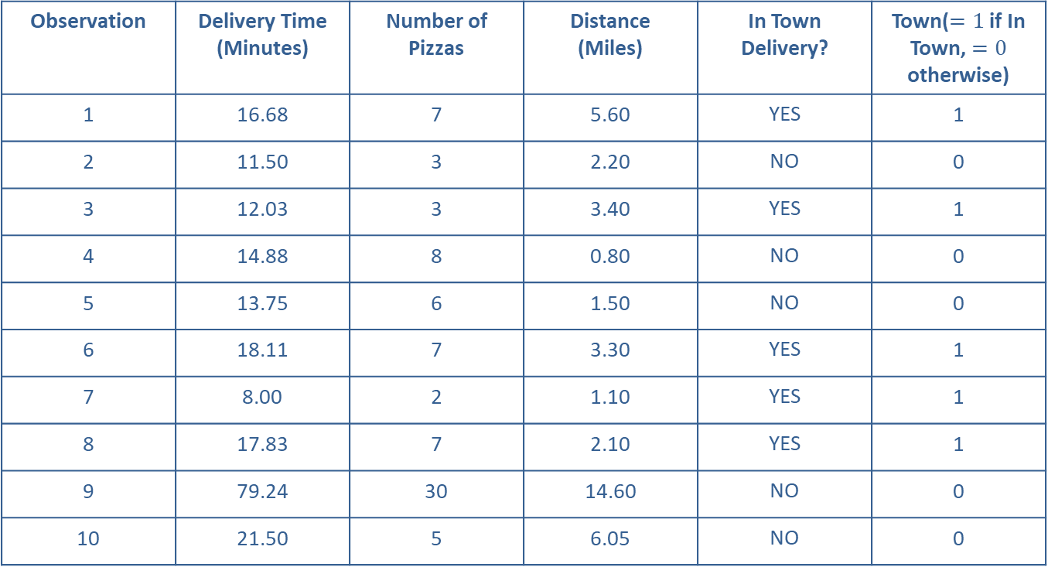
Example 1: Determining the Significance of a Qualitative Variable in a Multiple Regression Model—Slide 2
Table 1 – Pizza Delivery Time Data
Observation | Delivery Time (Minutes) | Number of Pizzas | Distance (Miles) | In Town Delivery? | Town($=1$ if In Town, $=0$ otherwise)
1 | 16.68 | 7 | 5.60 | YES | 1
2 | 11.50 | 3 | 2.20 | NO | 0
3 | 12.03 | 3 | 3.40 | YES | 1
4 | 14.88 | 8 | 0.80 | NO | 0
5 | 13.75 | 6 | 1.50 | NO | 0
6 | 18.11 | 7 | 3.30 | YES | 1
7 | 8.00 | 2 | 1.10 | YES | 1
8 | 17.83 | 7 | 2.10 | YES | 1
9 | 79.24 | 30 | 14.60 | NO | 0
10 | 21.50 | 5 | 6.05 | NO | 0

Slide 11
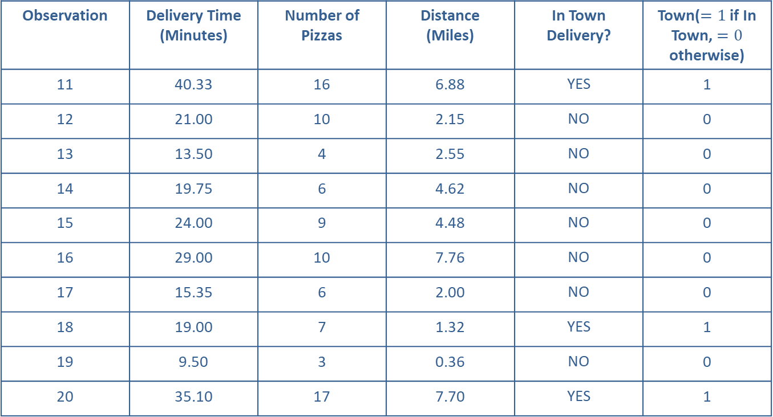
Example 1: Determining the Significance of a Qualitative Variable in a Multiple Regression Model—Slide 3
Table 1 – Pizza Delivery Time Data
Observation | Delivery Time (Minutes) | Number of Pizzas | Distance (Miles) | In Town Delivery? | Town($=1$ if In Town, $=0$ otherwise)
11 | 40.33 | 16 | 6.88 | YES | 1
12 | 21.00 | 10 | 2.15 | NO | 0
13 | 13.50 | 4 | 2.55 | NO | 0
14 | 19.75 | 6 | 4.62 | NO | 0
15 | 24.00 | 9 | 4.48 | NO | 0
16 | 29.00 | 10 | 7.76 | NO | 0
17 | 15.35 | 6 | 2.00 | NO | 0
18 | 19.00 | 7 | 1.32 | YES | 1
19 | 9.50 | 3 | 0.36 | NO | 0
20 | 35.10 | 17 | 7.70 | YES | 1

Slide 12
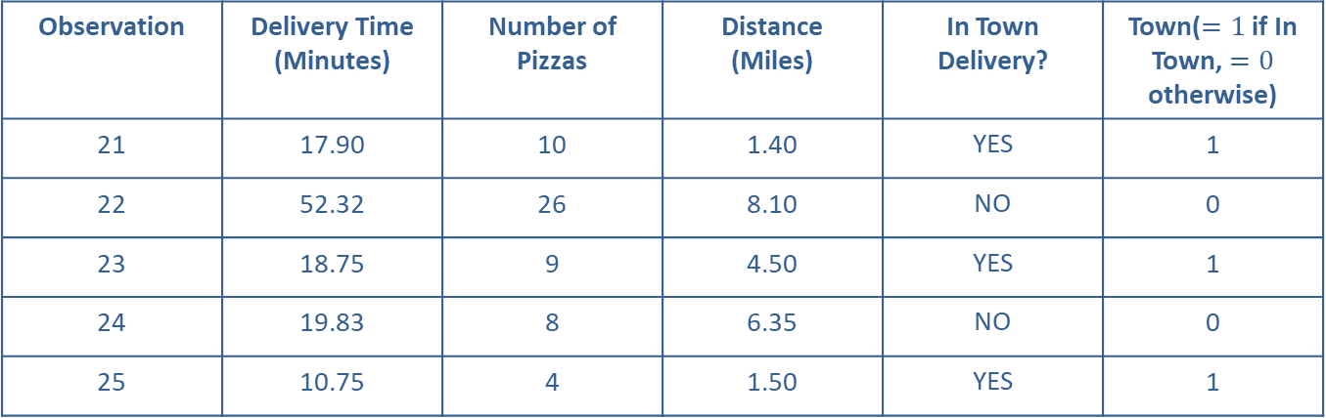
Example 1: Determining the Significance of a Qualitative Variable in a Multiple Regression Model—Slide 4
Table 1 – Pizza Delivery Time Data
Observation | Delivery Time (Minutes) | Number of Pizzas | Distance (Miles) | In Town Delivery? | Town($=1$ if In Town, $=0$ otherwise)
21 | 17.90 | 10 | 1.40 | YES | 1
22 | 52.32 | 26 | 8.10 | NO | 0
23 | 18.75 | 9 | 4.50 | YES | 1
24 | 19.83 | 8 | 6.35 | NO | 0
25 | 10.75 | 4 | 1.50 | YES | 1

Slide 13
Example 1: Determining the Significance of a Qualitative Variable in a Multiple Regression Model—Slide 5
You may recall that we are interested in modeling the delivery time (in minutes) as a function of the following variables.
x₁ = Number of Pizzas
x₂ = Distance (miles)
The multiple regression model is given by
The fitted regression model is as follows.
Estimated Delivery Time = 2.4589
= 2.4589 + 1.5936 (Number of Pizzas) + 1.5294(Distance) – 1.2493(Town)

Slide 14
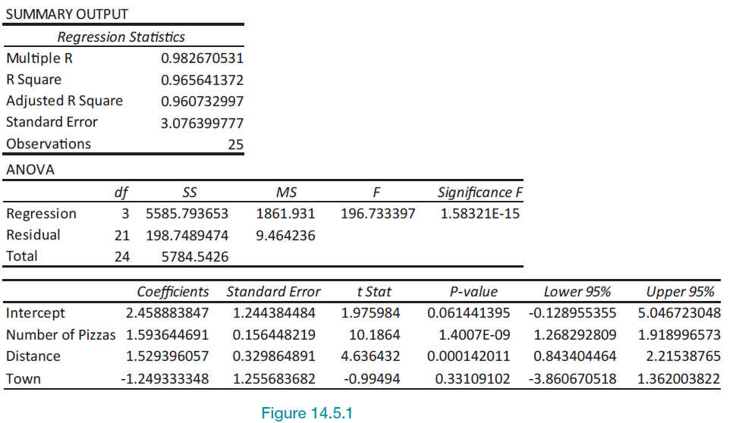
Example 1: Determining the Significance of a Qualitative Variable in a Multiple Regression Model—Slide 6
Figure 1

Slide 15
Example 1: Determining the Significance of a Qualitative Variable in a Multiple Regression Model—Slide 7
Now that we are fitting the model with Town as the indicator variable, we are interested in the effect that delivering pizzas in town or out of town has on the average delivery time. The estimate of β₃ is −1.2493. This means that the difference in average delivery time is approximately 1.25 minutes. Specifically, the average delivery time in town is about 1.25 minutes less than out of town.

Slide 16
Example 1: Determining the Significance of a Qualitative Variable in a Multiple Regression Model—Slide 8
Another important question would be, is the slope associated with the town variable significant? The formal test can be carried out just as we did in Section 14.3. That is, our hypotheses are the following.
H ₀: β₃ = 0(Implies Town is not a useful predictor of delivery time.)
H _{α}: β₃ = 0 (Implies Town is a useful predictor of delivery time.)

Slide 17

Example 1: Determining the Significance of a Qualitative Variable in a Multiple Regression Model—Slide 9
According to the Excel output, we have a t-statistic of $−$0.995 with a P-value of 0.3311. Given the large
P-value associated with this test, we would fail to reject the null hypothesis and conclude that the Town variable is not a useful predictor of delivery time.

Slide 18
Example 2: Determining a Multiple Regression Model with Qualitative Variables—Slide 1
A real estate investor wants to study the relationship between annual return on his commercial retail shops (measured in thousands of dollars) as it relates to their location and the number of homes near the shops. Specifically, the investor has collected data on the annual return of the shops, the number of households within 15 miles of the shops (measured in thousands), and the location of the shops (whether the shops are in a suburban area, near a shopping mall, or downtown). The annual return data are given in the following table.

Slide 19
Example 2: Determining a Multiple Regression Model with Qualitative Variables—Slide 2
Table 2 – Shop Data
Shop | Location | Annual Return (Thousands of Dollars) | Number of Households (Thousands)
1 | Mall | 185.69 | 163
2 | Suburban | 203.00 | 215
3 | Mall | 245.81 | 232
4 | Mall | 137.07 | 108
5 | Suburban | 207.36 | 220
6 | Suburban | 146.12 | 150
7 | Downtown | 111.21 | 102
8 | Suburban | 188.19 | 198
9 | Downtown | 152.23 | 149
10 | Suburban | 182.23 | 192

Slide 20
Example 2: Determining a Multiple Regression Model with Qualitative Variables—Slide 3
Table 2 – Shop Data
Shop | Location | Annual Return (Thousands of Dollars) | Number of Households (Thousands)
11 | Mall | 198.88 | 179
12 | Mall | 139.65 | 111
13 | Mall | 156.22 | 130
14 | Downtown | 224.17 | 232
15 | Downtown | 195.62 | 199
16 | Suburban | 210.38 | 224
17 | Downtown | 209.16 | 215
18 | Mall | 260.82 | 250
19 | Mall | 200.16 | 180
20 | Suburban | 127.66 | 129

Slide 21
Example 2: Determining a Multiple Regression Model with Qualitative Variables—Slide 4
Table 2 – Shop Data
Shop | Location | Annual Return (Thousands of Dollars) | Number of Households (Thousands)
21 | Downtown | 170.59 | 170
22 | Mall | 219.93 | 203
23 | Downtown | 166.61 | 166
24 | Downtown | 225.71 | 234
25 | Downtown | 143.25 | 139
26 | Downtown | 239.55 | 250
27 | Downtown | 219.67 | 227
28 | Suburban | 224.84 | 241
29 | Mall | 232.32 | 217
30 | Downtown | 163.95 | 163

Slide 22
Data
This data set can be found at stat.hawkeslearning.com under Data Sets → Retail Shops.

Slide 23

Example 2: Determining a Multiple Regression Model with Qualitative Variables—Slide 5
Solution
Given the data, we can define our variables as follows.
x₁ = Number of Households
Since location is a qualitative variable and there are three locations, we will use c $−$ 1 = 3 $−$ 1 = 2 variables to represent the locations. The variables representing locations are

Slide 24
Example 2: Determining a Multiple Regression Model with Qualitative Variables—Slide 6
The suburban location is known as the base level variable since for suburban locations x₂ = 0 and x₃ = 0. The coefficients estimated for the x₂ and x₃ indicator variables will represent a difference between the mall and downtown locations and the suburban location.

Slide 25
Definition: Base Level Variable
When a categorical variable has more than two classes, the base level variable is the one that is not represented by a dummy variable in the model. The base level variable is the category against which all other categories are compared (i.e., when all the other categorical variables in the model are set equal to zero).

Slide 26
Example 2: Determining a Multiple Regression Model with Qualitative Variables—Slide 7
The multiple regression model for annual return is given by
The fitted regression model is
Estimated Annual Return
= 15.5071+ 0.8704 (Number of households)
+ 27.8186 (Mall) + 6.7185 (Downtown).

Slide 27
Example 2: Determining a Multiple Regression Model with Qualitative Variables—Slide 8
Let's discuss the model and its implications. First of all, we want to know if the location and the number of households in the area are useful predictors of annual return of the shops. You may recall that the test of the model's significance is conducted using the F-test that tests the following hypotheses.

Slide 28
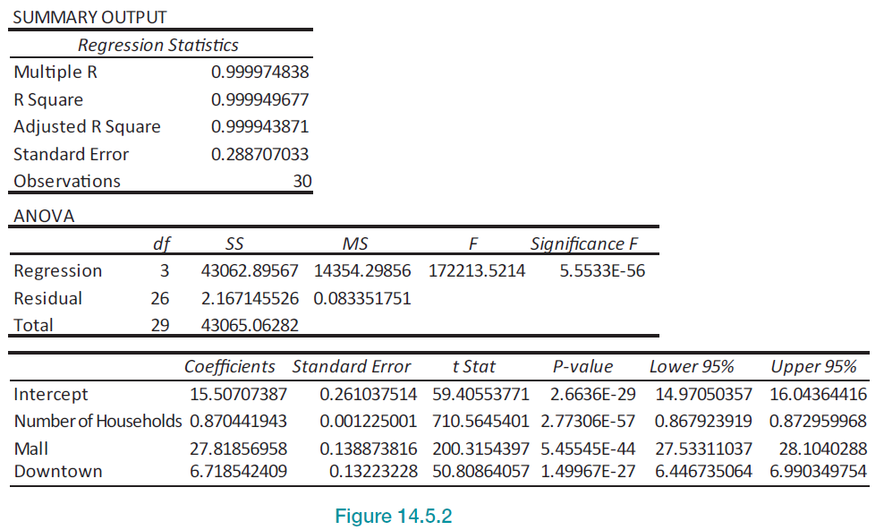
Example 2: Determining a Multiple Regression Model with Qualitative Variables—Slide 9
Figure 2

Slide 29
Example 2: Determining a Multiple Regression Model with Qualitative Variables—Slide 10
Examining the Excel output in Figure 2, we see that the F-statistic for the test is 172,213.5214 with a P-value near zero. This is an indication that we reject H₀ and conclude that at least one of the slopes in the model is significantly different from zero, and the model can be useful.

Slide 30
Example 2: Determining a Multiple Regression Model with Qualitative Variables—Slide 11
Having concluded that the model is significant, we focus our attention on the individual regression coefficients. That is, we can test the following hypotheses.
If we examine the P-values in the Excel output for each of the coefficients, it is noted that each of them is near zero, indicating that each coefficient is different from zero, and each independent variable is useful in predicting annual return.

Slide 31
Example 2: Determining a Multiple Regression Model with Qualitative Variables—Slide 12
Now we can examine the average annual return of the investments as a function of the location of the shops (i.e., whether they are near a mall, downtown, or in a suburban area). The estimated models can be written as follows.
For the mall location (x₂ = 1, x₃ = 0):
Estimated Annual Return
= (b₀ + b₂) + b₁ (Number of Households)
= (15.5071 + 27.8186) + 0.8704 (Number of Households).

Slide 32

Example 2: Determining a Multiple Regression Model with Qualitative Variables—Slide 13
For the downtown location (x₂ = 0, x₃ = 1$):$
Estimated Annual Return
= (b₀ + b₃) + b₁ (Number of Households)
= (15.5071 + 6.7185) + 0.8704 (Number of Households).

Slide 33
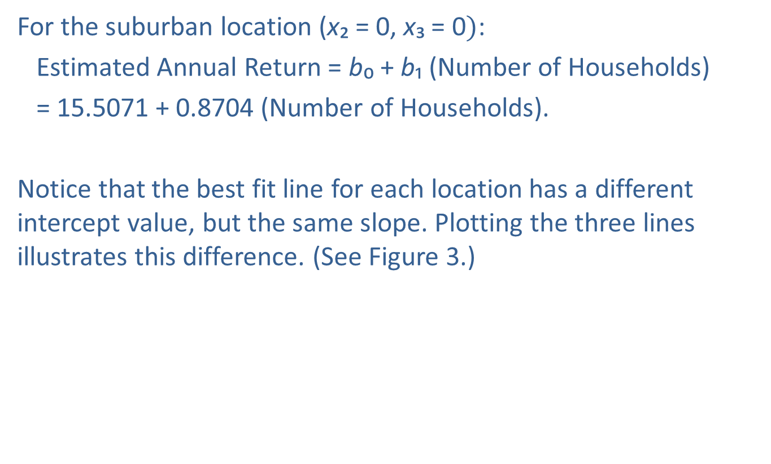
Example 2: Determining a Multiple Regression Model with Qualitative Variables—Slide 14
For the suburban location (x₂ = 0, x₃ = 0$)$:
Estimated Annual Return = b₀ + b₁ (Number of Households)
= 15.5071 + 0.8704 (Number of Households).
Notice that the best fit line for each location has a different intercept value, but the same slope. Plotting the three lines illustrates this difference. (See Figure 3.)

Slide 34
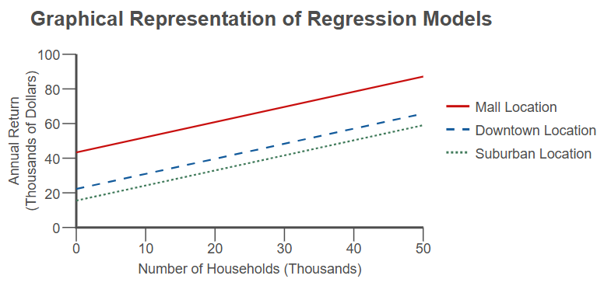
Example 2: Determining a Multiple Regression Model with Qualitative Variables—Slide 15
Figure 3

Slide 35
Example 2: Determining a Multiple Regression Model with Qualitative Variables—Slide 16
So, modeling with the qualitative variables allows us to compare the average difference in annual return of the shops by location. That is, in order to compare the mall and suburban locations, the difference (as can be seen in the model) is

Slide 36
Example 2: Determining a Multiple Regression Model with Qualitative Variables—Slide 17
Therefore, the estimate of β₂ (which is 27.8186) represents the difference between the average annual return for shops in the mall locations having x₁ households in the area and the average annual return for shops in the suburban locations having x₁ households in the area.

Slide 37
Example 2: Determining a Multiple Regression Model with Qualitative Variables—Slide 18
Thus, we can say that for any number of households in a given area, the average annual return in a mall location will be approximately $27,818.60 greater than the average annual return in a suburban location.
Similarly, to compare downtown and suburban returns, we get

Slide 38
Example 2: Determining a Multiple Regression Model with Qualitative Variables—Slide 19
Thus, the estimate of β₃ (which is 6.7185) represents the difference between the average annual return for shops in the downtown locations having x₁ households in the area and the average annual return for shops in the suburban locations having x₁ households in the area.

Slide 39
Example 2: Determining a Multiple Regression Model with Qualitative Variables—Slide 20
So, we can say that for any number of households in a given area, the average annual return in a downtown location will be $6718.50 greater than the average annual return in a suburban location.
Lastly, to compare mall and downtown locations, we look at

Slide 40
Example 2: Determining a Multiple Regression Model with Qualitative Variables—Slide 21
The estimated difference between β₂ and β₃ (which is 21.1001) represents the difference between the average annual return for shops in the mall locations having x₁ households in the area and the average annual return for shops in the downtown locations having x₁ households in the area. In terms of the problem, we can say that for any number of households in a given area, the average annual return in a mall area will be $21,100.10 greater than the average annual return in a downtown location.

Slide 41
Models with Qualitative Independent Variables—Slide 7
There are three potential issues to keep in mind when using these regression results.
1. These results are only meaningful within the relevant range of the data that was used to estimate the regression equation.

Slide 42
Models with Qualitative Independent Variables—Slide 8
2. The regression lines for the three locations in Example 2 are assumed to have the same slope, but in reality they could have very different slopes. Using a regression model with interaction terms allows the slopes for the regression lines to differ.

Slide 43
Models with Qualitative Independent Variables—Slide 9
3. The regression lines estimated in this example are all linear. This implies that annual return increases by the same amount for each additional thousand households within 15 miles of the shops. This assumption is sometimes unrealistic. This issue can be addressed using polynomial (or nonlinear) regression models.

Slide 44
Definition: Interaction Term
The interaction term is represented in the multiple linear regression model by the product of two independent variables (for example, the interaction term may appear as β₃ x₁ ∗ x₂ in the model). When testing the significance of the slope associated with the interaction term, if the slope is significant, it will be an indication that there is a relationship between the two independent variables included in the interaction term.

Slide 45
Definition: Polynomial (or Nonlinear) Regression Models
Polynomial regression models are used when the relationship between the independent variable and the dependent variable are modeled using an n ^{th} degree polynomial in the independent variable. For example, the regression model could resemble
y = β₀ + β₁ x³ + ε.

