Slide 1
Section 15.1
Time Series Components

Slide 2
Definition: Forecasting
Forecasting is a prediction of what will occur in the future.

Slide 3
Definition: Time Series Analysis (TSA)
Time Series Analysis (TSA) is a statistical technique that uses time series data for explaining the past or forecasting the future events.

Slide 4
Definition: Timeframe
Timeframe refers to how far we want to predict into the future. The timeframe will be a function of the number of observations and the structure of the data into periods.

Slide 5
Definition: Trend
Trend is a gradual, long-term movement (up or down) of a variable.

Slide 6
Definition: Seasonal Variation
Seasonal Variation is an up-and-down repetitive movement that occurs within a trend and occurs periodically.

Slide 7
Definition: Cycle or Cyclical Variation
Cycle or Cyclical Variation is an up-and-down repetitive movement in a variable that repeats itself over a long period of time.

Slide 8
Definition: Random Variations
Random Variations are erratic movements that are not predictable because they do not follow a pattern.

Slide 9
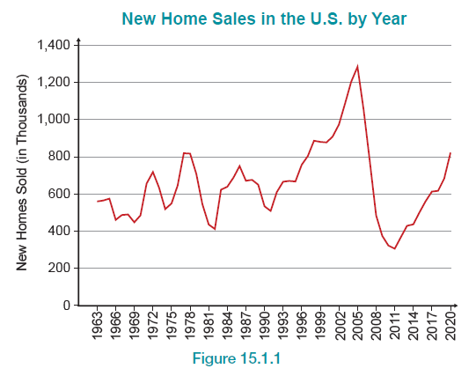
Time Series Plot—Slide 1
Figure 1

Slide 10
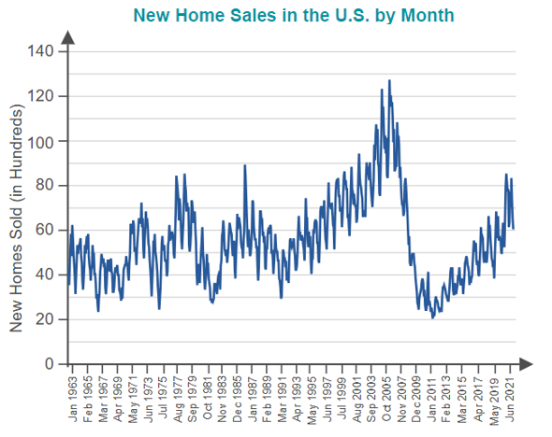
Time Series Plot—Slide 2
Figure 2

Slide 11
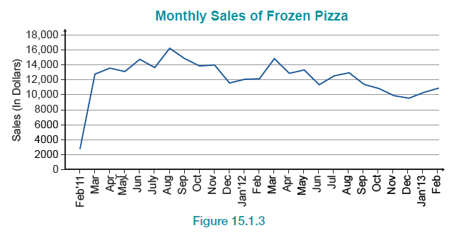
Time Series Plot—Slide 3
Figure 3

Slide 12
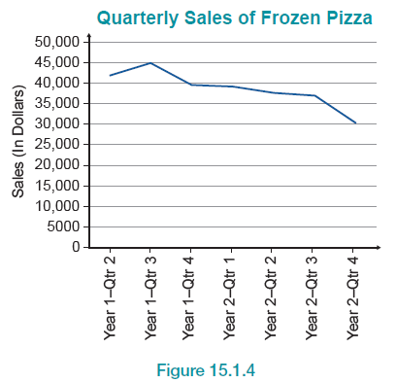
Time Series Plot—Slide 4
Figure 4

Slide 13
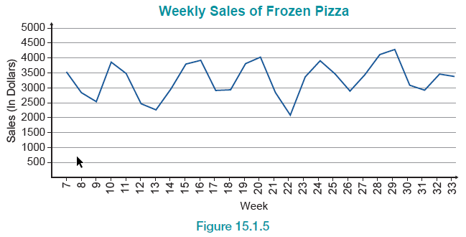
Time Series Plot—Slide 5
Figure 5

Slide 14
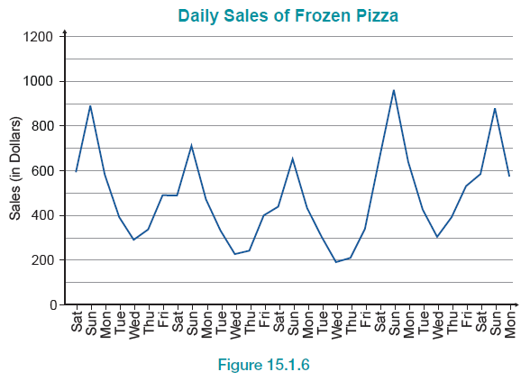
Time Series Plot—Slide 6
Figure 6

Slide 15
Definition: Types of Time series Data
Stationary data is the result of a time series variable exhibiting no significant upward or downward trend over time.
Nonstationary data is the result of a time series variable exhibiting a significant upward or downward trend over time.
Seasonal data is the result of a time series variable exhibiting a repeating pattern at regular intervals over time.

Slide 16
Time Series Methods—Slide 1
Table 1 The Most Common Time Series Profiles
Pattern Profile | Description
Constant Level | No upward or downward trend
Linear trend | Consistent increase in either upward or downward direction
Exponential trend | Growth rate increases to higher rates over time
Damped trend | Growth pattern gradually decays after a few periods to no increase
Nonseasonal | No seasonal variation
Additive seasonality | The seasonal variation does not grow or decline systemically over time
Multiplicative seasonality | The seasonal variation widens over time with the increase in level of data
Note: Theses pattern profiles may also occur in combination.

Slide 17
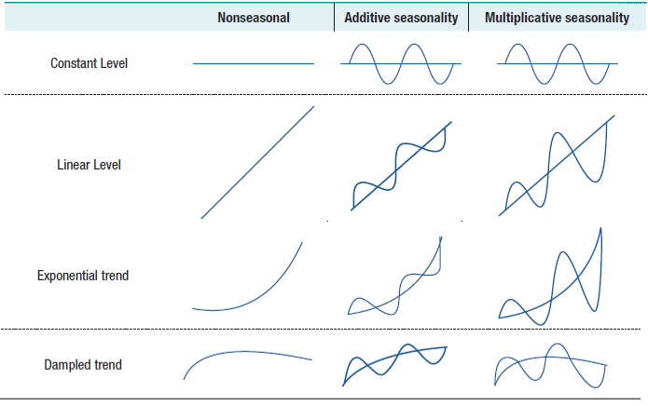
Time Series Methods—Slide 2
Time Series Profile Based on Pegels’ and Gardner’s Classification
Figure 8

