Slide 1
Section 15.2
Moving Averages

Slide 2
Definition: Simple Moving Average (SMA)
The simple moving average (SMA), uses the average of several values (two or more) from the recent past to develop a forecast.

Slide 3
Formula: Simple Moving Average
M A _{n} denotes the moving average over n periods, and it is the sum of the most recent n data values in the time series divided by the number of periods (n) that we use to calculate that moving average.
Where n = the number of periods used to compute the moving average, and
D _{i} = the actual data value of the time series in period i.

Slide 4
Example 1: Calculating a 3-Month Moving Average—Slide 1
Suppose TixPixx is a company that sells concert tickets and would like to predict the sales for June using a 3-month moving average. The data for January through May can be found in the table below.
Month | Tickets Purchased
January | 9
February | 15
March | 11
April | 10
May | 12
June | *

Slide 5
Example 1: Calculating a 3-Month Moving Average—Slide 2
Solution
Using the data for January through May, we want to predict the sales for June. To calculate a 3-month moving average for June, we use the data values for the previous three months of March, April, and May, which are 11, 10, and 12, respectively, to predict the tickets purchased for June. The computation is as follows:
It would be helpful to forecast the demand for the preceding months for benchmarking or if we would like to analyze the accuracy of the forecasts.

Slide 6
Example 1: Calculating a 3-Month Moving Average—Slide 3
It should be noted that we cannot compute a 3-month moving average for January, February, or March since we do not have three months of prior data. Thus, the first month that we can compute a forecast for demand is April. To compute the moving average for April, we need to use the data values for ticket purchases for January, February, and March, which are 9, 15, and 11, respectively, and divide by 3. The 3-month moving average for April is given by:

Slide 7
Example 1: Calculating a 3-Month Moving Average—Slide 4
The 3-month moving average for May will be calculated using the data values from the previous three months, which will be 15, 11, and 10, divided by 3.
What is the value of calculating the 3-month moving average for April and May? While we do not need them now, they will be helpful to determine the accuracy of this forecast when compared to other forecasting methods.

Slide 8
Example 1: Calculating a 3-Month Moving Average—Slide 5
What would we do if we wanted to predict or forecast for several periods in the future? We would use the forecast for multiple periods and then update these forecasts as the data becomes available. For example, if we wanted a moving average for July, then we will use the actual data value for April plus the actual data value for May, and then we would use the forecast for June. For example, the 3-month moving average for July can be calculated as

Slide 9
Example 1: Calculating a 3-Month Moving Average—Slide 6
Using the 3-month moving average, we predict that we will have 11 ticket purchases for the month of July. Note that the 11 in the numerator is the forecast for June. We would update this forecasted value for June when we have new data. Similarly, if we wanted to predict two months into the future, we would have to use the forecast for July to help us predict for August.
The advantages to using the simple moving average is that it is quick, it is easy, and it is simple. It does not take a lot of time to calculate these moving averages. One of the constraints in simple moving average is that

Slide 10
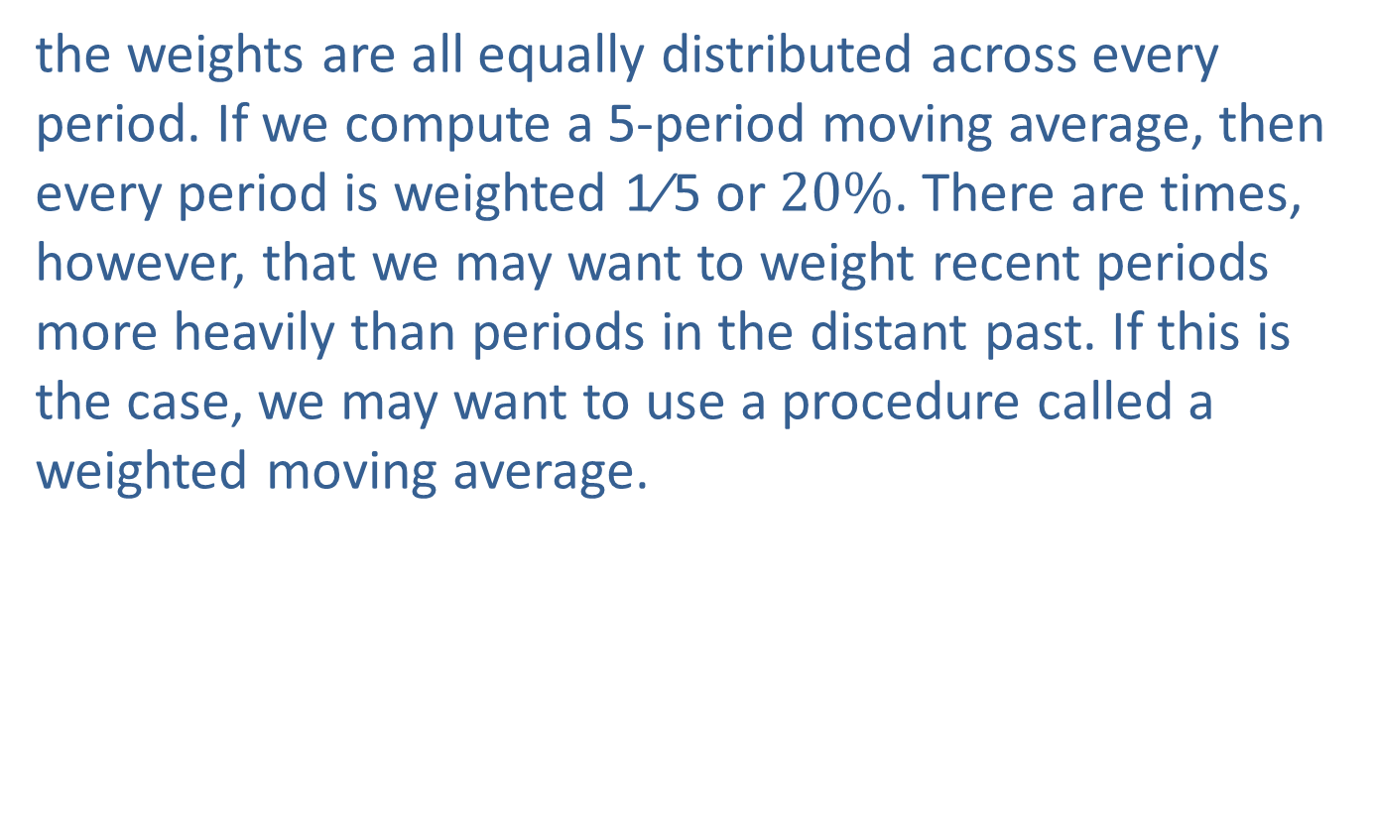
Example 1: Calculating a 3-Month Moving Average—Slide 7
the weights are all equally distributed across every period. If we compute a 5-period moving average, then every period is weighted 1⁄5 or $20\%$. There are times, however, that we may want to weight recent periods more heavily than periods in the distant past. If this is the case, we may want to use a procedure called a weighted moving average.

Slide 11
Definition: Weighted Moving Average—Slide 1
In a weighted moving average, each value in the time window (number of periods chosen) is multiplied by a weight between 0 and 1, with the sum of the weights equaling 1.

Slide 12
Definition: Weighted Moving Average—Slide 2
The computational formula for weighted moving average involves summing the product of the weights and corresponding time series data values as follows:
Where W _{i} = the weight for period i, D _{i} = the data value for the period i, n = number of periods chosen, and

Slide 13
Example 2: Calculating a Weighted Moving Average for the TixPixx Data
Using the TixPixx data, calculate a weighted moving average for June using the weights of 0.1, 0.3, and 0.6 on the most recent months.
Solution
Note that the instructions imply that we want to put the 0.6 weight on the most recent month, 0.3 on the next most recent month, and 0.1 on the more distant month’s data value. The sum of the weights is equal to 1 and it should be noted that this a three-period weighted moving average. Therefore, the forecast for June using a 3-month WMA is
Recall that the simple moving average forecast was 11.

Slide 14
Example 3: Calculating Moving Averages (SMA and WMA) for Truck Crossings—Slide 1
The Department of Transportation wanted to predict the number of truck crossings at the Port of Laredo for 2019. Using the data in the table below which contain annual truck crossings from 2011 through 2018, predict the number of truck crossings in 2019 using a 3-period moving average.
Year | Number of Truck Crossings
2011 | 1,695,916
2012 | 1,789,546
2013 | 1,846,282
2014 | 1,947,846
2015 | 2,015,773
2016 | 2,083,964
2017 | 2,182,984
2018 | 2,313,967

Slide 15
Example 3: Calculating Moving Averages (SMA and WMA) for Truck Crossings—Slide 2
Solution
For 2019, the SMA using 3-periods is
However, we clearly know the number of crossings are increasing and have a positive trend, but the moving average is taking an average of the past three periods which are lower values – hence the forecast will always lag behind! Even if we chose WMA, the maximum weight we can give is about 100% or 1.0 to the most recent period, which in this case would be the number

Slide 16
Example 3: Calculating Moving Averages (SMA and WMA) for Truck Crossings—Slide 3
of crossings for 2018. Hence the best forecast would be is 2,313,967 – which is still not following a positive trend. It should be noted that when the weight is 1.0, the forecast is called the naïve forecast, where the forecast is nothing but the previous period's value. As the name suggests, it is simplistic in nature and is used for benchmarking forecasting methods.

Slide 17
Example 4: Calculating Moving Averages for Frozen Pizza Sales—Slide 1
Gigi's Grocery wants to track the number of frozen pizzas that she sells. The table below shows her quarterly pizza sales. Using the data provided in the table, use a 3-quarter moving average method to predict sales for the 5th quarter.
Quarter | Frozen Pizza Sales
1 | 38,828
2 | 37,302
3 | 36,642
4 | 30,022

Slide 18
Example 4: Calculating Moving Averages for Frozen Pizza Sales—Slide 2
Solution
If one examines the data in the table above, it's easy to see that the pizza sales follow decreasing (or negative) trend. The three-period simple moving average forecast would be
Note that this forecast does not capture the decreasing trend. The same will be true for a weighted moving average method regardless of the weighting. In general, moving averages are not well suited for time series that depicts trend or seasonality.

