Slide 1
Section 15.3
Exponential Smoothing Techniques

Slide 2
Definition: Simple Exponential Smoothing
In simple exponential smoothing, we weigh the most recent observation more than the past using a convex combination of weights.

Slide 3
Formula: Simple Exponential Smoothing
The forecast for the next period is given by
where:
D _{t} = the actual data value for the present period,
F _{t} = the forecast for the present period, and
α = the weight (smoothing constant).

Slide 4
Example 1: Computing an Exponential Smoothing Forecast—Slide 1
Using the TixPixx data, from Example 1 compute an exponentially smoothed forecast for June using α = 0.3.
Solution
Recall that the formula for exponentially smoothed forecasting is given by
To determine the forecast for June using the simple exponential smoothing method we need to calculate the forecast for periods one through six, which would include June (period six). We assume that the forecast for the first period is same as the actual time series data value. Therefore,

Slide 5

Example 1: Compute an Exponentially Smoothed Forecast—Slide 2
Using previous forecasts, we eventually see that our forecast for the month of June (F₆$\text{)}$ is 11.02.

Slide 6
Definition: Adjusted Exponential Smoothing
Adjusted exponential smoothing is a simple exponential smoothing forecast that we adjust using a trend factor.

Slide 7
Formula: Adjusted Exponential Smoothing—Slide 1
The adjusted forecast for the next period is given by
Where:
F _{t+1} = the forecast component of the period computed as a simple exponential smoothing forecast.

Slide 8
Formula: Adjusted Exponential Smoothing—Slide 2
α = the smoothing constant for the forecast component,
AF _{t} = the previous period’s trend adjusted forecast,
T _{t+1} = the forecast for the trend factor,
β = the smoothing constant for the trend component, and
T _{t} = the trend factor for the previous period.

Slide 9
Example 2: Computing an Adjusted Exponential Smoothing Forecast—Slide 1
Compute the adjusted exponential smoothing forecast for June using β = 0.2 and α = 0.3 (the same α value as in Example 1).

Slide 10
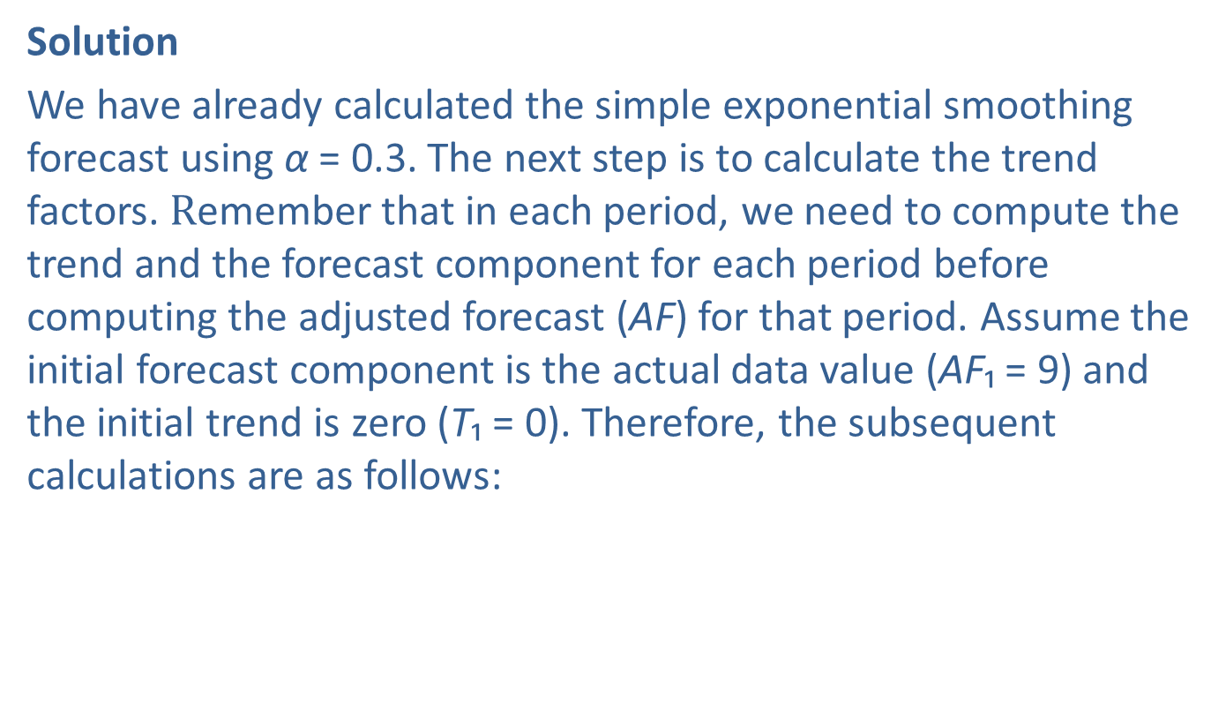
Example 2: Computing an Adjusted Exponential Smoothing Forecast—Slide 2
Solution
We have already calculated the simple exponential smoothing forecast using α = 0.3. The next step is to calculate the trend factors. Remember that in each period, we need to compute the trend and the forecast component for each period before computing the adjusted forecast (AF) for that period. Assume the initial forecast component is the actual data value (AF₁ = 9$\text{)}$ and the initial trend is zero (T₁ = 0). Therefore, the subsequent calculations are as follows:

Slide 11
Example 15.3.2: Computing an Adjusted Exponential Smoothing Forecast—Slide 3
Period 1:
F₁ = D₁ = 9
T₁ = 0
AF₁ = 9 + 0 = 9
Period 2:
AF₂ = F₂ + T₂ = 9 + 0 = 9
Period 3:
AF₃ = 11.16

Slide 12
Example 2: Computing an Adjusted Exponential Smoothing Forecast—Slide 4
This table contains the remaining forecasts.
Month | Actual sales | Forecast Component | Trend Component | Adjusted Forecast
January | 9 | 9.00 | 0.00 | 9.00
February | 15 | 9.00 | 0.00 | 9.00
March | 11 | 10.80 | 0.36 | 11.16
April | 10 | 11.11 | 0.35 | 11.46
May | 12 | 11.02 | 0.26 | 11.28
June | - | 11.50 | 0.30 | 11.80

Slide 13
Example 2: Computing an Adjusted Exponential Smoothing Forecast—Slide 5
Therefore, The adjusted exponential smoothing forecast for June is 11.80.
Figure 4 contains the simple exponentially smoothed and the adjusted exponentially smoothed forecasts for yearly Laredo truck crossing using α = 0.3 and β = 0.4, respectively. Note that the forecast is very close to the actual data.

Slide 14
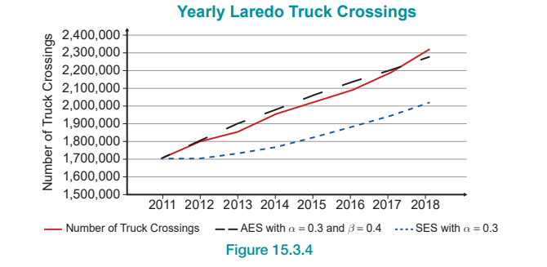
Example 2: Computing an Adjusted Exponential Smoothing Forecast—Slide 6
Figure 4

