Slide 1
Section 15.4
Forecast Accuracy

Slide 2
Definition: Forecast error
Forecast error is the difference between the forecast and the actual data value.

Slide 3
Formula: Mean Absolute Deviation (MAD)
The mean absolute deviation is the sum of the absolute value of the differences between the actual data and the forecast, divided by n, the number of periods for which the error is computed.
Where
D _{t} = the actual data for the t ^{th} period,
F _{t} = the forecast for the t ^{th} period,
N = the total number of periods for which we have computed the forecasts, and
t = the time period number.

Slide 4
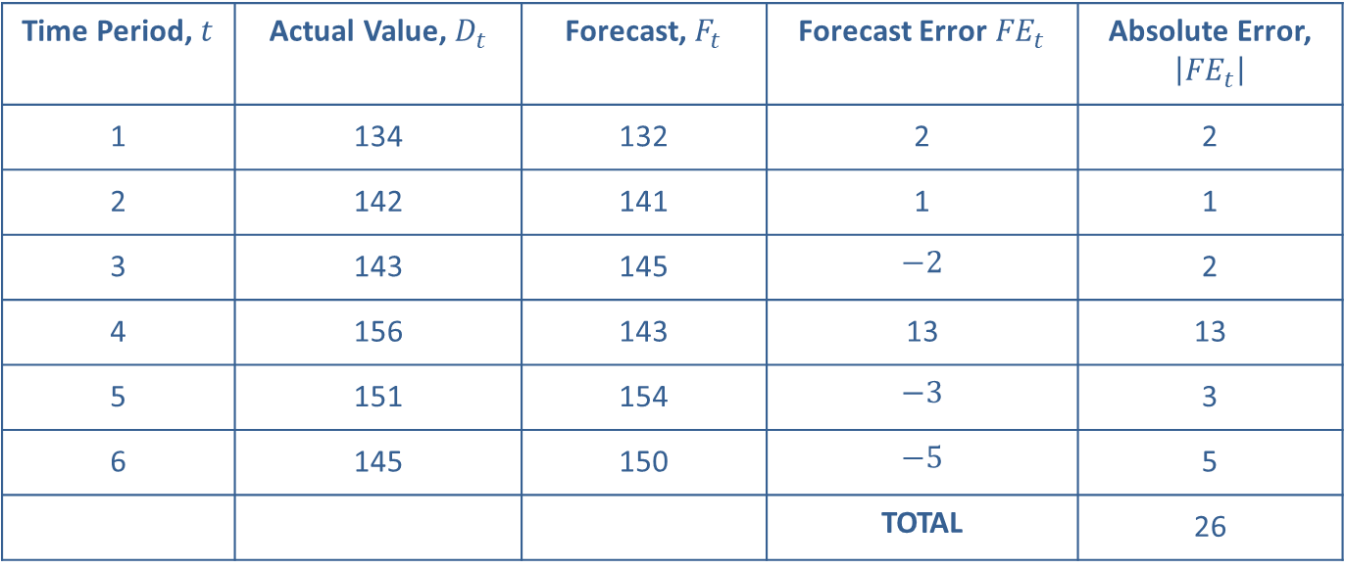
Example 1: Calculating the Mean Absolute Deviation of Forecasts—Slide 1
Consider the following time series data and forecast for the number of deliveries made by a driver over the last six months. Compute the MAD of the forecast.
Time Period, $t$ | Actual Value, $D_{t}$ | Forecast, $F_{t}$ | Forecast Error ${FE}_{t}$ | Absolute Error, $\left|{FE}_{t}\right|$
​1 | ​134 | ​132 | ​2 | ​2
​2 | ​142 | ​141 | ​1 | ​1
​3 | ​143 | ​145 | ​$−2$ | ​2
​4 | ​156 | ​143 | ​13 | ​13
​5 | ​151 | ​154 | ​$−3$ | ​3
​6 | ​145 | ​150 | ​$−5$ | ​5
 |  |  | TOTAL | ​26

Slide 5
Example 1: Calculating the Mean Absolute Deviation of Forecasts—Slide 2
Solution
If we were actually performing calculations using a 3-month simple moving average method, the first period we could forecast is period 4. In that case, we could compute the forecast for only periods 4, 5 and 6, in the above example. Thus, when MAD is computed, we would divide by 3, which represents the number of periods for which we have forecasts. Therefore, remember n in the denominator represents the number of periods for which we have forecasts.

Slide 6
Formula: Mean Absolute Percentage Error (MAPE)
In this error metric, we compute the percent by which we miss the actual data in every period. The formula is as follows:
Where:
D _{t} = the actual data for t ^{th} period,
F _{t} = the forecast for the t ^{th} period,
n = the total number of periods for which we have computed the forecasts, and
t = the period number.

Slide 7
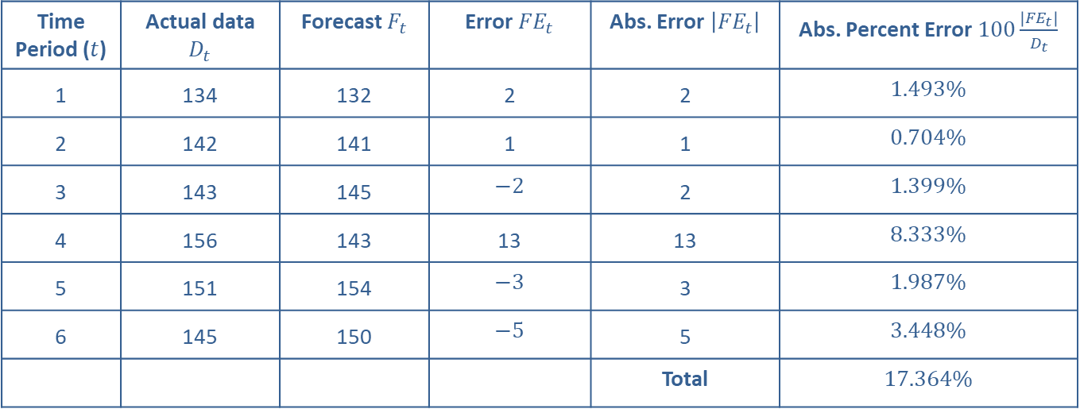
Example 2: Calculating the MAPE of Forecasts—Slide 1
For the previous time series data in Example 1, compute the MAPE.
Time Period ($t$) | Actual data $D_{t}$ | Forecast $F_{t}$ | Error ${FE}_{t}$ | Abs. Error $\left|{FE}_{t}\right|$ | Abs. Percent Error $100\frac{\left|{FE}_{t}\right|}{D_{t}}$
​1 | ​134 | ​132 | ​2 | ​2 | ​$1.493\%$
​2 | ​142 | ​141 | ​1 | ​1 | ​$0.704\%$
​3 | ​143 | ​145 | ​$−2$ | ​2 | ​$1.399\%$
​4 | ​156 | ​143 | ​13 | ​13 | ​$8.333\%$
​5 | ​151 | ​154 | ​$−3$ | ​3 | ​$1.987\%$
​6 | ​145 | ​150 | ​$−5$ | ​5 | ​$3.448\%$
 |  |  |  | Total | ​$17.364\%$

Slide 8
Example 2: Calculating the MAPE of Forecasts—Slide 2
Solution
The above error metric is useful as it gives a relative measure of accuracy. Anyone looking at this error metric would know if the time series forecast is good or not without looking at the actual data. However, this error metric is not popular with the primary drawback being that it is possible to have time series data with actual zeros. In that case, the absolute percent error would be indeterminate since we will be dividing by zero. It would also not be appropriate to omit that period's error metric since the forecast may be a non-zero value. Therefore, we need another metric that addresses this deficiency but still maintains the advantage of a scaled error metric.

Slide 9
Definition: Mean Absolute Percentage Deviation (MAPD)
The mean absolute percentage deviation is the sum of the absolute difference between the actual data and the forecasts divided by the sum of the actual data.

Slide 10
Definition: Mean Squared Error (MSE)
The mean squared error is the average of the squared errors.

Slide 11
Formula: Mean Squared Error (MSE)
The MSE is computed as follows:
Where:
D _{t} = the actual data for the t^{th} period,
F _{t} = the forecast for the t^{th} period,
n = the total number of periods for which we have
computed the forecasts, and
t = the time period number.

Slide 12
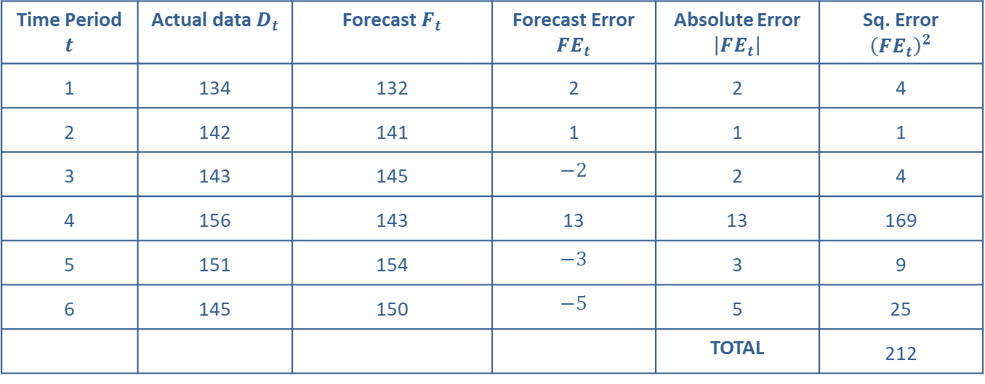
Example 3: Calculating the Mean Squared Error of Forecasts—Slide 1
Using the data in Example 1, compute the MSE.
Time Period $t$ | Actual data $D_{t}$ | Forecast $F_{t}$ | Forecast Error ${FE}_{t}$ | Absolute Error $\left|{FE}_{t}\right|$ | Sq. Error ${\left({FE}_{t}\right)}^{2}$
​1 | ​134 | ​132 | ​2 | ​2 | ​4
​2 | ​142 | ​141 | ​1 | ​1 | ​1
​3 | ​143 | ​145 | ​$−2$ | ​2 | ​4
​4 | ​156 | ​143 | ​13 | ​13 | ​169
​5 | ​151 | ​154 | ​$−3$ | ​3 | ​9
​6 | ​145 | ​150 | ​$−5$ | ​5 | ​25
 |  |  |  | TOTAL | ​212

Slide 13
Example 3: Calculating the Mean Squared Error of Forecasts—Slide 2
Solution
Looking at the above table, we can clearly see that Period 4 is an outlier. If one wants to reduce the error associated with Period 4, one may try by changing the number of periods in a moving average method or by changing the α and β of the exponential smoothing methods.
One point of caution is that lower mean squared errors may result from a technique that fits older values better than the most recent values. Keep in mind that

Slide 14
Example 3: Calculating the Mean Squared Error of Forecasts—Slide 3
sometimes it is better to compute the mean squared error using the most recent values rather than using the entire data set. That is, it may be better to pick a recent set of observations from the data set to compute the MSE. It is feasible to take a subset of the most recent observations and calculate the MSE to determine the quality of the forecasts if the user is more concerned about forecasting recent values rather than those values in the distant past.

Slide 15

Definition: Cumulative Error ($E$)
The cumulative error (E) is the sum of the forecast error.

Slide 16
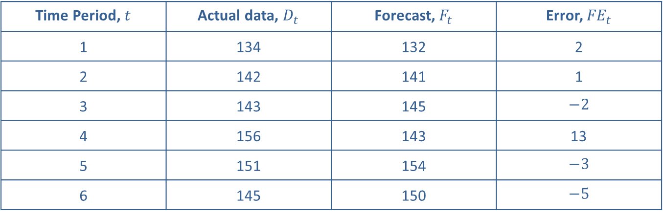
Example 4: Calculating the Cumulative Error—Slide 1
Using the data in Example 1, compute the cumulative error.
Time Period, $t$ | Actual data, $D_{t}$ | Forecast, $F_{t}$ | Error, ${FE}_{t}$
​1 | ​134 | ​132 | ​2
​2 | ​142 | ​141 | ​1
​3 | ​143 | ​145 | ​$−2$
​4 | ​156 | ​143 | ​13
​5 | ​151 | ​154 | ​$−3$
​6 | ​145 | ​150 | ​$−5$

Slide 17
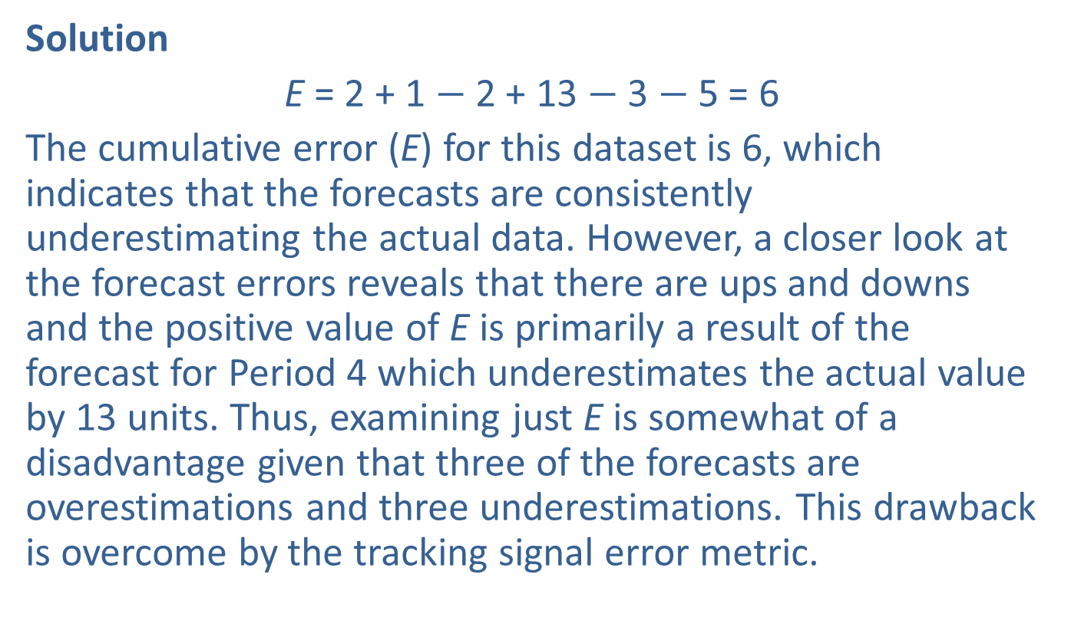
Example 4: Calculating the Cumulative Error—Slide 2
Solution
E = 2 + 1 $−$ 2 + 13 $−$ 3 $−$ 5 = 6
The cumulative error (E) for this dataset is 6, which indicates that the forecasts are consistently underestimating the actual data. However, a closer look at the forecast errors reveals that there are ups and downs and the positive value of E is primarily a result of the forecast for Period 4 which underestimates the actual value by 13 units. Thus, examining just E is somewhat of a disadvantage given that three of the forecasts are overestimations and three underestimations. This drawback is overcome by the tracking signal error metric.

Slide 18
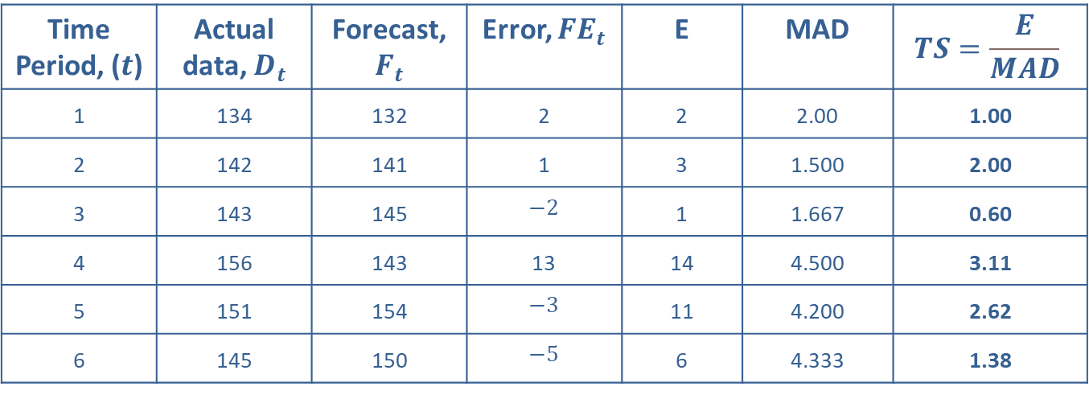
Example 5: Calculating the Tracking Signal for Forecasts—Slide 1
Using the data in Example 1, compute the tracking signal (TS).
Time Period, ($t$) | Actual data, $D_{t}$ | Forecast, $F_{t}$ | Error, ${FE}_{t}$ | E | MAD | $$TS=\frac{E}{MAD}$$
​1 | ​134 | ​132 | ​2 | ​2 | ​2.00 | ​1.00
​2 | ​142 | ​141 | ​1 | ​3 | ​1.500 | ​2.00
​3 | ​143 | ​145 | ​$−2$ | ​1 | ​1.667 | ​0.60
​4 | ​156 | ​143 | ​13 | ​14 | ​4.500 | ​3.11
​5 | ​151 | ​154 | ​$−3$ | ​11 | ​4.200 | ​2.62
​6 | ​145 | ​150 | ​$−5$ | ​6 | ​4.333 | ​1.38

Slide 19
Example 5: Calculating the Tracking Signal for Forecasts—Slide 2
Solution
As you can see from the above table, the forecast is biased as indicated by E. But the TS is within +4 and −4 and there is no discernible trend; it goes up and down randomly.
There are several error metrics is forecasting analysis. They all let you make the same decisions—whether the forecast is good or not. Depending upon on our need, we could choose the appropriate error metric on which to focus. For example, MAPD is suggested for accuracy, TS is suggested for bias, and MSE is suggested for outliers.

