Slide 1
Section 16.1
The Chi-Square Distribution

Slide 2
Definition: Chi-Square Statistic
If n observations are randomly selected from a normal population with variance σ², and s² is computed for the sample, then the chi-square statistic
has a chi-square distribution with n − 1 degrees of freedom.

Slide 3
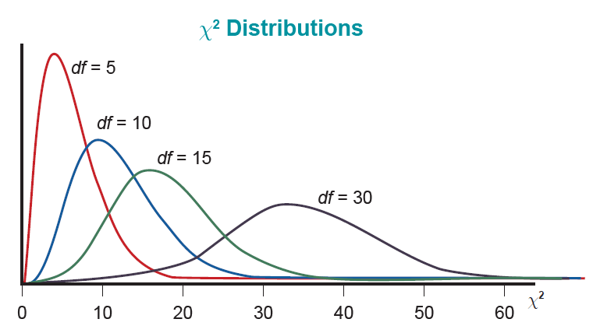
Chi-Square Statistic—Slide 1
Figure 1

Slide 4
Chi-Square Statistic—Slide 2
A chi-square distribution is a continuous distribution. Unlike the normal distribution and the t-distribution, the chi-square distribution is not symmetric. In fact, for small values of n, it is very skewed, as you can see from Figure 1.

Slide 5
Chi-Square Statistic—Slide 3
Another property of the chi-square distribution which is different from the normal and t-distributions is that it only takes on values which are nonnegative.

Slide 6


Determining the Chi-Square Critical Values—Slide 1
Suppose a significance level of α$=0.05$ has been specified and our sample size is $20$. The chi-square distribution has one parameter, degrees of freedom, which is equal to n$−1$. If the null hypothesis is rejected for large values of the test statistic, we look in the table under the column labeled
and find the critical value corresponding to 20 − 1, or $19$ degrees of freedom. The corresponding critical value is 30.144, as shown in Figure 2.

Slide 7
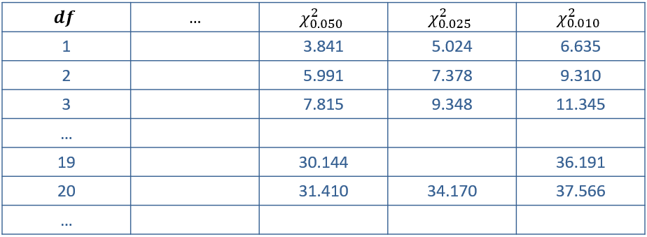
Determining the Chi-Square Critical Values—Slide 2

Slide 8
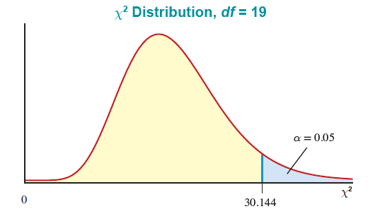
Determining the Chi-Square Critical Values—Slide 3
Figure 2

