Slide 1
Section 16.2
The Chi-Square Test for Goodness of Fit

Slide 2
Definition: Multinomial Probability Distribution
The multinomial probability distribution is a type of probability distribution used to calculate the outcomes of experiments that have random variables with two or more outcomes.

Slide 3
Properties: Multinomial Experiment
1. ​The experiment consists of n independent, identical trials.
2. ​There are k possible outcomes for each trial.
3. ​The probabilities of the k outcomes,
are constant from trial to trial.
4. The random variables of interest are the counts in each of the k possible outcomes,

Slide 4
Procedure: Chi-Square Test for Goodness of Fit —Slide 1
Hypotheses:
H _{a}: Any possible difference.

Slide 5
Procedure: Chi-Square Test for Goodness of Fit —Slide 2
Test Statistic:
where n _{i} is the actual number of observations observed in each category, and E(n _{i}) is the expected number of observations for each category given that the null hypothesis is true.

Slide 6

Procedure: Chi-Square Test for Goodness of Fit —Slide 3
Assuming that the null hypothesis is true, and n is large enough so that E(n _{i}) is at least 5 for each category, the test statistic has a chi-square distribution with k − 1 degrees of freedom.
Rejection Region:
Reject H₀ if
with k$−1$ degrees of freedom.

Slide 7
Example 1: Detecting a Change in a Qualitative Variable—Slide 1
Let's return to the survey at the beginning of the chapter regarding support for basic research between surveys conducted in January of 2017 and again in January of 2021. A cursory look at Table 2 appears to suggest that the American public's perception of support for basic research has increased over time.

Slide 8
Example 1: Detecting a Change in a Qualitative Variable—Slide 2
This difference may simply be due to random variation in the samples or it could represent a real shift in the public sentiment. We will rely on statistical inference methods to determine if the differences are too large to be attributed to sampling variation alone. The chi-square test for goodness of fit can be used to answer the question of whether or not there had been any change in the American sentiment towards support for basic research.

Slide 9
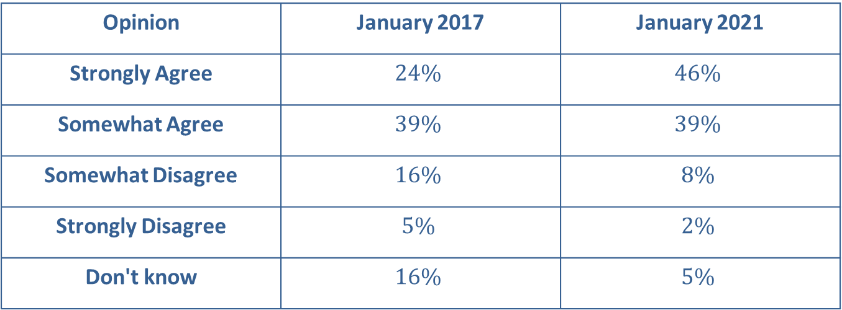
Example 1: Detecting a Change in a Qualitative Variable—Slide 3
Table 2 – Opinion on Support for Basic Research
Opinion | January 2017 | January 2021
Strongly Agree | $$24\%$$ | $$46\%$$
Somewhat Agree | $$39\%$$ | $$39\%$$
Somewhat Disagree | $$16\%$$ | $$8\%$$
Strongly Disagree | $$5\%$$ | $$2\%$$
Don't know | $$16\%$$ | $$5\%$$

Slide 10
Example 1: Detecting a Change in a Qualitative Variable—Slide 4
The question: Do you agree or disagree with the following statement? Even if it brings no immediate benefits, basic scientific research that advances the frontiers of knowledge is necessary and should be supported by the federal government.

Slide 11
Example 1: Detecting a Change in a Qualitative Variable—Slide 5
There were 1215 respondents in the January 2017 survey. Is there sufficient evidence to conclude at α = 0.10 that American sentiment towards support for basic research changed from January 2017 to January 2021?

Slide 12
Example 1: Detecting a Change in a Qualitative Variable—Slide 6
Solution
Step 1: Determine the null hypothesis.
The null hypothesis states that the American sentiment toward support for basic research did not change from January 2017 to January 2021.

Slide 13
Example 1: Detecting a Change in a Qualitative Variable—Slide 7
The variable to be analyzed is opinion, which has five possible values: Strongly Agree, Somewhat Agree, Somewhat Disagree, Strongly Disagree, and Don't Know. Further, our interest is in the proportion (or percentage) of Americans that falls into each of the opinion categories.
The null hypothesis can be written as

Slide 14
Example 1: Detecting a Change in a Qualitative Variable—Slide 8
Step 2: Determine the alternative hypothesis and whether it should be one-sided or two-sided.
The alternative hypothesis is that the American sentiment did change from January 2017 to January 2021. This can be written as
H _{a}: Any possible difference from the hypothesized proportions.

Slide 15
Example 1: Detecting a Change in a Qualitative Variable—Slide 9
The chi-square test for goodness of fit is always a one-tailed test because of the way the test statistic is constructed. We will reject the null hypothesis in favor of the alternative hypothesis for large values of the test statistic.

Slide 16
Example 1: Detecting a Change in a Qualitative Variable—Slide 10
Step 3: Select the appropriate test statistic based on the information at hand and the assumptions you are willing to make.
The number of Americans falling into a particular sentiment category satisfies the properties of a multinomial probability distribution, and the expected number of observations in each category is at least 5. Thus, we can use the chi-square test for goodness of fit. The chi-square test statistic is given by

Slide 17
Example 1: Detecting a Change in a Qualitative Variable—Slide 11
This test statistic has an approximate chi-square distribution with 5 − 1 = 4 degrees of freedom, assuming the null hypothesis is true.

Slide 18
Example 1: Detecting a Change in a Qualitative Variable—Slide 12
Step 4: Determine the critical value of the test statistic.
The significance level of the test is specified in the statement of the problem as α = 0.10.
Since the level of the test is α = 0.10 and we reject the null hypothesis for large values of the test statistic, the chi-square critical value is
with 4 degrees of
freedom, or 7.779.

Slide 19
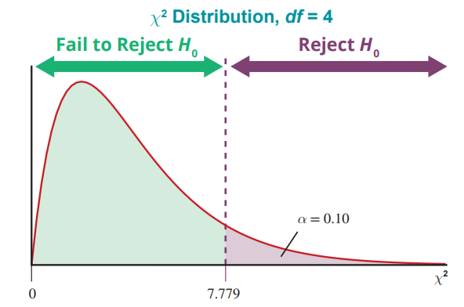
Example 1: Detecting a Change in a Qualitative Variable—Slide 13
Figure 3

Slide 20
Example 1: Detecting a Change in a Qualitative Variable—Slide 14
Step 5: Collect the sample data and compute the value of the test statistic.
To compute the test statistic, the expected number of observations in each category must be computed. Using the proportions from the January 2017 data, we would expect the number of respondents in each category in January 2021 to be as follows.

Slide 21
Example 1: Detecting a Change in a Qualitative Variable—Slide 15
The actual number of respondents in each category in the January 2021 sample is as follows.

Slide 22
Example 1: Detecting a Change in a Qualitative Variable—Slide 16
Our test statistic is calculated as

Slide 23
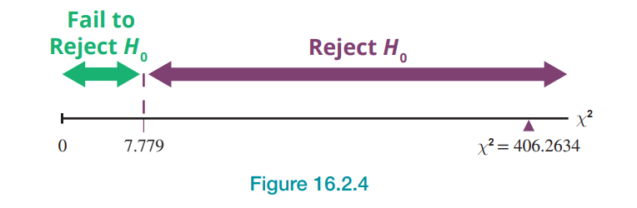
Example 1: Detecting a Change in a Qualitative Variable—Slide 17
Step 6: Make the decision and state the conclusion in terms of the original question.
Figure 4

Slide 24
Example 1: Detecting a Change in a Qualitative Variable—Slide 18
If the null hypothesis is true, the test statistic will be greater than or equal to the critical value of 7.779 only 10% of the time. Since
is larger than 7.779, we will reject H ₀. Large values of the test statistic indicate that the proportion of Americans falling into a category changed from January 2017 to January 2021, and the change is too great to be due to ordinary sampling variation.

Slide 25

Example 1: Detecting a Change in a Qualitative Variable—Slide 19
The P-value for a test statistic value of $406.2634$ and degrees of freedom equal to 4 is approximately 0. Therefore, we reject the null hypothesis.

Slide 26
Example 1: Detecting a Change in a Qualitative Variable—Slide 20
Conclusion and Interpretation: At the 10% level of significance, there is sufficient evidence to conclude that American sentiment towards support for basic research changed from January 2017 to January 2021. The difference in sentiment over the 4-year period is much too great to be attributed to ordinary sampling variation alone.

