Slide 1
Section 16.3
The Chi-Square Test for Association

Slide 2
Definition: Contingency Table
A contingency table organizes data on two characteristics simultaneously. Each cell in a contingency table contains a count (or a proportion) which represents the number of observations falling into that combination of categories.

Slide 3
Procedure: Chi-Square Test for Association between Two Qualitative Variables—Slide 1
Hypotheses:
H ₀: The two qualitative variables are independent (not related).
H _{a}: The two qualitative variables are dependent (related).

Slide 4
Procedure: Chi-Square Test for Association between Two Qualitative Variables—Slide 2
Test Statistic:
Where r = the number of rows and c = the number of columns.
Where n is the total number of observations and p _{i} and p _{j} are estimates of the true population proportions calculated as follows.

Slide 5
Procedure: Chi-Square Test for Association between Two Qualitative Variables—Slide 3
If the null hypothesis is true and n is large enough so that the expected number of observations in each cell is at least 5, then the test statistic has an approximate chi-square distribution with (r − 1) (c − 1) degrees of freedom.
Rejection Region:
Reject H₀ if
with (r − 1) (c − 1) degrees of
freedom.

Slide 6
Example 1: Detecting an Association Between Qualitative Variables—Slide 1
Many grocery stores have self-checkout scanners so that customers can check out faster. Some customers are concerned that the scanners will be wrong and overcharge them. However, the manufacturer of the scanners indicates that the scanners will err in favor of the customer most of the time. In a random sample of customers checking themselves out of the grocery store as well as those that allow the employees to check them out, we have the following contingency table.

Slide 7
Example 1: Detecting an Association Between Qualitative Variables—Slide 2
Table 7 – Self-Checkout versus Employee Checkout at the Grocery Store
Price Charged | Self-Checkout | Employee Checkout | Total
Undercharge | 20 | 10 | 30
Overcharge | 15 | 30 | 45
Correct Price | 200 | 225 | 425
Total | 235 | 265 | 500
Based on the data, can we conclude that the price charged using scanners is independent of whether a customer checks themselves out or if a store employee checks them out?

Slide 8
Example 1: Detecting an Association Between Qualitative Variables—Slide 3
Solution
Step 1: Determine the null hypothesis.
The null hypothesis is that the price charged at checkout and method of checkout are independent (not related). The null hypothesis is written as
H ₀: Price charged at checkout and method of checkout are independent (not related).
For this example, we are interested in the proportion of data in each of the Price Charged and Checkout Method categories.

Slide 9
Example 1: Detecting an Association Between Qualitative Variables—Slide 4
Step 2: Determine the alternative hypothesis and whether it should be one-sided or two-sided.
The alternative hypothesis is that the price charged at checkout and method of checkout are dependent (related). The alternative hypothesis is written as
H _{a}: Price charged at checkout and method of checkout are dependent (related).

Slide 10
Example 1: Detecting an Association Between Qualitative Variables—Slide 5
The chi-square test for association between two qualitative variables is always a one-tailed test because of the way we construct the test statistic. We will reject the null hypothesis that price charged at checkout is independent of checkout method for large values of the test statistic.

Slide 11
Example 1: Detecting an Association Between Qualitative Variables—Slide 6
Step 3: Select the appropriate test statistic based on the information at hand and the assumptions that you are willing to make.
Since each piece of data cannot belong to more than one category and the expected cell count for each category is at least 5, we can use the chi-square test for association between two qualitative variables. The formula for the test statistic is given as follows.

Slide 12
Example 1: Detecting an Association Between Qualitative Variables—Slide 7

Slide 13
Example 1: Detecting an Association Between Qualitative Variables—Slide 8
This test statistic has an approximate chi-square distribution with (3 − 1)(2 − 1) = 2 degrees of freedom, assuming the null hypothesis is true.
We must specify the level of the test ourselves since we are not given one in the problem. Let's choose α = 0.10.

Slide 14
Example 1: Detecting an Association Between Qualitative Variables—Slide 9
Step 4: Determine the critical value of the test statistic.
Since the level of the test is α = 0.10 and we will reject the null hypothesis for large values of the test statistic, the chi-square critical value is
with (3 − 1)(2 − 1) = 2 degrees of freedom, or 4.605. Values of the test statistic greater than or equal to 4.605 would indicate that the dependence of the two classifications is not likely due to ordinary sampling variation alone.

Slide 15
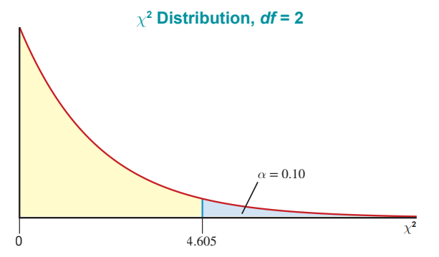
Example 1: Detecting an Association Between Qualitative Variables—Slide 10
Figure 3

Slide 16
Example 1: Detecting an Association Between Qualitative Variables—Slide 11
Step 5: Collect the sample data and compute the value of the test statistic.
The expected values are calculated in Table 8, and Table 9 gives the actual data values in each category versus the expected values in each category.

Slide 17
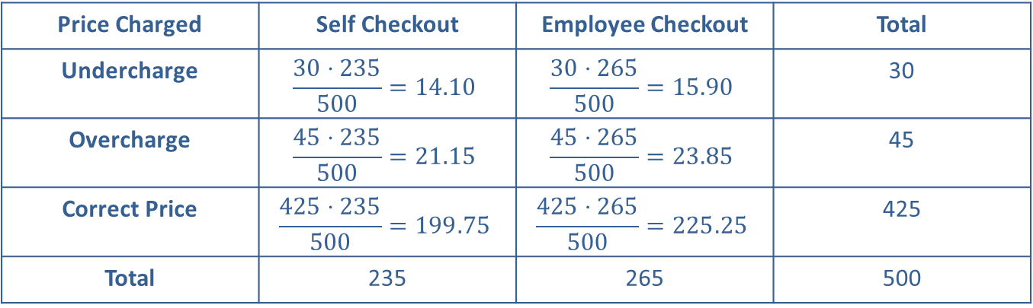
Example 1: Detecting an Association Between Qualitative Variables—Slide 12
Table 8 – Self-Checkout versus Employee Checkout at the Grocery Store: Expected Values
Price Charged | Self Checkout | Employee Checkout | Total
Undercharge | $$\frac{30⋅235}{500}=14.10$$ | $$\frac{30⋅265}{500}=15.90$$ | 30
Overcharge | $$\frac{45⋅235}{500}=21.15$$ | $$\frac{45⋅265}{500}=23.85$$ | 45
Correct Price | $$\frac{425⋅235}{500}=199.75$$ | $$\frac{425⋅265}{500}=225.25$$ | 425
Total | 235 | 265 | 500

Slide 18
Example 1: Detecting an Association Between Qualitative Variables—Slide 13
Table 9 – Self-Checkout versus Employee Checkout at the Grocery Store: Observed and Expected Values
Price Charged
Self Checkout
Employee Checkout
 | Observed | Expected | Observed | Expected
Undercharge | 20 | 14.10 | 10 | 15.90
Overcharge | 15 | 21.15 | 30 | 23.85
Correct Price | 200 | 199.75 | 225 | 225.25

Slide 19
Example 1: Detecting an Association Between Qualitative Variables—Slide 14
Based on these results, the test statistic is calculated as follows.

Slide 20
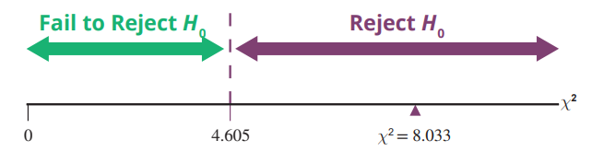
Example 1: Detecting an Association Between Qualitative Variables—Slide 15
Step 6: Make the decision and state the conclusion in terms of the original question.
Since the
test statistic is greater than the critical value
and falls in the rejection region, the null hypothesis should be rejected.
Figure 4

Slide 21
Example 1: Detecting an Association Between Qualitative Variables—Slide 16
Using technology the P-value for the test statistic of 8.033 with 2 degrees of freedom is approximately 0.0180, which is less than the significance level of 0.10. The null hypothesis should be rejected.

Slide 22
Example 1: Detecting an Association Between Qualitative Variables—Slide 17
Conclusion and Interpretation: There is significant evidence at the 0.10 level to conclude that the price charged at checkout and checkout method are dependent. The difference is much too great to be attributed to ordinary sampling variation alone.

