Slide 1
Section 17.1
The Sign Test

Slide 2
Definition: Nonparametric Statistics
Nonparametric statistics are methods that do not rely on an underlying distribution or assumptions about the distribution of the population from which a sample is taken.

Slide 3
Definition: Parametric Statistics
Parametric statistics are methods that rely on assumptions concerning the distribution of the population from which a sample is taken.

Slide 4
Properties: Nonparametric Statistical Methods
There are three characteristics of nonparametric statistical methods:
​They do not involve the estimation of specific population parameters.
​These methods are tests of hypotheses using data measured on an ordinal scale (in most instances).
Assumptions regarding the underlying distribution of the data are not required.

Slide 5
Example 1: Performing the Sign Test on Paired Data—Slide 1
Are the demands of college significantly less than the demands of high school? Students from Tech University were surveyed asking them the amount of time they spent watching TV per day in high school and the amount of time they spent watching TV in college. The data are listed in the following table. Can the researcher conclude at the 1% level of significance that the median TV-watching time (in minutes) is greater in college than in high school?

Slide 6
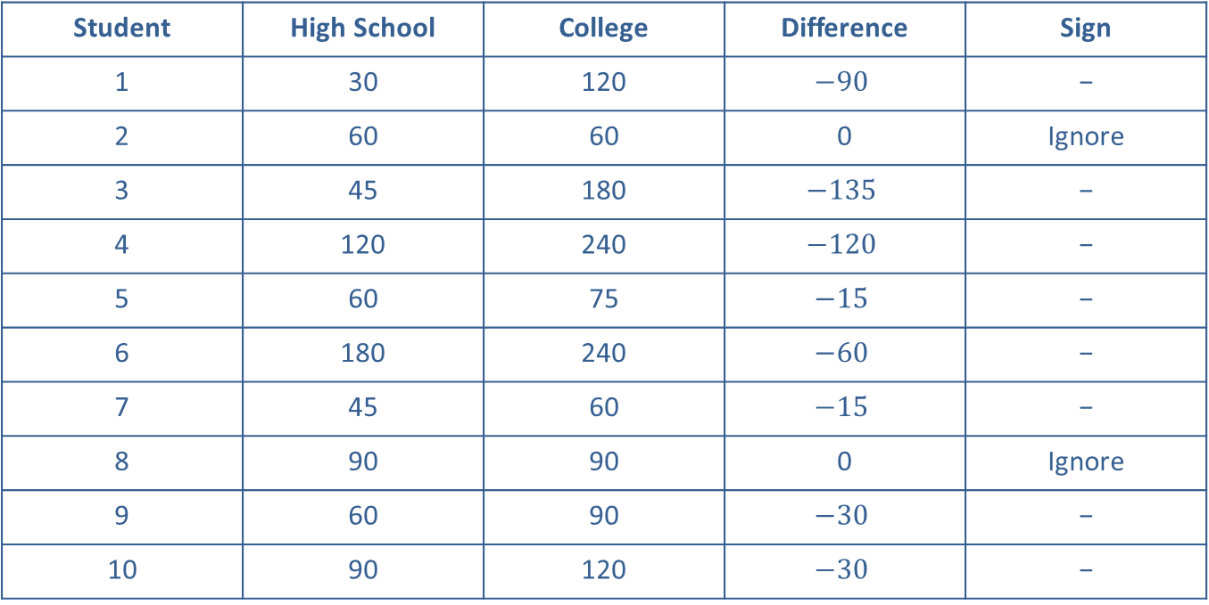
Example 1: Performing the Sign Test on Paired Data—Slide 2
Table 2 – TV-Watching Times (Minutes)
Student | High School | College | Difference | Sign
1 | 30 | 120 | $$−90$$ | −
2 | 60 | 60 | 0 | Ignore
3 | 45 | 180 | $$−135$$ | −
4 | 120 | 240 | $$−120$$ | −
5 | 60 | 75 | $$−15$$ | −
6 | 180 | 240 | $$−60$$ | −
7 | 45 | 60 | $$−15$$ | −
8 | 90 | 90 | 0 | Ignore
9 | 60 | 90 | $$−30$$ | −
10 | 90 | 120 | $$−30$$ | −

Slide 7
Example 1: Performing the Sign Test on Paired Data—Slide 3
Solution
Normally, we would analyze these data with a paired difference test (see Section 11.3). However, if we doubt that the differences follow a normal distribution, we will use the sign test to determine if the populations are different.

Slide 8
Example 1: Performing the Sign Test on Paired Data—Slide 4
The sign test is based on the idea that if two data sets have the same median, the number of differences with positive signs should approximately equal the number of differences with negative signs. We will conclude that the median number of minutes of TV-watching time increases in college if the number of negative signs is larger than the number of positive signs. How large is large? We will answer this question in Step 4.

Slide 9
Example 1: Performing the Sign Test on Paired Data—Slide 5
Step 1: Determine the null hypothesis.
The null hypothesis is that the median TV-watching time in college is equal to the median TV-watching time in high school.
For the Sign Test, we would write the null hypothesis as
H₀: The number of negative signs is equal to the number of positive signs. (The median TV-watching time is the same in college as it was in high school.)

Slide 10
Example 1: Performing the Sign Test on Paired Data—Slide 6
Step 2: Determine the alternative hypothesis.
The alternative hypothesis is that the median TV-watching time is greater in college than in high school.
For the Sign Test, we would write the alternative hypothesis as
H _{a}: The number of negative signs is greater than the number of positive signs. (The median TV-watching time is greater in college than in high school.)

Slide 11
Example 1: Performing the Sign Test on Paired Data—Slide 7
Since the researcher is interested in whether the TV-watching time is longer in college than in high school, this is a one-tailed test. Thus, the alternative hypothesis will be one-sided.

Slide 12
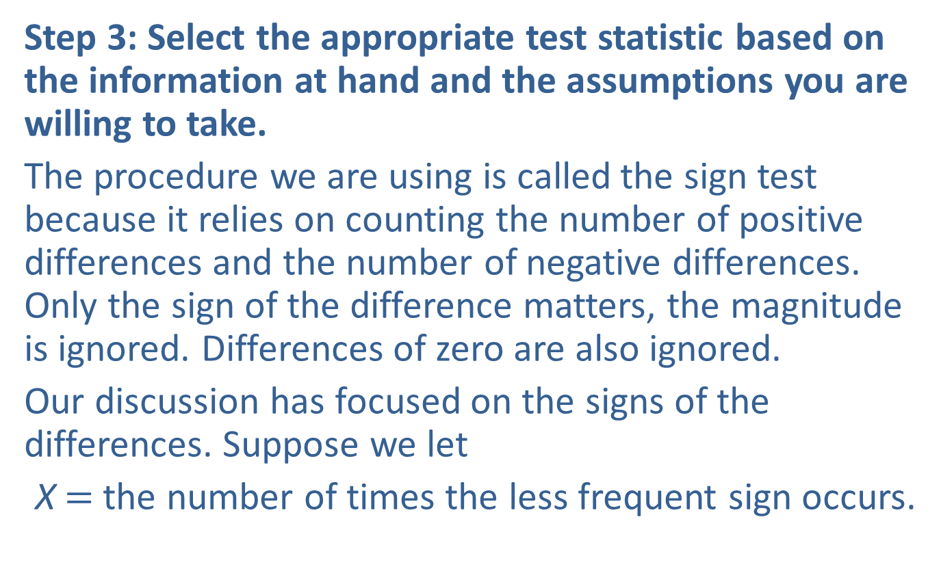
Example 1: Performing the Sign Test on Paired Data—Slide 8
Step 3: Select the appropriate test statistic based on the information at hand and the assumptions you are willing to take.
The procedure we are using is called the sign test because it relies on counting the number of positive differences and the number of negative differences. Only the sign of the difference matters, the magnitude is ignored. Differences of zero are also ignored.
Our discussion has focused on the signs of the differences. Suppose we let
X$=$ the number of times the less frequent sign occurs.

Slide 13
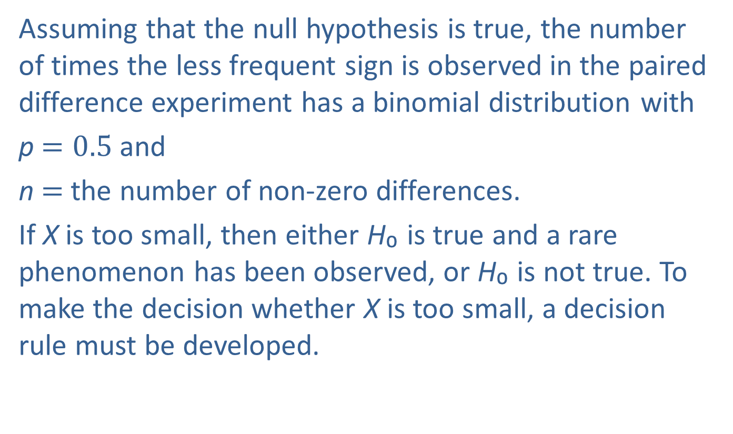
Example 1: Performing the Sign Test on Paired Data—Slide 9
Assuming that the null hypothesis is true, the number of times the less frequent sign is observed in the paired difference experiment has a binomial distribution with
p$=0.5$ and
n$=$ the number of non-zero differences.
If X is too small, then either H₀ is true and a rare phenomenon has been observed, or H₀ is not true. To make the decision whether X is too small, a decision rule must be developed.

Slide 14

Example 1: Performing the Sign Test on Paired Data—Slide 10
If n ≤ 25, where n$=$ the number of non-zero differences, the test statistic of the sign test is the variable X described previously.
If n > 25, X can be approximated by a normal distribution and the test statistic is given by
Assuming the null hypothesis is true, z has an approximately standard normal distribution.

Slide 15
Example 1: Performing the Sign Test on Paired Data—Slide 11
Step 4: Determine the critical value of the test statistic.
The researcher wants to determine if the median TV-watching time for college students is longer than that of high school students. The statistical measures being used are counts of the number of positive signs and negative signs. If the amount of TV-watching time is greater in college than in high school, then we would expect the negative differences to outnumber the positive differences.

Slide 16
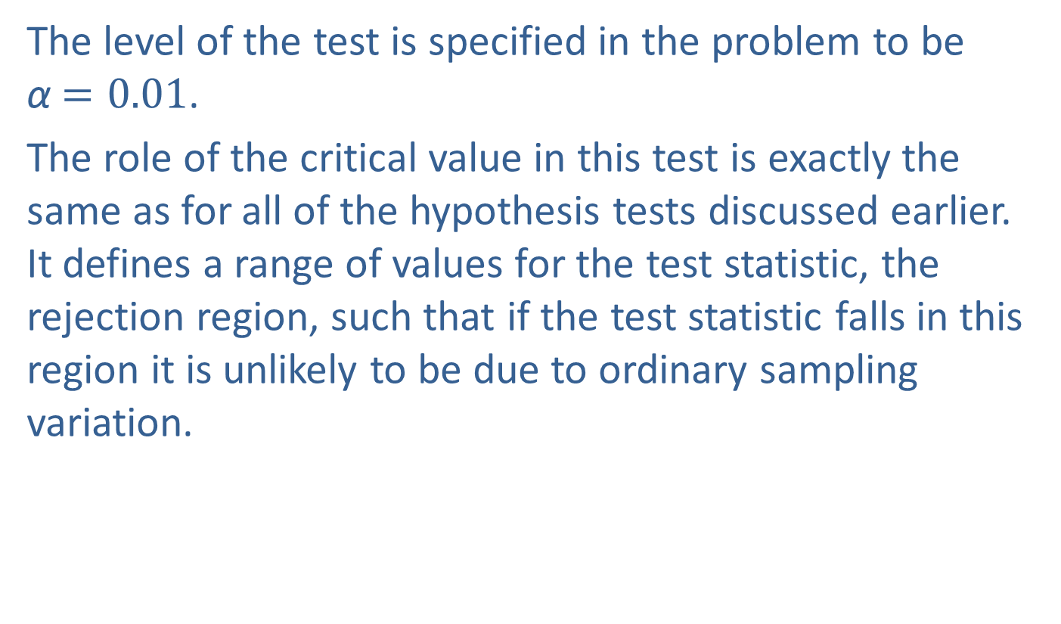
Example 1: Performing the Sign Test on Paired Data—Slide 12
The level of the test is specified in the problem to be α$=0.01$.
The role of the critical value in this test is exactly the same as for all of the hypothesis tests discussed earlier. It defines a range of values for the test statistic, the rejection region, such that if the test statistic falls in this region it is unlikely to be due to ordinary sampling variation.

Slide 17
Example 1: Performing the Sign Test on Paired Data—Slide 13
The level of the test defines the rareness criterion that will be used and implicitly determines the size of the rejection region. Should the computed value of the test statistic fall in the rejection region, its value will be presumed to be too rare to have occurred because of ordinary sampling variation, and the null hypothesis will be rejected.

Slide 18
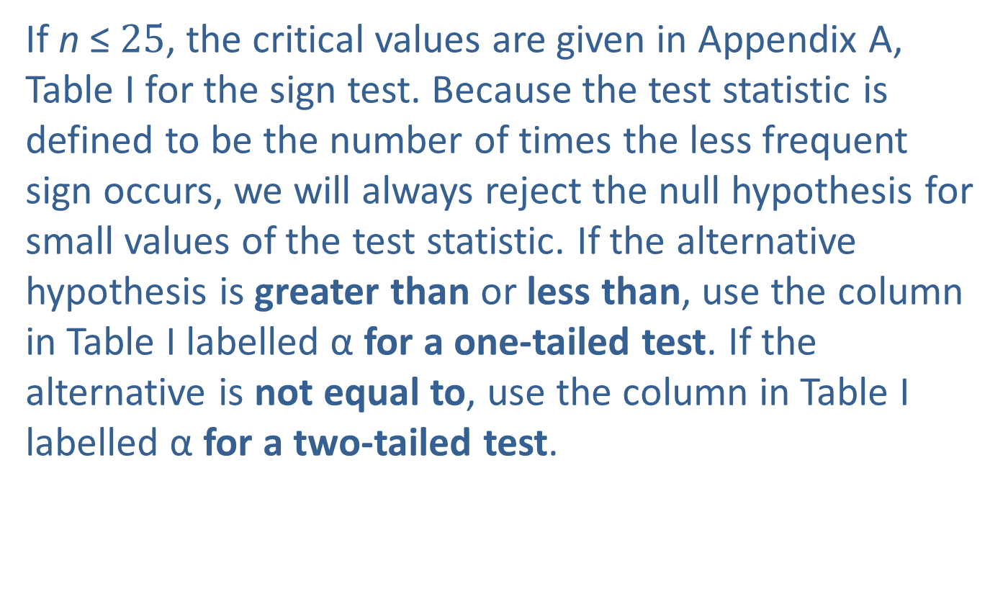
Example 1: Performing the Sign Test on Paired Data—Slide 14
If n ≤$25$, the critical values are given in Appendix A, Table I for the sign test. Because the test statistic is defined to be the number of times the less frequent sign occurs, we will always reject the null hypothesis for small values of the test statistic. If the alternative hypothesis is greater than or less than, use the column in Table I labelled α for a one-tailed test. If the alternative is not equal to, use the column in Table I labelled α for a two-tailed test.

Slide 19
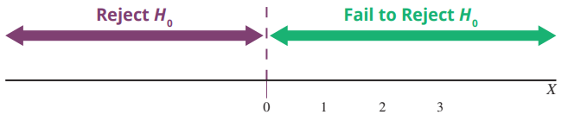

Example 1: Performing the Sign Test on Paired Data—Slide 15
There are n$=8$ nonzero differences in the TV-watching example, α$=0.01$, and the alternative hypothesis is greater than. From Table I in the Appendix, we find that the critical value is 0. The rejection region is drawn in Figure 1.
Figure 1

Slide 20
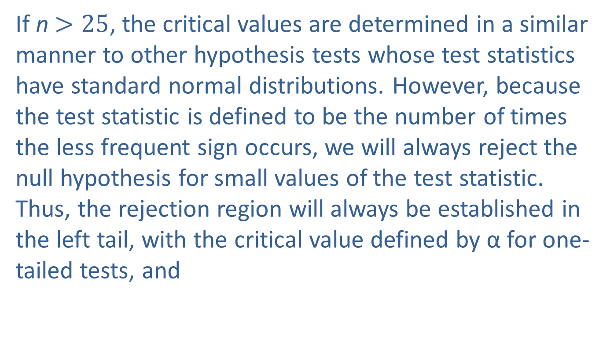
Example 1: Performing the Sign Test on Paired Data—Slide 16
If n $>25$, the critical values are determined in a similar manner to other hypothesis tests whose test statistics have standard normal distributions. However, because the test statistic is defined to be the number of times the less frequent sign occurs, we will always reject the null hypothesis for small values of the test statistic. Thus, the rejection region will always be established in the left tail, with the critical value defined by α for one-tailed tests, and
for two-tailed tests.

Slide 21
Example 1: Performing the Sign Test on Paired Data—Slide 17
Note: Because of the manner in which the test statistic is defined, fail to reject the null hypothesis and do not proceed with the test procedure if the computed value of the test statistic does not tend to support the alternative hypothesis.

Slide 22
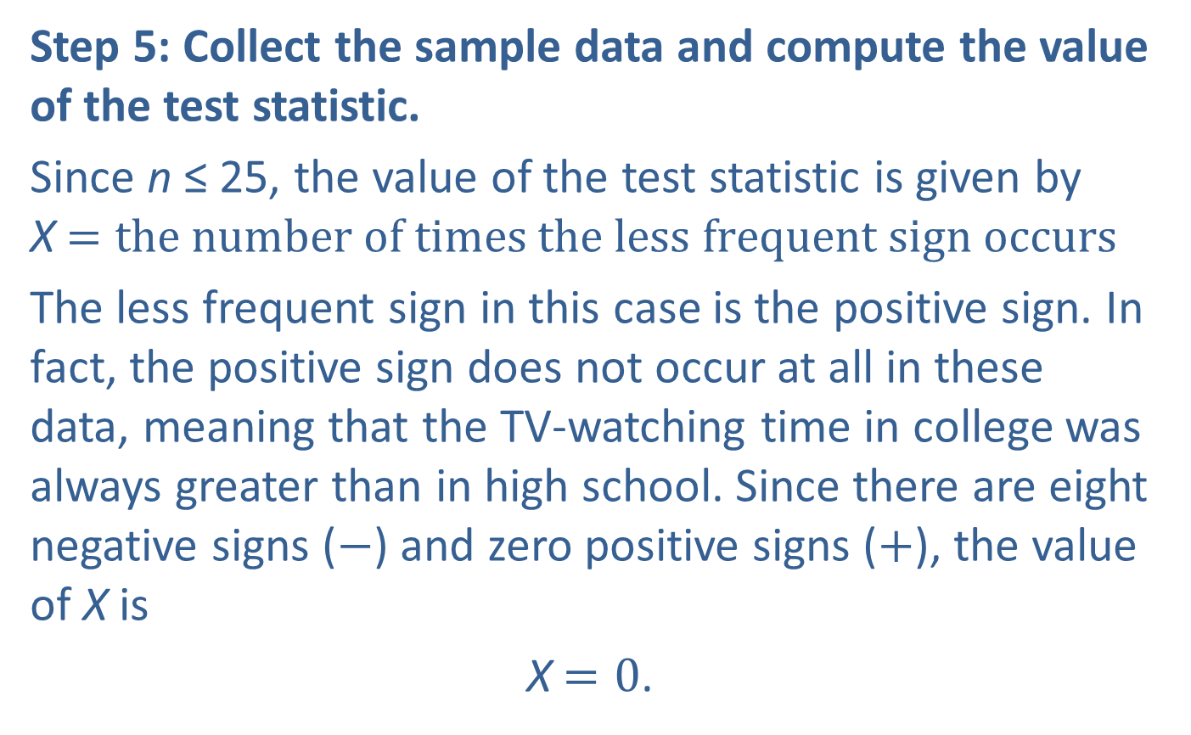
Example 1: Performing the Sign Test on Paired Data—Slide 18
Step 5: Collect the sample data and compute the value of the test statistic.
Since n ≤ 25, the value of the test statistic is given by X$=the number of times the less frequent sign occurs$
The less frequent sign in this case is the positive sign. In fact, the positive sign does not occur at all in these data, meaning that the TV-watching time in college was always greater than in high school. Since there are eight negative signs ($−$) and zero positive signs ($+$), the value of X is
X$=0$.

Slide 23
Example 1: Performing the Sign Test on Paired Data—Slide 19
Note that differences of zero are ignored.
Since the number of positive signs is zero, this tends to support the alternative hypothesis that the number of minutes watching TV in college is greater than in high school. It is safe to proceed with the test. Suppose there were not any negative signs, meaning that all of the TV-watching times in college were less than or equal to the times in high school.

Slide 24
Example 1: Performing the Sign Test on Paired Data—Slide 20
This evidence would not support the alternative hypothesis, and the test must be halted at this point with a conclusion that the null hypothesis cannot be rejected. This stage of a one-sided sign test will always require thinking to be sure that the sign with the minimum value is the sign that supports the alternative hypothesis.

Slide 25
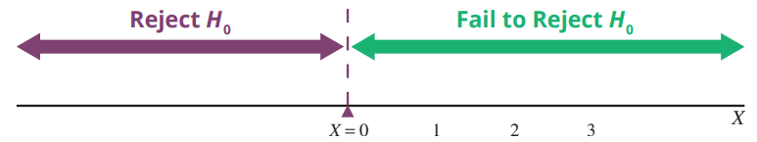
Example 1: Performing the Sign Test on Paired Data—Slide 21
Step 6: Make the decision and state the conclusion in terms of the original question.
Figure 2

Slide 26

Example 1: Performing the Sign Test on Paired Data—Slide 22
As shown in Figure 2, the value of the test statistic (X$=0$) falls in the rejection region. Thus, we reject the null hypothesis at α$=0.01$. It is unlikely that the small number of positive differences could be attributed to ordinary sampling variation.

Slide 27

Example 1: Performing the Sign Test on Paired Data—Slide 23
Conclusion and Interpretation: There is sufficient evidence for the researcher to conclude at α$=0.01$ that the median TV-watching time for college students is longer than the median TV-watching time when those students were in high school.

Slide 28
Procedure: Sign Test—Slide 1
Hypotheses:
H ₀: The number of positive [negative] signs is equal to the number of negative [positive] signs.
H _{a}: The number of negative [positive] signs is greater than, less than, or not equal to the number of positive [negative] signs (depending on the claim which is being tested).
Note: No sign is given if the difference is zero and the difference is ignored.

Slide 29
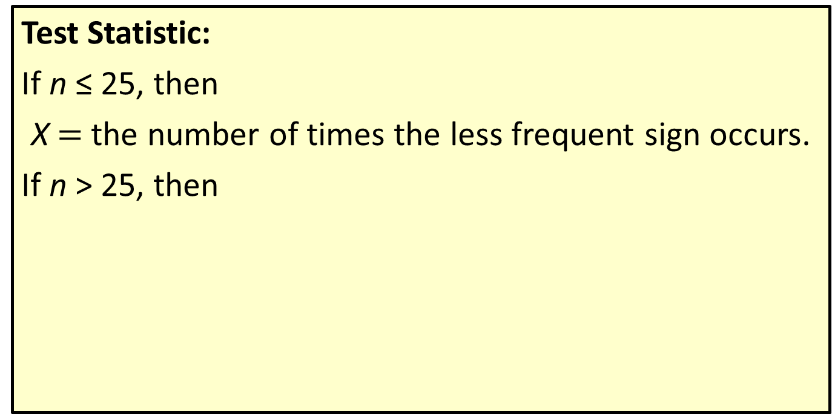
Procedure: Sign Test—Slide 2
Test Statistic:
If n ≤ 25, then
X$=$ the number of times the less frequent sign occurs.
If n > 25, then
where X is defined just as when n ≤ 25.

Slide 30
Procedure: Sign Test—Slide 3
Critical Value(s):
If the data tend to support the alternative hypothesis and n ≤ 25:
Reject the null hypothesis if the test statistic is less than or equal to the critical value in Appendix A, Table I.
n > 25:
The critical values are based on the standard normal distribution with the critical values defined such that we reject the null hypothesis for small values of the test statistic.
Assumptions:
The pairs of data are randomly selected.

Slide 31
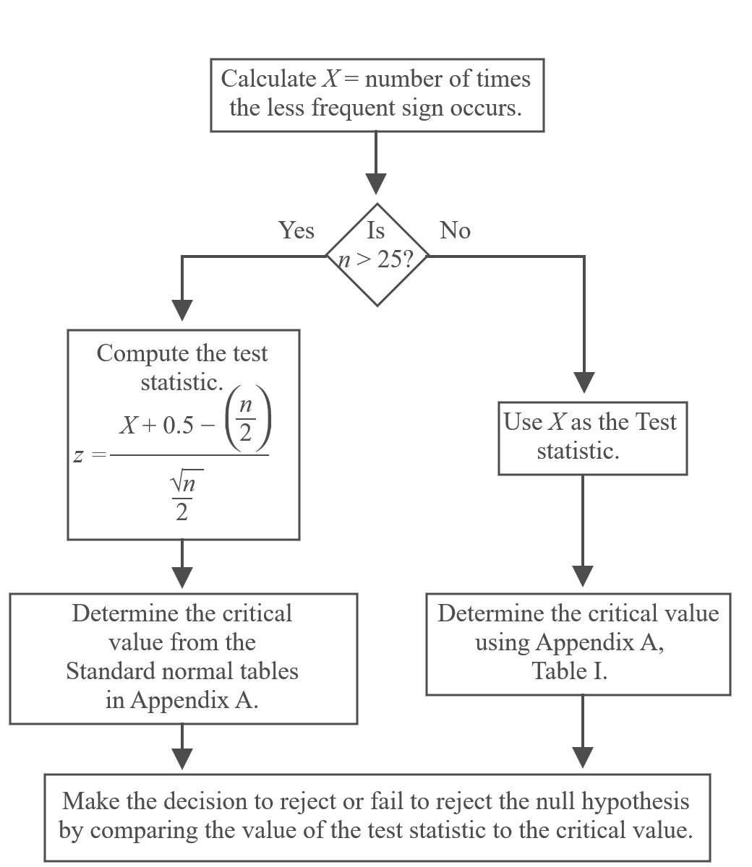
Making the Decision in the Sign Test

Slide 32
Example 2: Testing a Population Median with the Sign Test—Slide 1
The CEO of Montgomery County Hospital (MCH) is interested in the length of patients' stays at her hospital. Most people tend to stay only a few days after being admitted to the hospital, but there are a few people that have hospital stays that are longer. She believes that the median length of stay at her hospital is less than the national median. In a recent National Health Statistics report, it was stated that the median hospital stay for hospitals in the United States is 4.7 days. Upon discharge, the lengths of stay for 50 randomly selected patients of MCH are noted. Of the randomly selected patients, the length of stay for 35 patients was less than 4.7 days. Can the CEO of Montgomery County Hospital conclude at the 10% significance level that the median length of stay at her hospital is shorter than the national median?

Slide 33
Example 2: Testing a Population Median with the Sign Test—Slide 2
Solution
Step 1: Determine the null hypothesis.
The null hypothesis is that the median hospital stay (in days) at Montgomery County Hospital is equal to the median hospital stay for the United States. The null hypothesis should be written as
H ₀: The number of positive signs is equal to the number of negative signs. (The median length of hospital stay at Montgomery County Hospital is equal to the median length of hospital stay for the United States.)

Slide 34
Example 2: Testing a Population Median with the Sign Test—Slide 3
Step 2: Determine the alternative hypothesis.
The alternative hypothesis is that the median hospital stay (in days) at Montgomery County Hospital is shorter than the median hospital stay for the United States. The alternative hypothesis should be written as
H _{a}: The number of negative signs outnumbers the number of positive signs. (The median length of hospital stay at Montgomery County Hospital is shorter that the median length of hospital stay in the United States.)

Slide 35
Example 2: Testing a Population Median with the Sign Test—Slide 4
Since the CEO's claim is that the median length of hospital stay is shorter than the median length of stay for the United States, this test is a one-tailed test. Thus, the alternative hypothesis will be one-sided.

Slide 36
Example 2: Testing a Population Median with the Sign Test—Slide 5
Step 3: Select the appropriate test statistic based on the information at hand and the assumptions you are willing to make.
Once again, we will look at differences, but in this case the differences will be created by subtracting the median from each data value. The sign test will rely on counting the number of positive signs (meaning that the length of hospital stay at MCH is longer than the median length of stay for the United States) and the number of negative signs (meaning that the length of stay at MCH is shorter than the median length of stay for the United States).

Slide 37
Example 2: Testing a Population Median with the Sign Test—Slide 6
Since n > 25, the test statistic is given by
Assuming the null hypothesis is true, z has an approximately standard normal distribution.

Slide 38
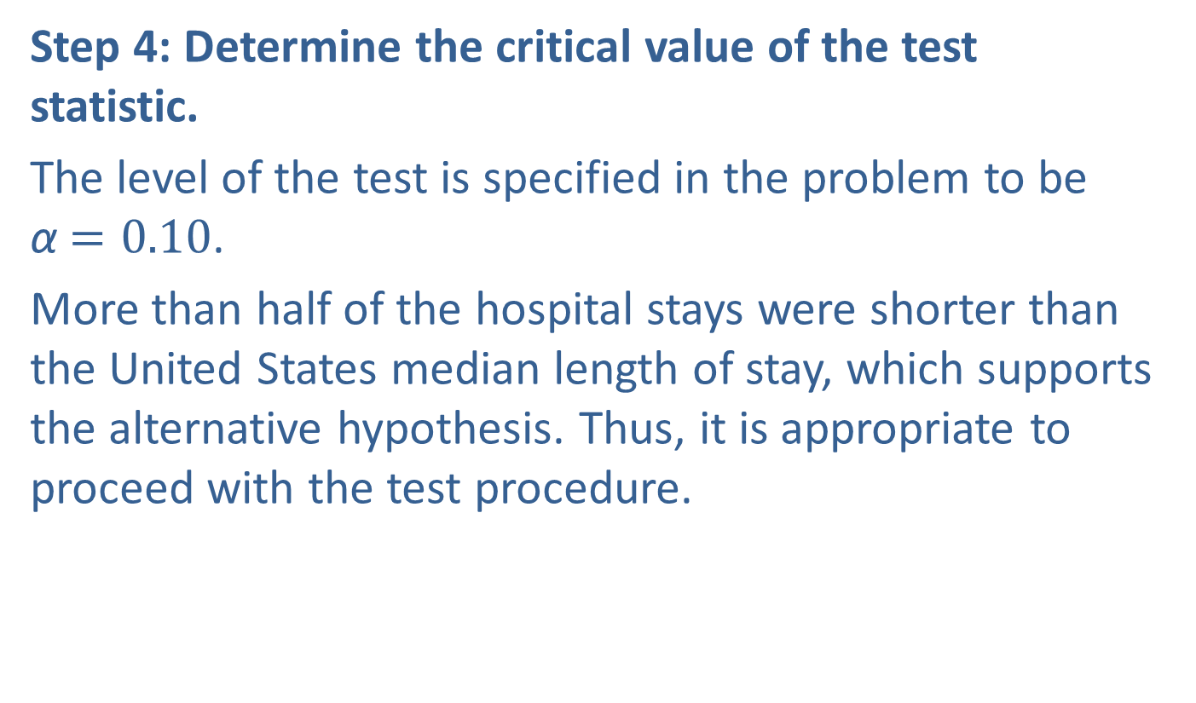
Example 2: Testing a Population Median with the Sign Test—Slide 7
Step 4: Determine the critical value of the test statistic.
The level of the test is specified in the problem to be α$=0.10$.
More than half of the hospital stays were shorter than the United States median length of stay, which supports the alternative hypothesis. Thus, it is appropriate to proceed with the test procedure.

Slide 39
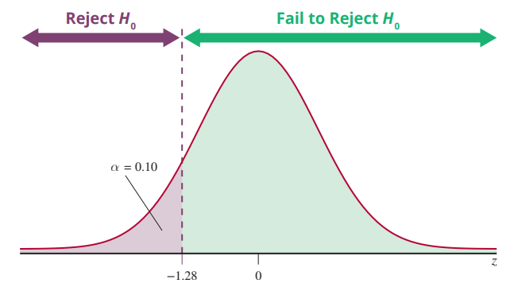
Example 2: Testing a Population Median with the Sign Test—Slide 8
Figure 3

Slide 40
Example 2: Testing a Population Median with the Sign Test—Slide 9
Since n > 25, the critical value is determined from the standard normal distribution. Because of the way the test statistic is defined, we will always reject the null hypothesis for small values of the test statistic. If the alternative hypothesis is greater than or less than, use an area of α in the left tail to determine the critical value.

Slide 41
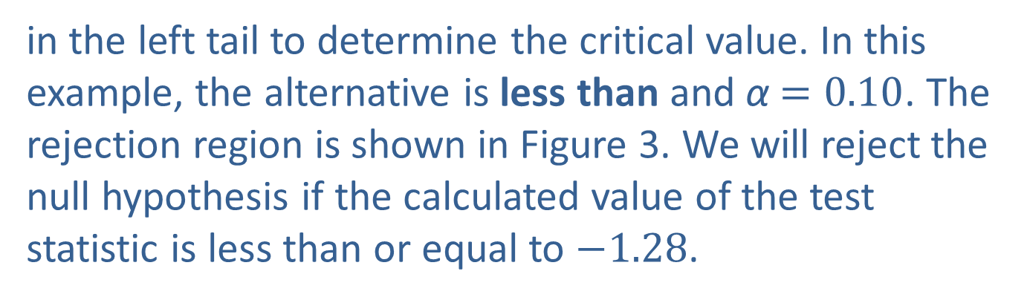
Example 2: Testing a Population Median with the Sign Test—Slide 10
If the alternative is not equal to, use an area of
in the left tail to determine the critical value. In this example, the alternative is less than and α$=0.10$. The rejection region is shown in Figure 3. We will reject the null hypothesis if the calculated value of the test statistic is less than or equal to $−1.28$.

Slide 42
Example 2: Testing a Population Median with the Sign Test—Slide 11
Step 5: Collect the sample data and compute the value of the test statistic.
Negative signs will occur if the length of stay for patients in MCH is shorter than the median length of stay for the United States. Thirty-five of the sampled patients had an actual length of stay shorter than the median length of stay for the United States. Thus, there will be 35 negative signs.

Slide 43
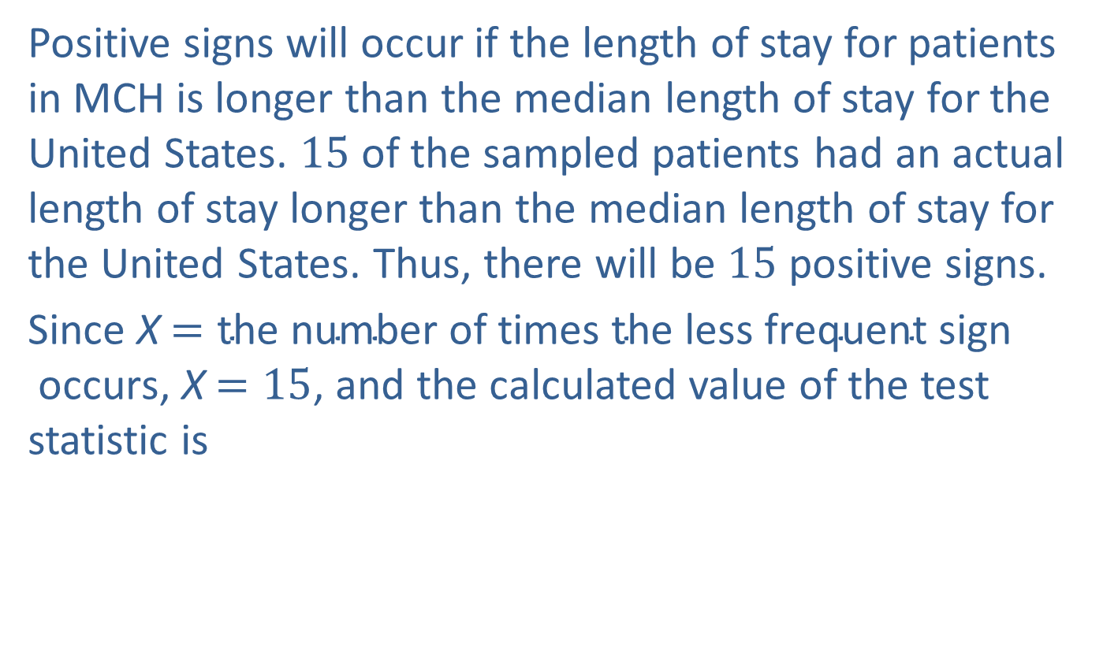
Example 2: Testing a Population Median with the Sign Test—Slide 12
Positive signs will occur if the length of stay for patients in MCH is longer than the median length of stay for the United States. 15 of the sampled patients had an actual length of stay longer than the median length of stay for the United States. Thus, there will be 15 positive signs.
Since X$=\text{the} \text{number} \text{of} \text{times} \text{the} \text{less} \text{frequent} \text{sign} \text{occurs}$, X$=15$, and the calculated value of the test statistic is

Slide 44
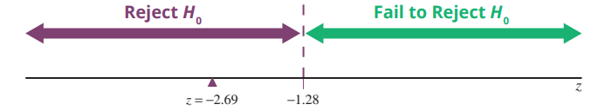
Example 2: Testing a Population Median with the Sign Test—Slide 13
Figure 4

Slide 45
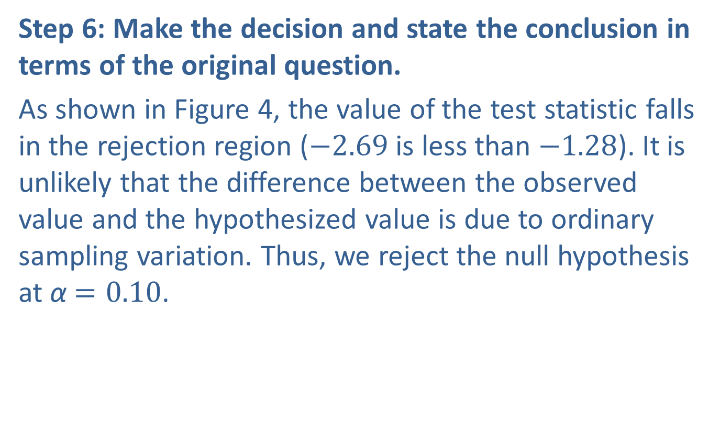
Example 2: Testing a Population Median with the Sign Test—Slide 14
Step 6: Make the decision and state the conclusion in terms of the original question.
As shown in Figure 4, the value of the test statistic falls in the rejection region ($−2.69$ is less than $−1.28$). It is unlikely that the difference between the observed value and the hypothesized value is due to ordinary sampling variation. Thus, we reject the null hypothesis at α$=0.10$.

Slide 46

Example 2: Testing a Population Median with the Sign Test—Slide 15
Conclusion and Interpretation: There is sufficient evidence for the Montgomery County Hospital CEO to conclude at α $=0.10$ that the median length of stay for her patients is significantly shorter than the median length of stay for the United States as a whole.

