Slide 1
Section 17.2
The Wilcoxon Signed-Rank Test

Slide 2
Example 1: Ranking Quantitative Data—Slide 1
Rank the following stocks, traded on the New York Stock Exchange, from smallest price to largest price.
Table 1 – Stock Prices
Stock | Price per Share($)
Merck & Co., Inc. | 78.25
AT&T, Inc. | 27.15
SecureWorks Corp. | 28.04
Micron Technology, Inc. | 73.21
HP Inc. | 25.16
AMC Entertainment Holdings, Inc. | 30.50
CitiGroup, Inc. | 60.12
Exxon Mobil Co. | 55.30
AutoCanada Inc. | 30.50

Slide 3

Example 1: Ranking Quantitative Data—Slide 2
Solution
The lowest priced stock is HP Inc. at $\$25.16$. It is assigned a rank of one. Rankings of two and three go to A T&T, Inc. and SecureWorks Corp., respectively, because they have the next lowest prices. Fourth place is a tie between AMC Entertainment Holdings, Inc. and AutoCanada Inc. To assign their ranks, compute the average of the ranks of the positions for which they are tied. The rank for each is determined as the average of four and five. Thus,

Slide 4
Example 1: Ranking Quantitative Data—Slide 3
Table 2 – Ranked Stock Prices
Stock | Price per Share($) | Rank
Merck & Co., Inc. | 78.25 | 9
AT&T, Inc. | 27.15 | 2
SecureWorks Corp. | 28.04 | 3
Micron Technology, Inc. | 73.21 | 8
HP Inc. | 25.16 | 1
AMC Entertainment Holdings, Inc. | 30.50 | 4.5 | Tied for 4th and 5th
CitiGroup, Inc. | 60.12 | 7
Exxon Mobil Co. | 55.30 | 6
AutoCanada Inc. | 30.50 | 4.5 | Tied for 4th and 5th

Slide 5
Example 1: Ranking Quantitative Data—Slide 4
There are no other ties. The ranking resumes with Exxon Mobile Co. being ranked sixth. The highest ranked stock is Merck & Co., Inc., which has a rank of nine.

Slide 6
Example 2: Performing the Wilcoxon Signed-Rank Test—Slide 1
It is believed by many economists that the United States entered into a recession in December of 2007. In tough economic times, most families tend to cut back on dining outside the home in an effort to save money. Thus, one indication of a weak economy is the reduction in the number of times a family dines out.

Slide 7
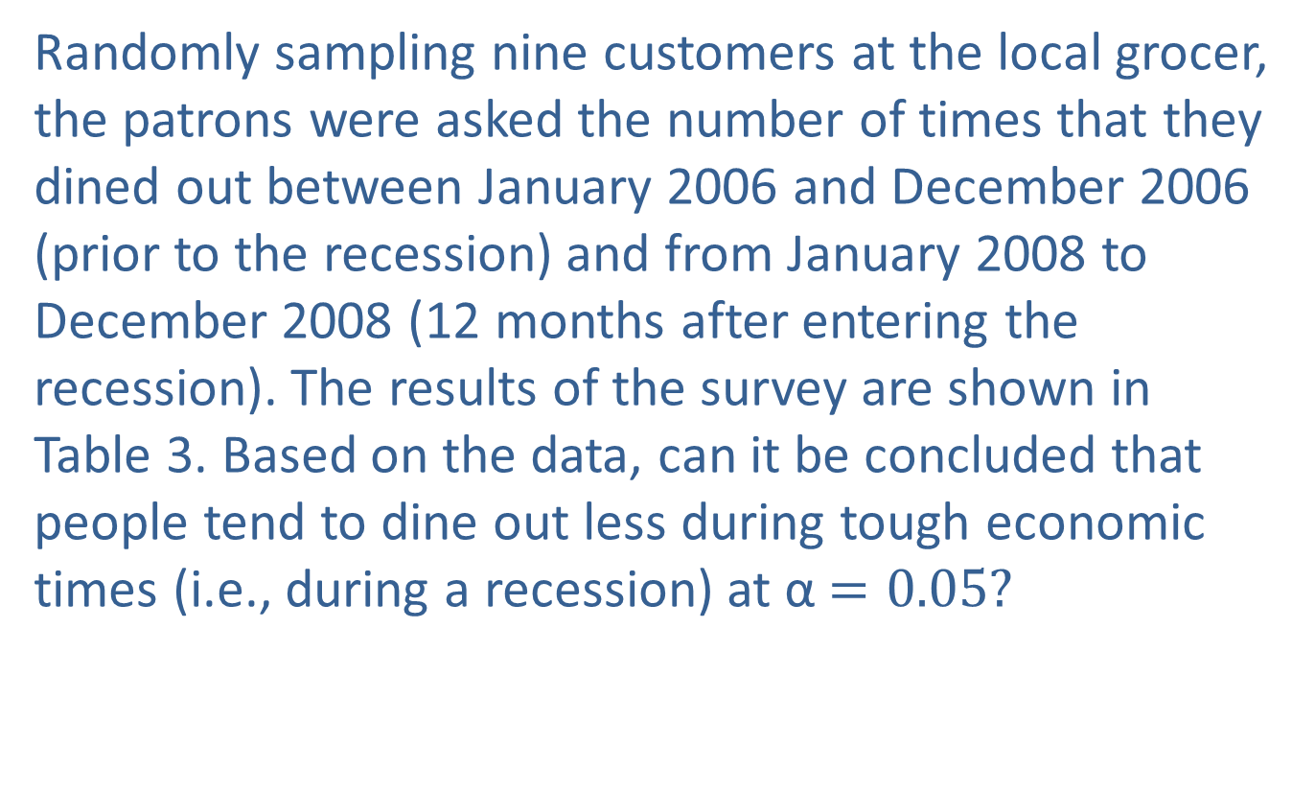
Example 2: Performing the Wilcoxon Signed-Rank Test—Slide 2
Randomly sampling nine customers at the local grocer, the patrons were asked the number of times that they dined out between January 2006 and December 2006 (prior to the recession) and from January 2008 to December 2008 (12 months after entering the recession). The results of the survey are shown in Table 3. Based on the data, can it be concluded that people tend to dine out less during tough economic times (i.e., during a recession) at α$=0.05$?

Slide 8
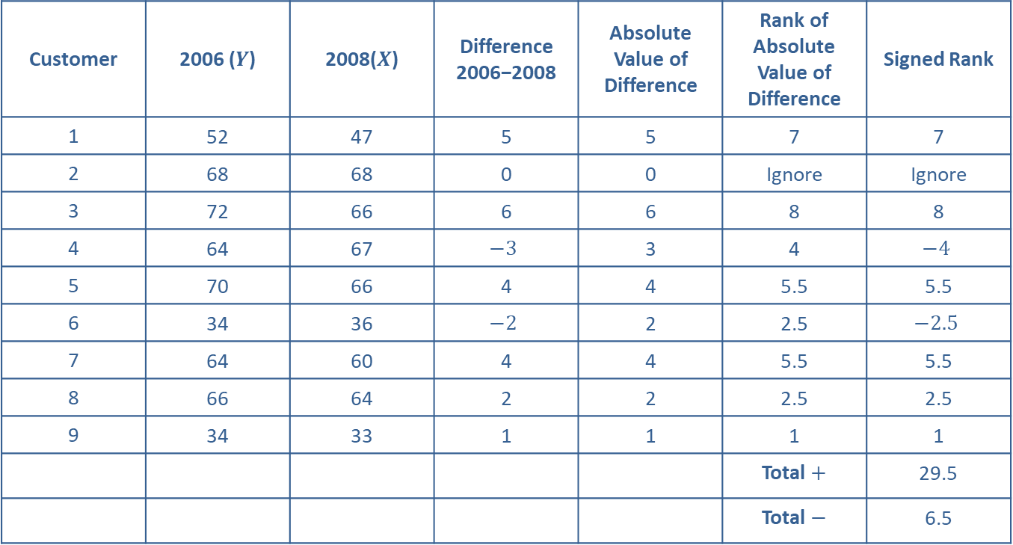
Example 2: Performing the Wilcoxon Signed-Rank Test—Slide 3
Table 3 – Number of Times Dining Out
Customer | 2006 ($Y$) | 2008($X$) | Difference 2006−2008 | Absolute Value of Difference | Rank of Absolute Value of Difference | Signed Rank
1 | 52 | 47 | 5 | 5 | 7 | 7
2 | 68 | 68 | 0 | 0 | Ignore | Ignore
3 | 72 | 66 | 6 | 6 | 8 | 8
4 | 64 | 67 | $$−3$$ | 3 | 4 | $$−4$$
5 | 70 | 66 | 4 | 4 | 5.5 | 5.5
6 | 34 | 36 | $$−2$$ | 2 | 2.5 | $$−2.5$$
7 | 64 | 60 | 4 | 4 | 5.5 | 5.5
8 | 66 | 64 | 2 | 2 | 2.5 | 2.5
9 | 34 | 33 | 1 | 1 | 1 | 1
 |  |  |  |  | Total $+$ | 29.5
 |  |  |  |  | Total $−$ | 6.5

Slide 9
Example 2: Performing the Wilcoxon Signed-Rank Test—Slide 4
Solution
Step 1: Determine the null hypothesis.
The null hypothesis is that the number of times that people dined out in 2006 (pre-recession) is equal to the number of times that people dined out in 2008 (recession). The null hypothesis can be written as H₀: The distribution of those dining out in 2008 after the U.S. economy entered into a recession is the same as the distribution of those dining out in 2006.

Slide 10
Example 2: Performing the Wilcoxon Signed-Rank Test—Slide 5
Step 2: Determine the alternative hypothesis.
The alternative hypothesis is that the number of times that people dined out in 2008 is less than the number of times that people dined out in 2006. The alternative hypothesis can be written as
H _{a}: The distribution of those dining out in 2008 after the U.S. economy entered into a recession is shifted to the left of the distribution of those dining out in 2006.
Since we are interested in knowing if the number of times people dined out has decreased, this test is a one-tailed test. Thus, the hypothesis will be one-sided.

Slide 11
Example 2: Performing the Wilcoxon Signed-Rank Test—Slide 6
Step 3: Select the appropriate test statistic based on the information at hand and the assumptions you are willing to make.
The Wilcoxon signed-rank test compares the probability distributions for 2006 and 2008 (i.e., before recession and during recession). How this is accomplished will be discussed in Step 6.

Slide 12
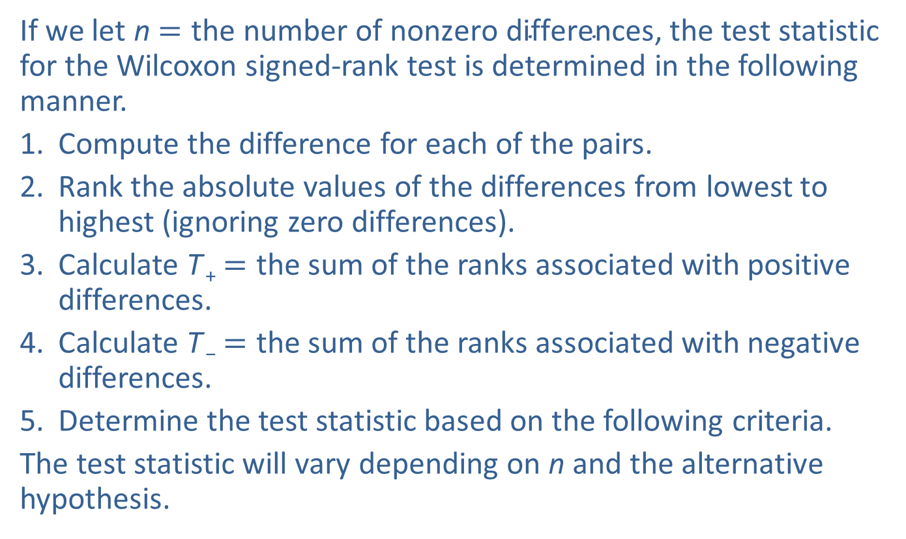
Example 2: Performing the Wilcoxon Signed-Rank Test—Slide 7
If we let n$=\text{the} \text{number} \text{of} \text{nonzero} \text{differences}$, the test statistic for the Wilcoxon signed-rank test is determined in the following manner.
1. Compute the difference for each of the pairs.
2. Rank the absolute values of the differences from lowest to highest (ignoring zero differences).
3. Calculate T ₊$=$ the sum of the ranks associated with positive differences.
4. Calculate T ₋$=$ the sum of the ranks associated with negative differences.
5. Determine the test statistic based on the following criteria.
The test statistic will vary depending on n and the alternative hypothesis.

Slide 13
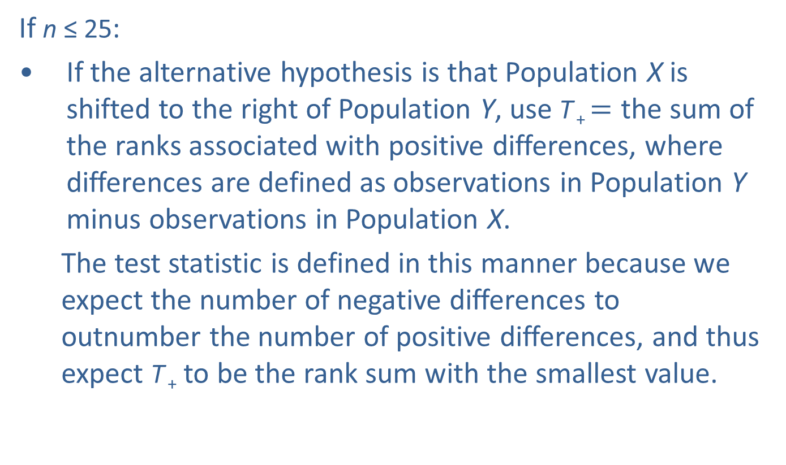
Example 2: Performing the Wilcoxon Signed-Rank Test—Slide 8
If n ≤ 25:
​If the alternative hypothesis is that Population X is shifted to the right of Population Y, use T ₊ $=$ the sum of the ranks associated with positive differences, where differences are defined as observations in Population Y minus observations in Population X.
The test statistic is defined in this manner because we expect the number of negative differences to outnumber the number of positive differences, and thus expect T ₊ to be the rank sum with the smallest value.

Slide 14
Example 2: Performing the Wilcoxon Signed-Rank Test—Slide 9
If the alternative hypothesis is that Population X is shifted to the left of Population Y, use T ₋ = the sum of the ranks associated with negative differences, where differences are defined as observations in Population Y minus observations in Population X.
The test statistic is defined in this manner because we expect the number of positive differences to outnumber the number of negative differences, and thus expect T ₋ to be the rank sum with the smallest value.

Slide 15
Example 2: Performing the Wilcoxon Signed-Rank Test—Slide 10
If the alternative hypothesis is that Population X is shifted to the left or to the right of Population Y, use
It is important to note that if the smaller sum of the ranks is not as expected, the test should be halted and the decision should be to fail to reject the null hypothesis since there is no evidence in favor of the alternative hypothesis.

Slide 16
Example 2: Performing the Wilcoxon Signed-Rank Test—Slide 11
If n > 25, the test statistic can be approximated by a standard normal distribution and is specified in the procedure for the signed-rank test following this example.
For the example at hand, n ≤ 25 and the alternative hypothesis is that the probability distribution for dining out in 2008 (recession) is shifted to the left of dining out in 2006 (pre-recession).

Slide 17
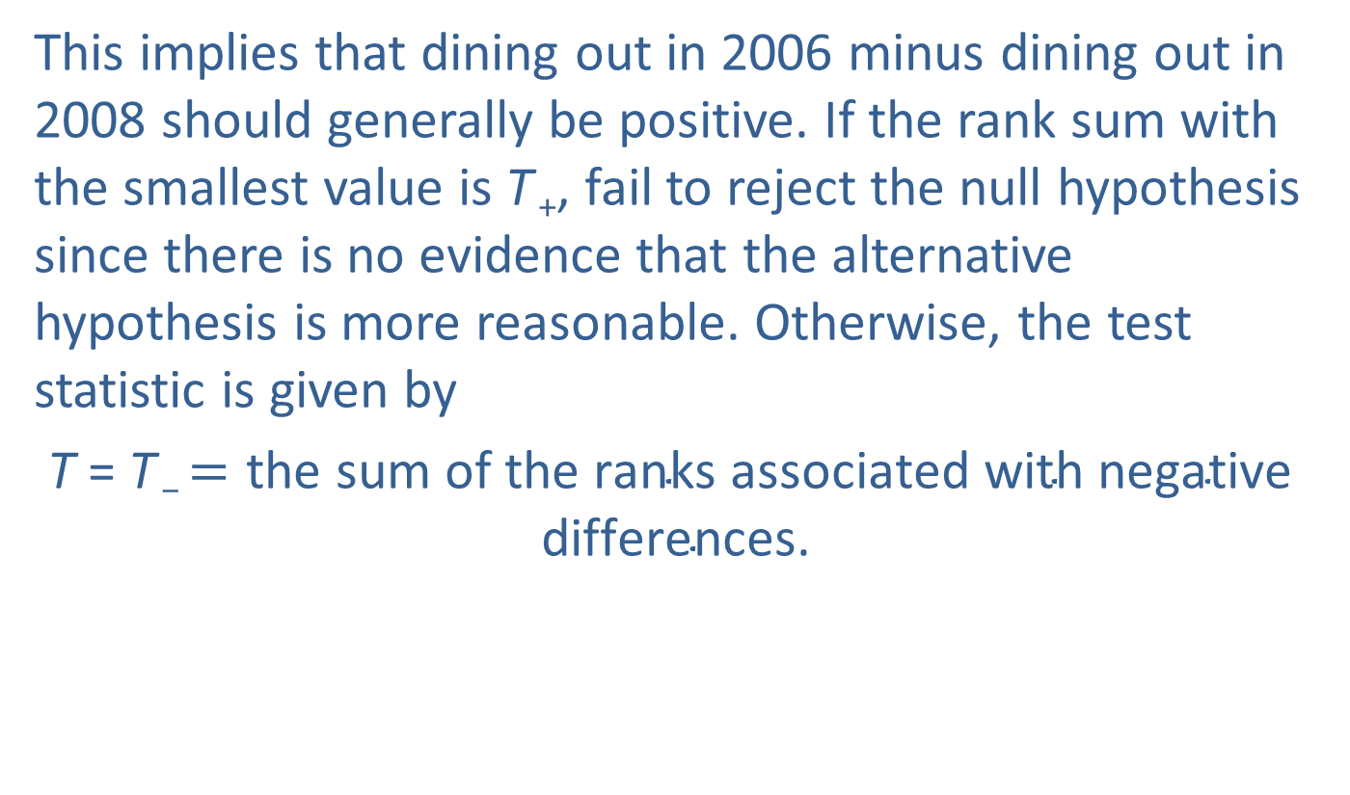
Example 2: Performing the Wilcoxon Signed-Rank Test—Slide 12
This implies that dining out in 2006 minus dining out in 2008 should generally be positive. If the rank sum with the smallest value is T ₊, fail to reject the null hypothesis since there is no evidence that the alternative hypothesis is more reasonable. Otherwise, the test statistic is given by
T = T ₋ $=\text{the} \text{sum} \text{of} \text{the} \text{ranks} \text{associated} \text{with} \text{negative} \text{differences}$.

Slide 18
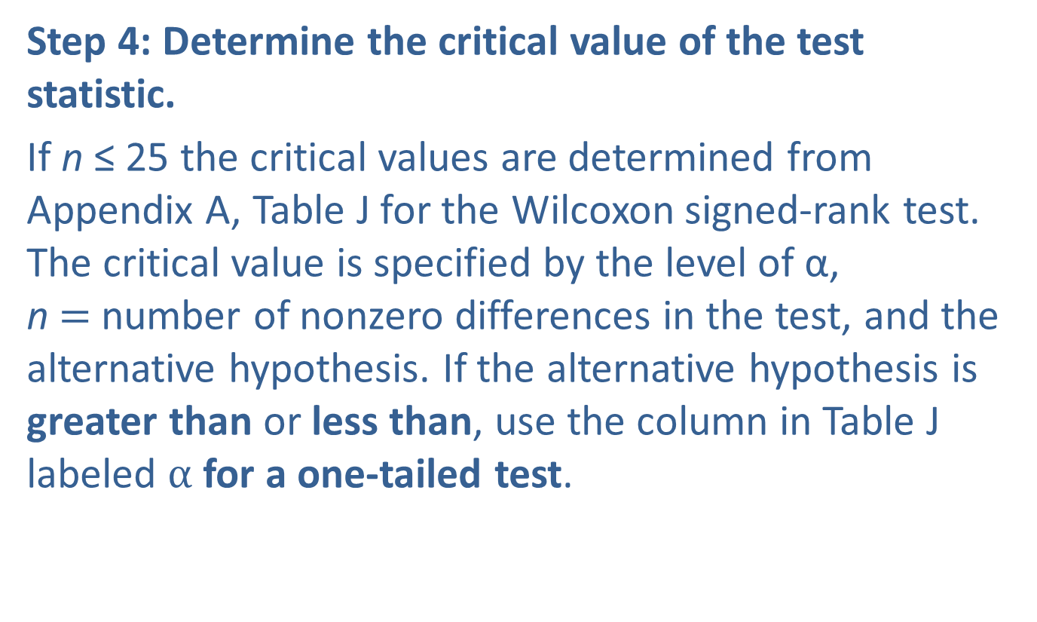
Example 2: Performing the Wilcoxon Signed-Rank Test—Slide 13
Step 4: Determine the critical value of the test statistic.
If n ≤ 25 the critical values are determined from Appendix A, Table J for the Wilcoxon signed-rank test. The critical value is specified by the level of α, n$=$ number of nonzero differences in the test, and the alternative hypothesis. If the alternative hypothesis is greater than or less than, use the column in Table J labeled $α$ for a one-tailed test.

Slide 19
Example 2: Performing the Wilcoxon Signed-Rank Test—Slide 14
If the alternative hypothesis is not equal to, use the column in Table J labelled α for a two-tailed test. Because of the way the test statistic is defined, the null hypothesis is always rejected if the test statistic is calculated from the data, T, is less than or equal to the critical value in Table J, T _{c}.

Slide 20
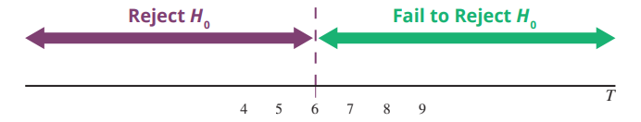
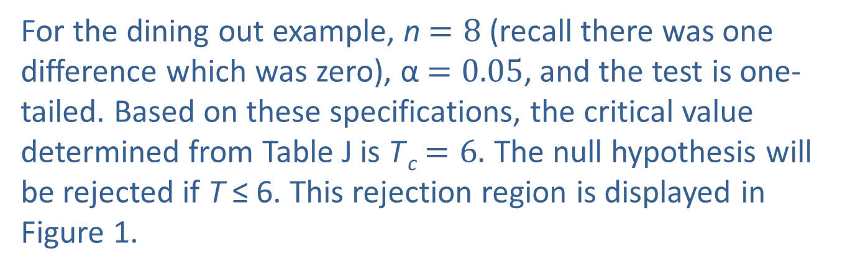
Example 2: Performing the Wilcoxon Signed-Rank Test—Slide 15
Figure 1
For the dining out example, n$=8$ (recall there was one difference which was zero), α$=0.05$, and the test is one-tailed. Based on these specifications, the critical value determined from Table J is T _{c}$=6.$ The null hypothesis will be rejected if T ≤ 6. This rejection region is displayed in Figure 1.

Slide 21
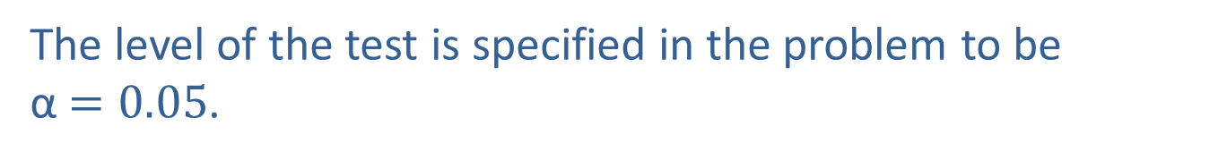
Example 2: Performing the Wilcoxon Signed-Rank Test—Slide 16
If n > 25, the critical values are determined in a similar manner to test statistics which have an approximate standard normal distribution under the null hypothesis. However, because of the way the test statistic is defined, we will always reject the null hypothesis for small values of the test statistic. Thus, the rejection region will always be established in the left tail, with the critical value defined by α for one-tailed tests, and
for two-tailed tests.
The level of the test is specified in the problem to be α $=0.05$.

Slide 22
Example 2: Performing the Wilcoxon Signed-Rank Test—Slide 17
Step 5: Collect the sample data and compute the value of the test statistic.
In order to calculate the test statistic, the signed ranks must be determined. To determine the signed ranks, first compute the difference for each pair of data values. Next, find the absolute value of each difference. Rank the absolute values of the differences using the ranking technique illustrated in Example 1 (ignore differences of zero).

Slide 23
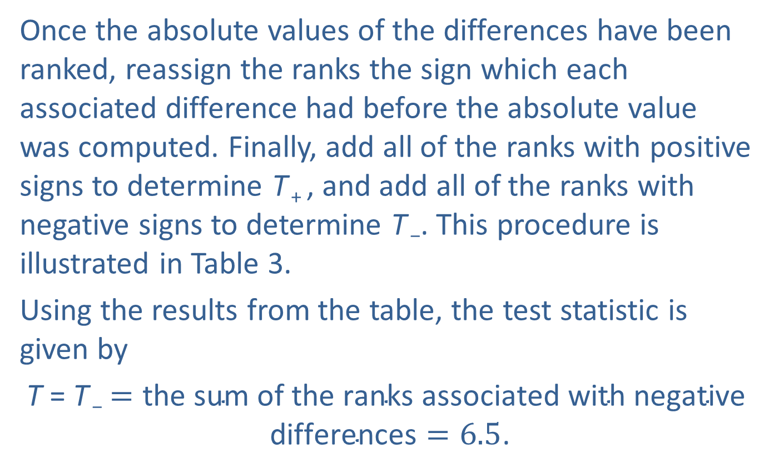
Example 2: Performing the Wilcoxon Signed-Rank Test—Slide 18
Once the absolute values of the differences have been ranked, reassign the ranks the sign which each associated difference had before the absolute value was computed. Finally, add all of the ranks with positive signs to determine T ₊ , and add all of the ranks with negative signs to determine T ₋. This procedure is illustrated in Table 3.
Using the results from the table, the test statistic is given by
T = T ₋$=\text{the} \text{sum} \text{of} \text{the} \text{ranks} \text{associated} \text{with} \text{negative} \text{differences}=6.5$.

Slide 24
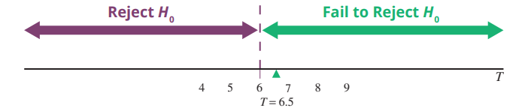
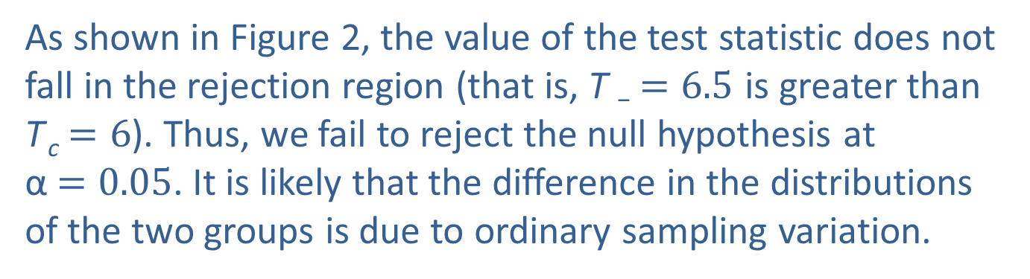
Example 2: Performing the Wilcoxon Signed-Rank Test—Slide 19
Step 6: Make the decision and state the conclusion in terms of the original question.
Figure 2
As shown in Figure 2, the value of the test statistic does not fall in the rejection region (that is, T ₋$=6.5$ is greater than T _{c}$=6$). Thus, we fail to reject the null hypothesis at α$=0.05$. It is likely that the difference in the distributions of the two groups is due to ordinary sampling variation.

Slide 25

Example 2: Performing the Wilcoxon Signed-Rank Test—Slide 20
Conclusion and Interpretation: There is insufficient evidence to conclude at α$=0.05$ that the number of times people dined out was significantly higher before the recession than during the recession.

Slide 26
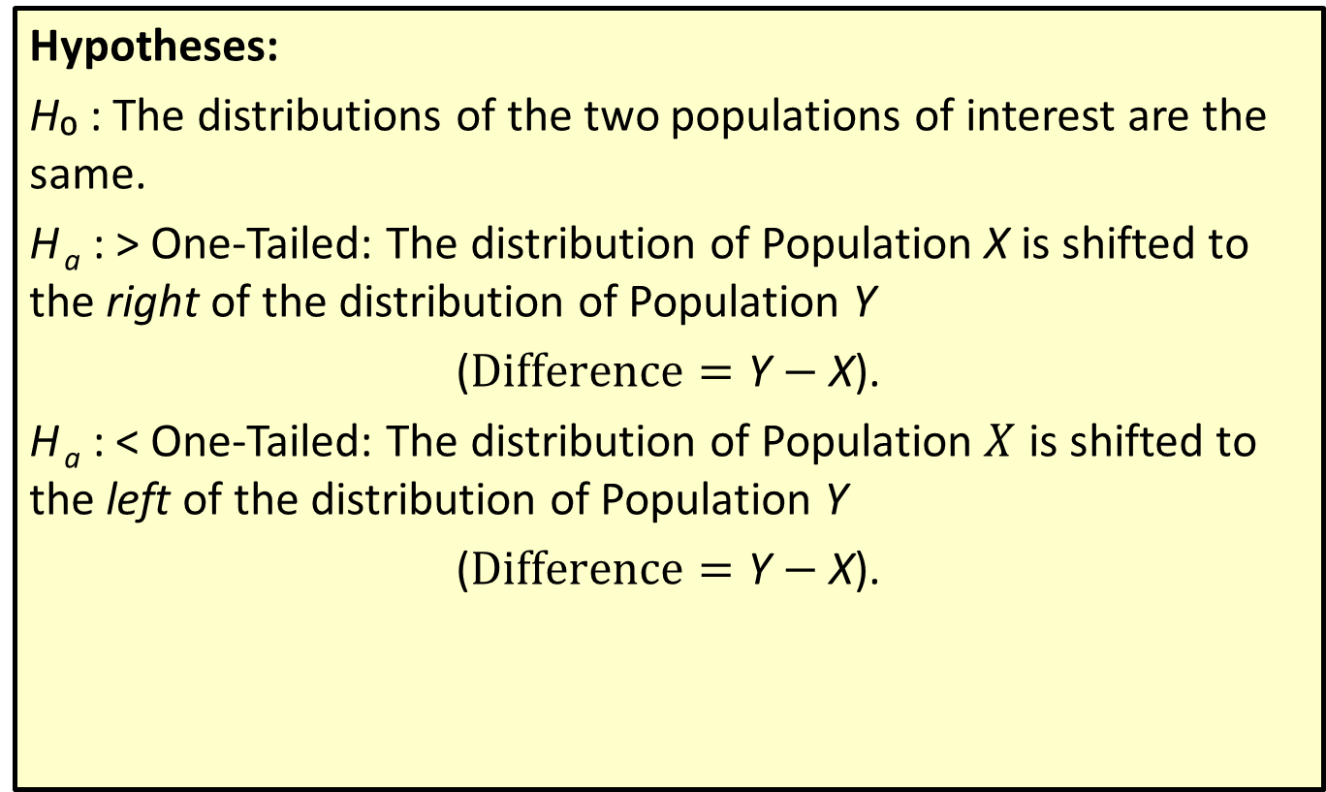
Procedure: Wilcoxon Signed-Rank Test—Slide 1
Hypotheses:
H₀ : The distributions of the two populations of interest are the same.
H _{a} : > One-Tailed: The distribution of Population X is shifted to the right of the distribution of Population Y
($Difference=\text{Y}−$X).
H _{a} : < One-Tailed: The distribution of Population $X$ is shifted to the left of the distribution of Population Y
($Difference=\text{Y}−\text{X}\text{).}$

Slide 27
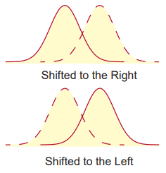
Procedure: Wilcoxon Signed-Rank Test—Slide 2
≠ Two-Tailed: The distribution of Population X is shifted to the left or to the right of the distribution of Population Y.

Slide 28
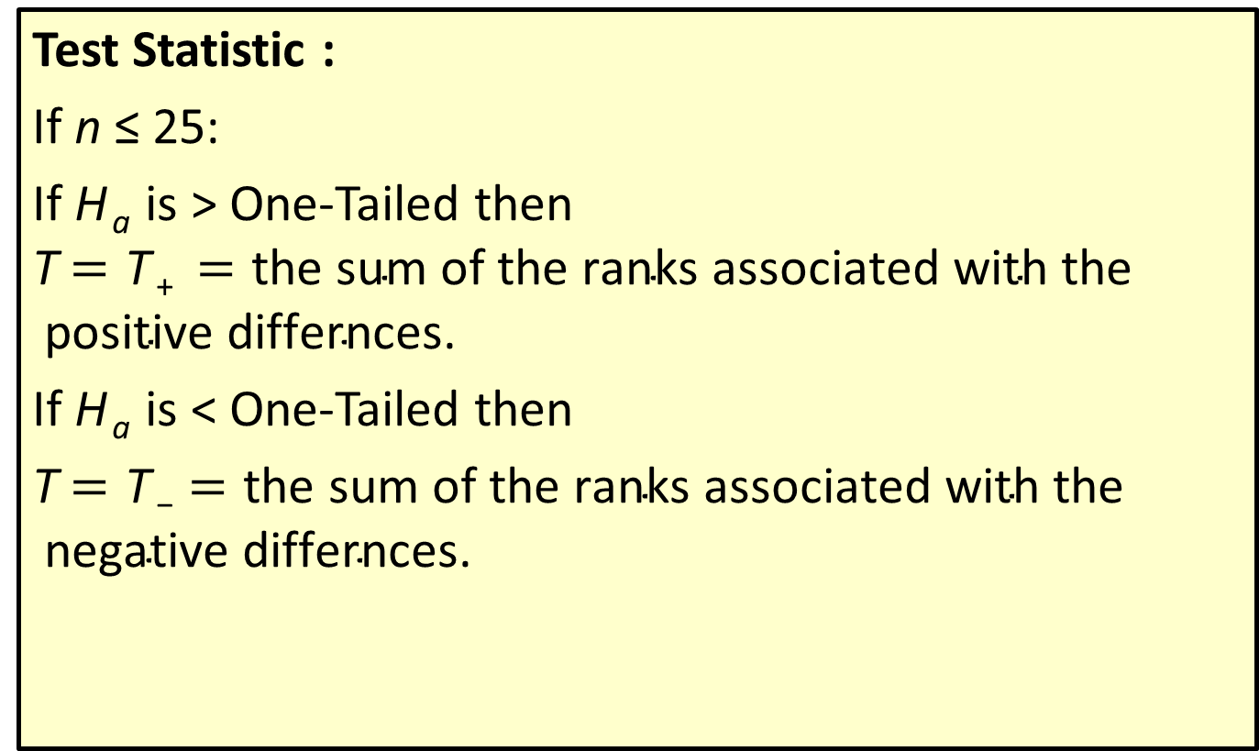
Procedure: Wilcoxon Signed-Rank Test—Slide 3
Test Statistic :
If n ≤ 25:
If H _{a} is > One-Tailed then T$=\text{T} \text{+ }=\text{the} \text{sum} \text{of} \text{the} \text{ranks} \text{associated} \text{with} \text{the} \text{positive} \text{differnces}$.
If H _{a} is < One-Tailed then
T$=\text{T} \text{−}=\text{the} \text{sum} \text{of} \text{the} \text{ranks} \text{associated} \text{with} \text{the} \text{negative} \text{differnces}$.

Slide 29
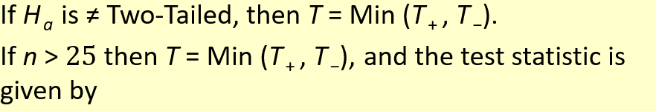
Procedure: Wilcoxon Signed-Rank Test—Slide 4

Slide 30
Procedure: Wilcoxon Signed-Rank Test—Slide 5
Critical Value(s):
If n ≤ 25, reject H₀ if T ≤ T _{c}, where T _{c} is the critical value found in Appendix A, Table J.
If n > 25;
One-Tailed Test: reject H₀ if z ≤ −z _{α}.
Two-Tailed Test: reject H₀ if
Assumptions:
Pairs of data have been randomly selected and are such that the absolute values of their differences can be ranked.

