Slide 1
Section 17.3
The Wilcoxon Rank-Sum Test

Slide 2
Example 1: Performing the Wilcoxon Rank-Sum Test—Slide 1
Audiophiles R U s (A R U) reviews high-end audio electronics as a service to customers and publishes their findings in A R U Magazine. One of the most popular issues is the one in which A R U reviews headphones. In its most recent magazine article about headphones, A R U reviewed two of the most popular high-end models of headphones on the market. Brand A headphones cost $449 and feature over the ear pads and crisp sound.

Slide 3
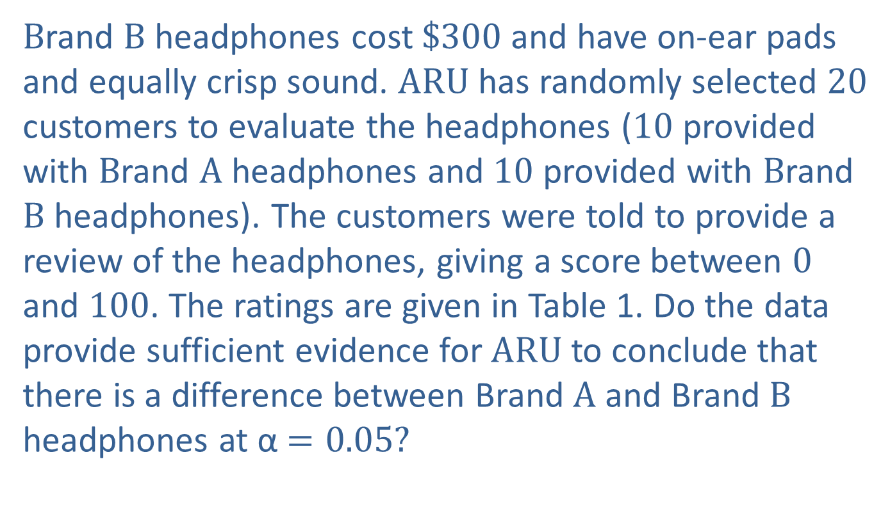
Example 1: Performing the Wilcoxon Rank-Sum Test—Slide 2
Brand B headphones cost $\$300$ and have on-ear pads and equally crisp sound. A R U has randomly selected 20 customers to evaluate the headphones (10 provided with Brand A headphones and 10 provided with Brand B headphones). The customers were told to provide a review of the headphones, giving a score between 0 and 100. The ratings are given in Table 1. Do the data provide sufficient evidence for A R U to conclude that there is a difference between Brand A and Brand B headphones at α$=0.05$?

Slide 4
Example 1: Performing the Wilcoxon Rank-Sum Test—Slide 3
Table 1–Headphone Ratings
Brand A | Rank | Brand B | Rank
93 | 15.5 | 99 | 19
100 | 20 | 84 | 8.5
75 | 3 | 76 | 4
92 | 14 | 93 | 15.5
55 | 1 | 87 | 12
98 | 18 | 95 | 17
85 | 10 | 77 | 5
84 | 8.5 | 79 | 6
82 | 7 | 61 | 2
90 | 13 | 86 | 11
Rank Sum | 110 |  | 100

Slide 5
Example 1: Performing the Wilcoxon Rank-Sum Test—Slide 4
Solution
Histograms of the two ratings are provided in Figure 1 and Figure 2. The histograms indicate that the ratings for Brand A and Brand B headphones appear to follow a skewed distribution. Thus, the assumption of normality may not be reasonable for these data.

Slide 6
Example 1: Performing the Wilcoxon Rank-Sum Test—Slide 5
If the assumption of normality is not met, the t-test for comparing two population means will not be valid. However, independent random samples were drawn for each set of customers and the data can be ranked. Thus, the assumptions for the Wilcoxon rank-sum test are satisfied and we can proceed with the test procedure.

Slide 7
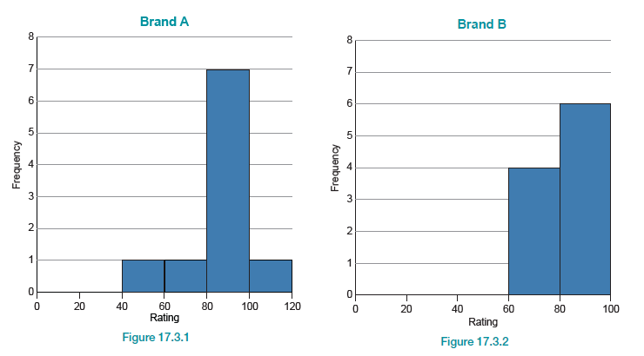
Example 1: Performing the Wilcoxon Rank-Sum Test—Slide 6
Figure 1
Figure 2

Slide 8
Example 1: Performing the Wilcoxon Rank-Sum Test—Slide 7
Step 1: Determine the null hypothesis.
The null hypothesis is that the ratings for Brand A and Brand B headphones are the same. The null hypothesis can be written as
H₀: The distributions of the ratings for Brand A
headphones and Brand B headphones are the
same.

Slide 9
Example 1: Performing the Wilcoxon Rank-Sum Test—Slide 8
Step 2: Determine the alternative hypothesis.
The alternative hypothesis is that the ratings for Brand A and Brand B headphones are different. The alternative hypothesis can be written as
H _{a}: The distribution of the ratings for Brand A
headphones is shifted to the right or to the left of
the distribution of the ratings for Brand B
headphones.
Since A R U wants to determine if there is a difference between the headphones, this is a two-tailed test, and the hypothesis will be two-sided.

Slide 10
Example 1: Performing the Wilcoxon Rank-Sum Test—Slide 9
Step 3: Select the appropriate test statistic based on the information at hand and the assumptions you are willing to make.
The Wilcoxon rank-sum test uses the idea that if the null hypothesis is true, both samples come from the same population and you should be able to combine them. After the samples are combined, rank the data and compute the sum of the ranks for each sample. In our example, the Wilcoxon rank-sum test compares the sum of the ranks, the rank sum, for Brand A headphone ratings to the rank sum for Brand B headphone ratings.

Slide 11
Example 1: Performing the Wilcoxon Rank-Sum Test—Slide 10
If the null hypothesis is true, we would expect the rank sums to have approximately the same value. If the rank sums are very different, it will cause us to doubt that the observations come from the same population. Thus, the rank sum will be the measure which will be used for our test statistic. How large a difference in the rank sums is necessary before they are considered significantly different? This question is answered by the critical values specified in Step 4.

Slide 12
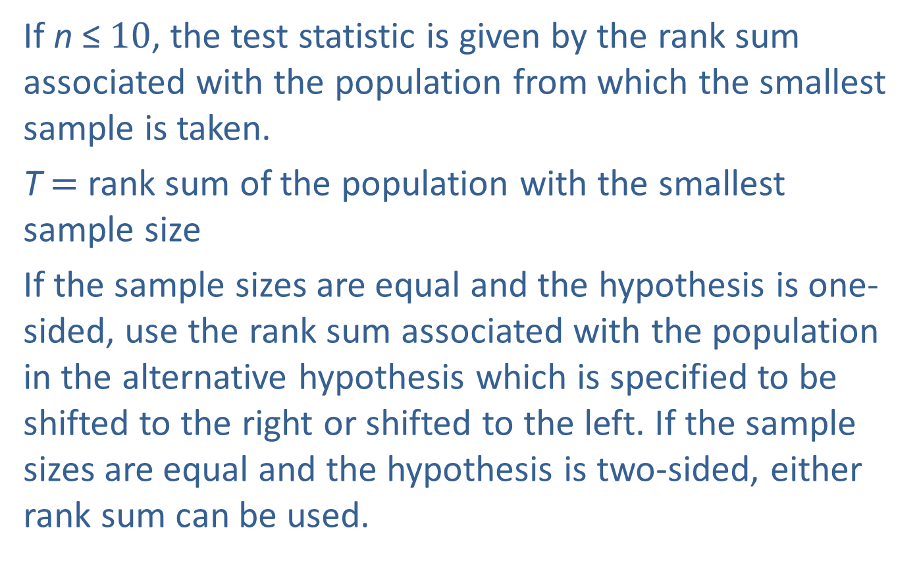
Example 1: Performing the Wilcoxon Rank-Sum Test—Slide 11
If n ≤$10$, the test statistic is given by the rank sum associated with the population from which the smallest sample is taken.
T$=$ rank sum of the population with the smallest sample size
If the sample sizes are equal and the hypothesis is one-sided, use the rank sum associated with the population in the alternative hypothesis which is specified to be shifted to the right or shifted to the left. If the sample sizes are equal and the hypothesis is two-sided, either rank sum can be used.

Slide 13

Example 1: Performing the Wilcoxon Rank-Sum Test—Slide 12
If n >$10$, the test statistic is given in the procedure following this example. The distribution of the test statistic can be approximated by a standard normal distribution.

Slide 14
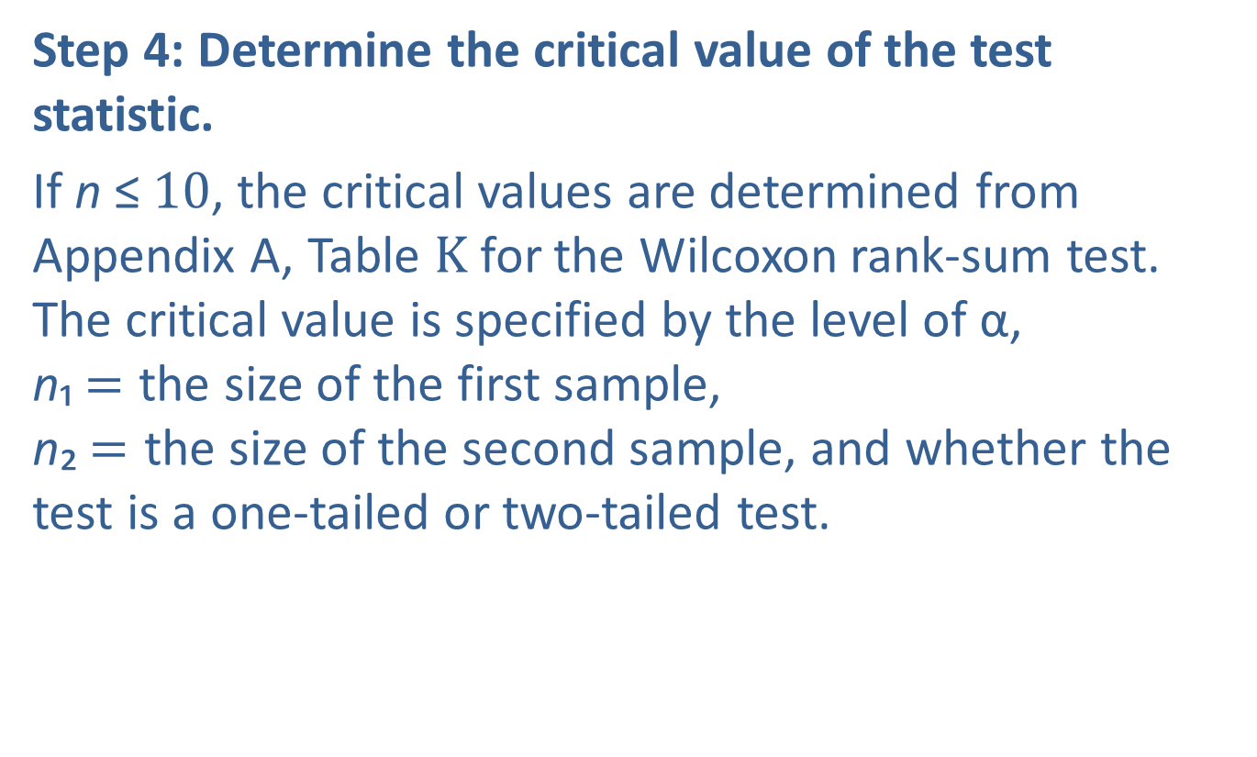
Example 1: Performing the Wilcoxon Rank-Sum Test—Slide 13
Step 4: Determine the critical value of the test statistic.
If n ≤$10$, the critical values are determined from Appendix A, Table K for the Wilcoxon rank-sum test. The critical value is specified by the level of α,
n₁$=$ the size of the first sample,
n₂$=$ the size of the second sample, and whether the test is a one-tailed or two-tailed test.

Slide 15
Example 1: Performing the Wilcoxon Rank-Sum Test—Slide 14
​If the alternative hypothesis is one-sided and specifies that the distribution of Population X is shifted to the right of the distribution of Population Y, the null hypothesis is rejected if T ≥ T _{U} from the table K.
If the alternative hypothesis is one-sided, and specifies that the distribution of Population X is shifted to the left of the distribution of Population Y, the null hypothesis is rejected if T ≤ T _{L} from
Table K.

Slide 16
Example 1: Performing the Wilcoxon Rank-Sum Test—Slide 15
If the alternative hypothesis is two-sided and specifies that the distribution of Population X is shifted to the left of the distribution of Population Y or the distribution of Population X is shifted to the right of the distribution of Population Y, the null hypothesis is rejected if T ≤ T _{L} or T ≥ T _{U} from
Table K.

Slide 17
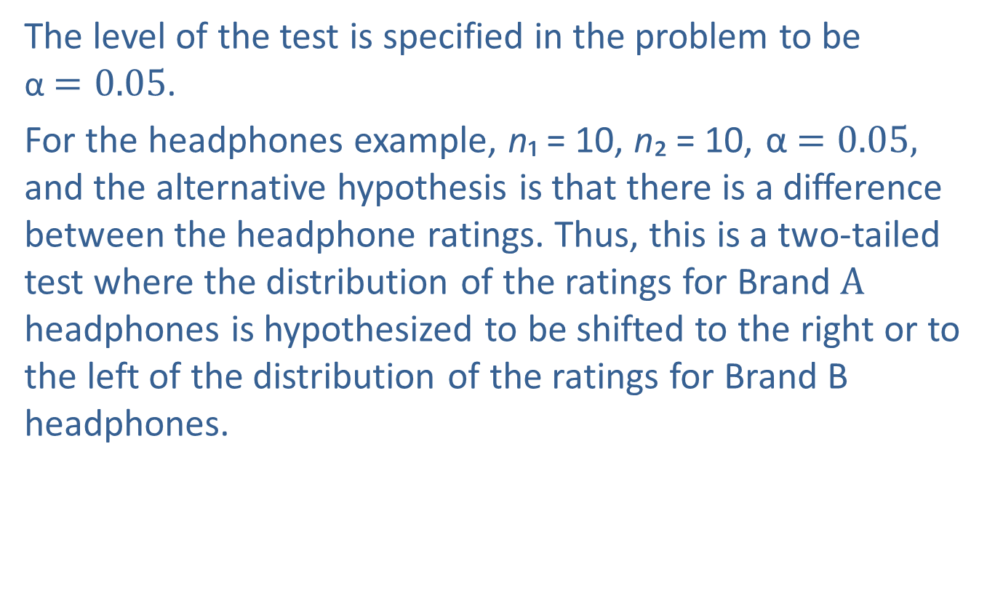
Example 1: Performing the Wilcoxon Rank-Sum Test—Slide 16
The level of the test is specified in the problem to be α$=0.05$.
For the headphones example, n₁ = 10, n₂ = 10, α $=0.05,$ and the alternative hypothesis is that there is a difference between the headphone ratings. Thus, this is a two-tailed test where the distribution of the ratings for Brand A headphones is hypothesized to be shifted to the right or to the left of the distribution of the ratings for Brand B headphones.

Slide 18
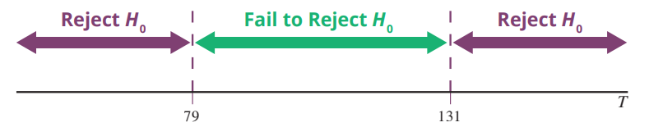
Example 1: Performing the Wilcoxon Rank-Sum Test—Slide 17
Using Table K, we find that the null hypothesis should be rejected if T ≤ 79 or T ≥ 131. The rejection region is displayed in Figure 3.
Figure 3

Slide 19

Example 1: Performing the Wilcoxon Rank-Sum Test—Slide 18
If n >$10$, the critical values are determined in the usual manner for test statistics which have an approximate standard normal distribution under the null hypothesis. The box following this example describes the procedure for determining the rejection region in this case.

Slide 20
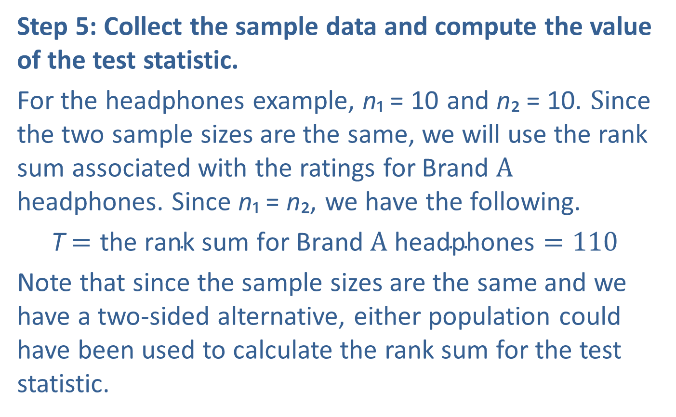
Example 1: Performing the Wilcoxon Rank-Sum Test—Slide 19
Step 5: Collect the sample data and compute the value of the test statistic.
For the headphones example, n₁ = 10 and n₂ = 10. Since the two sample sizes are the same, we will use the rank sum associated with the ratings for Brand A headphones. Since n₁ = n₂, we have the following.
T$=\text{the} \text{rank} \text{sum} \text{for} \text{Brand} \text{A} \text{headphones}=110$
Note that since the sample sizes are the same and we have a two-sided alternative, either population could have been used to calculate the rank sum for the test statistic.

Slide 21
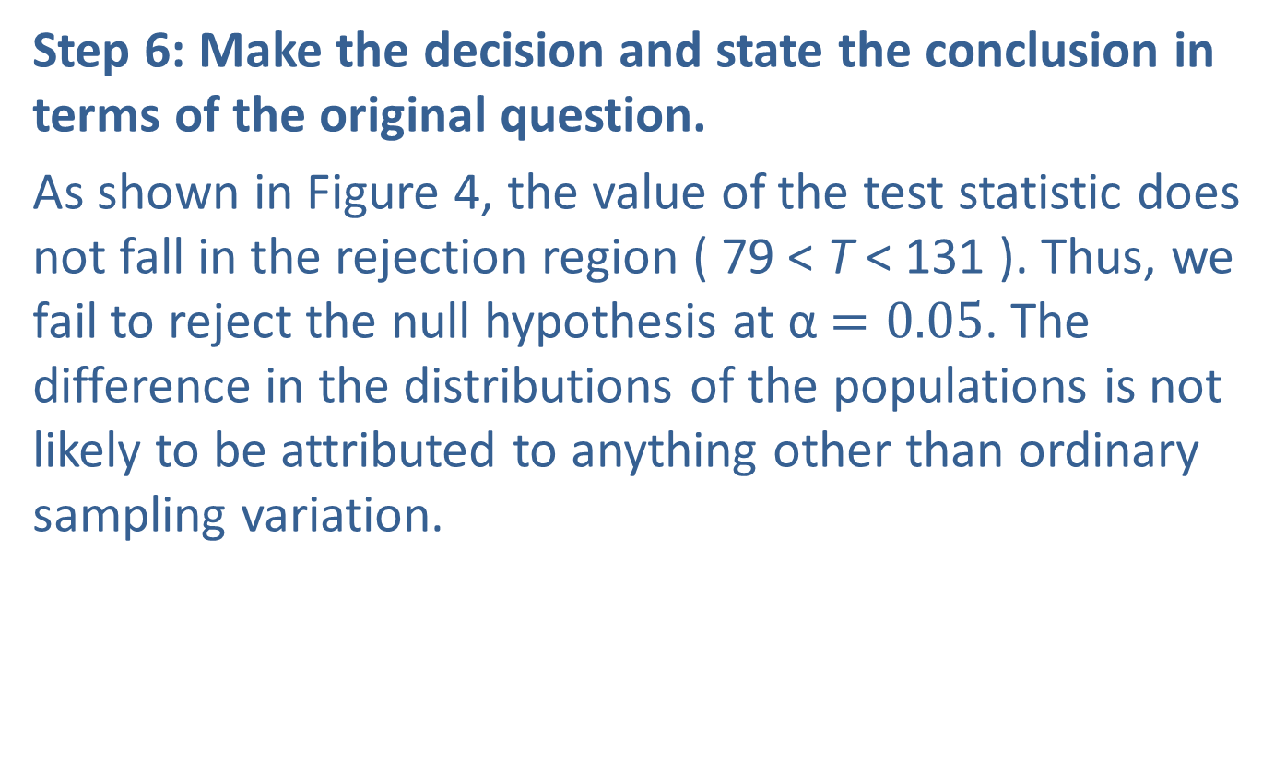
Example 1: Performing the Wilcoxon Rank-Sum Test—Slide 20
Step 6: Make the decision and state the conclusion in terms of the original question.
As shown in Figure 4, the value of the test statistic does not fall in the rejection region ( 79 < T < 131 ). Thus, we fail to reject the null hypothesis at α$=0.05$. The difference in the distributions of the populations is not likely to be attributed to anything other than ordinary sampling variation.

Slide 22
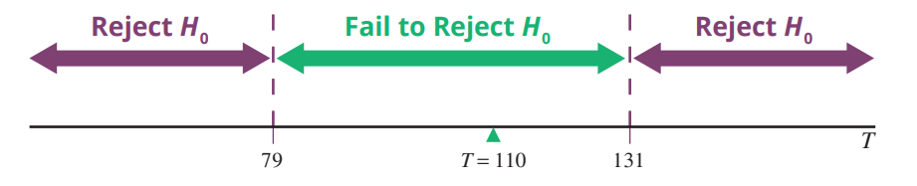
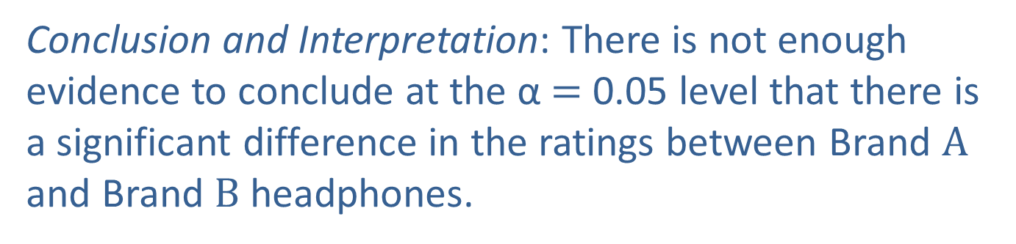
Example 1: Performing the Wilcoxon Rank-Sum Test—Slide 21
Figure 4
Conclusion and Interpretation: There is not enough evidence to conclude at the α$=$ 0.05 level that there is a significant difference in the ratings between Brand A and Brand B headphones.

Slide 23
Definition: Wilcoxon Rank-Sum Test—Slide 1
Hypotheses:
H₀ : The distributions of the two populations of interest
are the same.
H _{a} : > One-Tailed: The distribution of Population X is shifted
to the right of the distribution of Population Y.
< One-Tailed: The distribution of Population X is shifted
to the left of the distribution of Population Y.
≠ Two-Tailed: The distribution of Population X is shifted
to the right or to the left of the distribution of
of Population Y.

Slide 24
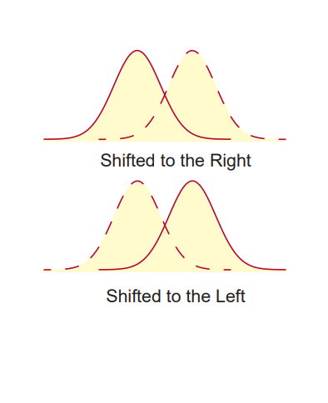
Definition: Wilcoxon Rank-Sum Test—Slide 2

Slide 25
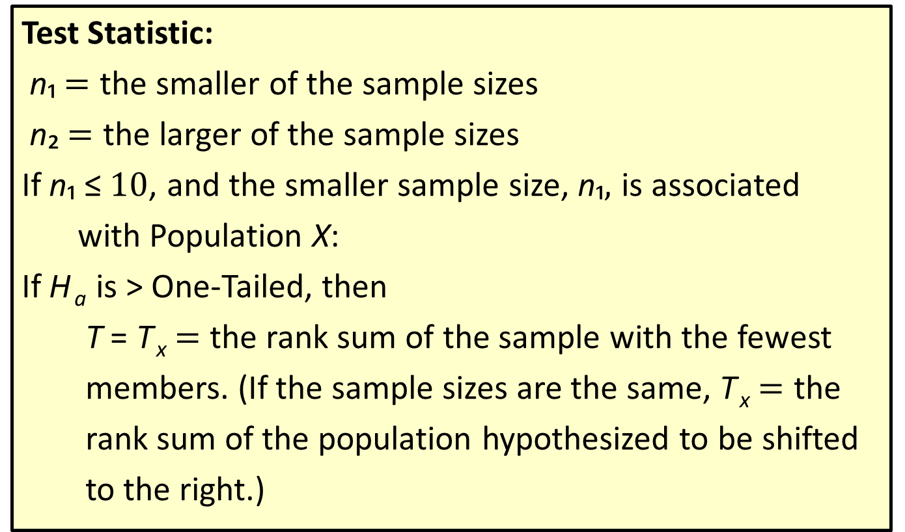
Definition: Wilcoxon Rank-Sum Test—Slide 3
Test Statistic:
n₁$=$ the smaller of the sample sizes
n₂$=$ the larger of the sample sizes
If n₁ ≤$10$, and the smaller sample size, n₁$,$ is associated
with Population X:
If H _{a} is > One-Tailed, then
T = T _{x}$=$ the rank sum of the sample with the fewest
members. (If the sample sizes are the same, T _{x}$=$ the
rank sum of the population hypothesized to be shifted
to the right.)

Slide 26
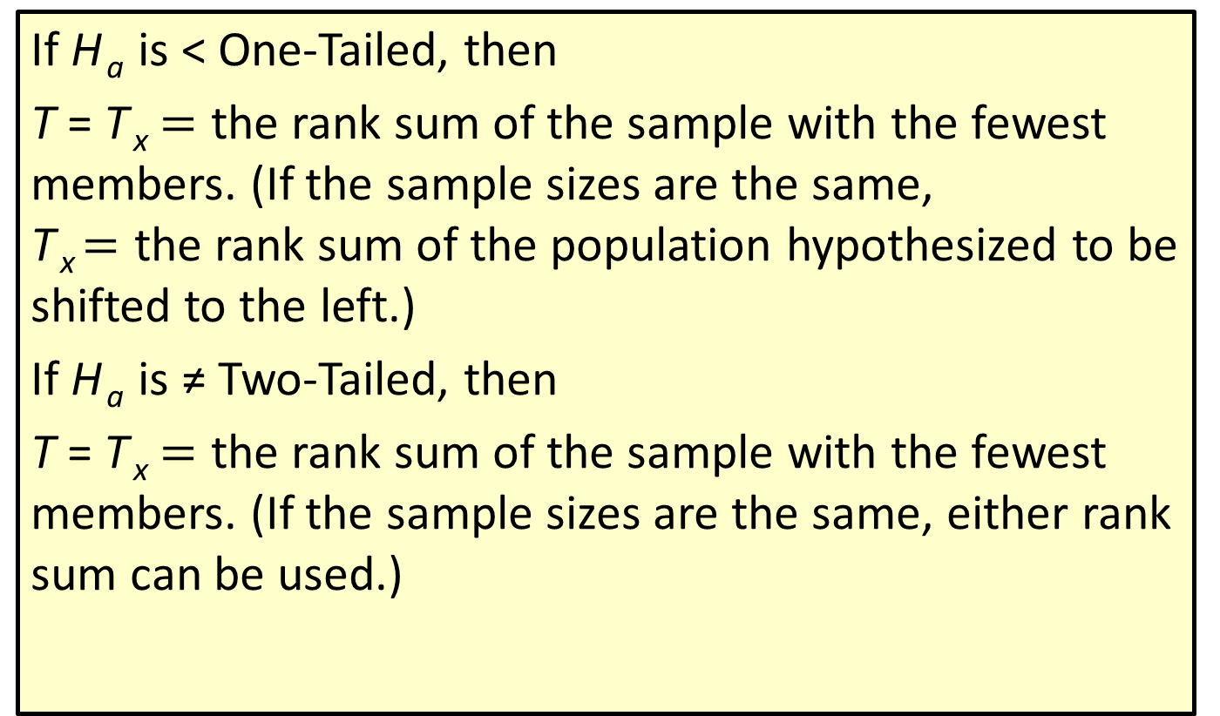
Definition: Wilcoxon Rank-Sum Test—Slide 4
If H _{a} is < One-Tailed, then
T = T _{x}$=$ the rank sum of the sample with the fewest members. (If the sample sizes are the same,
T _{x} $=$ the rank sum of the population hypothesized to be shifted to the left.)
If H _{a} is ≠ Two-Tailed, then
T = T _{x}$=$ the rank sum of the sample with the fewest members. (If the sample sizes are the same, either rank sum can be used.)

Slide 27
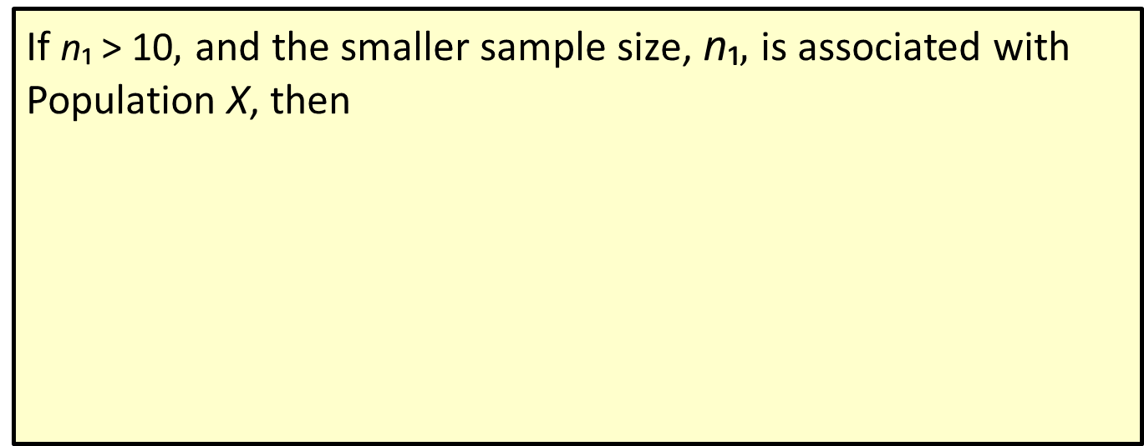
Definition: Wilcoxon Rank-Sum Test—Slide 5
If n₁ > 10$,$ and the smaller sample size, n₁$,$ is associated with Population X, then
Where T is defined just as when n₁ ≤$10$.

Slide 28
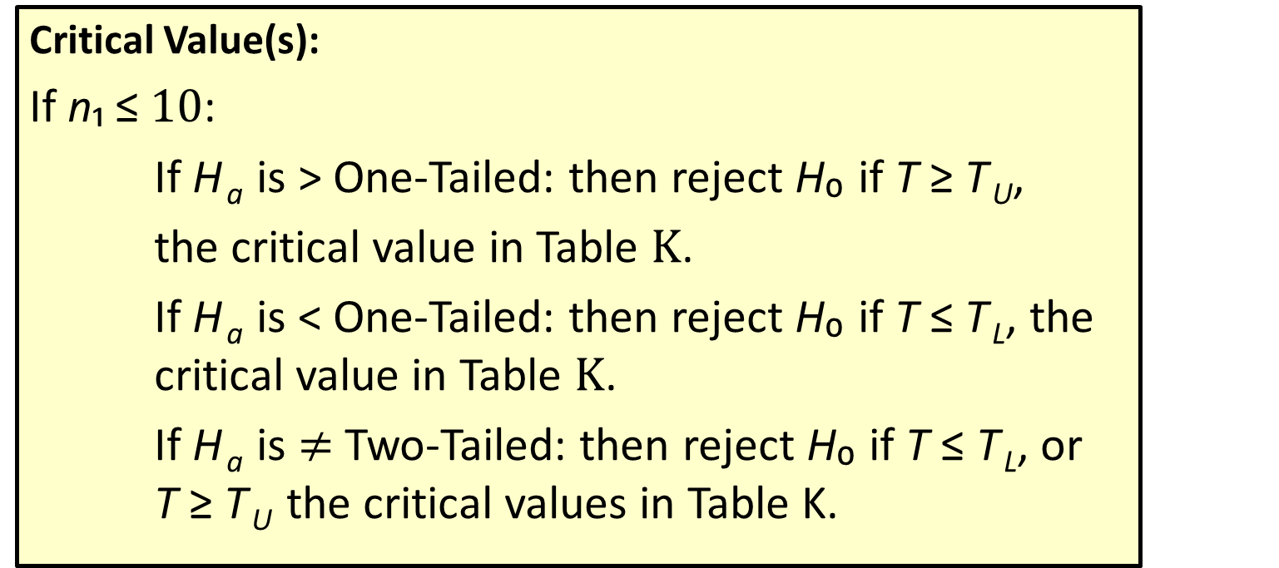
Definition: Wilcoxon Rank-Sum Test—Slide 6
Critical Value(s):
If n₁ ≤$10$:
If H _{a} is > One-Tailed: then reject H₀ if T ≥ T _{U},
the critical value in Table K.
If H _{a} is < One-Tailed: then reject H₀ if T ≤ T _{L}, the critical value in Table K.
If H _{a} is $≠$ Two-Tailed: then reject H₀ if T ≤ T _{L}, or
T ≥ T _{U} the critical values in Table K.

Slide 29

Definition: Wilcoxon Rank-Sum Test—Slide 7
If n₁ > 10:
if H _{a} is > One-Tailed, then reject H₀ if z ≥ z _{α}.
if H _{a} is < One-Tailed, then reject H₀ if z ≤$−$z _{α}.
if H _{a} is ≠ Two-Tailed, then reject H₀ if
or if
Assumptions:
The data are such that they can be ranked. The two samples are selected in an independent and random fashion.

