Slide 1
Section 17.4
The Rank Correlation Test

Slide 2
Formula: Spearman Rank Correlation Coefficient
The Spearman Rank correlation coefficient is given by
where

Slide 3
Example 1: Calculating the Spearman Rank Correlation Coefficient—Slide 1
A faculty member at State University is curious if there is a relationship between the number of hours that a student spends studying in their freshman math course versus the number of hours spent studying in their freshman English class. The data in Table 1 below is a random sample of four students in the faculty member's class. The variables x and y represent the number of hours spent studying for math and English, respectively.

Slide 4
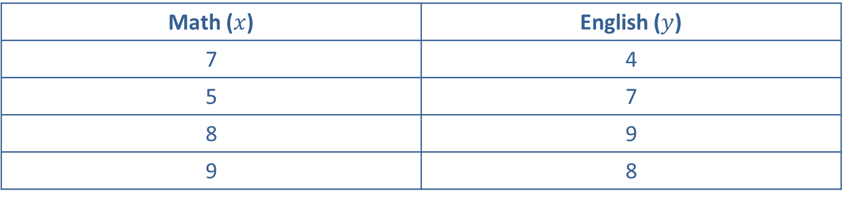
Example 1: Calculating the Spearman Rank Correlation Coefficient—Slide 2
Table 1 – Time Spent Studying (hours)
Math ($x$) | English ($y$)
7 | 4
5 | 7
8 | 9
9 | 8
Calculate the Spearman rank correlation coefficient, r _{s}, for these data.

Slide 5
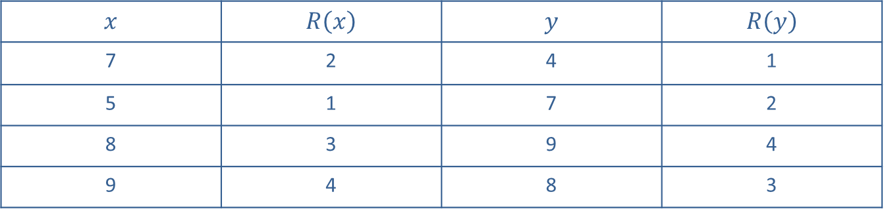
Example 1: Calculating the Spearman Rank Correlation Coefficient—Slide 3
Solution
Converting the data to ranks (from smallest to largest), we obtain
Table 2 – Ranked Data
$$x$$ | $$R⁡\left(x\right)$$ | $$y$$ | $$R⁡\left(y\right)$$
7 | 2 | 4 | 1
5 | 1 | 7 | 2
8 | 3 | 9 | 4
9 | 4 | 8 | 3

Slide 6
Example 1: Calculating the Spearman Rank Correlation Coefficient—Slide 4
The value of r _{s} is then given by

Slide 7
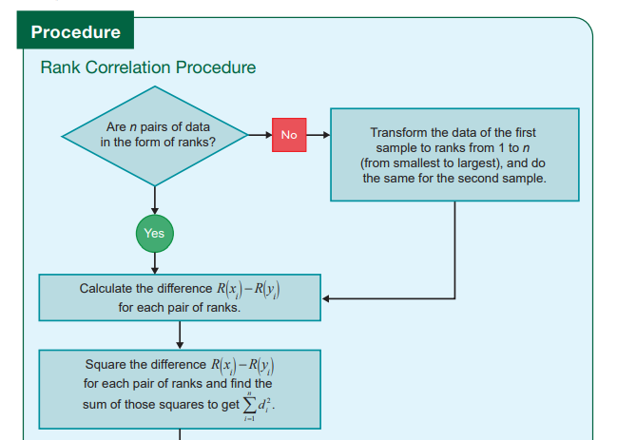
Rank Correlation Procedure—Slide 1

Slide 8
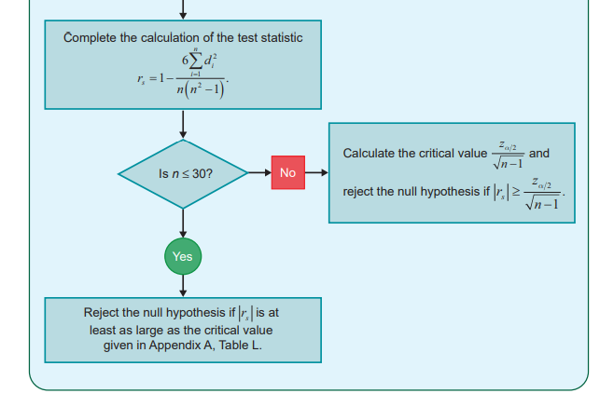
Rank Correlation Procedure—Slide 2

Slide 9
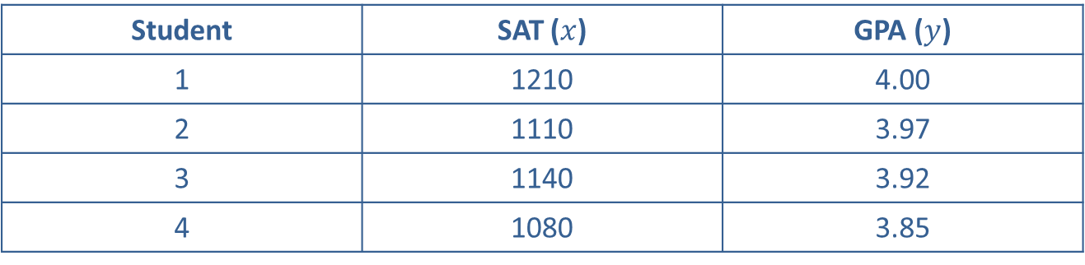
Example 2: Performing the Rank Correlation Test—Slide 1
The academic performances of 12 college graduates are observed to examine the relationship between their S A T scores and their G P A s. The S A T scores (combined mathematics and critical reading sections which could yield a maximum score of 1600) and the G P A s are given in the following table.
Table 3 – S A T Scores and G P A s
Student | SAT ($x$) | GPA ($y$)
1 | 1210 | 4.00
2 | 1110 | 3.97
3 | 1140 | 3.92
4 | 1080 | 3.85

Slide 10

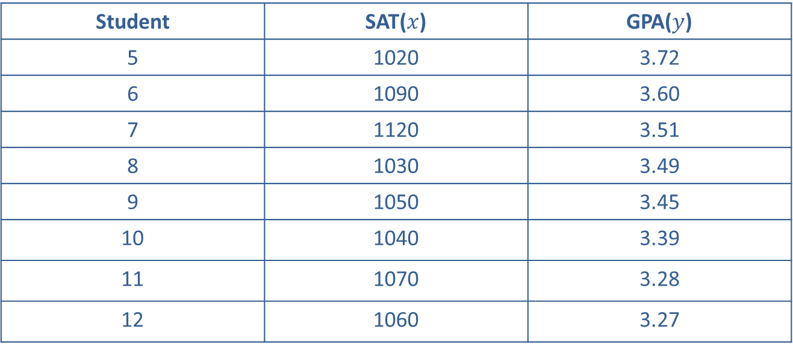
Example 2: Performing the Rank Correlation Test—Slide 2
Table 3 – S A T Scores and G P A s
Student | SAT($x$) | GPA($y$)
5 | 1020 | 3.72
6 | 1090 | 3.60
7 | 1120 | 3.51
8 | 1030 | 3.49
9 | 1050 | 3.45
10 | 1040 | 3.39
11 | 1070 | 3.28
12 | 1060 | 3.27
Test the hypothesis that there is a relationship between the variables at the α$=0.10$ level.

Slide 11

Example 2: Performing the Rank Correlation Test—Slide 3
Solution
In order to test whether an association exists between these two variables at α$=0.10$ we prepare the following table.

Slide 12
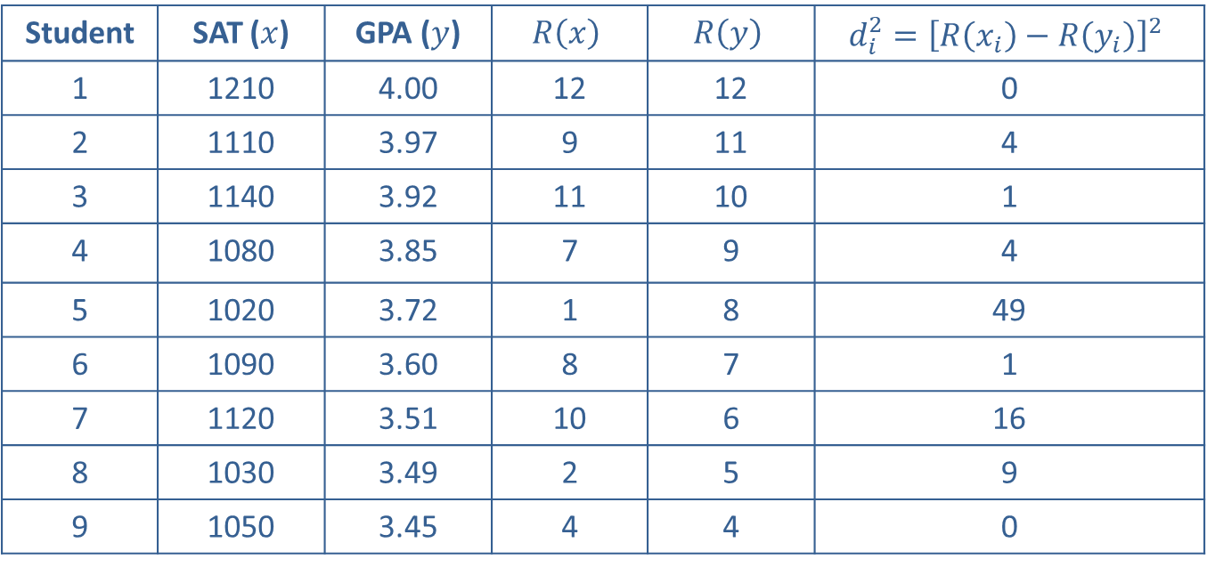
Example 2: Performing the Rank Correlation Test—Slide 4
Table 4 – S A T Scores and G P A s
Student | SAT ($x$) | GPA ($y$) | $$R⁡\left(x\right)$$ | $$R⁡\left(y\right)$$ | $$d_{i}^{2}={\left[R\left(x_{i}\right)−R\left(y_{i}\right)\right]}^{2}$$
1 | 1210 | 4.00 | 12 | 12 | 0
2 | 1110 | 3.97 | 9 | 11 | 4
3 | 1140 | 3.92 | 11 | 10 | 1
4 | 1080 | 3.85 | 7 | 9 | 4
5 | 1020 | 3.72 | 1 | 8 | 49
6 | 1090 | 3.60 | 8 | 7 | 1
7 | 1120 | 3.51 | 10 | 6 | 16
8 | 1030 | 3.49 | 2 | 5 | 9
9 | 1050 | 3.45 | 4 | 4 | 0

Slide 13
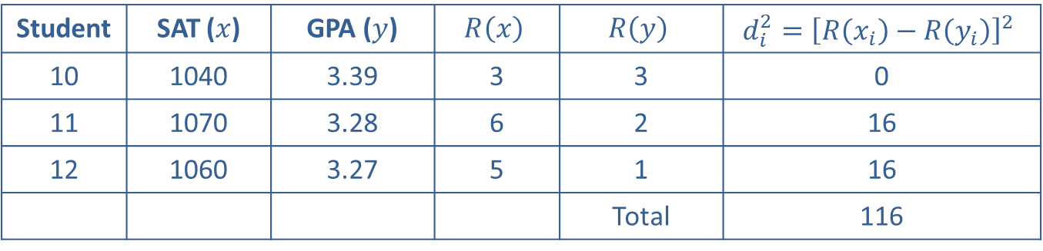
Example 2: Performing the Rank Correlation Test—Slide 5
Table 4 – S A T Scores and G P A s
Student | SAT ($x$) | GPA ($y$) | $$R⁡\left(x\right)$$ | $$R⁡\left(y\right)$$ | $$d_{i}^{2}={\left[R\left(x_{i}\right)−R\left(y_{i}\right)\right]}^{2}$$
10 | 1040 | 3.39 | 3 | 3 | 0
11 | 1070 | 3.28 | 6 | 2 | 16
12 | 1060 | 3.27 | 5 | 1 | 16
 |  |  |  | Total | 116
We then calculate the test statistic

Slide 14
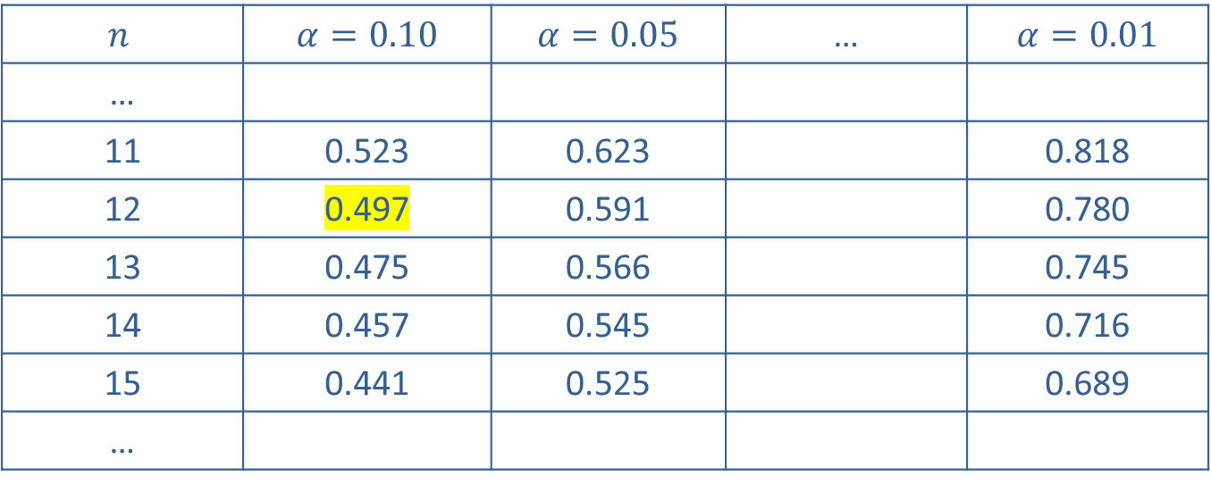

Example 2: Performing the Rank Correlation Test—Slide 6
Since our sample size is 12 (n <$30$), the value of the statistic is compared with the critical value obtained using Appendix A, Table L.
$$n$$ | $α=0.10$ | $α=0.05$ | … | $α=0.01$
…
11 | 0.523 | 0.623 |  | 0.818
12 | 0.497 | 0.591 |  | 0.780
13 | 0.475 | 0.566 |  | 0.745
14 | 0.457 | 0.545 |  | 0.716
15 | 0.441 | 0.525 |  | 0.689
…

Slide 15
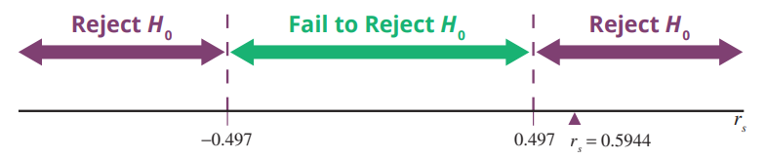
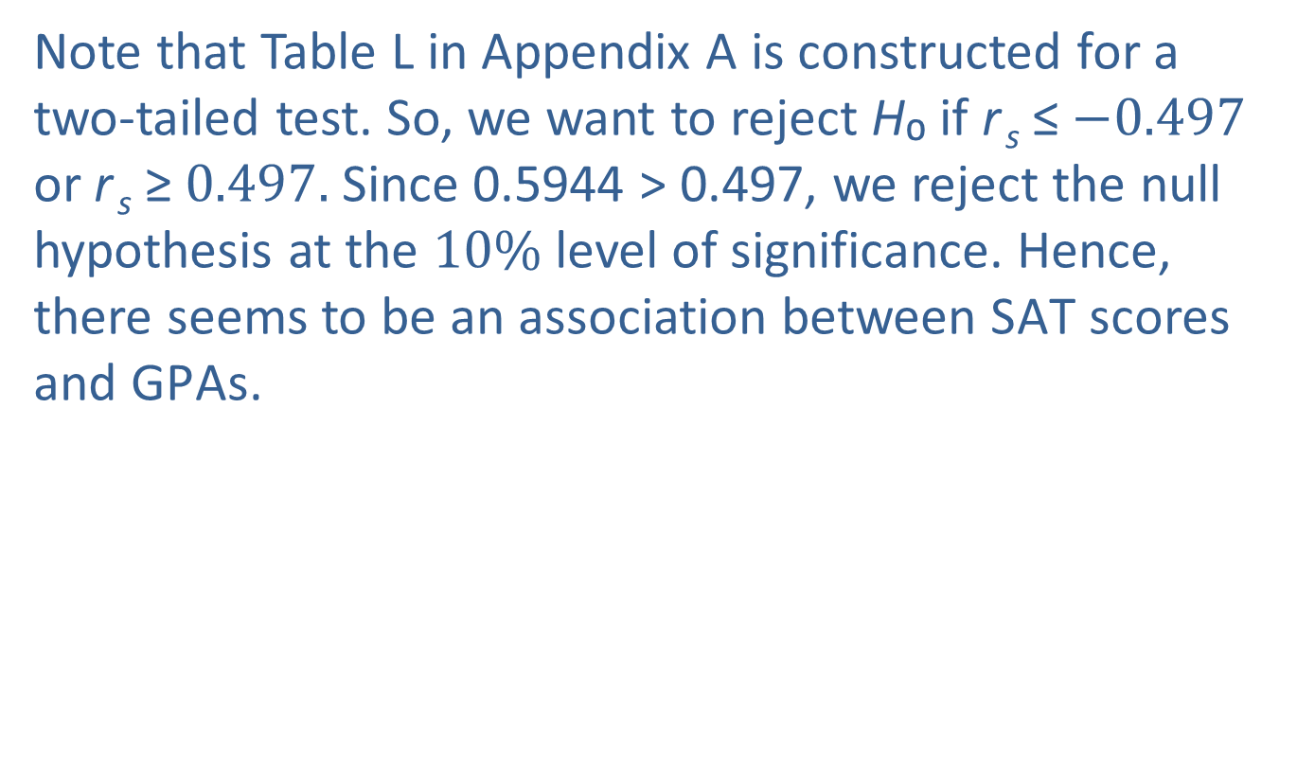
Example 2: Performing the Rank Correlation Test—Slide 7
Note that Table L in Appendix A is constructed for a two-tailed test. So, we want to reject H₀ if r _{s} ≤$−0.497$ or r _{s} ≥$0.497.$Since 0.5944 > 0.497, we reject the null hypothesis at the $10\%$ level of significance. Hence, there seems to be an association between S A T scores and G P A s.
Figure 1

