Slide 1
Section 17.5
The Runs Test for Randomness

Slide 2
Definition: Run
A run is a series of increasing values, a series of decreasing values, or a sequence of at least one symbol.

Slide 3
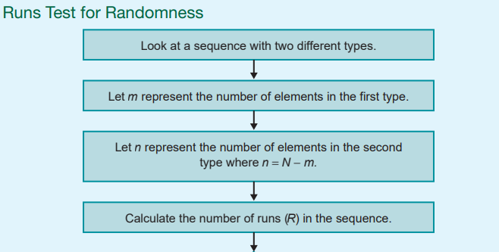
Procedure: Runs Test for Randomness—Slide 1

Slide 4
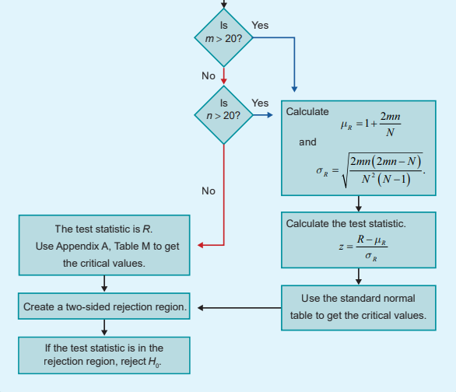
Procedure: Runs Test for Randomness—Slide 2

Slide 5
Example 1: Performing the Runs Test to Determine if a Sequence of Coin Flips is Random—Slide 1
Let us apply the runs test for randomness to each of the sequences of heads and tails seen earlier in this section. In each test the hypotheses are as follows.
H₀ : The sequence is random.
H _{a} : The sequence is not random.

Slide 6
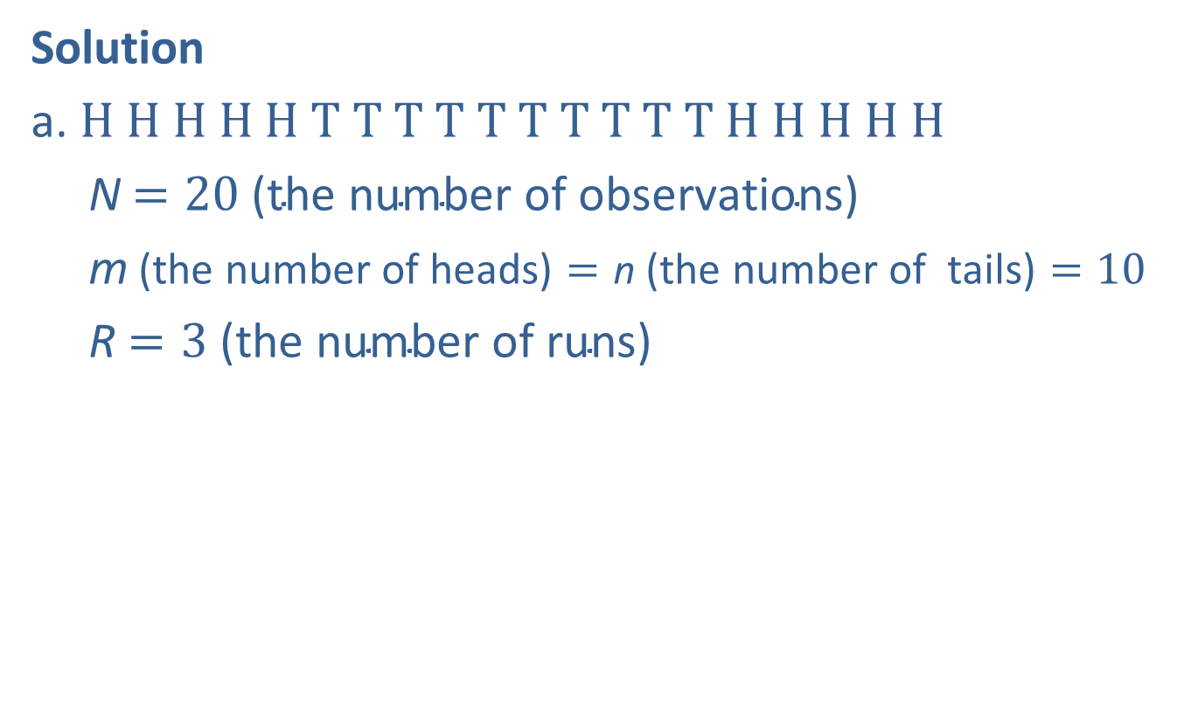
Example 1: Performing the Runs Test to Determine if a Sequence of Coin Flips is Random—Slide 2
Solution
a. ​H H H H H T T T T T T T T T T H H H H H
N$=20 \text{(}\text{the} \text{number} \text{of} \text{observations}\text{)}$
m$\text{(}\text{the} \text{number} \text{of} \text{heads}\text{)}=\text{n} \text{(}\text{the} \text{number} \text{of} \text{tails}\text{)}=10$
R$=3 \text{(}\text{the} \text{number} \text{of} \text{runs}\text{)}$

Slide 7
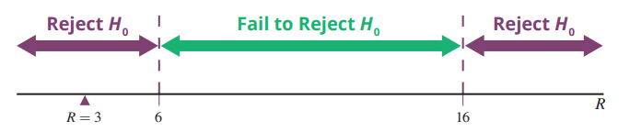
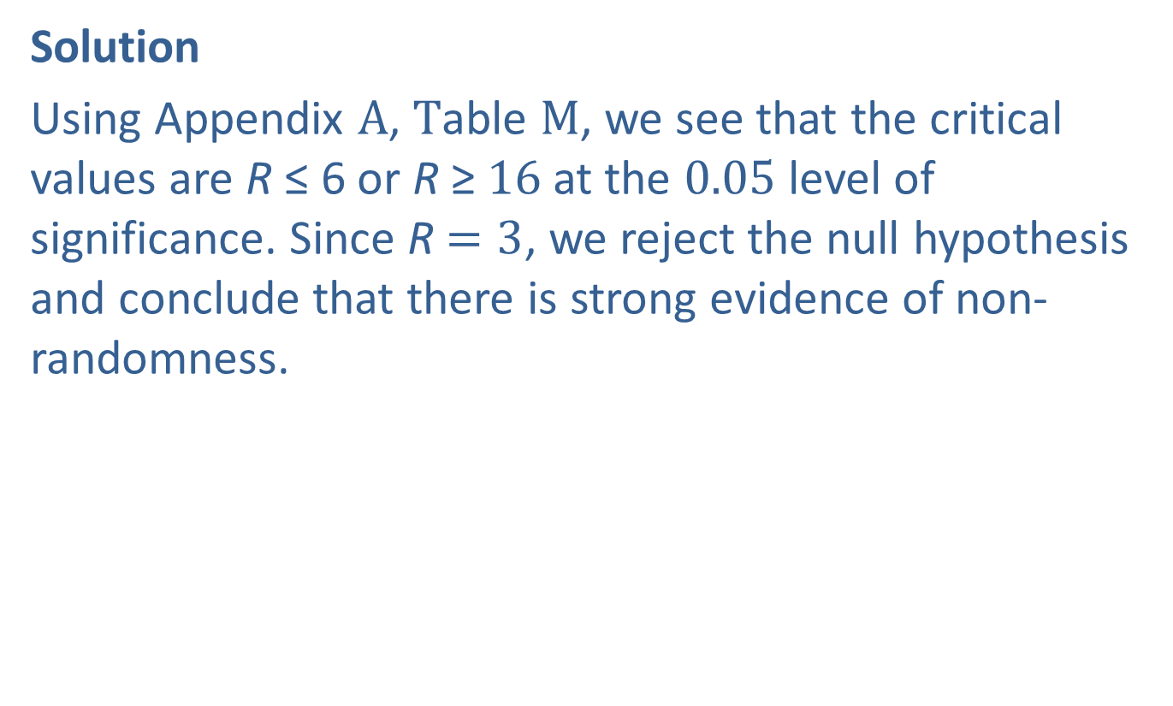
Example 1: Performing the Runs Test to Determine if a Sequence of Coin Flips is Random—Slide 3
Solution
​Using Appendix A, Table M, we see that the critical values are R ≤ 6 or R ≥$16$ at the 0.05 level of significance. Since R$=3$, we reject the null hypothesis and conclude that there is strong evidence of non-randomness.
Figure 1

Slide 8
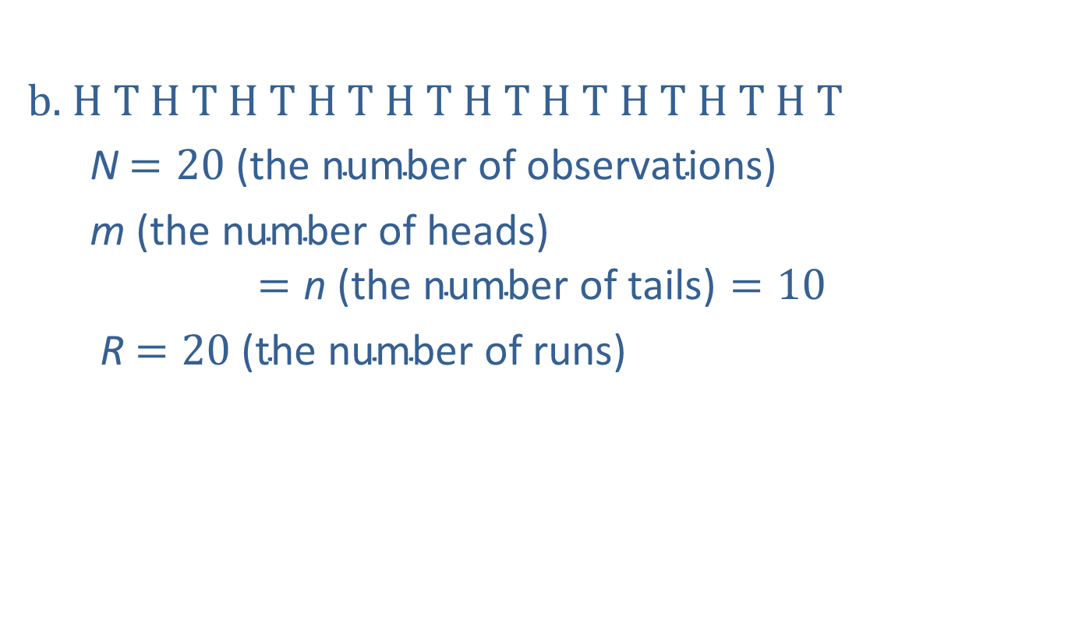
Example 1: Performing the Runs Test to Determine if a Sequence of Coin Flips is Random—Slide 4
b. ​H T H T H T H T H T H T H T H T H T H T
N$=20 \text{(}\text{the} \text{number} \text{of} \text{observations}\text{)}$
m​$\text{(}\text{the} \text{number} \text{of} \text{heads}\text{)}$ $$=\text{n} \text{(}\text{the} \text{number} \text{of} \text{tails}\text{)}=10$$
R$=20 \text{(}\text{the} \text{number} \text{of} \text{runs}\text{)}$​

Slide 9
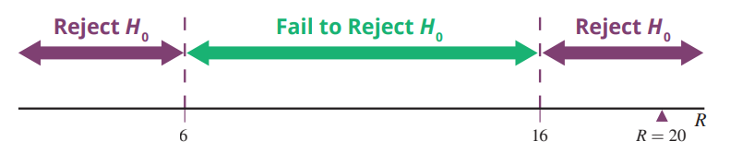

Example 1: Performing the Runs Test to Determine if a Sequence of Coin Flips is Random—Slide 5
​Using Appendix A, Table M, we see that the critical values are R ≤ 6 or R ≥$16$ at the 0.05 level of significance. Since R$=20$, we reject the null hypothesis and conclude that there is strong evidence of non-randomness.
​
Figure 2

Slide 10
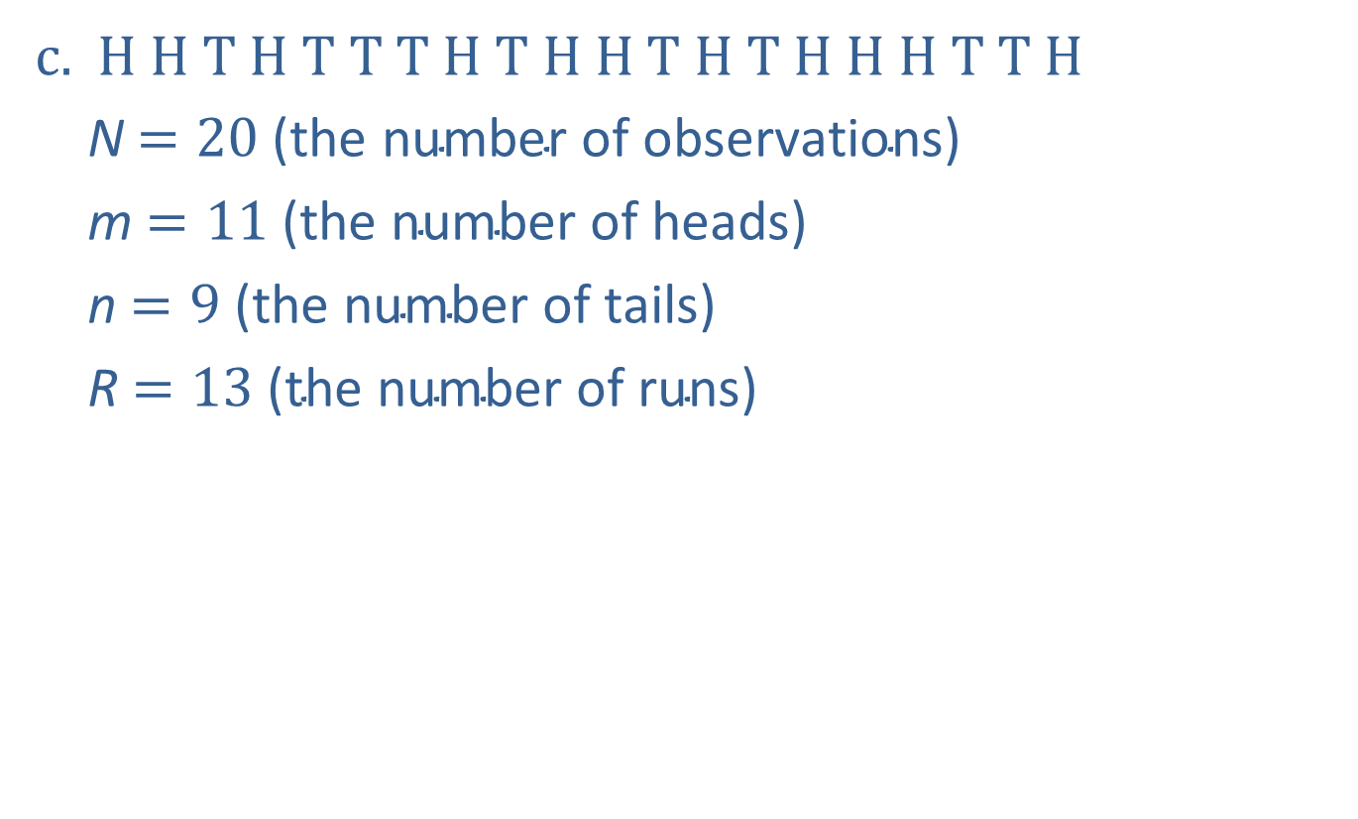
Example 1: Performing the Runs Test to Determine if a Sequence of Coin Flips is Random—Slide 6
c. H H T H T T T H T H H T H T H H H T T H
N$=20 \text{(}\text{the} \text{number} \text{of} \text{observations}\text{)}$
m$=11 \text{(}\text{the} \text{number} \text{of} \text{heads}\text{)}$
n$=9 \text{(}\text{the} \text{number} \text{of} \text{tails}\text{)}$
R$=13 \text{(}\text{the} \text{number} \text{of} \text{runs}\text{)}$
​​

Slide 11
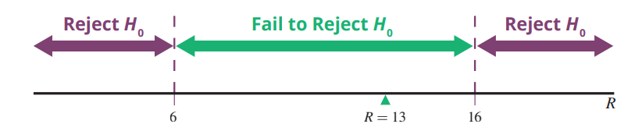

Example 1: Performing the Runs Test to Determine if a Sequence of Coin Flips is Random—Slide 7
​Using Appendix A, Table M, we see that the critical values are R ≤ 6 or R ≥$16$ at the 0.05 level of significance. Since R$=13$, we fail to reject the null hypothesis and conclude that there is not sufficient evidence of non-randomness.
​
Figure 3

Slide 12
Example 2: Performing the Runs Test to Detect a Pattern in College Applications—Slide 1
The admissions office of a college records the in-state versus out-of-state status of 28 applicants in the order the applications arrive. The data set is given as follows.
I O O I I I O O O O I I I I I I I I I I O I I I I I I I
Is this sequence random? Test at the 0.05 level.

Slide 13
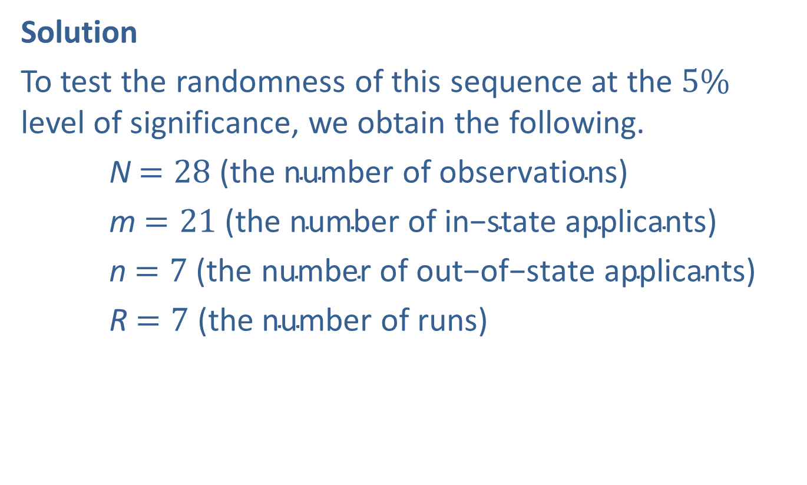
Example 2: Performing the Runs Test to Detect a Pattern in College Applications—Slide 2
Solution
To test the randomness of this sequence at the $5\%$ level of significance, we obtain the following.
N$=28 \text{(}\text{the} \text{number} \text{of} \text{observations}\text{)}$
m$=21 \text{(}\text{the} \text{number} \text{of} \text{in}\text{−}\text{state} \text{applicants}\text{)}$
n$=7 \text{(}\text{the} \text{number} \text{of} \text{out}\text{−}\text{of}\text{−}\text{state} \text{applicants}\text{)}$
R$=7 \text{(}\text{the} \text{number} \text{of} \text{runs}\text{)}$

Slide 14

Example 2: Performing the Runs Test to Detect a Pattern in College Applications—Slide 3
Since m >$20$, we calculate
Thus, we have the following.

Slide 15
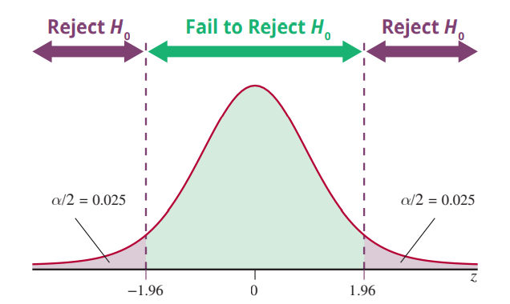
Example 2: Performing the Runs Test to Detect a Pattern in College Applications—Slide 4
Figure 4

Slide 16
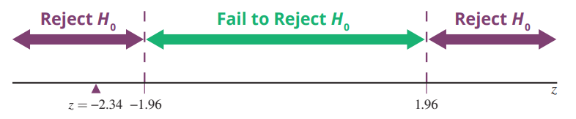
Example 2: Performing the Runs Test to Detect a Pattern in College Applications—Slide 5
Since the test statistic is in the rejection region, we reject the null hypothesis that the status of the arriving student applications follows a random sequence.
Figure 5

Slide 17

Example 3: Detecting Randomness of a Set of Numbers—Slide 1
Are the following data random? Test at α $=0.05$.
$$\left.16\text{, }25\text{, }52\text{, }11\text{, }38\text{, }47\text{, }12\text{, }98\text{, }4\right.$$

Slide 18
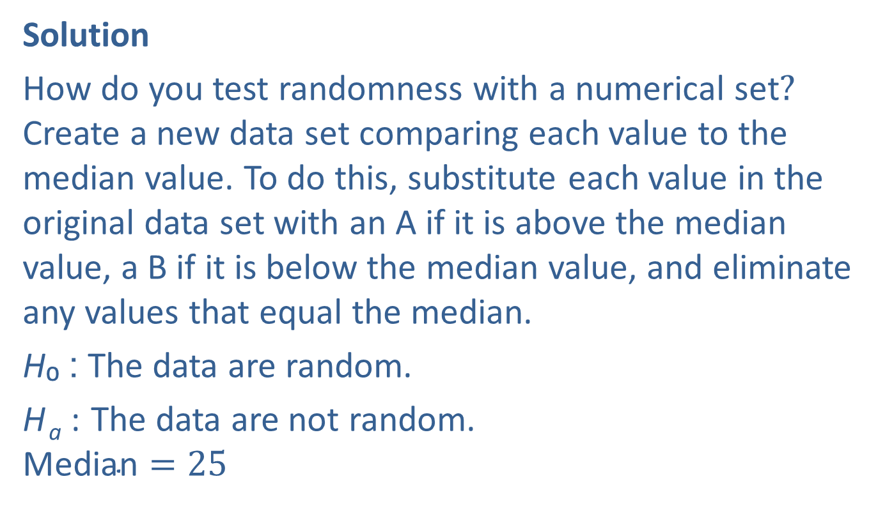
Example 3: Detecting Randomness of a Set of Numbers—Slide 2
Solution
How do you test randomness with a numerical set? Create a new data set comparing each value to the median value. To do this, substitute each value in the original data set with an A if it is above the median value, a B if it is below the median value, and eliminate any values that equal the median.
H₀ : The data are random.
H _{a} : The data are not random.
$$\text{Median}=25$$

Slide 19
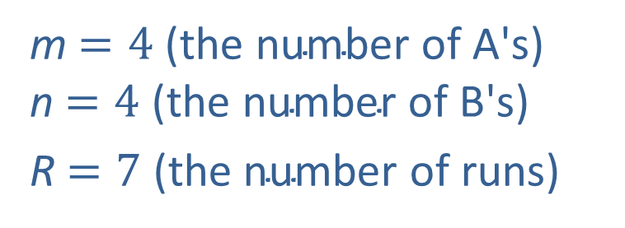
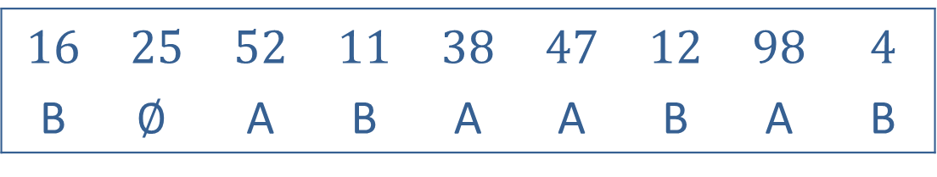
Example 3: Detecting Randomness of a Set of Numbers—Slide 3
16 | 25 | 52 | 11 | 38 | 47 | 12 | 98 | 4
B | $$∅$$ | A | B | A | A | B | A | B
m$=4 \text{(}\text{the} \text{number} \text{of} \text{A}\text{'}\text{s}\text{)}$ n$=4 \text{(}\text{the} \text{number} \text{of} \text{B}\text{'}\text{s}\text{)}$
R$=7 \text{(}\text{the} \text{number} \text{of} \text{runs}\text{)}$

Slide 20
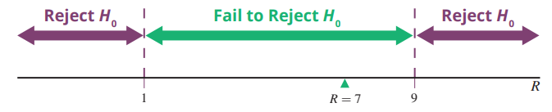

Example 3: Detecting Randomness of a Set of Numbers—Slide 4
Using Appendix A, Table M the rejection region is R ≤ 1 or R ≥$9$ at the 0.05 level of significance. Since R$=7$, we fail to reject H₀ and conclude that there is not sufficient evidence of non-randomness.
Figure 6

