Slide 1
Section 17.6
The Kruskal-Wallis Test

Slide 2
Definition: The Kruskal-Wallis Test
The Kruskal-Wallis test is a nonparametric procedure that can be used to determine if two or more distributions are different.

Slide 3
Formula: The Kruskal-Wallis Test Statistic

Slide 4
Example 1: Performing the Kruskal-Wallis Test to Determine If Stain Distributions are Identical—Slide 1
Ris Bocaj, the owner of Master Deck Sealer (M D S), specializes in staining and sealing wooden decks of residential homes. The company has developed a new stain, called M D S 1, that not only stains but seals the decks from inclement weather for a period of 10 years. Even though there are other products on the market, M D S believes that its product is significantly better than the competition.

Slide 5
Example 1: Performing the Kruskal-Wallis Test to Determine If Stain Distributions are Identical—Slide 2
To test his claim, Ris conducted accelerated-climate tests in a laboratory, exposing the wood (treated with his M D S 1 and two other popular brands) to inclement weather such as rain, snow, high temperatures, and other conditions that would eventually result in the wood needing to be re-treated. The number of months before the stain began to wear and needed to be re-treated is recorded in the following table.

Slide 6

Example 1: Performing the Kruskal-Wallis Test to Determine if Stain Distributions are Identical—Slide 3
Table 1–Wood Stains: Months Before Re-Treatment
M D S 1 | Competition Brand 1 | Competition Brand 2
124 | 39 | 25
75 | 29 | 14
69 | 26 | 26
70 | 28 | 35
122 | 26 | 34
73 |  | 16
 |  | 12
Use the Kruskal-Wallis test to determine whether there is a difference between the deck stains using α$=0.05$.

Slide 7
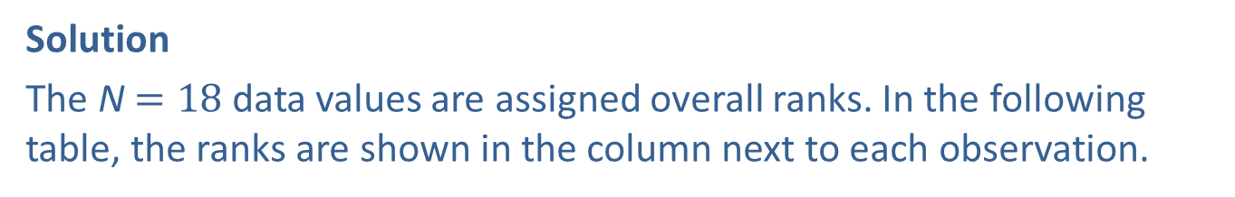
Example 1: Performing the Kruskal-Wallis Test to Determine if Stain Distributions are Identical—Slide 4
Solution
The N$=18$ data values are assigned overall ranks. In the following table, the ranks are shown in the column next to each observation.
Table 2–Wood Stain Rankings
M D S 1 | Rank | Competition Brand 1 | Rank | Competition Brand 2 | Rank
124 | 18 | 39 | 12 | 25 | 4
75 | 16 | 29 | 9 | 14 | 2
69 | 13 | 26 | 6 | 26 | 6
70 | 14 | 28 | 8 | 35 | 11
122 | 17 | 26 | 6 | 34 | 10
73 | 15 |  |  | 16 | 3
 |  |  |  | 12 | 1

Slide 8
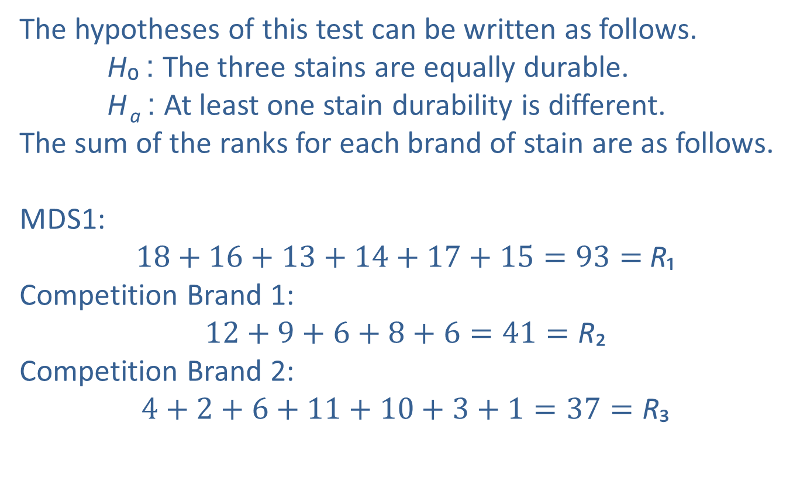
Example 1: Performing the Kruskal-Wallis Test to Determine If Stain Distributions are Identical—Slide 5
The hypotheses of this test can be written as follows.
H₀ : The three stains are equally durable.
H _{a} : At least one stain durability is different.
The sum of the ranks for each brand of stain are as follows.
M D S 1:
$18+16+13+14+17+15=93=$R₁
Competition Brand 1:
$12+9+6+8+6=41=\text{R}$₂
Competition Brand 2:
$4+2+6+11+10+3+1=37=\text{R}$₃
​

Slide 9
Example 1: Performing the Kruskal-Wallis Test to Determine If Stain Distributions are Identical—Slide 6
​ Hence, we have the following test statistic.

Slide 10
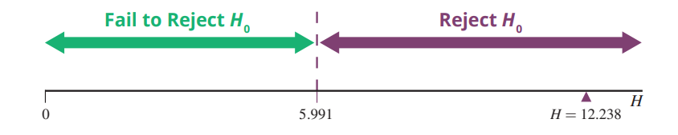

Example 1: Performing the Kruskal-Wallis Test to Determine If Stain Distributions are Identical—Slide 7
There are k$−1=3−1=2$ degrees of freedom. The critical value is given in Appendix A, Table G as
Since 12.238 > 5.991, we reject the null hypothesis and state that the durability of the stains does differ significantly.
Figure 1

Slide 11
Example 2: Performing the Kruskal-Wallis Test to Detect Differences in Braking Distances—Slide 1
A traffic safety engineer records the braking distances of a test vehicle at a fixed speed using three different brake pads. Braking distances (in feet) and their respective ranks (in parentheses) for brake pads of types A, B, and C are given in the following table. Is there sufficient evidence at the 0.05 level to conclude that the braking distances for the three pads differ?

Slide 12
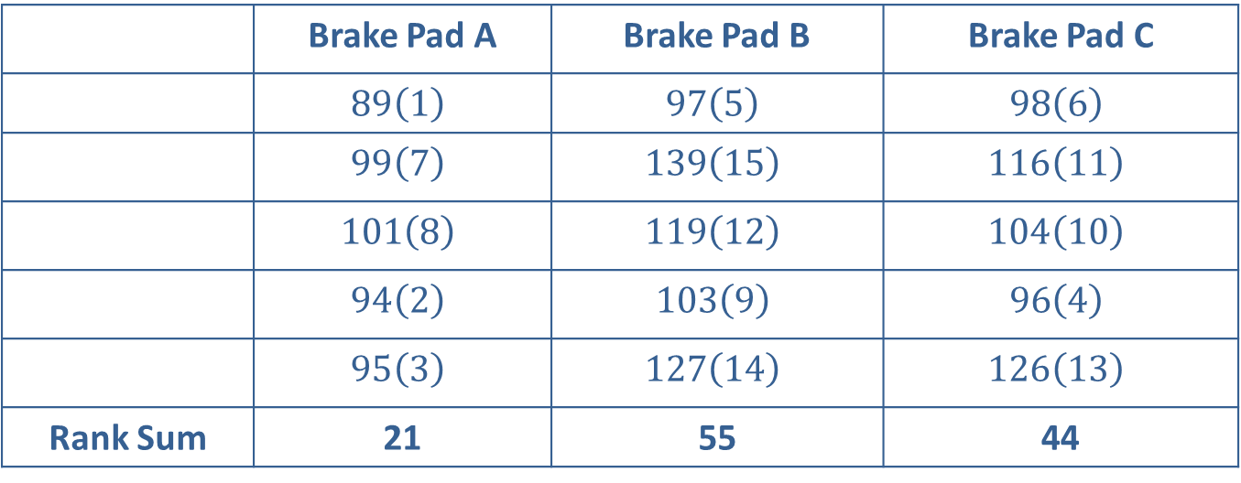
Example 2: Performing the Kruskal-Wallis Test to Detect Differences in Braking Distances—Slide 2
Table 3–Braking Distances
 | Brake Pad A | Brake Pad B | Brake Pad C
 | $$89\left(1\right)$$ | $$97\left(5\right)$$ | $$98\left(6\right)$$
 | $$99\left(7\right)$$ | $$139\left(15\right)$$ | $$116\left(11\right)$$
 | $$101\left(8\right)$$ | $$119\left(12\right)$$ | $$104\left(10\right)$$
 | $$94\left(2\right)$$ | $$103\left(9\right)$$ | $$96\left(4\right)$$
 | $$95\left(3\right)$$ | $$127\left(14\right)$$ | $$126\left(13\right)$$
Rank Sum | 21 | 55 | 44

Slide 13
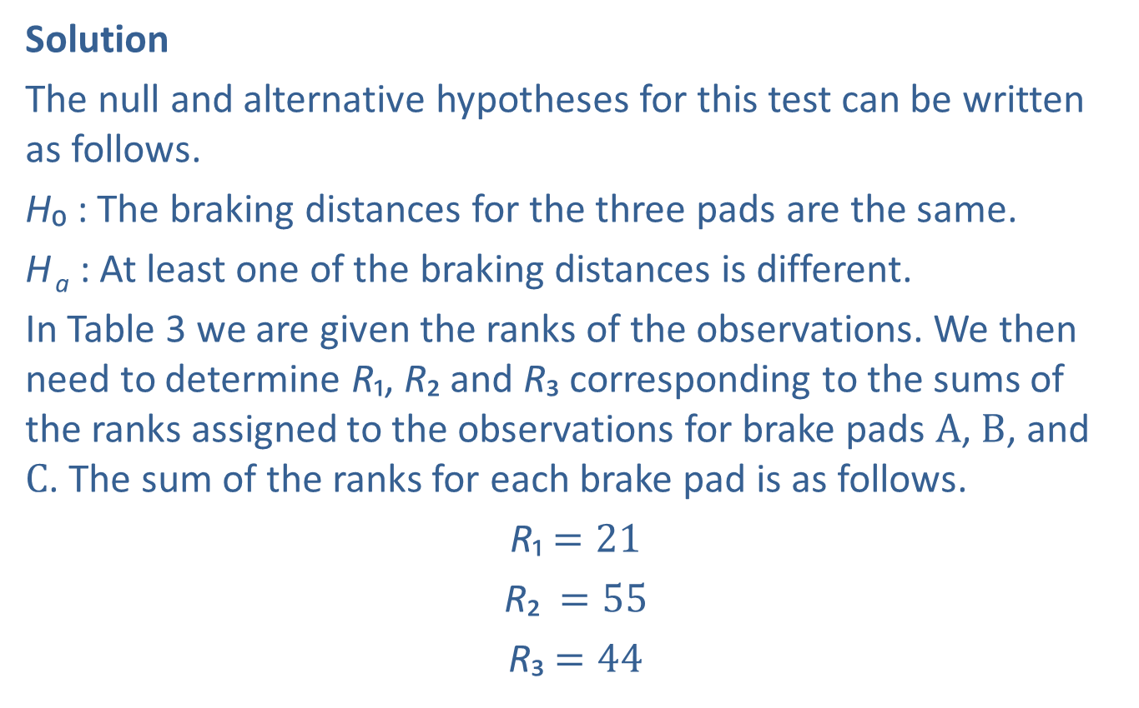
Example 2: Performing the Kruskal-Wallis Test to Detect Differences in Braking Distances—Slide 3
Solution
The null and alternative hypotheses for this test can be written as follows.
H₀ : The braking distances for the three pads are the same.
H _{a} : At least one of the braking distances is different.
In Table 3 we are given the ranks of the observations. We then need to determine R₁, $\text{R}$₂ and $\text{R}$₃ corresponding to the sums of the ranks assigned to the observations for brake pads A, B, and C. The sum of the ranks for each brake pad is as follows.
R₁ $=21$
$\text{R}$₂ $=55$
$\text{R}$₃ $=44$

Slide 14
Example 2: Performing the Kruskal-Wallis Test to Detect Differences in Braking Distances—Slide 4
Having the ranks, we can now calculate the test statistic, H.

Slide 15
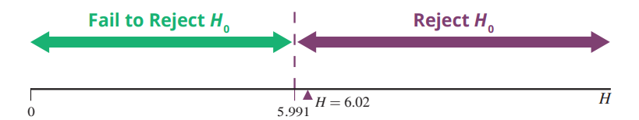
Example 2: Performing the Kruskal-Wallis Test to Detect Differences in Braking Distances—Slide 5
Referring to Appendix A, Table G, we see that
Thus, we want to reject the null hypothesis if the test statistic, H, is greater than or equal to 5.991. Since the test statistic exceeds the critical value (6.02 > 5.991), we reject the null hypothesis and conclude that the braking distances are sufficiently different.
Figure 2

