Slide 1
Section 18.1
Basic Charts and Diagrams Used in Quality Control

Slide 2
Definition: Statistical Quality Control
Statistical quality control was developed by Shewhart as a way to control the quality of a product as it is manufactured instead of after it has been manufactured.

Slide 3
Definition: Six Sigma
Six sigma is a program developed by Motorola in the 1980s that encourages companies to take a customer focus in order to improve business processes.

Slide 4
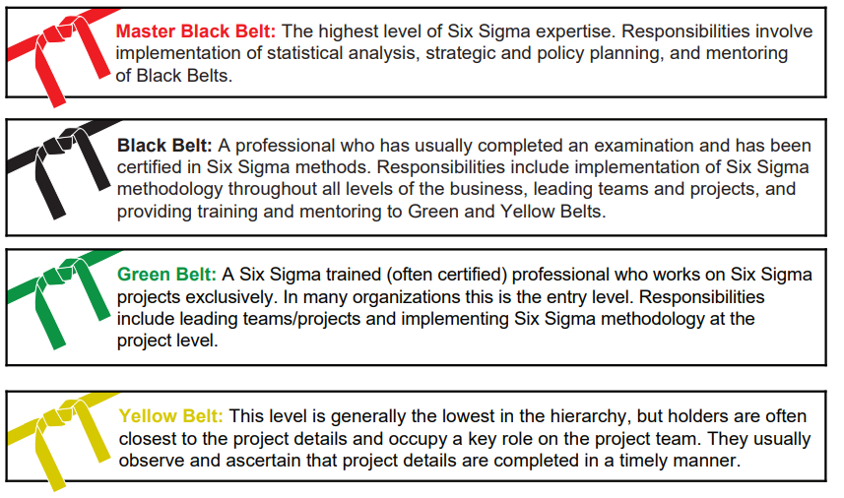
Belt Colors in Six Sigma

Slide 5
Definition: Pareto Chart
A Pareto chart is a bar graph with the categories ranked from largest to smallest.

Slide 6
Definition: Pareto Principle
The Pareto principle is a general rule where approximately 20% of the causes produce 80% of the problems. It is used as a decision-making tool to focus attention on the key areas for process improvement.

Slide 7
Procedure: Pareto Chart
A Pareto chart is constructed using the following steps.
1.​ Create a list of problems that will be the subject of the chart.
2.​ Determine what data need to be collected. These could be count data, percentages, or costs.
3.​ Determine the timeframe to be used for collecting the data.
4.​ Use a check sheet to tally the data. Then add the numbers in each category.
5.​ List the items in decreasing order of the measure of comparison.
6. List the items (problems) being tracked on the horizontal axis. Label the vertical axis with frequencies, percentages, etc.
7. Analyze the chart(s). The largest bars represent the vital few problems. If there does not appear to be one or two major problems, re-check the categories to determine if another analysis is necessary.

Slide 8
Pareto Chart—Slide 1
Suppose you are a publishing company executive and you have just learned that your typesetting budget had been exceeded by 40%. By carefully studying typesetting budget overruns during the next six months, you observe the following causes.

Slide 9
Pareto Chart—Slide 2
Table 1 – Typesetting Budget Overrun Causes
Causes of Problems | Frequency of Occurrence | Percentage (%)
Author late with corrections | 48 | 41.0
Author late with original manuscript | 35 | 29.9
Author made too many corrections | 12 | 10.3
Book longer than planned | 9 | 7.7
Proofreader late | 4 | 3.4
Figures incorrectly done | 3 | 2.6
Permissions received late | 1 | 0.9
Typesetter correction errors | 1 | 0.9
Schedule changed by editor | 1 | 0.9

Slide 10
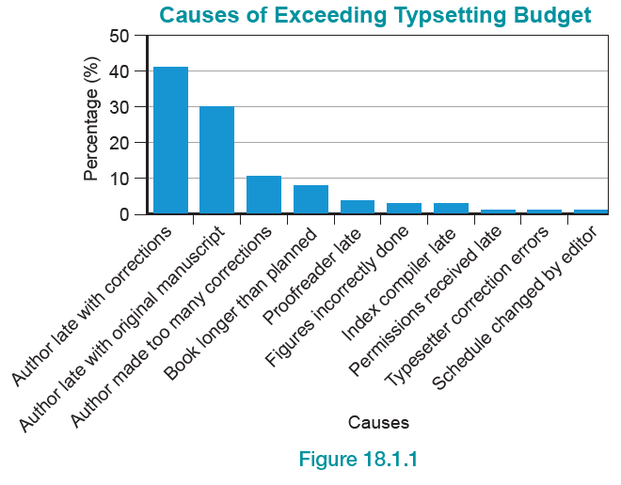
Pareto Chart—Slide 3
Figure 1

Slide 11
Pareto Chart—Slide 4
The Pareto chart in Figure 1 indicates that approximately 81.2% of the problems are associated with the author. The executives need to discuss issues with the author to determine if problems can be alleviated. The visual summary of these data is quite powerful and should provide a manager with an extremely sharp focus of what problems need to be attacked.

Slide 12
Pareto Chart—Slide 5
In addition to the main bar graph, the Pareto chart may also include an integrated line graph that shows the cumulative frequency (or cumulative relative frequency) of the observations at each bar on the bar graph. The line graph can be used to help determine which problems (the bars) belong to the vital few (the 20%) and the trivial many (the 80%).

Slide 13
Definition: Run Chart
A run chart is a form of time series plot that plots manufacturing or business process data in a time sequence.

Slide 14
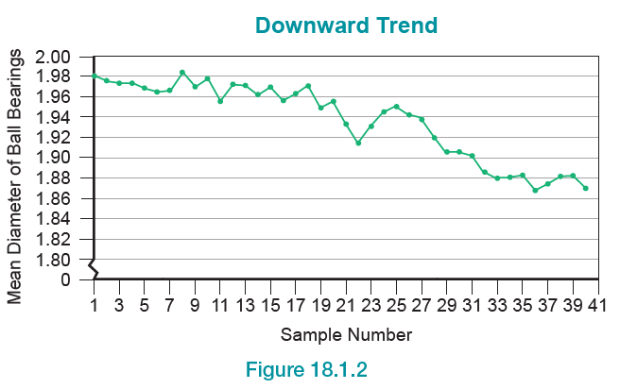
Run Chart—Slide 1
Figure 2

Slide 15
Run Chart—Slide 2
In Figure 2, the mean diameter of the ball bearings is trending downward. In Figure 3, the mean diameter of the ball bearings is trending upward. Both of these charts suggest that process output is unstable. These patterns indicate a gradual process shift that
will eventually produce output that is unusable.

Slide 16
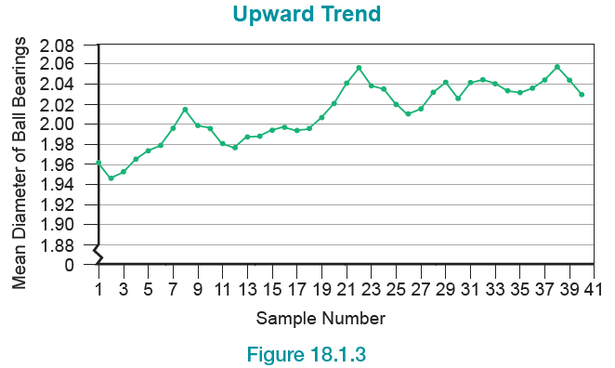
Run Chart—Slide 3
Figure 3

Slide 17
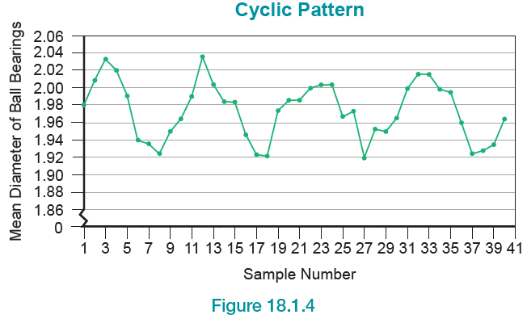
Run Chart—Slide 4
Figure 4

Slide 18
Run Chart—Slide 5
Notice how the data in the graph in Figure 4 move systematically up and down in a repeating pattern. This pattern (called a cycle) is also an indication of a process that is unstable.

Slide 19
Definition: Cycle
A cycle is a systematic repeating pattern observed in a run chart.

