Slide 1
Section 18.2
Basic Concepts

Slide 2
Basic Concepts—Slide 1
The scientific method for attaining quality relies on two basic concepts.
1. No matter what the specifications are for a product, the process that produces the product will create output that has variation. (For example, suppose a manufacturer desires to produce ball bearings with a diameter of two inches. If a process is set up to produce ball bearings with a diameter of two inches, then each item, when actually measured, will show deviation from the ideal of two inches.)

Slide 3
Basic Concepts—Slide 2
2. Improving a process requires removing variation from it. (Though the ideal would be to remove all variation, this cannot be achieved. The goal then is to move towards the ideal. This notion is known as continuous improvement.)

Slide 4
Definition: Control Chart Terminology
A control chart for a process consists of values plotted over time. This chart has an upper bound and a lower bound called the upper control limit (UCL) and the lower control limit (LCL), respectively. The process is out of control when a measurement falls either above the UCL or below the LCL. The control chart also contains a centerline that represents the average value of the quality characteristic corresponding to the in-control state.

Slide 5
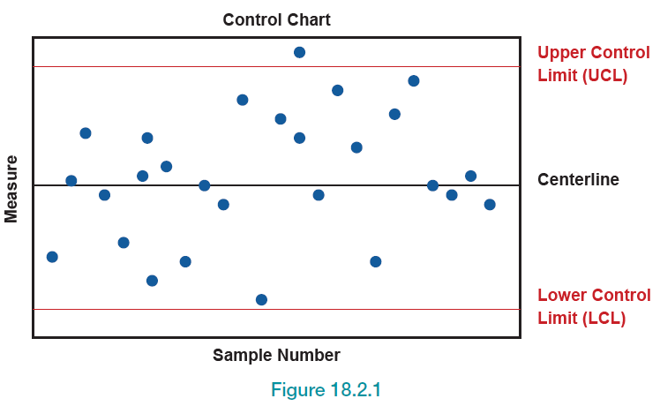
Control Chart—Slide 1
Figure 1

Slide 6
Control Chart—Slide 2
The control chart with its limits tells us when to stop the process (if it is out of control) and when not to interrupt the process. When data points fall within the UCL and LCL, we think the variation is due to normal process variation (also called common cause variation or chance variation). But when a point or points fall outside the control limits, the cause is said to be assignable variation (or special cause variation).

Slide 7
Control Chart—Slide 3
This type of variation is not random and can be eliminated (or reduced) by investigating the problem and determining the root cause(s). Reducing system variation is the surest path toward continuous improvement. For assignable causes, the system should be stopped and the cause(s) should be found and removed before the process is resumed.

Slide 8
Definition: Types of Variation
Normal process variation is normal variation in a process in which the data falls within the control limits. Assignable variation is random variation that causes data to fall outside the control limits but can be reduced by determining the root cause of the variation.

