Slide 1
Section 18.3
Monitoring with x bar and R Charts

Slide 2
Definition: X bar Chart and Range Chart (R Chart)
An
is a control chart used to monitor the
process mean to make sure the process is operating at its target level.
A Range chart (R chart) is a control chart used to monitor the variability of a process where the variation is measured using the range of a set of observations.

Slide 3
Formula: 3σ Control Limits for X bar When Standard Values of the Process Mean and Standard Deviation Are Known—Slide 1
where μ is the process mean, σ is the process standard deviation, and n is the number of observations in each sample.

Slide 4
Formula: 3σ Control Limits for X bar When Standard Values of the Process Mean and Standard Deviation Are Known—Slide 2
​
where
the mean of the sample ranges,
the mean of the sample means, and
A = a factor that relates 3σ to
and can be found using Table 1

Slide 5
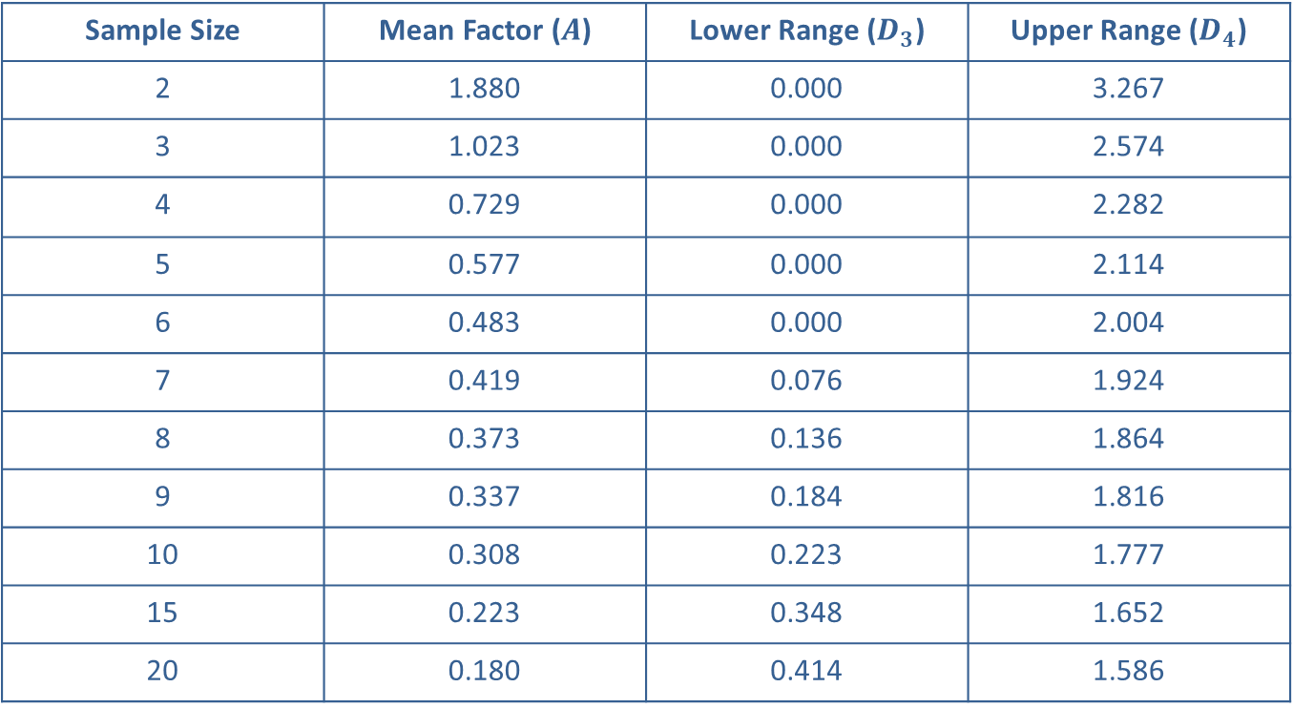
3σ Control Limits for X bar When Standard Values of the Process Mean and Standard Deviation Are Known—Slide 1
Table 1 – 3σ Factors for Computer Control Chart Limits
Sample Size | Mean Factor ($A$) | Lower Range ($D_{3}$) | Upper Range ($D_{4}$)
2 | 1.880 | 0.000 | 3.267
3 | 1.023 | 0.000 | 2.574
4 | 0.729 | 0.000 | 2.282
5 | 0.577 | 0.000 | 2.114
6 | 0.483 | 0.000 | 2.004
7 | 0.419 | 0.076 | 1.924
8 | 0.373 | 0.136 | 1.864
9 | 0.337 | 0.184 | 1.816
10 | 0.308 | 0.223 | 1.777
15 | 0.223 | 0.348 | 1.652
20 | 0.180 | 0.414 | 1.586

Slide 6
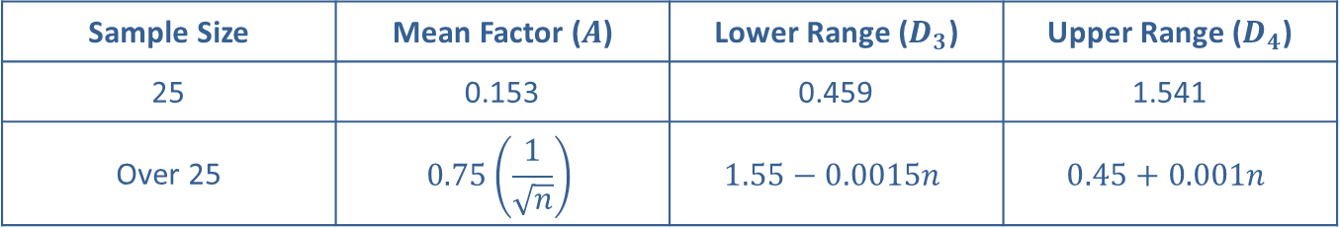
3σ Control Limits for X bar When Standard Values of the Process Mean and Standard Deviation Are Known—Slide 2
Table – $3σ$ Factors for Computer Control Chart Limits (cont.)
Sample Size | Mean Factor ($A$) | Lower Range ($D_{3}$) | Upper Range ($D_{4}$)
25 | 0.153 | 0.459 | 1.541
Over 25 | $$0.75\left(\frac{1}{\sqrt{n}}\right)$$ | $$1.55−0.0015n$$ | $$0.45+0.001n$$

Slide 7
Formula: 3σ Control Chart for the Process Range
where
is the mean of the sample ranges and D₃ and
D₄ are factors which can be found in Table 1.

Slide 8
Example 1: Determining If a Process Is in Control Using an X bar Chart—Slide 1
A manufacturing company uses a machine to punch out parts of a window hinge. Historically, the manufacturing process has produced hinges with a mean width of 0.45 inches with a process standard deviation of 0.022 inches. To monitor the production and to make sure the parts are acceptable for the next stage of home window assembly, a sample of three parts is taken each hour.

Slide 9
Example 1: Determining If a Process Is in Control Using an X bar Chart—Slide 2
The width of each part is then measured. As a result there are a total of eight samples with three observations in each sample. Table 2 contains the data for the widths of the hinges. Determine if the process is in control using an
chart. Indicate which (if any)
samples are out of control.

Slide 10
Example 1: Determining If a Process Is in Control Using an X bar Chart—Slide 3
Table 2 – Sampling Data for Window Hinges (Inches)
Sample Number | Observation 1 | Observation 2 | Observation 3
1 | 0.42 | 0.48 | 0.46
2 | 0.44 | 0.48 | 0.45
3 | 0.44 | 0.45 | 0.41
4 | 0.47 | 0.42 | 0.46
5 | 0.53 | 0.43 | 0.42
6 | 0.47 | 0.42 | 0.45
7 | 0.44 | 0.47 | 0.50
8 | 0.48 | 0.43 | 0.44

Slide 11
Example 1: Determining If a Process Is in Control Using an X bar Chart—Slide 4
Solution
Control limits need to be established and plotted on the
​
chart. Typically, control limits for the
chart are
three standard deviations above and below the process mean for the given quality characteristic.
In this problem, we have external standards to gauge our process. In particular, the process mean (0.45) and process standard deviation (0.022) are known. Thus, the control limits are determined as follows.

Slide 12
Example 1: Determining If a Process Is in Control Using an X bar Chart—Slide 5

Slide 13
Example 1: Determining If a Process Is in Control Using an X bar Chart—Slide 6
Table 3 – Sampling Data for Window Hinges (Inches)
Sample Number | Observation 1 | Observation 2 | Observation 3 | Sample Mean
1 | 0.42 | 0.48 | 0.46 | 0.453
2 | 0.44 | 0.48 | 0.45 | 0.457
3 | 0.44 | 0.45 | 0.41 | 0.433
4 | 0.47 | 0.42 | 0.46 | 0.450
5 | 0.53 | 0.43 | 0.42 | 0.460
6 | 0.47 | 0.42 | 0.45 | 0.447
7 | 0.44 | 0.47 | 0.50 | 0.470
8 | 0.48 | 0.43 | 0.44 | 0.450

Slide 14
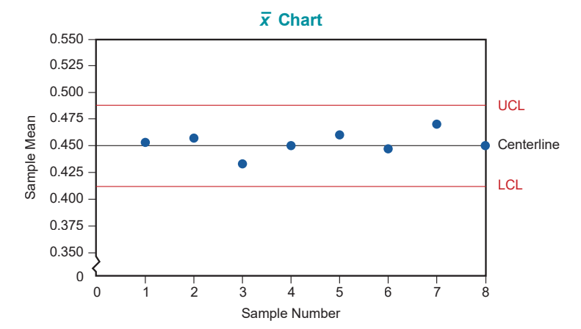
Example 1: Determining If a Process Is in Control Using an X bar Chart—Slide 7
Figure 2

Slide 15
Example 1: Determining If a Process Is in Control Using an X bar Chart—Slide 8
The mean for each sample is calculated and displayed in Table 3. The sample means are plotted in the Figure 2 along with the UCL, LCL, and centerline. Note that according to the
chart, since all of the sample means
fall within the control limits, the process is in control.

Slide 16
Example 2: Constructing X bar and R charts for a Process—Slide 1
Using the data in Example 1 and assuming that we do not know the mean or standard deviation of the process, construct the
chart and R chart for this process.

Slide 17
Example 2: Constructing X bar and R charts for a Process—Slide 2
Solution
In this example, we do not know the process standard deviation. However, we are going to use another measure of variation, the sample range, to compute the UCL and LCL. Since we do not know the true process mean, we are going to estimate that mean with
the mean of the sample means.

Slide 18
Example 2: Constructing X bar and R charts for a Process—Slide 3
chart and R
Before calculating the control limits for the
chart, we need to perform some preliminary calculations. We need to calculate the mean and range for each sample. That is, the i ^{th} sample mean and range are calculated as follows.
R _{i} = Maximum Observation in i ^{th} Sample − Minimum Observation in i ^{th} Sample.
Note that n is the number of observations in each sample. The mean and range for each sample are presented in Table 4

Slide 19
Example 2: Constructing X bar and R charts for a Process—Slide 4
Table 4 – Sampling Data for Window Hinges (Inches)
Sample | Observation 1 | Observation 2 | Observation 3 | Mean | Range
1 | 0.42 | 0.48 | 0.46 | 0.453 | 0.06
2 | 0.44 | 0.48 | 0.45 | 0.457 | 0.04
3 | 0.44 | 0.45 | 0.41 | 0.433 | 0.04
4 | 0.47 | 0.42 | 0.46 | 0.450 | 0.05
5 | 0.53 | 0.43 | 0.42 | 0.460 | 0.11
6 | 0.47 | 0.42 | 0.45 | 0.447 | 0.05
7 | 0.44 | 0.47 | 0.50 | 0.470 | 0.06
8 | 0.48 | 0.43 | 0.44 | 0.450 | 0.05

Slide 20
Example 2: Constructing X bar and R charts for a Process—Slide 5
Using the mean and range for each sample, we can calculate the grand mean and average range of the process. They are given by
and
where m is the number of samples.

Slide 21
Example 2: Constructing X bar and R charts for a Process—Slide 6
Using the data in Table 4 we find the grand mean and the average range to be the following.
The 5 provides 3σ factors for computing control chart limits.

Slide 22
Example 2: Constructing X bar and R charts for a Process—Slide 7
Table 5 – 3σ Factors for Computing Control Chart Limits
Sample Size | Mean Factor (A) | Lower Range (D₃) | Upper Range (D₄)
2 | 1.880 | 0.000 | 3.267
3 | 1.023 | 0.000 | 2.574
4 | 0.729 | 0.000 | 2.282
5 | 0.577 | 0.000 | 2.114
6 | 0.483 | 0.000 | 2.004
7 | 0.419 | 0.076 | 1.924
8 | 0.373 | 0.136 | 1.864
9 | 0.337 | 0.184 | 1.816
10 | 0.308 | 0.223 | 1.777
15 | 0.223 | 0.348 | 1.652

Slide 23
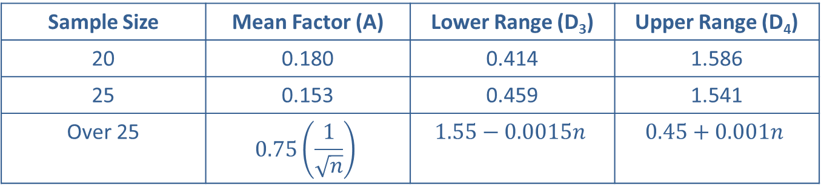
Example 2: Constructing X bar and R charts for a Process—Slide 8
Table 5 – 3σ Factors for Computing Control Chart Limits
Sample Size | Mean Factor (A) | Lower Range (D₃) | Upper Range (D₄)
20 | 0.180 | 0.414 | 1.586
25 | 0.153 | 0.459 | 1.541
Over 25 | $$0.75\left(\frac{1}{\sqrt{n}}\right)$$ | $$1.55−0.0015n$$ | $$0.45+0.001n$$

Slide 24

Example 2: Constructing X bar and R charts for a Process—Slide 9
For a sample size of 3, the mean factor, A$=1.023$. Using a mean value of 0.4525 and an average range of 0.0575, the control limits for the
​
chart are
determined as follows.

Slide 25
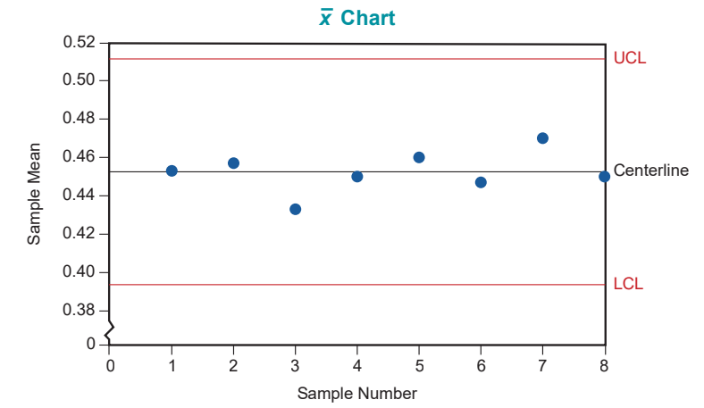
Example 2: Constructing X bar and R charts for a Process—Slide 10
Figure 3

Slide 26
Example 2: Constructing X bar and R charts for a Process—Slide 11
Computing the control limits for the R chart, we have

Slide 27
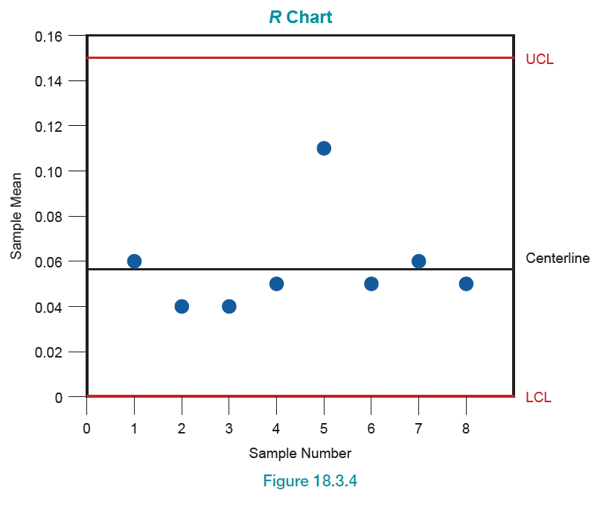
Example 2: Constructing X bar and R charts for a Process—Slide 12
Figure 4

Slide 28
Example 2: Constructing X bar and R charts for a Process—Slide 13
Examining the
chart and R chart, one can see that
both the process mean and variability are within the control limits. That is, each of the sample means and sample ranges falls within the control limits of the
chart and R chart, respectively, indicating that the process is in control.

